Slide 1
Outline of this tutorial
Motivation
Background: bandit algorithms
Bandit learning for recommender systems
Bandit learning for retrieval systems
Ethical considerations in IR with bandit learning
Conclusion & future directions

Slide 2


































Real-world challenges: recap
  Huge exploration space, but the problem space has structure
  User’s preference can be non-stationary
Clustered, correlated responses?
Horror
Romance
Drama
Expected Reward
Time
Social influence?
Figure credit: Schnabel et al. 2016 ^{[SSSCJ16]}

Slide 3
Bandit learning for recommender systems
Contextual bandits for recommendation
Collaborative bandit learning
Learning in a non-stationary environment

Slide 4

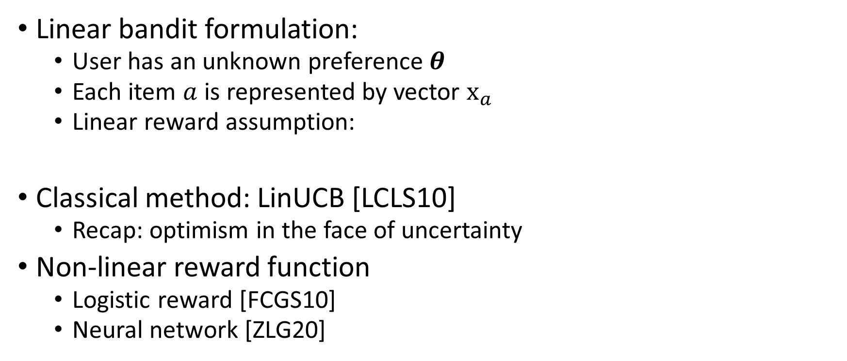
Contextual bandits for recommendation
Linear bandit formulation:
  User has an unknown preference $θ$
  Each item $a$ is represented by vector $x_{a}$
  Linear reward assumption:
Classical method: LinUCB [LCLS10]
  Recap: optimism in the face of uncertainty
Non-linear reward function
  Logistic reward [FCGS10]
  Neural network [ZLG20]

Slide 5
Bandit learning for recommender systems
Contextual bandits for recommendation
Collaborative bandit learning
  With user-dependency structure
  Online user / item clustering
  Matrix factorization for low-rank structure
  Warm-start exploration
Learning in a non-stationary environment

Slide 6




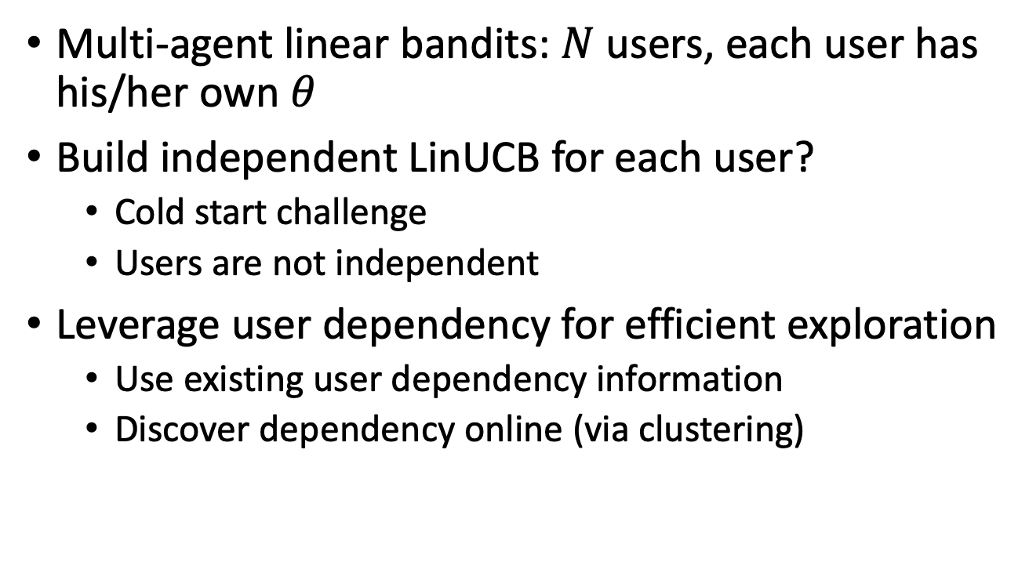
Collaborative bandit learning
Multi-agent linear bandits: $N$ users, each user has his/her own $θ$
Build independent LinUCB for each user?
  Cold start challenge
  Users are not independent
Leverage user dependency for efficient exploration
  Use existing user dependency information
  Discover dependency online (via clustering)

Slide 7

Collaborative bandit learning
GOBLin [CGZ13]
  Connected users are assumed to share similar model parameters
  Graph Laplacian based regularization upon ridge regression to model dependency
Graph $E$ is input. Regularization term:

Slide 8

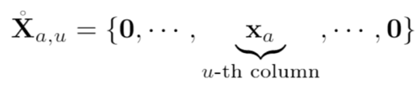






Collaborative bandit learning
GOBLin [CGZ13]
  Graph Laplacian based regularization upon ridge regression to model dependency
  Encode graph Laplacian in context, formulate as a dN-dimensional LinUCB
Graph Laplacian
Closed form estimator
Regret for empty graph:
Regret for complete graph:

Slide 9











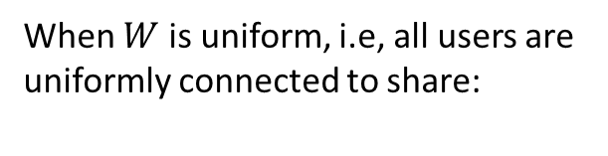
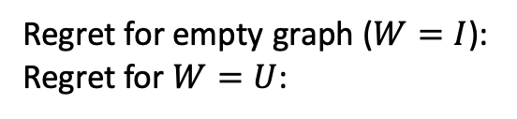
Collaborative bandit learning
CoLin [WWGW16]
  Social influence among users: content and opinion sharing in social network $W$
  Reward: weighted average of expected reward among friends
  A dN-dimensional LinUCB
in which
Closed form estimator
Regret for empty graph ($W=I$):
Regret for $W=U$:
0.6 | 0.1 | 0.2 | 0.0
0.0 | 0.7 | 0.0 | 0.0
0.0 | 0.1 | 0.8 | 0.5
0.4 | 0.1 | 0.0 | 0.5
When $W$ is uniform, i.e, all users are uniformly connected to share:

Slide 10

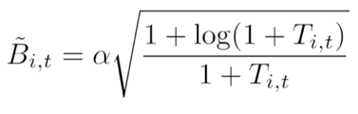




Online Clustering
Remove edge if
Discover user dependency structure on the fly
CLUB[GLZ14]
  Adaptively cluster users into groups by keep removing edges
  Threshold to remove edges is based on closeness of the users’ models
  Build LinUCB on each cluster
Regret: . Reduce regret from n (users) to m (clusters)
Closed form estimator

Slide 11








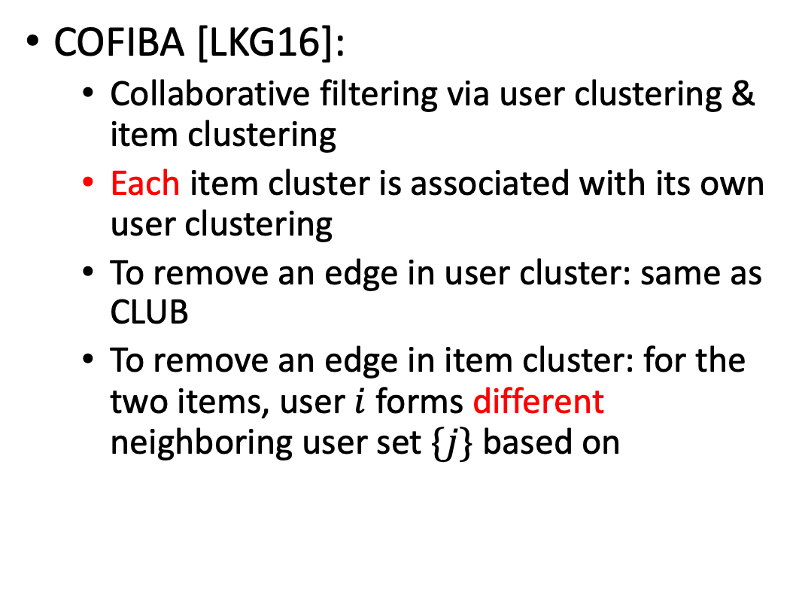
Online Clustering
COFIBA [LKG16]:
  Collaborative filtering via user clustering & item clustering
  Each item cluster is associated with its own user clustering
  To remove an edge in user cluster: same as CLUB
  To remove an edge in item cluster: for the two items, user $i$ forms different neighboring user set $\{j\}$ based on

Slide 12

Online Clustering
CAB [GLKKZE17]:
  Context-dependent clustering
  For current user $i$ , find neighboring user set $\{j\}$ for every candidate item $x_{a}$
  Then aggregate the history rewards / predictions within the user cluster.

Slide 13

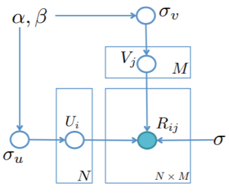
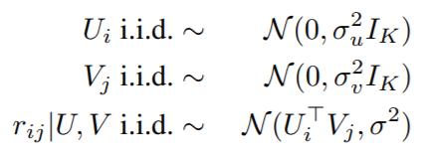
Low rank structures
Particle Thompson Sampling (PTS) [KBKTC15]
  Probabilistic Matrix Factorization framework
  Particle filtering for online Bayesian parameter estimation
  Thompson Sampling for exploration
0.6 | ? | 0.2 | ?
0.5 | 0.7 | ? | 0.1
? | 0.1 | ? | ?
? | 0.1 | ? | 0.5
Generative Model

Slide 14
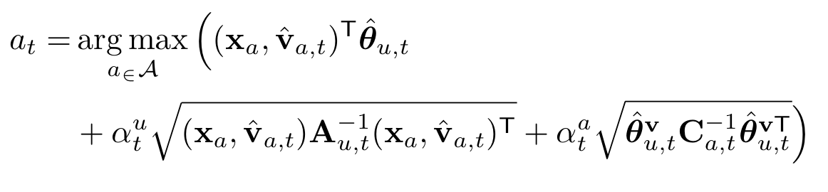
Low rank structures
Hidden LinUCB [WWW16]
  Matrix Factorization framework: user & item factors
  Alternating Least Squares for optimization
  Exploration considers uncertainty from two factors
Source of uncertainty in confidence bound estimation
Hidden feature (of an item): known to the environment, but unknown to the learner
Uncertainty of user preference $θ_{u}$ estimation
Uncertainty of hidden feature $v_{a}$ estimation

Slide 15
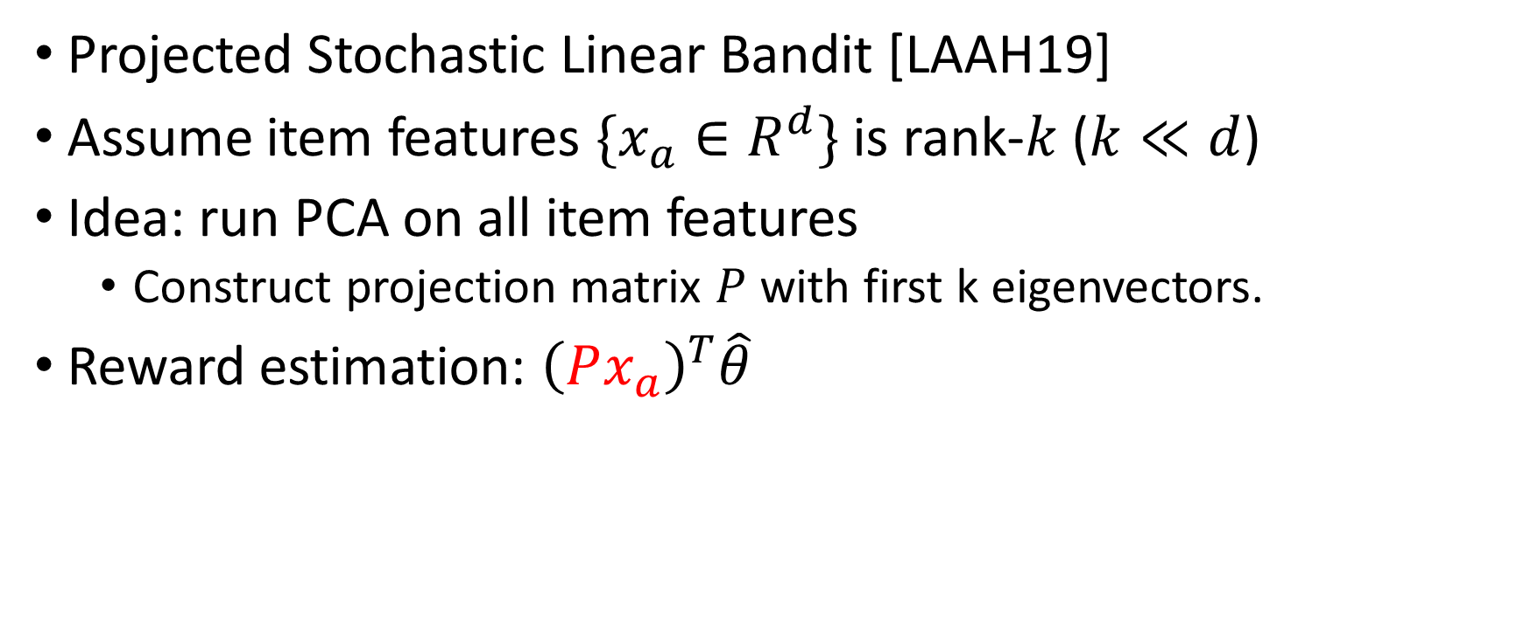
Low rank structures
Projected Stochastic Linear Bandit [LAAH19]
Assume item features $\{x_{a}∈R^{d}\}$ is rank-$k$ ($k≪d$)
Idea: run PCA on all item features
  Construct projection matrix $P$ with first k eigenvectors.
Reward estimation: ${\left(Px_{a}\right)}^{T}\hat{θ}$

Slide 16
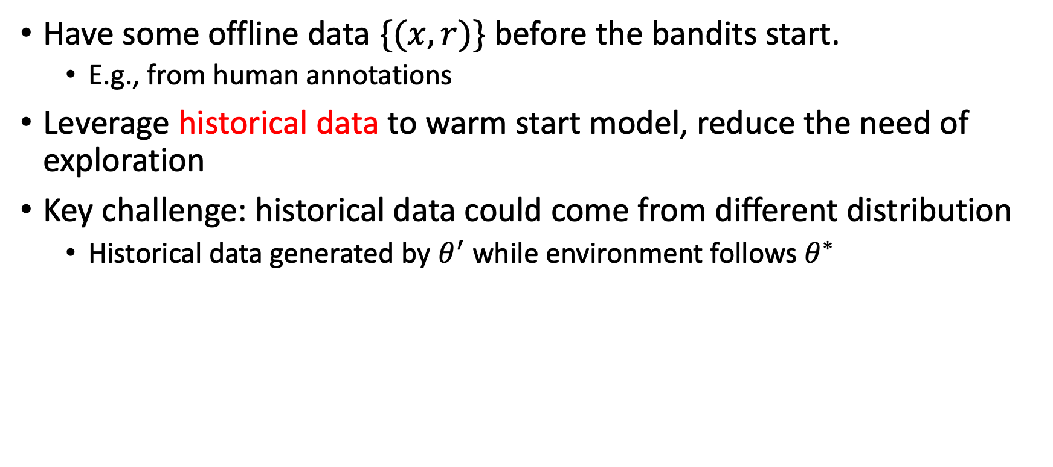
Warm-start exploration
Have some offline data $\{(x, r)\}$ before the bandits start.
  E.g., from human annotations
Leverage historical data to warm start model, reduce the need of exploration
Key challenge: historical data could come from different distribution
  Historical data generated by $θ^{′}$ while environment follows $θ^{∗}$

Slide 17
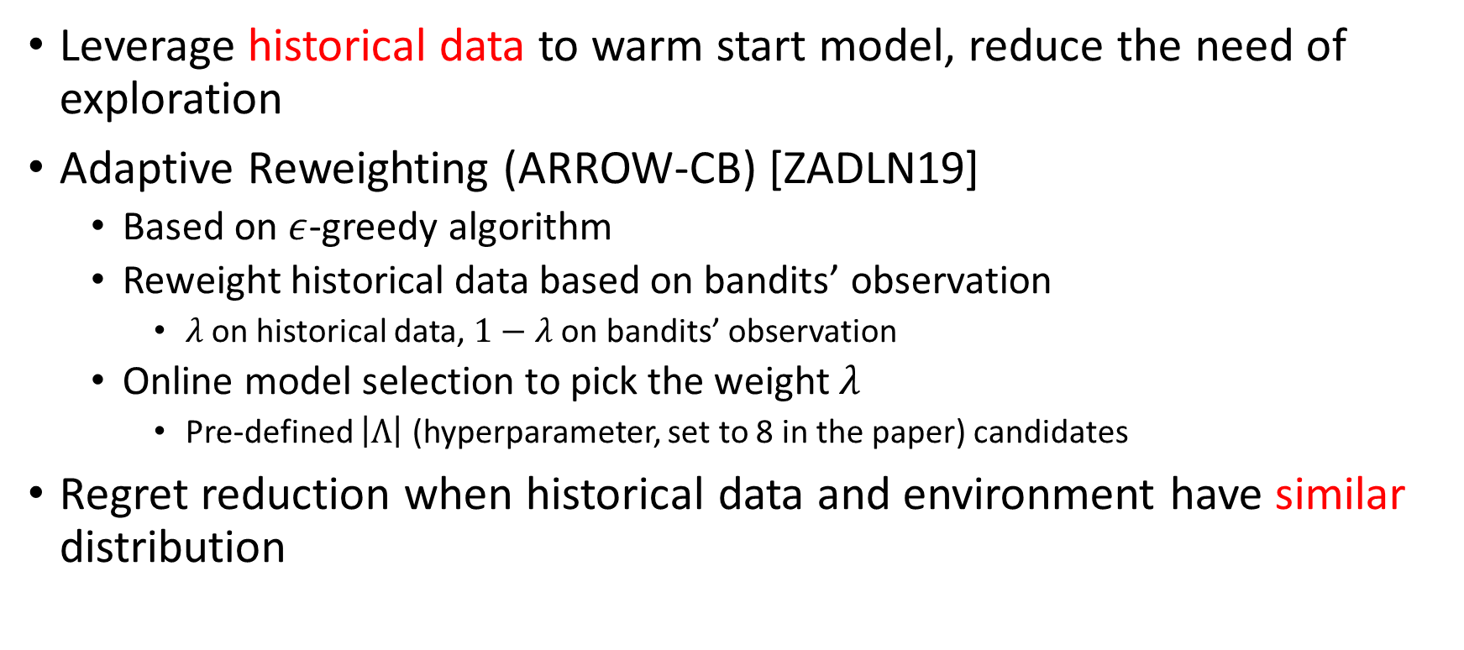
Warm-start exploration
Leverage historical data to warm start model, reduce the need of exploration
Adaptive Reweighting (ARROW-CB) [ZADLN19]
  Based on $ε$-greedy algorithm
  Reweight historical data based on bandits’ observation
    $λ$ on historical data, $1−λ$ on bandits’ observation
  Online model selection to pick the weight $λ$
    Pre-defined $\left|Λ\right|$ (hyperparameter, set to 8 in the paper) candidates
Regret reduction when historical data and environment have similar distribution

Slide 18
Open questions
What is the problem-related (structure-related) regret lower bound
  E.g., user dependency structure, low rank, offline data
  Did current algorithms fully utilize the information in problem structure?
Efficient exploration for other structures in real-world problem
  E.g., sparse structure, ranking structure, etc.

Slide 19
Bandit learning for recommender systems
Contextual bandits for recommendation
Collaborative bandit learning
Learning in a non-stationary environment
  Passively adaptive approaches
  Actively adaptive approaches
  Unifying clustering and non-stationarity detection

Slide 20


















Exploration in non-stationary environments
Action
Exploitation + Exploration
Stationary assumption is commonly used
The learner is usually facing a non-stationary environment ☹
Reward
Expected Reward
Time
Non-stationary environments

Slide 21
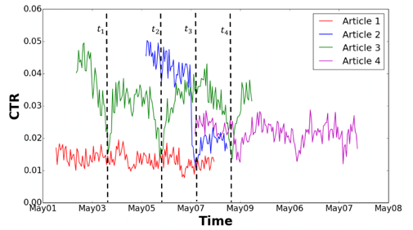
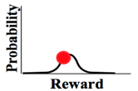
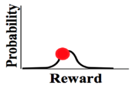
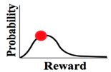
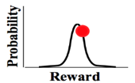
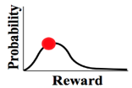










Problem formulation
(stochastic) Multi-arm bandit
Non-stationary
…
…
Reward distribution
…
Real-time click-through-rate of 4 news articles collected from Yahoo user click log dataset
Actions
I need to be adaptive about potential changes in the environment
☹
Agent/learner/policy
Reward
☺
Regret
History is no longer helpful and may even be misleading in the player’s decision-making
Non-stationary environments
Time

Slide 22





Problem formulation
  Different types of non-stationary environments
    Piecewise stationary environments
    Gradually changing environments
Main focus of this tutorial
More difficult and less studied.
Expected Reward
Expected Reward
Time
Time
Non-stationary environments

Slide 23
Problem to solve
  Changes (when and how) are unknown to the learner
  (otherwise we can just restart the learner)
  Online learning setting and bandit feedback: incomplete knowledge
  (change detection in the offline batch setting has been extensively studied in statistics and control theory ^{[BN93]} )
Non-stationary environments

Slide 24
Approaches
  Passively adaptive approaches
Key idea: design a proper mechanism to forget old observations
Assumption: old observations are less relevant
  Actively adaptive approaches
Key idea: actively detect potential changes in the environment during online decision making
Assumption: abrupt changes, i.e., piece-wise stationary environment
Non-stationary environments
Notes:
Actively adaptive: Instead of blindly discount or forget past observations, the bandit learning algorithm should actively detect the change points (assuming abrupt change points)

Slide 25









Passively adaptive approaches
Discounted UCB and Sliding window UCB [GM08]
Discount the old observations
Only utilize the most recent $τ$ observations
Weighted linear bandit [RVC19]
  Discounted-UCB in the linear contextual bandit setting
Non-stationary environments

Slide 26
Passively adaptive approaches
Pros
  Simple: easy to implement and have almost no computation overhead
  Have provable theoretical guarantee in piece-wise non-stationary environment and environments with slow changes
Cons
  Passive: always assuming old observations are less relevant
  Not practical: very sensitive to hyper-parameters discount factor, sliding-window size
Non-stationary environments

Slide 27
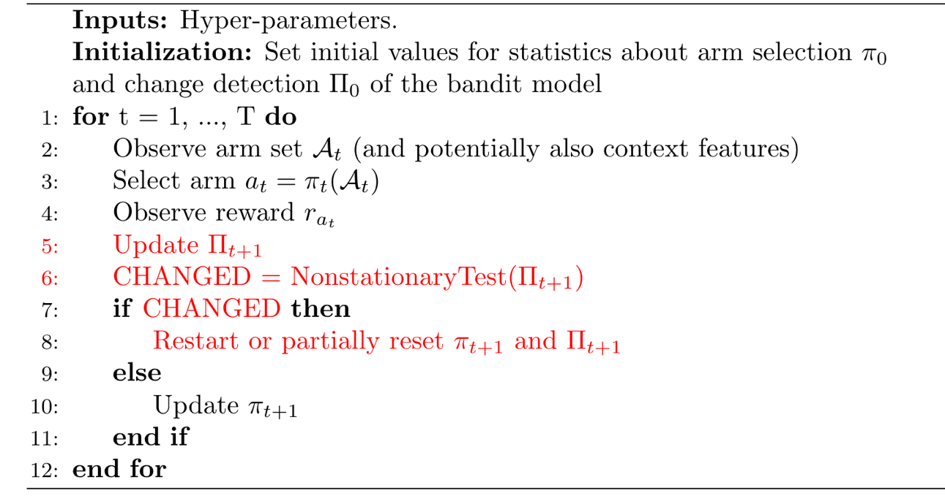
Actively adaptive approaches
General framework
Statistics about the stationarity of the environment
Non-stationary environments

Slide 28
Non-stationarity detection with bandit feedback
Cumulative sum control chart (CUSUM) based detection
  AdTS [HMB15], CD-UCB [LLS18]
Generalized likelihood ratio test
  GLR-kl-UCB [BK19]
Online reward mean-shift detection
  WMD-UCB1 [YM09], M-UCB [CWKX19]
Confidence bound based detection
  dLinUCB [WIW18], DenBand [WWLW19]
Other
  Ada-ILTCB, Ada-greedy [LWAL18], Ada-ILTCB^{[+]} [CLLW19]
…
Non-stationary environments

Slide 29
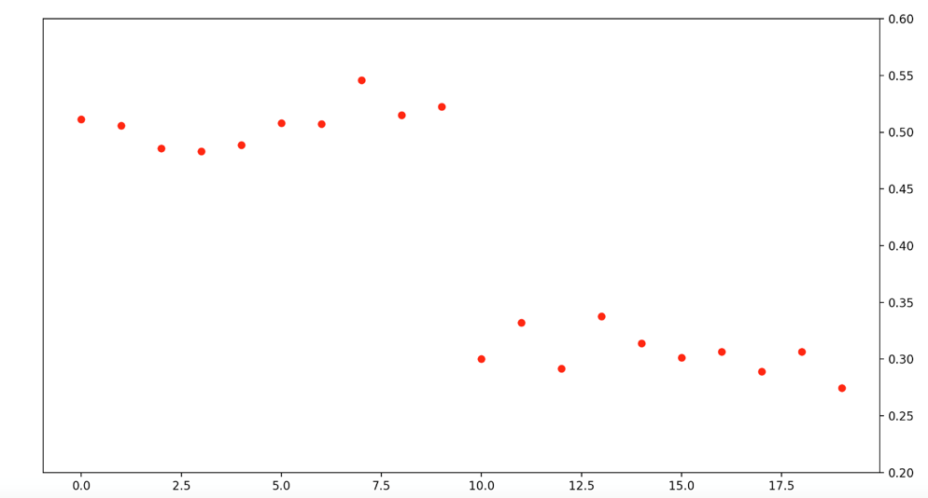










CUSUM-based online change detection
CUSUM in the offline setting
Cumulative sum of log-likelihood ratio before and after change points:
Observed reward
0
Non-stationary environments

Slide 30


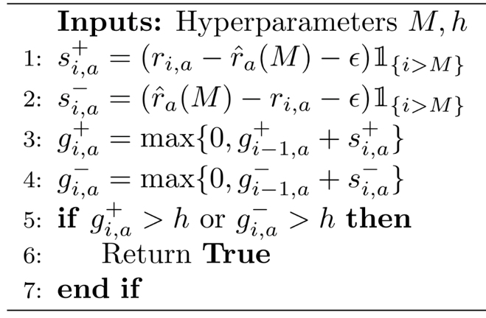
CUSUM-based online change detection
Tailored CUSUM in the Bernoulli bandit setting
CUSUM in CD-UCB [LLS18]
  Intuition:
Each arm needs to have at least M observations
Requirement on the minimum magnitude of changes on the reward
  has negative mean drift before the change point and positive after the change point
  Assumptions:
    Piecewise stationary with detectability assumption
    Bernoulli bandit
Detection threshold
Local restart: restart the related statistics for the changed arms
Non-stationary environments

Slide 31
Generalized likelihood ratio test based online change detection
CUSUM requires the pre-change and post-change environment parameters to be known to get the log-likelihood.
Unknown pre-change and/or post-change parameters -> Generalized Likelihood Ratio Test (GLRT)
  GLRT with Bernoulli reward -> GLR-klUCB [BK19]
  GLRT can achieve asymptotically optimal detection delay with sub-Gaussian reward assumption [Mai19]
Non-stationary environments

Slide 32

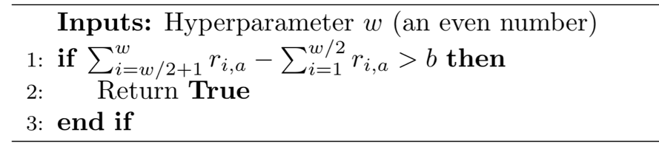
Online mean-shift detection
Monitored-UCB [CWKX19]
Compare running sample means over a sliding window
>b
Global restart: once a change is detected, restart the related statistics for all the arms
Need to periodically perform uniform arm selection (uniform exploration)
to ensure sufficient data can be gathered for all arms to perform CD
Arm selection between detected change points (except for the uniform exploration iterations): UCB1
Non-stationary environments

Slide 33

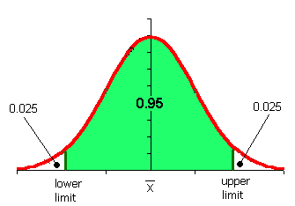
CB based online change detection
Utilizing the reward estimation confidence bound [WNW18, WWLW19]
    If the environment is stationary, the reward prediction residual should be within a confidence bound with high probability,
Predicted reward of bandit model m
Observed reward
Confidence bound of reward estimation
We can bound this to further exclude this possibility!
Unexpected outcome is caused by,
Something wrong in the observed reward: large noise
Something wrong in the predicted reward: the model is incorrect
Non-stationary environments

Slide 34


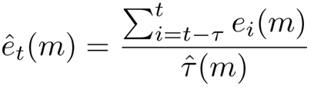





CB based online change detection
Prediction badness at interaction $i$:
Similar to the goodness of fit concept in chi-squared test
Badness of model m over a sliding time window:
a sliding time window to collect badness observations
Detection threshold:
Bad enough:
Good enough:
Change detected.
(abandon learner m)
When no learner is good enough, will also report a change.
(but do not abandon learner m)
Non-stationary environments

Slide 35







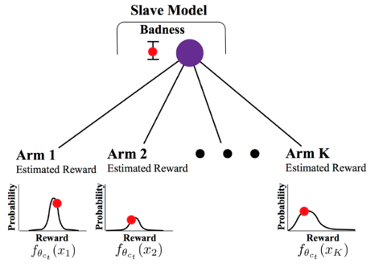


CB based online change detection
dLinUCB [WNW18]
Adaptively creates new learners
Monitors the prediction quality of each learner
Selects a learner according to each learner’s ‘badness’
.
.
…
badness
badness
Badness estimation update
Reward estimation update
…
…
Non-stationary environments

Slide 36














Detection of context-dependent changes
Change-sensitive arms
Expected Reward
Change-invariant arms
Time
Learner 1
Learner 2
DenBand [WWLW19]
Reuse the experiences learnt in old models for change-invariant arms
Reward estimation on change-invariant arms
Save unnecessarily exploration
…
…
Non-stationary environments

Slide 37











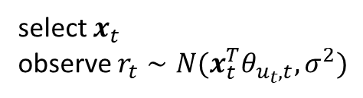








Unifying clustering and change detection
A clustered and non-stationary environment
user 1
$$θ_{1, ∙}$$
$$φ_{1}$$
$c_{1,1}$
$$φ_{2}$$
$c_{1,2}$
$$φ_{1}$$
shared parameters
$${\left\{φ_{k}\right\}}_{k=1}^{K}$$
select $x_{t}$
observe $r_{t}∼N(x_{t}^{T}θ_{u_{t},t},σ^{2})$
user $u_{t}$
$$θ_{u_{t}, ∙}$$
$$φ_{2}$$
$$t$$
user $N$
$$θ_{N, ∙}$$
$$φ_{2}$$
$c_{N,1}$
$$φ_{3}$$

Slide 38
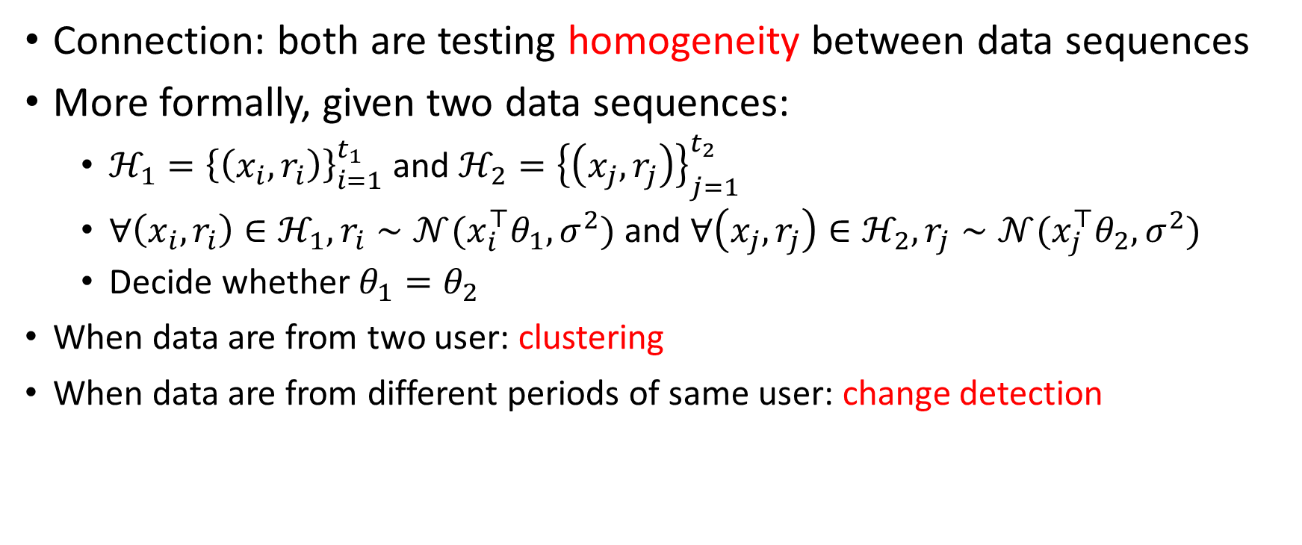
Unifying clustering and change detection
Connection: both are testing homogeneity between data sequences
More formally, given two data sequences:
  $ℋ_{1}={\left\{\left(x_{i},r_{i}\right)\right\}}_{i=1}^{t_{1}}$ and $ℋ_{2}={\left\{\left(x_{j},r_{j}\right)\right\}}_{j=1}^{t_{2}}$
  $∀\left(x_{i},r_{i}\right)∈ℋ_{1},r_{i}∼𝒩(x_{i}^{⊤}θ_{1},σ^{2})$ and $∀\left(x_{j},r_{j}\right)∈ℋ_{2},r_{j}∼𝒩(x_{j}^{⊤}θ_{2},σ^{2})$
  Decide whether $θ_{1}=θ_{2}$
When data are from two user: clustering
When data are from different periods of same user: change detection

Slide 39

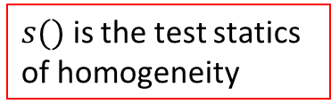


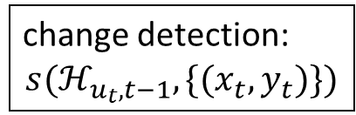

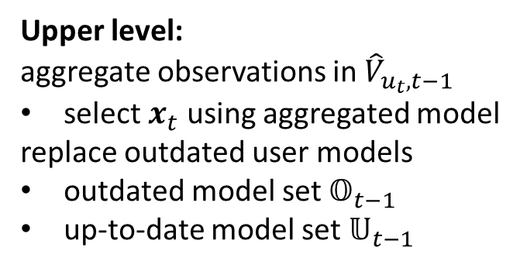
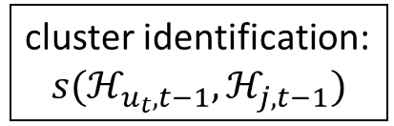
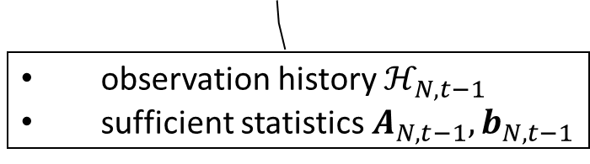



Dynamic Clustering (DyClu) [LWW21a]
Lower level:
maintain local user models
Upper level:
aggregate observations in ${\hat{V}}_{u_{t},t−1}$
select $x_{t}$ using aggregated model
replace outdated user models
outdated model set $𝕆_{t−1}$
up-to-date model set $𝕌_{t−1}$
$$𝕆_{t−1}$$
$$𝕌_{t−1}$$
$$𝕄_{1,t−1}$$
$$𝕄_{u_{t},t−1}$$
$${\hat{V}}_{u_{t},t−1}$$
$$\{(x_{t},y_{t})\}$$
$$𝕄_{N,t−1}$$
cluster identification:
$$s(ℋ_{u_{t},t−1},ℋ_{j,t−1})$$
$s()$ is the test statics of homogeneity
observation history $ℋ_{N,t−1}$
sufficient statistics $A_{N,t−1}, b_{N,t−1}$
change detection:
$$s(ℋ_{u_{t},t−1},\{(x_{t},y_{t})\})$$
DyClu: one model per stationary period
Detect change; cluster individual bandit models; select arm

Slide 40












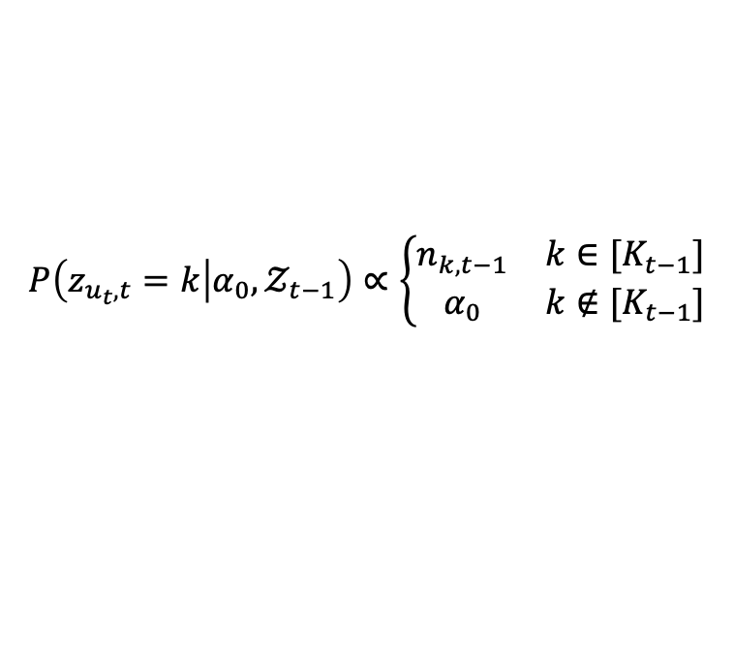












CoDBand [LWW21b]
Dirichlet Process (DP) mixture of regression models
  $θ$s are samples from infinite mixture model $G$ with prior $DP(α_{0},G_{0})$
  The set of unique bandit parameters: ${\left\{φ_{k}\right\}}_{k=1}^{K_{t−1}}$
  Indicator variable $z_{u,c}$: $θ_{u,c}=φ_{z_{u,c}}$
$$φ_{1}$$
$$φ_{2}$$
$$θ$$
$$φ_{3}$$
$$φ_{4}$$
user 1
$$θ_{1, ∙}$$
$$φ_{1}$$
$c_{1,1}$
$$φ_{2}$$
$c_{1,2}$
$$φ_{1}$$
shared parameters
$${\left\{φ_{k}\right\}}_{k=1}^{K}$$
$$P\left(z_{u_{t},t}=k | α_{0},𝒵_{t−1}\right)∝\left\{\begin{matrix}n_{k,t−1} & k∈[K_{t−1}] \\ α_{0} & k∉[K_{t−1}]\end{matrix}\right.$$
user $u_{t}$
$$θ_{u_{t}, ∙}$$
$$φ_{2}$$
$$t$$
“Chinese Restaurant Process”
user $N$
$$θ_{N, ∙}$$
$$φ_{2}$$
$c_{N,1}$
$$φ_{3}$$

Slide 41







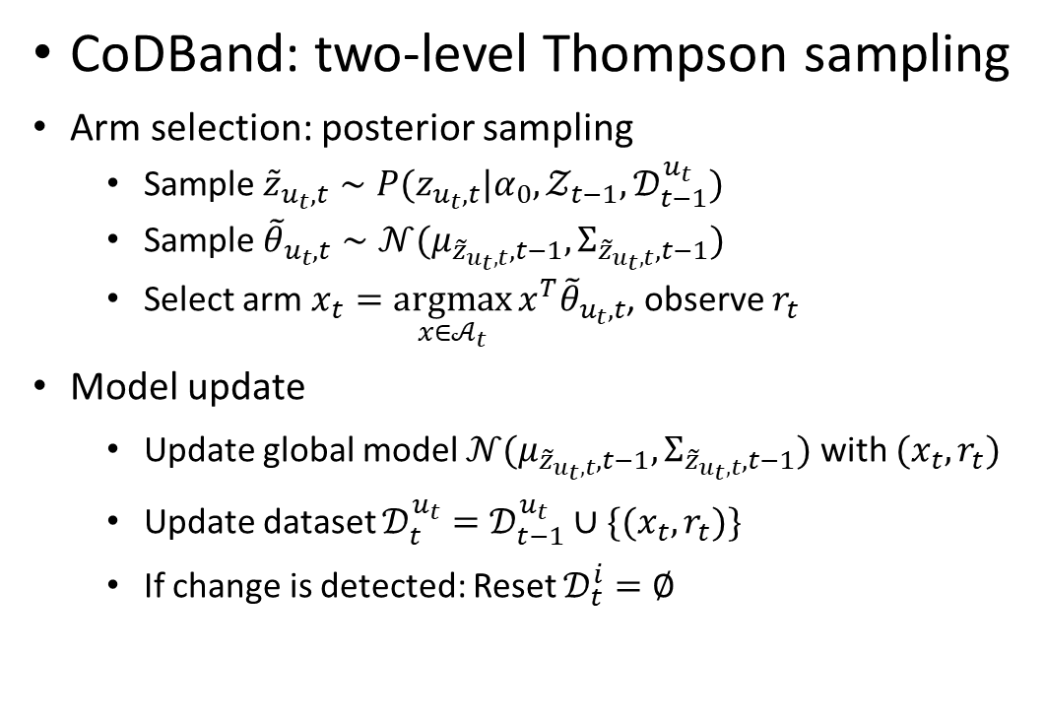





CoDBand [LWW21b]
CoDBand: two-level Thompson sampling
Arm selection: posterior sampling
  Sample ${\tilde{z}}_{u_{t},t}∼P(z_{u_{t},t}|α_{0},𝒵_{t−1},𝒟_{t−1}^{u_{t}})$
  Sample ${\tilde{θ}}_{u_{t},t}∼𝒩(μ_{{\tilde{z}}_{u_{t},t},t−1},Σ_{{\tilde{z}}_{u_{t},t},t−1})$
  Select arm $x_{t}=\underset{x∈𝒜_{t}}{argmax}{x^{T}{\tilde{θ}}_{u_{t},t}}$, observe $r_{t}$
Model update
  Update global model $𝒩(μ_{{\tilde{z}}_{u_{t},t},t−1},Σ_{{\tilde{z}}_{u_{t},t},t−1})$ with $(x_{t},r_{t})$
  Update dataset $𝒟_{t}^{u_{t}}=𝒟_{t−1}^{u_{t}}∪\{(x_{t},r_{t})\}$
  If change is detected: Reset $𝒟_{t}^{i}=∅$
$$𝒟_{t−1}^{1}$$
Globally-shared bandit models
$$𝒟_{t−1}^{2}$$
$$𝒩(μ_{1,t−1},Σ_{1,t−1})$$
$$𝒩(μ_{2,t−1},Σ_{2,t−1})$$
$$𝒟_{t−1}^{3}$$
$$𝒩(μ_{3,t−1},Σ_{3,t−1})$$
$$𝒩(0,λ^{−1}I)$$
$$𝒟_{t−1}^{4}$$
create a new global model
CoDBand: one model per unique parameter
Detect change; select global bandit model; select arm

Slide 42
Open questions
    Can we re-use related historical observations (e.g., recurring environment, or context-dependent changes) and what’s the benefit of it?
How to handle gradually changing environment?
Non-stationary environments

Slide 43
References III
[FCGS10] Filippi, S., Cappe, O., Garivier, A., & Szepesvári, C. (2010, December). Parametric Bandits: The Generalized Linear Case. In NIPS (Vol. 23, pp. 586-594).
[ZLG20] Zhou, D., Li, L., & Gu, Q. (2020, November). Neural contextual bandits with UCB-based exploration. In International Conference on Machine Learning (pp. 11492-11502). PMLR.
[CGZ13] Cesa-Bianchi, N., Gentile, C., & Zappella, G. (2013). A gang of bandits. In Advances in Neural Information Processing Systems (pp. 737-745).
[WWGW16] Wu, Q., Wang, H., Gu, Q., & Wang, H. (2016, July). Contextual bandits in a collaborative environment. In Proceedings of the 39th International ACM SIGIR conference on Research and Development in Information Retrieval (pp. 529-538).
[GLZ14] Gentile, C., Li, S., & Zappella, G. (2014, January). Online clustering of bandits. In International Conference on Machine Learning (pp. 757-765).
[GLKKZE17] Gentile, C., Li, S., Kar, P., Karatzoglou, A., Zappella, G., & Etrue, E. (2017, July). On context-dependent clustering of bandits. In International Conference on Machine Learning (pp. 1253-1262).
[LKG16] Li, S., Karatzoglou, A., & Gentile, C. (2016, July). Collaborative filtering bandits. In Proceedings of the 39th International ACM SIGIR conference on Research and Development in Information Retrieval (pp. 539-548).
[KBKTC15] Kawale, J., Bui, H. H., Kveton, B., Tran-Thanh, L., & Chawla, S. (2015). Efficient Thompson Sampling for Online￼ Matrix-Factorization Recommendation. In Advances in neural information processing systems (pp. 1297-1305).
[KKSVW17] Katariya, S., Kveton, B., Szepesvari, C., Vernade, C., & Wen, Z. (2017, April). Stochastic rank-1 bandits. In Artificial Intelligence and Statistics (pp. 392-401).
[WWW16] Wang, H., Wu, Q., & Wang, H. (2016, October). Learning hidden features for contextual bandits. In Proceedings of the 25th ACM International on Conference on Information and Knowledge Management (pp. 1633-1642).

Slide 44
References IV
[ZADLN19] Zhang, C., Agarwal, A., Daumé III, H., Langford, J., & Negahban, S. N. (2019). Warm-starting contextual bandits: Robustly combining supervised and bandit feedback. arXiv preprint arXiv:1901.00301.
[LAAH19] Lale, S., Azizzadenesheli, K., Anandkumar, A., & Hassibi, B. (2019). Stochastic linear bandits with hidden low rank structure. arXiv preprint arXiv:1901.09490.
[BN93] Basseville, M., & Nikiforov, I. V. (1993). Detection of abrupt changes: theory and application (Vol. 104). Englewood Cliffs: prentice Hall.
[GM08] Garivier, A., & Moulines, E. (2008). On upper-confidence bound policies for non-stationary bandit problems. arXiv preprint arXiv:0805.3415.
[RVC19] Russac, Y., Vernade, C., & Cappé, O. (2019). Weighted linear bandits for non-stationary environments. In Advances in Neural Information Processing Systems (pp. 12040-12049).
[YM09] Yu, J. Y., & Mannor, S. (2009, June). Piecewise-stationary bandit problems with side observations. In Proceedings of the 26th annual international conference on machine learning (pp. 1177-1184).
[HMB15] Hariri, N., Mobasher, B., & Burke, R. (2015, June). Adapting to user preference changes in interactive recommendation. In Twenty-Fourth International Joint Conference on Artificial Intelligence.
[WNW18] Wu, Q., Iyer, N., & Wang, H. (2018, June). Learning contextual bandits in a non-stationary environment. In The 41st International ACM SIGIR Conference on Research & Development in Information Retrieval (pp. 495-504).

Slide 45
References V
[LWAL18] Luo, H., Wei, C. Y., Agarwal, A., & Langford, J. (2018, July). Efficient contextual bandits in non-stationary worlds. In Conference On Learning Theory (pp. 1739-1776).
[CWKX19] Cao, Y., Wen, Z., Kveton, B., & Xie, Y. (2019, April). Nearly optimal adaptive procedure with change detection for piecewise-stationary bandit. In The 22nd International Conference on Artificial Intelligence and Statistics (pp. 418-427).
[LLS18] Liu, Fang, Joohyun Lee, and Ness Shroff. “A change-detection based framework for piecewise-stationary multi-armed bandit problem.” Thirty-Second AAAI Conference on Artificial Intelligence. 2018.
[WWLW19] Wu, Q., Wang, H., Li, Y., & Wang, H. (2019, May). Dynamic Ensemble of Contextual Bandits to Satisfy Users' Changing Interests. In The World Wide Web Conference (pp. 2080-2090).
[CLLW19] Chen, Y., Lee, C. W., Luo, H., & Wei, C. Y. (2019). A new algorithm for non-stationary contextual bandits: Efficient, optimal, and parameter-free. arXiv preprint arXiv:1902.00980.
[BK19] Besson, L., & Kaufmann, E. (2019). The generalized likelihood ratio test meets klucb: an improved algorithm for piece-wise non-stationary bandits. arXiv preprint arXiv:1902.01575.
[Mai19] Maillard, O. A. (2019). Sequential change-point detection: Laplace concentration of scan statistics and non-asymptotic delay bounds.
[LWW21a] Li, C., Wu, Q., & Wang, H. (2021, March). Unifying Clustered and Non-stationary Bandits. In International Conference on Artificial Intelligence and Statistics (pp. 1063-1071). PMLR.
[LWW21b] Li, C., Wu, Q., & Wang, H. (2021). When and Whom to Collaborate with in a Changing Environment: A Collaborative Dynamic Bandit Solution. In SIGIR 2021.

