Slide 1
Adapting Deep RankNet for Personalized Search
¹Yang Song, ²Hongning Wang, ¹Xiaodong He
¹Microsoft Research, Redmond
²University of Illinois at Urbana-Champaign

Slide 2
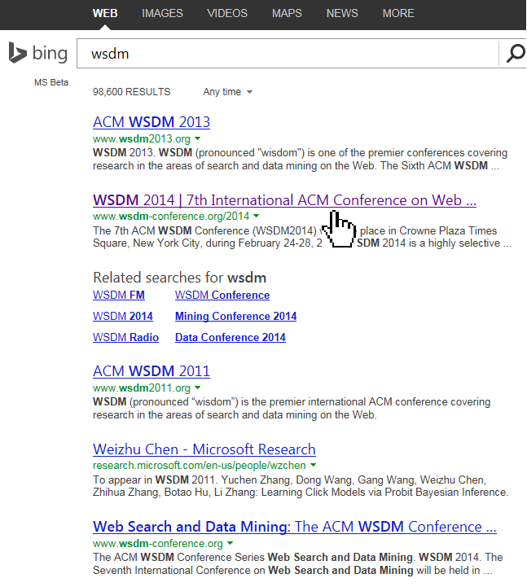
Personalized Search
Tailor search engines for each individual searcher
Improve searcher satisfaction and engagement
Remember user historical query & click information
Infer user preference from search history
Learn from user search behavior
Learn from like-minded users
Personal CTR
Notes:
For example, a simple but very effective way of doing personalization is to remember user clicks. And next time when the user issue the same query, we rerank the results based his personal CTR

Slide 3
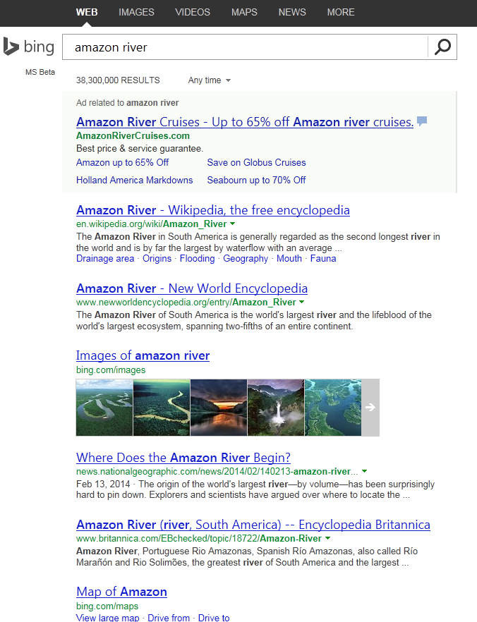
Personalized Search
Shopping
Geography
…
Notes:
Another common type of personalization comes from inferring user interests based on their clicked document. Often time users are categoried into one or more existing categories in a predefined user-interest taxnonmy. So that by associating user profiles with web documents, web documents can be reranked accordingly

Slide 4
Past Work on Personalized Search
Memory-based personalization [White and Drucker WWW’07, Shen et al. SIGIR’05]
Learn direct association between query and URLs
Limited coverage and generalization
Extracting user-centric features ^{[Teevan et al. SIGIR’05]}
Location, gender, click history
Require large volume of user history
Notes:
As illustrated previously, there are in general two types of work in personalized search

Slide 5
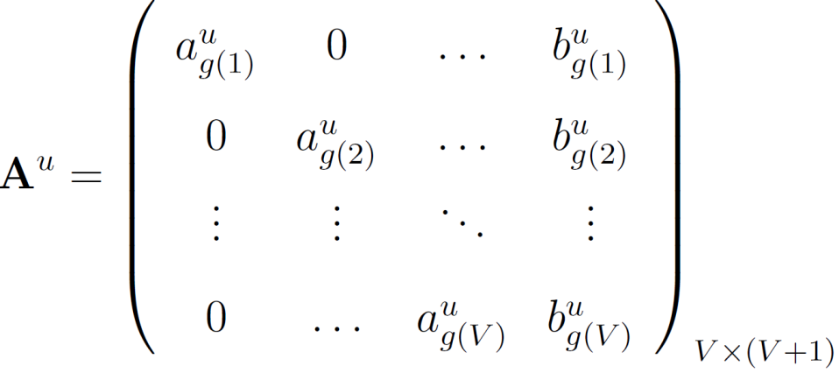
Past Work on Personalized Search
Adapting the global ranking model for each individual user ^{[Wang et al. SIGIR’13]}
Adjusting the generic ranking model’s parameters with respect to each individual user’s ranking preferences
Notes:
One of our previous work presented in last year’s sigir tried to address the aforementioned issue by proposing a framework that adapt a globally trained ranking model to each individual users by adjust parameters according to user search history

Slide 6
Past Work on Personalized Search
Adapting the global ranking model for each individual user ^{[Wang et al. SIGIR’13]}
Adjusting the generic ranking model’s parameters with respect to each individual user’s ranking preferences
Notes:
It was a generic framework that can be optimized using different loss function with a regularization term for groups of parameters. One of the generalization we tried was a RankNet without hidden layers, which is similar to logistic regression in this sense. That model works pretty well comparing to other generalizations, which brought us to this subject

Slide 7
Our Contribution
Train a set of Deep/Shallow RankNet models on generic training data
Instead of RankNet without hidden layers (good performance already) ^{[Wang et al. SIGIR’13]}
Continue to train on each users search/click history
One model per user
Use several strategies to improve personalization performance
Control the adaptation data
Regularize back-propagation
Notes:
Our contribution of this paper is multifold. Given the recent success of deep learning, we want to fully explore its capability in improving ranking performance. So we want to train a set of ranknet models, from shallow ones to very deep ones, to see how the performance changes with the increase of hidden layers and model parameters.
The way we perform adaptation is to do continue-train for each individual users, so one model per user
And finally, to improve the personalization performance, we leverage serval strategies by either control the adaptation data or regularize the bp

Slide 8
RankNet Revisit
Originally proposed by Burges et al. ICML’05
Good performance on document ranking
One-type of feed-forwarding Neural network
Learn from query-level pair-wise preference
Use cross entropy as cost function
Perform back propagation using SGD
Notes:
Let’s first briefly review RankNet. Instead of learning from individual labeled instances, RankNet learns from pair-wise preference for each query instances

Slide 9
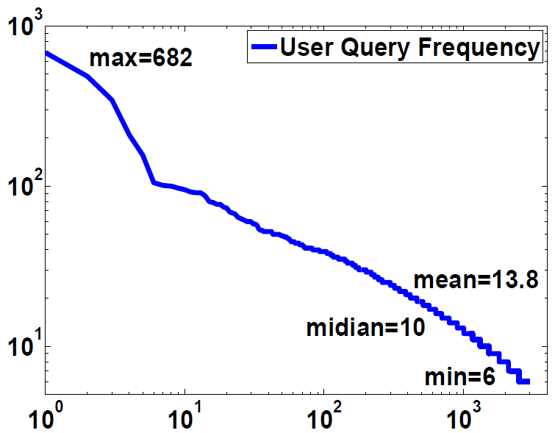
Data Set Overview
Two sources of data
Global model training: sampled from Bing search logs from April ~ October 2011. Each queries associated with 10~30 URLs for triple-judge (5-scale).
Personalized model adaptation: sampled 10,000 unique users from Jan ~ March 2013. Users are required to have at least 6 queries. Filtering those out and then randomly sample 3,000 users.

Slide 10
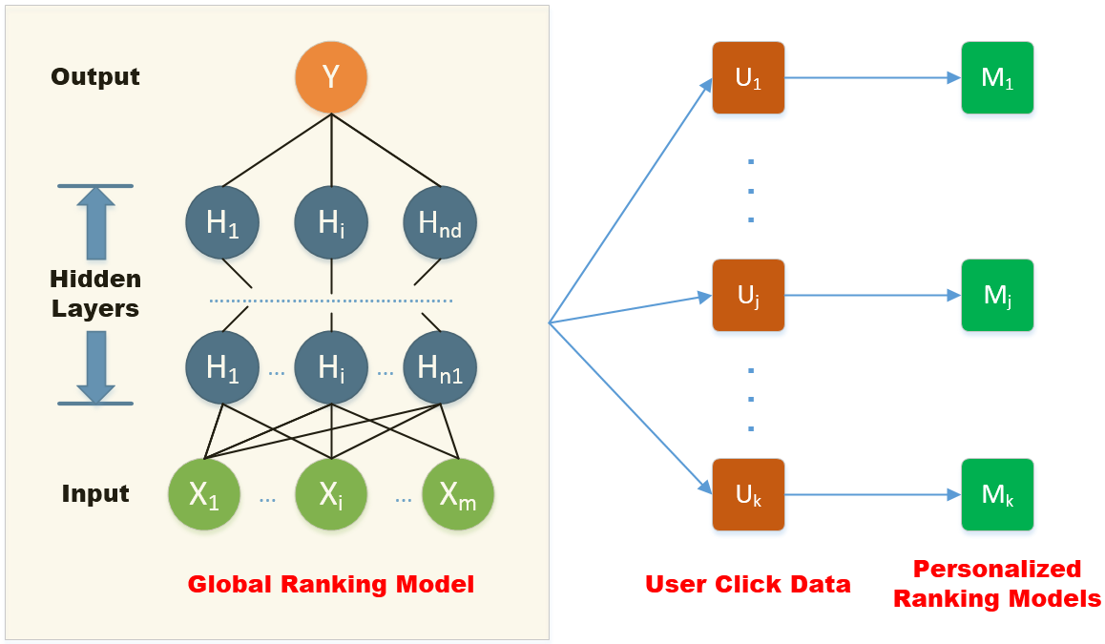
Train Global RankNet Models
Using 400 ranking features (a subset) for training
Learning rate decreases over time
Initial value 0.01
Reduce by 1/5 when validation NDCG drops by > 1% or pair-wise errors increase by > 3%
Early-stop is used when validation NDCG changes less than 0.00001 for 10 iterations.
A total of 20 configurations of RankNet are tested
Best performance achieved by two models
“50 50” – a shallow two hidden layer model
“100 100 50 50 20” – a deep five hidden layer model

Slide 11
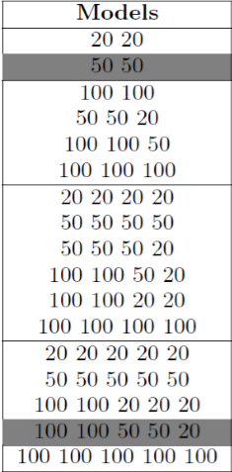
Train Global RankNet Models
Larger models tend to perform better
Smaller models often have lower variance
Initialization of RankNet is important to train a successful model
Using multiple starting points and choose the best one for initialization
Larger models take more time to train
Added one hidden layer increase training time by 2~5 times
The biggest model (with 5-hidden layer) takes two weeks to train
With parallelization on back-prop on a MSR HPC server

Slide 12
Personalized Model Adaptation
Perform continue-train on global models for each user
Construct user preference data based on user clicks: $U_{i}≻U_{j}$
Click > Skip Above & Click > No Click Next
Efficiency: avoid revisiting generic (large) training set
Effectiveness: adapt the model more accurately on user preference data
Issue of continue-train
Noisy adaptation data
Limited data could lead to over-fitting
Notes:
After having the global model trained, we then perform our adaptation using continue-train. We construct user preference… A common assumption is that clicked document is treated more relevant than skiped doc by the user. In addition, to address the position-bias introduced by ranking, we use two click feedback strategies

Slide 13
Personalized Model Adaptation
Baseline Ranking Performance
Split data into three parts for train/validate/test according to timestamp
Baseline: no adaptation, evaluate directly on test data
Poor performance by baseline models
Worse than production system
Adaptation increase the performance significantly
No Adaptation
With Adaptation

Slide 14
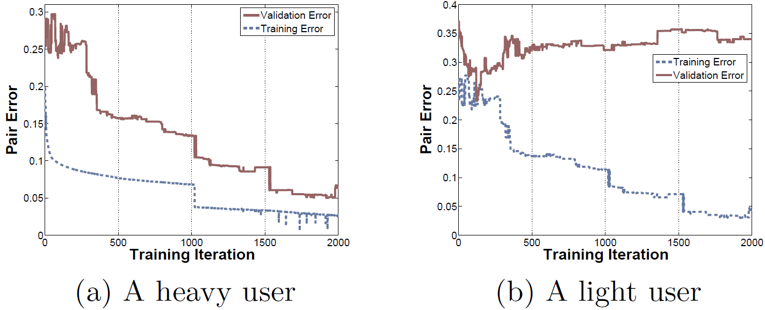
A case of overfitting
Randomly select two test users
One with 300 queries (heavy user)
One with 20 queries (light user)
The adaptation overfitting the training data for light user
Notes:
Despite the fact that adaptation increases the performance significantly, we still see a lot of issues with that in terms of generalization. In particular, our adaptation stragetires often fails for infrequent users, or light user if you will
We see the training errors keep going down, but the validation error increases after a certain period of iteration

Slide 15
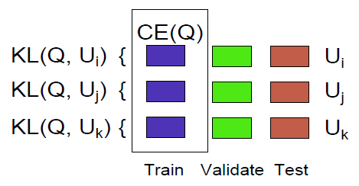
Strategy 1: Control Adaptation Data
General idea
Put more weights on queries that can exhibit user preference
Three heuristics
H1: weight adaptation query on per-user basis using KL divergence (KL)
Compare user’s click pattern $P_{u}\left(q_{i}^{(u)}\right)$ with the remaining users $P_{¬u}\left(q_{i}^{(u)}\right)$
H2: weight adaptation query cross users using click entropy measurement (CE)
Aggregate all clicks for a query across all users
Queries with high click entropies are more useful for personalization ^{[Teevan SIGIR’08]}
H3: remove top-result-click queries from adaptation (DT)
Notes:
So, we propose to use different strategies to reduce the cases of overfitting.
The first stragety is to control what data use for adaptation
H1: so if the difference is pretty large, that means the user treats this query differently from the rest of users and this we put more weights on it
H2: instead per user basis, we weight

Slide 16
Strategy 2: Regularize on Back Propagation
General idea
Update the weight of a neuron only if it’s not certain about an adaptation example
Each neuron is trained to emphasize on certain portion of the feature space
New training data with different feature distribution causes some neuron to learn new information
Similar ideas in machine learning
L₁-regularized subgradient
Truncated gradient ^{[Langford et al. JMLR’09]}
Confidence-weighted learning ^{[Dredez et al. ICML’08]}
Difference: our truncation is enforced on each neuron not each feature
Notes:
Each neuron focus on specific feature space, for example, in CV, neurons are trained to recognized different patterns of edges of the images as edge detectors.

Slide 17
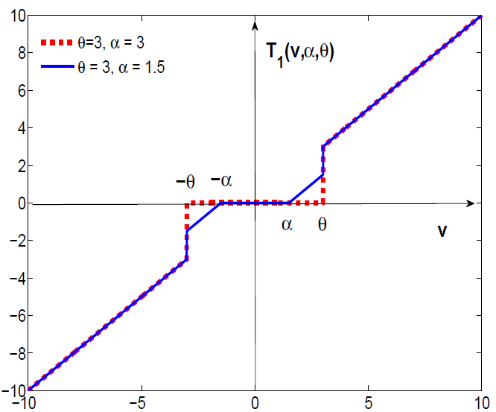
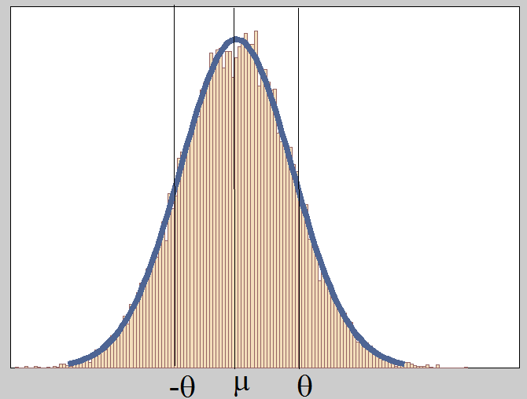
Strategy 2: Regularize on Back Propagation
H4: perform truncated gradient on adaptation
Rewrite the back propagation formula, adding a truncation function T₁
a(k) is the output of neuron k, C is the cross entropy cost function
Use a held-out validation set after global model training
Store the output (activation) value at each neuron
Assume the outputs following a Normal distribution $N \sim (μ_{k}, σ_{k}^{2})$
Set $θ_{k}=μ_{k}+σ_{k}$

Slide 18
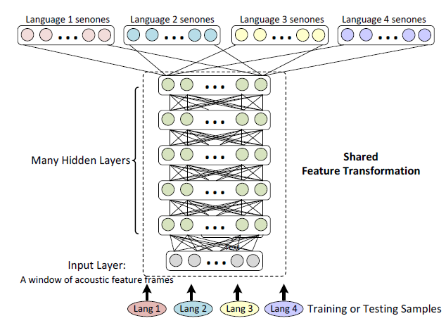
Strategy 2: Regularize on Back Propagation
H5: Back propagate to the highest layer only
Inspired by research advance in cross-language knowledge transfer in speech ^{[Huang et al. ICASSP’13]}
Treat training and adaptation as two different learning tasks
Share the same network structure (input/hidden layer)
But different output layer with different objective function
Assumption: the highest layer contains most abstract features
More likely to be applicable to different tasks/domains
Important when one domain (adaptation) data is sparse

Slide 19
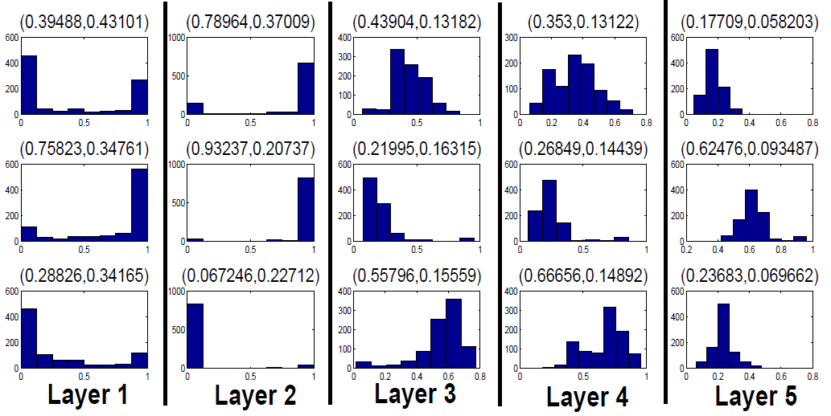
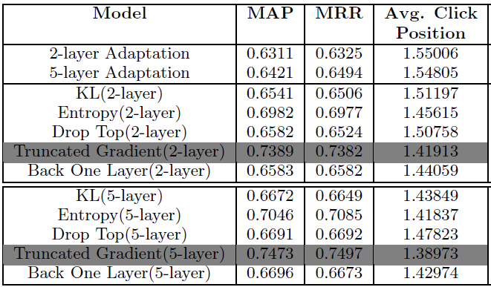
Adaptation Performance
2-layer
Overall performance (5-layer models outperform 2-layer)
Truncated gradient (TG) outperforms other strategies significantly
Analysis TG by random sampling neuron’s output values for validation set
Bottom layer (layer 1) tends to have higher variance than top layers
Less updates happens in lower layers (more gradients are truncated)
5-layer

Slide 20
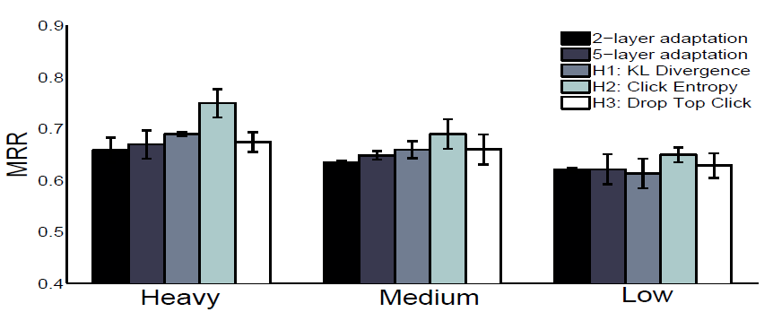
Adaptation Performance
2-layer
Overall performance (5-layer models outperform 2-layer)
Using cross entropy (CE) to set query weight works well
Coverage matters: CE reweights much more queries than the other two heuristics
Works best for heavy users with sufficient search history
5-layer

Slide 21
Adaptation Performance
Performance breakdown by query types
Most improvement from repeated queries
Heuristics helps in some cases, hurts in some others
Improve informational queries is still challenging

Slide 22
Conclusions
Addressed large-scale personalized search using Deep Learning
Train a variety of RankNet models using generic training data
Adapt to individual users via continue-train
Global models: Deep RankNet often outperforms shallow RankNet
Improve adaptation performance using strategies
S1: reweight adaptation queries: CE > DT > KL
S2: regularize BP: TG > BO
Heuristics helps!
Truncated gradient (TG) works best

