Slide 1
Joint Relevance and Freshness Learning From Clickthroughs for News Search
Hongning Wang⁺, Anlei Dong*, Lihong Li*, Yi Chang*, Evgeniy Gabrilovich*
⁺CS@UIUC *Yahoo! Labs

Slide 2
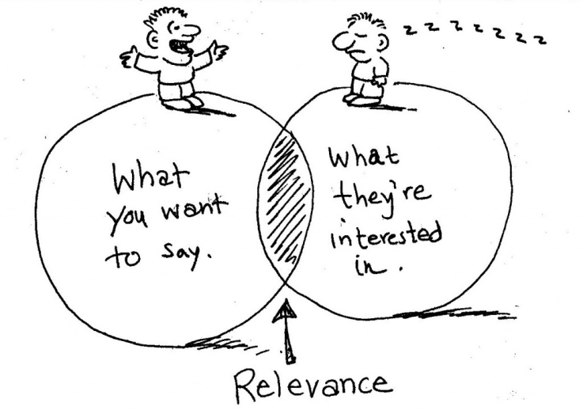
Relevance v.s. Freshness
Relevance
Topical relatedness
Metric: tf*idf, BM25, Language Model
Freshness
Temporal closeness
Metric: age, elapsed time
Trade-off
Serve for user’s information need
Notes:
In traditional web search, relevance, is narrowly defined as topical relatedness, where various ranking features have been proposed to capture such relevance, including tf*idf, BM25 and language modeling approaches.
While in news search, the increased importance of freshness is one distinctive characteristic. The emphasis on freshness is crucial for news search, as even the seemingly current event can quickly become outdated, dwarfed by the importance of new developments.
In addition, the relative emphasis, or trade-off, between these two aspects are highly specific to the query and time when the query was issued. And such trade-off reflects the end-user’s underlying information need.

Slide 3
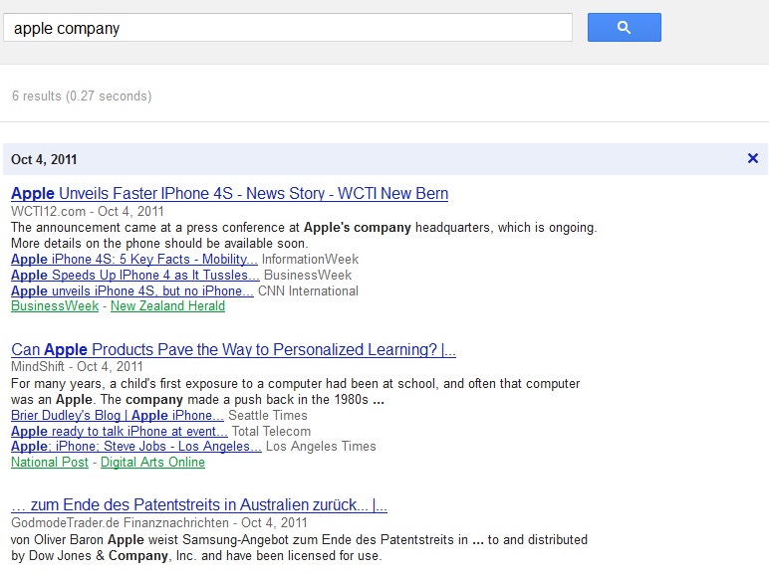
Freshness is Important for News Search
“Apple Company” @ Oct. 4, 2011
Release of iPhone 4S
Notes:
Let’s take the event happened on “apple company” last October as an example. When a user submit the query “Apple Company” into a news search engine, on Oct. 4, 2011, she was expecting to find a list of news reports covering the new release of Apple’s iPhone4S.

Slide 4
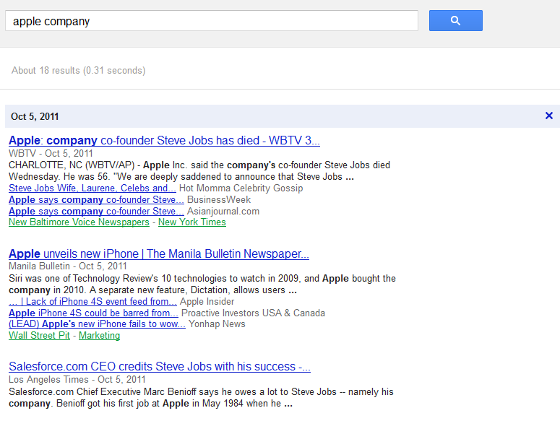
Freshness is Important for News Search
“Apple Company” @ Oct. 5, 2011
Steve Jobs passed away
Release of iPhone 4S
Notes:
However, the news talking about release of iPhone 4s became less relevant to the query just one day after, when Apple Inc.’s former CEO Steve Jobs passed away on Oct. 5, 2011. Such case is quite common in news search, and urges us to give seriously consider and model freshness and the trade-off between relevance and freshness in news search scenario.

Slide 5
Understand User’s Information Need
User’s emphasis on relevance/freshness varies
Breaking news queries
Prefer latest news reports – freshness driven
E.g., “apple company”
Newsworthy queries
Prefer high coverage and authority news reports – relevance driven
E.g., “bin laden death”
Notes:
Incorporating freshness into news ranking is not a trivial exercise of combining relevance and freshness scores, as users’ search intents need to be taken into consideration. For breaking news queries, as in our previous example, returning most recent news would always improve users' satisfaction. In other cases, for newsworthy queries such as ``bin laden death'', preferring older but more relevant reports, in terms of coverage and authority, makes more sense.

Slide 6
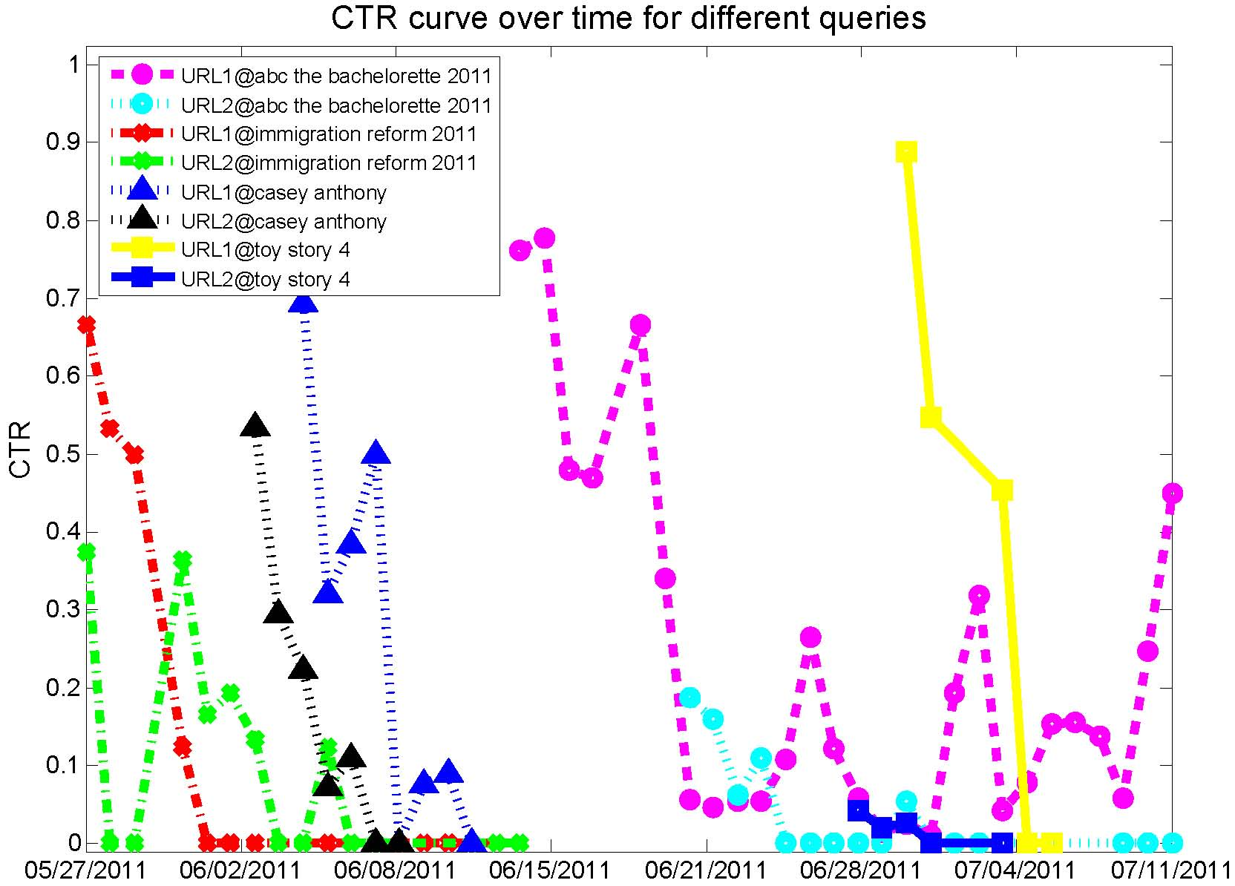
Understand User’s Information Need
User’s emphasis on relevance/freshness varies
Breaking news queries
Newsworthy queries
Notes:
Previous studies have shown that the relationship between returned documents and queries varies as users' intent in web search changes over time. To demonstrate this phenomenon in news search scenario, we select 8 most frequently returned URLs under 4 different queries (2 URLs per query) from Yahoo! news search engine in a period of two months (late May to late July, 2011).
Two of these queries have the highest search frequency within one day, namely, “toy story 4” and “casey antony”, and the other two have the longest lifetime span over this period, i.e., “abc the bachelorette 2011'' and “immigration reform 2011''. We illustrate the Click-Through Rate (CTR) curves for these 8 URLs during the period in this figure.
From the result, we can clearly observe the difference between these two types of queries. For the query “casey antony”, the CTR for the returned URLs quickly diminished because new stories came out quickly; on the other hand, for the query “abc the bachelorette 2011”, users' interest was maintained over much longer period of time. In the latter case, users found those URLs containing summary report useful in a long time after this TV episode was shown. These results imply that users' preferences are highly dependent on the query as well as its issuing time.

Slide 7
Assess User’s Information Need
Unsupervised integration ^{[Efron 2011, Li 2003]}
Limited on timestamps
Editor’s judgment ^{[Dong 2010, Dai 2011]}
Expensive for timely annotation
Inadequate to recover end-user’s information need
Notes:
Some work has been done to tackle the time-sensitive ranking problems in web search. Li et al. and Efron et al. came up with solutions from a content analysis perspective, by introducing document publication timestamp into language models. However, the temporal property for both queries and documents are not limited to timestamps alone; various signals are available to depict it.
To incorporate multiple signals, supervised learning to rank algorithm applied on the human annotation data set is the choice. However, given the highly dynamic nature of news events and the sheer scale of news reported around the globe, it is often impractical for human editors to constantly keep track of the news and provide timely relevance and freshness judgments. In addition, it’s quite difficult, if not impossible, for the editors to understand and recover the end-user’s information need, or the unobserved trade-off, between relevance and freshness aspects.

Slide 8
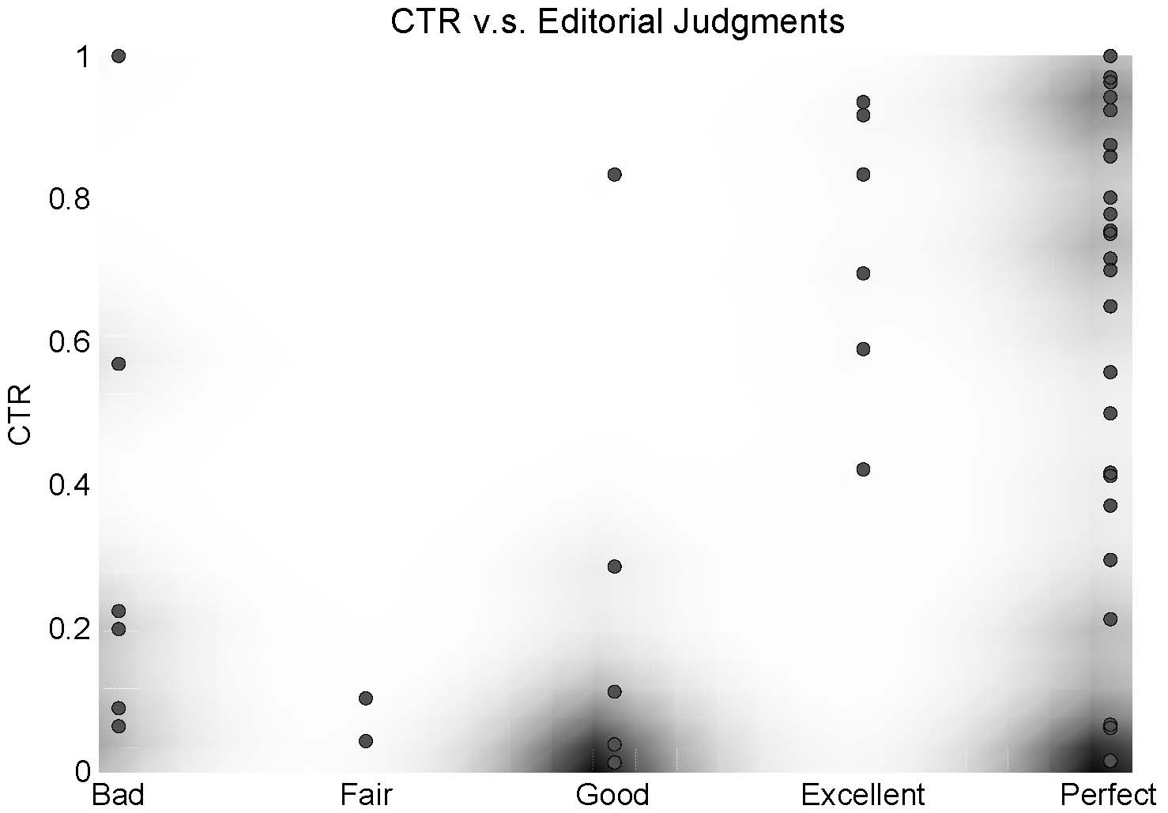
Manipulate Editor’s Annotation
Freshness-demoted relevance
Rule-based hard demotion ^{[Dong 2010]}
E.g., if the result is somewhat outdated, it should be demoted by one grade (e.g., from excellent to good)
Correlation: 0.5764±0.6401
Notes:
Dong et al., designed a set of editorial guidance to annotate the relevance and freshness, and they used the freshness grade to demote the relevance grade when computing the final ranking grade for training learning to rank algorithms. However, we believe such rule-based demotion is often sub-optimal. To validate this conjecture, we asked editors to annotate the news query log for the day of Aug. 9, 2011 immediately one day after, and then demoted the news search results based on their judgments using the demotion method from Dong et al.
The relation between observed CTR and the demoted grades is visualized by a scatter plot in this figure. From this result, we can observe that the clicks are not strictly correlated with the demoted grades: the average Pearson correlation between them across the queries is 0.5764 with a standard deviation 0.6401. The main reason for this inconsistency is the hard demotion rule: users might have different demotion preferences for different queries, and it's almost impossible for an editor to predefine the combination rules given the plurality of possibilities. As we can expect, the uncertainty from this heuristically-derived ranking grades will limit the performance of subsequent learning-to-rank algorithms.
In this work, we propose to model relevance and freshness, and the query-specific relative mix of these two aspects for news search simultaneously from the real users’ click logs.

Slide 9
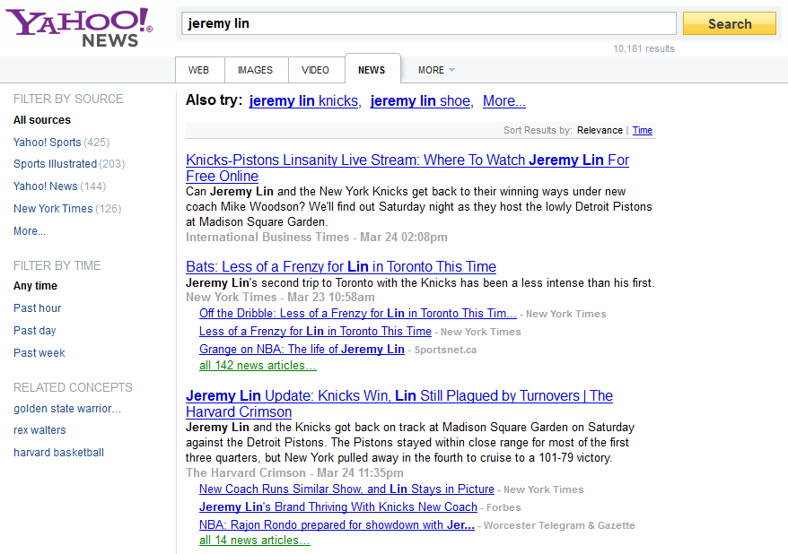
User’s Judgment on Relevance and Freshness
User’s browsing behavior
Freshness weight=0.8
R=0.39
F=2.34
Y=1.95
R=1.72
F=2.18
Y=2.01
R=2.41
F=1.76
Y=2.09
Notes:
Suppose, when a user submits a query to a news search engine and gets an according list of ranked news documents, she has a clear mind of her emphasis over relevance and freshness on the expected results.
Then, she would sequencially judge the usefulness of each document by her underlining sense of relevance and freshness, and gives it an overall impression grade by her preference over relevance and freshness at that particular time.
Once she has such impressions in mind, she would deliberately click the documents most interesting to her and skip all the others.

Slide 10
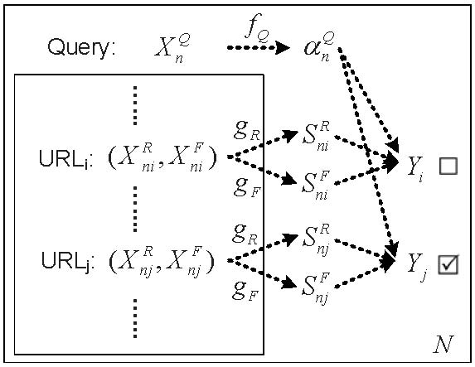
Joint Relevance and Freshness Learning
JRFL: (Relevance, Freshness) -> Click
Query => trade-off
URL => relevance/freshness
Click => overall impression
Notes:
Inspired by this example, we proposed to model the users' click behavior in news search as a direct consequence of examining the relevance and freshness aspects of the returned documents. And we name our method as Joint Relevance and Freshness Learning, or JRFL in short.
We can abstract the user’s decision process discussed in the last slide by this figure. In addition to give a good estimate of a candidate URL’s relevance and freshness aspects, a good ranking function should be able to infer the trade-off and return the optimally combined ranking results for individual queries as well, because the relative emphasis the users put over these two aspects can vary substantially, reflecting the searching intention for the specific news event.
However, we cannot explicitly obtain the users' relevance/freshness judgments and the preferences over these two aspects, since their evaluation process is not directly observable from the search engine. Fortunately, the users' click patterns are recorded, from which we can assume the clicked documents are more meaningful to her than the non-clicked ones. Therefore, we model relevance and freshness as two latent factors and assume a linear combination of these two, which is also latent, generates the observed click preferences.

Slide 11
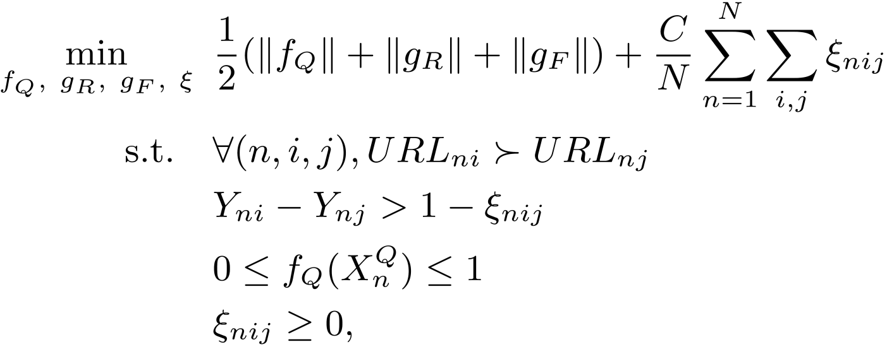
Joint Relevance and Freshness Learning
Model formalization
Query-specific
Latent
Notes:
Based on the previous discussion, we characterize the observed pairwise click preferences as the joint consequences of examining the combined relevance and freshness aspects of the URLs for the query.
For a given collection of click logs, we are looking for a set of optimal models, which can explain the observed pairwise preferences as many as possible. As a result, we formalized this pairwise learning problem as an optimization task and formally defined it as follows.
From the model formalization, we can clearly notice the difference between our proposed JRFL and other classic pairwise-learning-to-rank algorithms, such as RankSVM and GBRank. A classic pairwise learning-to-rank algorithm only uses one scoring function to account for all the observed click preferences, where different ranking criteria cannot be easily incorporated. Besides, even though RankSVM model shares a similar object function as JRFL, they are still quite different: JRFL simultaneously learns a relevance model and a freshness model, which are both latent by the way, and utilizes a query-specific model to leverage these two aspects to explain the observed click patterns. Neither RankSVM nor GBRank deal with such query-specific multi-criterion ranking.

Slide 12
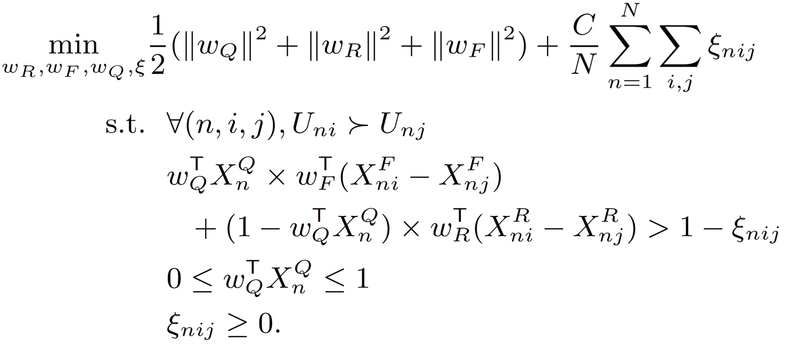
Joint Relevance and Freshness Learning
Linear instantiation
Associative property
Relevance/Freshness model learning
Query model learning
Notes:
In our previous model description, we didn't specify the way for estimating the relevance, freshness and query-specific trade-off. Although many alternatives exist, we choose linear functions for all these purposes to simplify the exposition and derive efficient model estimation procedures. Other types of functions can also be employed, although numerical approximation is unavoidable in general when optimizing their model parameters.
As a result, the proposed JRFL model can be instantiated as shown in this slide.
Thanks to the associative property of linear functions, this optimization problem can be divided into two sub-problems: relevance/freshness model estimation and query model estimation. And more importantly, each of them is a convex programming problem.

Slide 13
Joint Relevance and Freshness Learning
Coordinate descent for JRFL
Randomly initialize , and set
Repeat until converge
Update Relevance/Freshness models:
Update Query model:
Return the final model
Convex programming
Notes:
Therefore, we can utilize the coordinate descent algorithm to iteratively solve the two convex programs.
At the first step, we randomly initialize the model parameters. Then, we update the relevance/freshness model with respect to the constrains in the optimization problem by fixing the query model; next, we update the query model accordingly by fixing the relevance/freshness model.
These two steps are alternated until the change in the object function is converged.
The interaction between the relevance/freshness models and query model is clearly stated in the optimization process: in relevance/freshness models estimation, the query-specific preference weight acts as a tuning factor, which increases or decreases the features in these two models to represent the searching intention; once we have the relevance/freshness models, we tune the query model to preserve as many click preferences as possible based on the current relevance/freshness predictions.

Slide 14
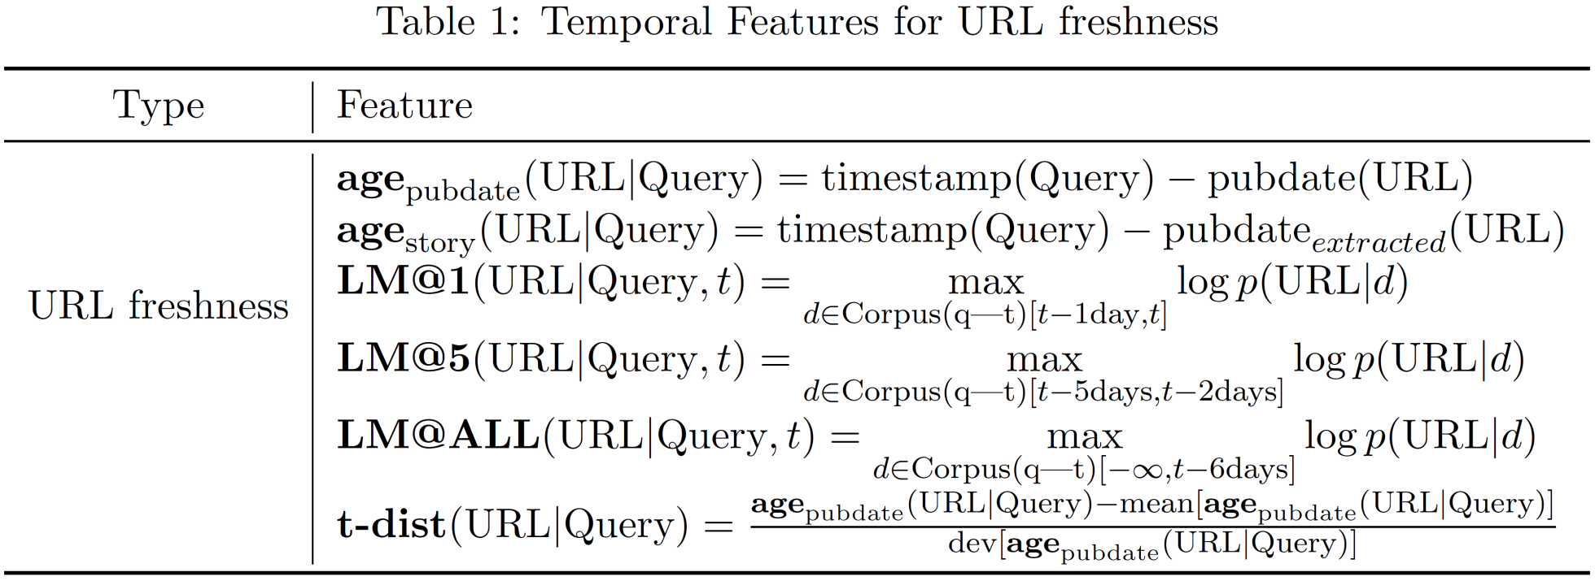
Temporal Features
URL freshness features
Identify freshness from content analysis
Notes:
To capture the temporal property of the news documents and queries, we propose a set of novel time-sensitive features as our URL freshness features and query features.
The complete definition can be found in our paper, here, to save some time, I would like to briefly highlight some of these newly proposed features.
Content coverage is an important character of the freshness for a news document. Newer stories should cover more content that has not been mentioned by the previous reports. For a given query with a list of candidate news articles at a particular time, we first collect all the previous news articles associated with this query in our query log, and build language models for each of these documents. Then, we separate those language models into different sets: for example, models with documents published one day before, and treat the candidate URLs as query to calculate the maximum generation probability given by the estimated language model in a specific set accordingly.

Slide 15
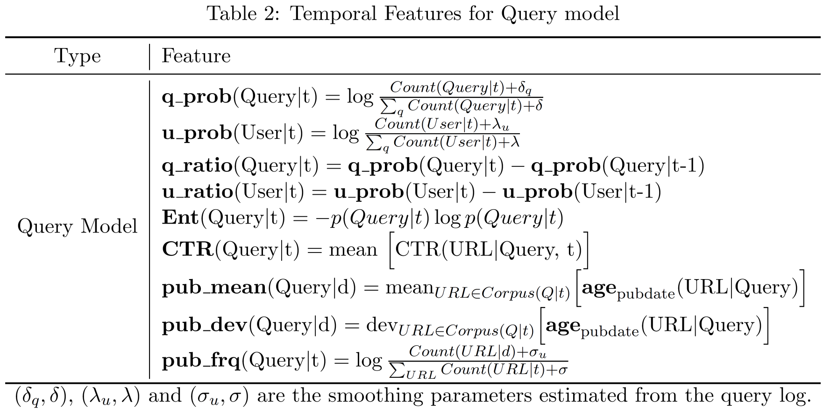
Temporal Features
Query freshness features
Capture latent preference
Notes:
Query freshness features are designed to capture the user’s latent preference over relevance and freshness aspects.
For example, the relative frequency ratio of a query within two consecutive time slots implies the change of users interest. A higher ratio indicates an increasing user interest on this news event.

Slide 16
Experiment Results
Data sets
Two months’ Yahoo! News Search sessions
Normal bucket: top 10 positions
Random bucket ^{[Li 2011]}
Randomly shuffled top 4 positions
Unbiased evaluation corpus
Editor’s judgment: 1 day’s query log
Preference pair selection ^{[Joachims 2005]}
Click > Skip above
Click > Skip next
Ordered by Pearson’s value
Notes:
We collected real search sessions from Yahoo! news search engine in a two months period, from late May to late July, 2011. In addition to normal click logs, we also set up a random bucket to collect exploration clicks from a small portion of traffic at the same time to unbiasedly compare different ranking algorithms. In this random bucket, the top four URLs were randomly shuffled and displayed to the real users. By doing such random shuffling, we were able to collect user click feedback on each document without positional bias, and such feedback can be thought as a reliable proxy on information utility of documents. As a result, we only collected the top 4 URLs from this random bucket.
In addition, we also asked editors to annotate the relevance and freshness in Aug. 9, 2011's query log immediately one day after, according to the editorial guidance given by Dong et al.
We decide to train our model on the normal click data, because such clicks are easier to collect without hurting the search engine's performance. However, this kind of clicks are known to be heavily positional biased. To reduce the bias for training, we followed Joachims et al.'s method to extract preferences from clicks. In particular, we employed two click heuristics: 1) clicked urls should be ranked higher than the urls displayed ahead of it but didn’t get any click; 2) clicked urls should be ranked higher than the one displayed just below it but didn’t get any click. To filter out noisy and conflicting preferences, the preference pairs are ordered according to their $\chi^2$ value and only the top ones would be selected for training purpose.

Slide 17
Experiment Results
Data sets
Statistics
Notes:
After these selection steps, we were able to keep the top 150K preference pairs from some portion of normal clicks. Besides, for testing purpose, we randomly select 500k query-URL pairs from original normal click set (not including the URLs used for generating the click preference pairs) and 500k from the random bucket clicks.
In order to guarantee the quality of freshness annotation, we asked the editors to finish the annotation in day. As a result, we only have about 13k query-URL pairs annotated out of that day's query log.
As a summary, we list the data sets for our experiments in this table.

Slide 18
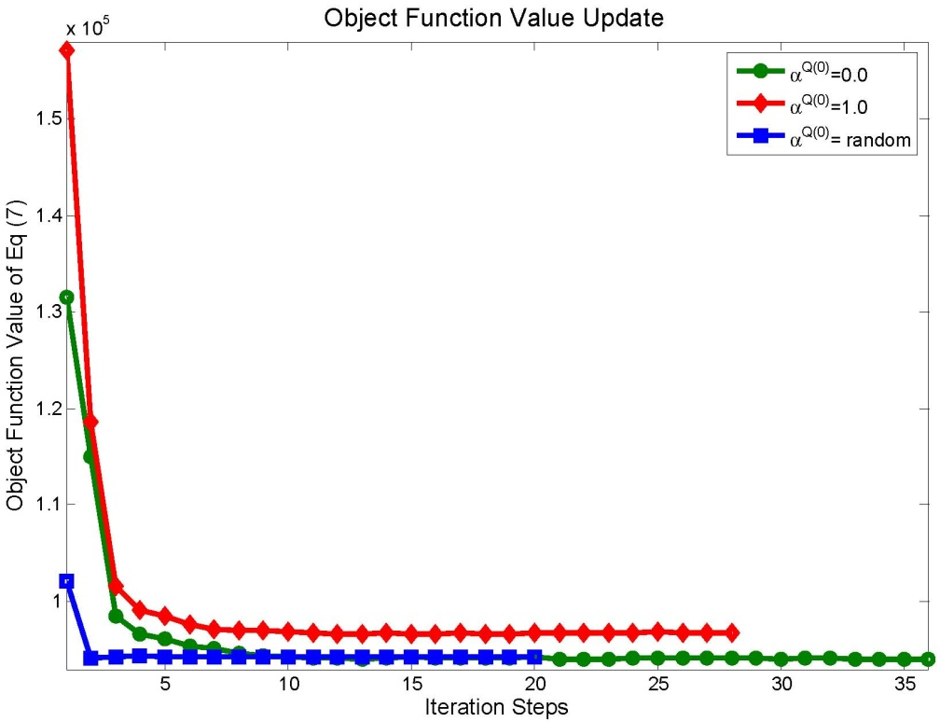
Analysis of JRFL
Convergence
Train/Test sets: 90k/60k preference pairs
Varying initial query weight
(a) Object Function Value Update
Notes:
We first demonstrate the convergency of the coordinate descent algorithm for JRFL model, which is the necessary condition for applying the proposed model in real ranking problems.
We randomly divided the training preference pairs into two sets, one with 90k pairs for training and the rest 60k for testing. To study if the algorithm's convergence is sensitive to the initial state, we tried 3 starting points: 1) fixing the initial query weights $\alpha^{Q(0)}$ to be $1.0$ (freshness only); 2) fixing $\alpha^{Q(0)}$ to be $0.0$ (relevance only); 3) setting it uniformly between $0$ and $1$, by directly set all the query weights accordingly at step 0.
The training process is illustrated in this figure by show the updating trace of JRFL’s object function. We can find that the proposed JRFL model converges during the coordinate descent optimization process, and such convergence does not depend on the initial state.

Slide 19
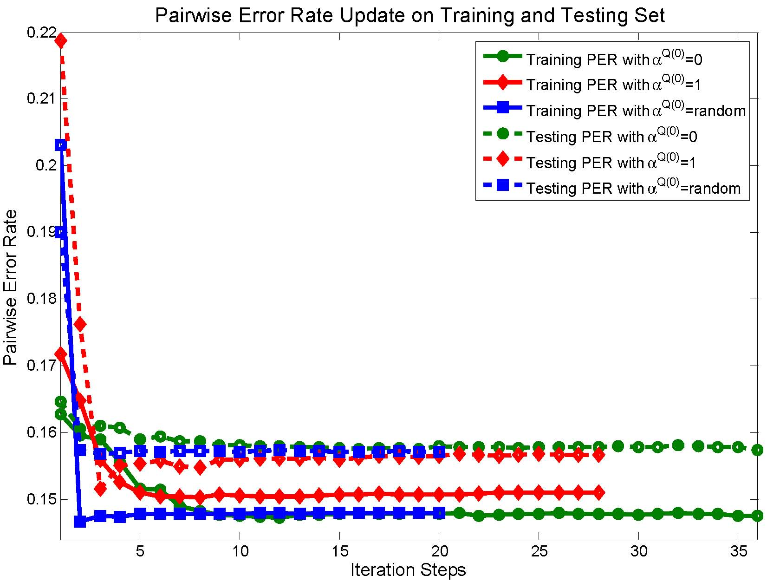
Analysis of JRFL
Convergence
Train/Test sets: 90k/60k preference pairs
Varying initial query weight
(b) Pairwise Error Rate Update
Notes:
By analyzing the pairwise error rate during the training process, we can find that even though, as shown in the last slide, the object function decreased quickly after the first several iterations, the pairwise error rate needs more iterations to reach its optimal value. Furthermore, during these updates, there were some inconsistent updates between the object function value and pairwise error rate: while the object function value always decreased with more iterations, the pairwise error rate did not show the same monotonic behavior. This inconsistence is expected, because the JRFL’s object function is a relaxed one: we do not directly minimize the pairwise error rate, which is computationally intractable, but we are trying to reduce the prediction gap between the mis-ordered pairs.

Slide 20
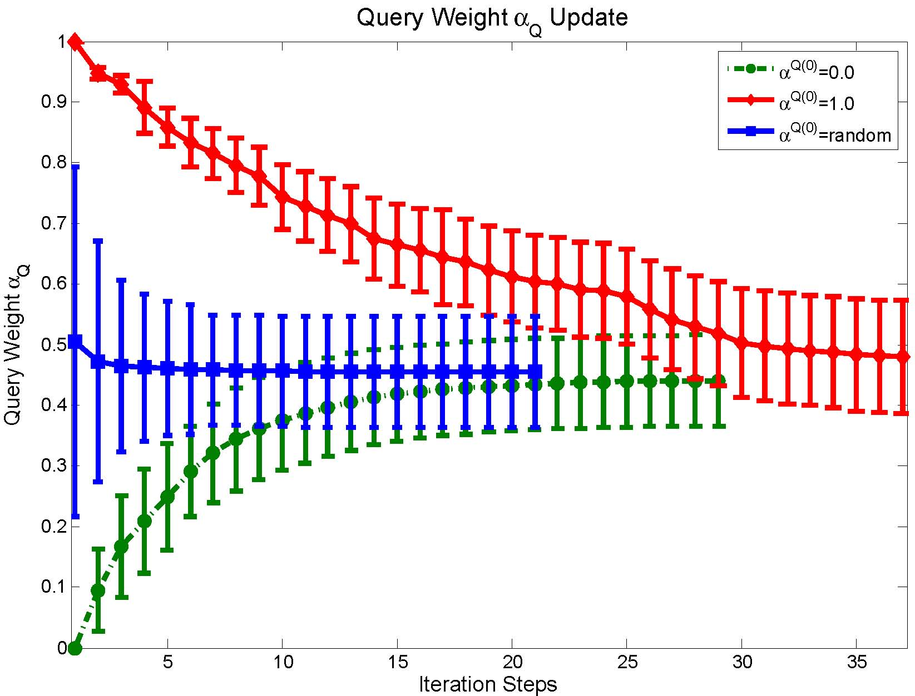
Analysis of JRFL
Convergence
Train/Test sets: 90k/60k preference pairs
Varying initial query weight
(c) Query Weight Update
Notes:
From the trace of query weight update, we can observe that the optimal query weight setting for this training set is usually around 0.4546 +/- 0.0914. Hence, the random initialization converges fastest comparing with two other settings, since the initial state given by random is closest to this optimal setting.

Slide 21
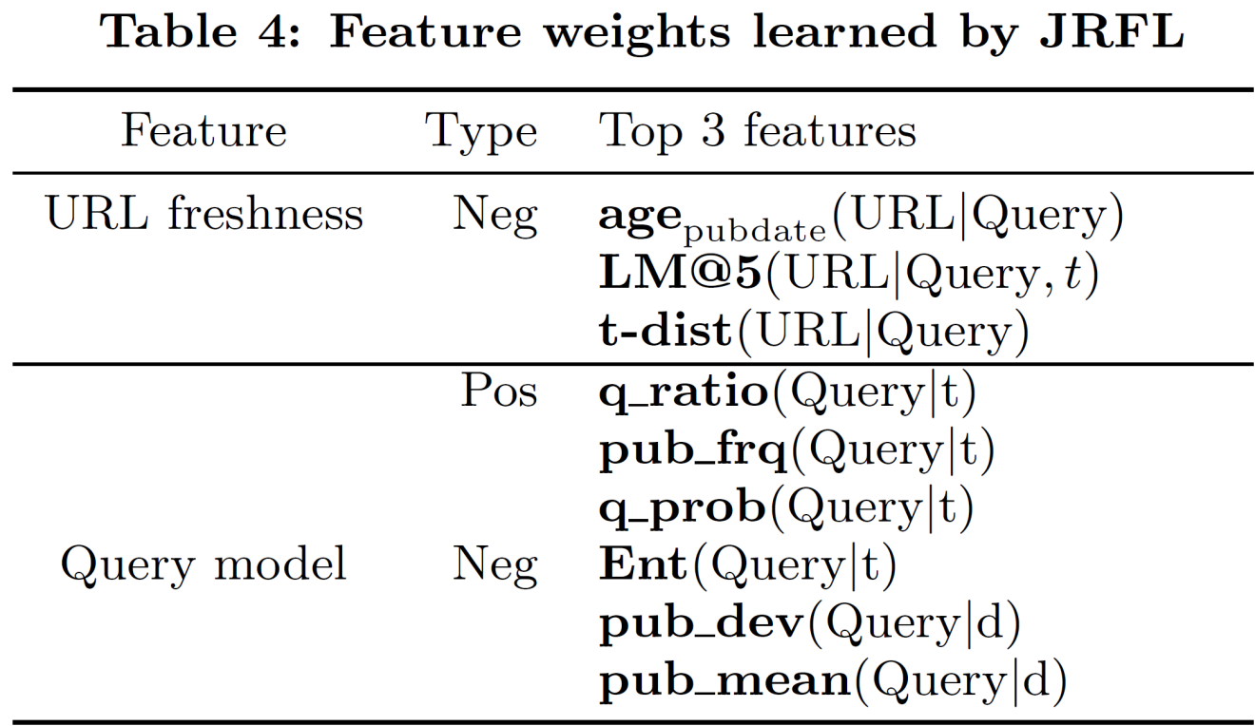
Analysis of JRFL
Feature weight learning
Notes:
We list the top 3 positive and negative features from the newly proposed URL freshness features and query features in this table, and order them by the learned weights. The weights in the linear model reflect the features' relative contribution to the final ranking decision. Because we only have 6 URL freshness features, and the learned weights for them are all negative, we only list the top 3 negative ones in this table.
The weights learned by the corresponding models are reasonable and consistent with our design: for example, for URL freshness features, the smaller generation probability given by the old corpus indicates the newer report content is; and for the query freshness features, the larger portion of recent news reports covering the event, the more emphasis should be put over the freshness aspect.

Slide 22
Analysis of JRFL
Relevance and Freshness Learning
Baseline: GBRank trained on Dong et al.’s relevance/freshness annotation set
Testing corpus: editor’s one day annotation set
Upper bound
Notes:
Since our JRFL model does not rely on explicit relevance/freshness annotations, it is important to evaluate how well our relevance and freshness models can estimate each aspect separately.
We separately used the relevance and freshness annotations on Aug. 9, 2011's query log as the test bed and utilized two GBRank models trained on Dong et al,'s relevance and freshness annotation data set accordingly (44,641 query-URL pairs). Because Don’t et al.’s data set does not contain the corresponding click information, those two GBrank models were trained without new query features. Our JRFL was trained on all the extracted click preference pairs.
We observe mixed results in this experiment: the relevance and freshness modules inside JRFL have worse ranking performance than the purely relevance/freshness trained GBRank models at the top positions (lower P@1 and MAP@3), but similar cumulative performance, i.e., DCG@5 for both aspects. The reason for this result is that JRFL model has to account for the trade-off between relevance and freshness imposed by the queries during training, the most relevant or recent documents might not be treated as good training examples if their another aspect was not desirable. However, the purely relevance/freshness trained GBRank models do not have such constraints, and can derive patterns to put the most relevant/recent documents at the top positions separately. As a result, those two GBRank models' performance can be interpreted as \emph{upper bounds} for each individual ranking criterion (freshness/relevance) in this data set.
We want to emphasize that such result is already very encouraging since the JRFL model successfully infers the relevance and freshness solely from the clicks, which confirms the soundness of our assumption in this work that users' click behavior is the joint consequence of examining the relevance and freshness of a news article for the given query; by properly modeling such relationships, we can estimate the relevance and freshness from the clickthroughs to certain extend.

Slide 23
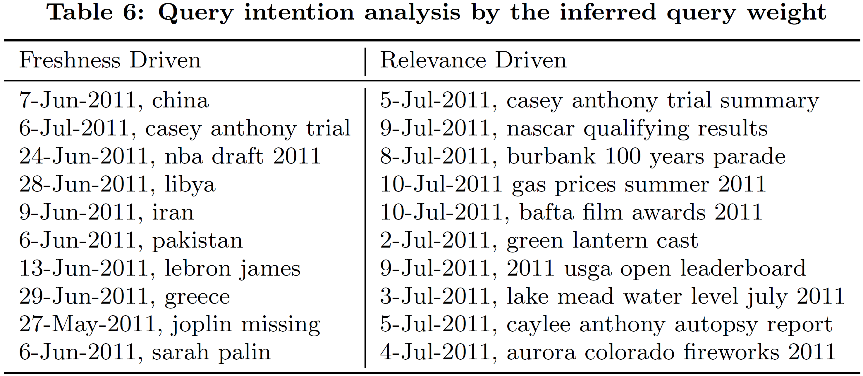
Analysis of JRFL
Query weight analysis
Notes:
There is no direct way for us to evaluate the correctness of the inferred query weights, since such information is not observable in the search log. Therefore, in this experiment, we investigate it in an indirect way: we ranked the queries in our training set according to the learned weights and list the top 10 (freshness-driven) and bottom 10 (relevance-driven) queries.
At the first glance, it may be surprising to notice that most of the top ranked freshness-driven queries are the name of some countries and celebrities, e.g., ``iran'', ``libya'' and ``lebron james''. But that is also quite reasonable: for those kind of queries, they are actually ambiguous, since there would be many candidate news reports related to different aspects of these queries. But when users issue such type of ``ambiguous'' queries in news search engine, they should be most interested in the recent updates about these countries and celebrities.
Another interesting finding from the learned query weights is that the length of relevance-driven queries is much longer than the freshness-driven queries.

Slide 24
Analysis of JRFL
Query weight analysis
Query length differs in relevance/freshness driven queries significantly
Notes:
To validate this observation, we selected the top 500 relevance-driven and top 500 freshness-driven queries to calculate the corresponding query length distributions comparing to the length distribution of all the queries.
This result is consistent with our intuition: when users are seeking specific information, they tend to put more constraints (i.e., longer queries) to describe their information need; in contrast, when users are making recency search, they usually do not have a pre-determined mind about the events, so they often issue broad queries (i.e., shorter queries) about entities of their interest to see what is happening recently to those entities.
Apparently, our query weight model is consistent with this intuition, and is able to distinguish these two typical searching scenarios. In addition, this also reminds us query length is a good feature to indicate the preference over freshness aspect.

Slide 25
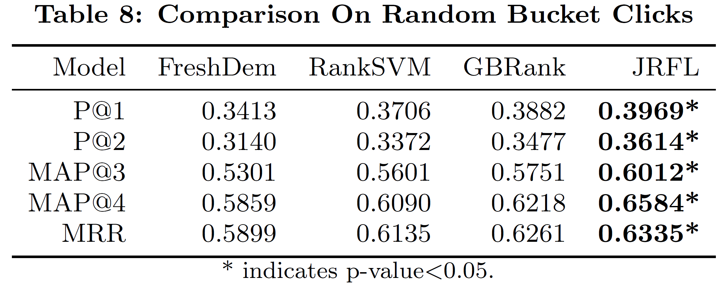
Quantitative Comparison
Ranking performance
Random bucket clicks
Notes:
To validate the effectiveness of the proposed JRFL model in real news search tasks, we quantitatively compare it with all our baseline methods on: random bucket clicks, normal clicks, and editorial judgments.
All the click-based learning algorithms are trained on all 150K click preferences. Since all these models have several parameters to be tuned, we report their best performance on the corresponding testing set according to MAP@4 metric in the following results and perform t-test to validate the significance of improvement (against the second best performance accordingly).
On this unbiased random bucket clicks, we can find the proposed JRFL model achieves encouraging improvement over the second best GBRank model, especially on MAP@4 the relative improvement is over 5.88%. This improvement confirms that properly integrating relevance and freshness can indeed improve the user's search satisfaction.

Slide 26
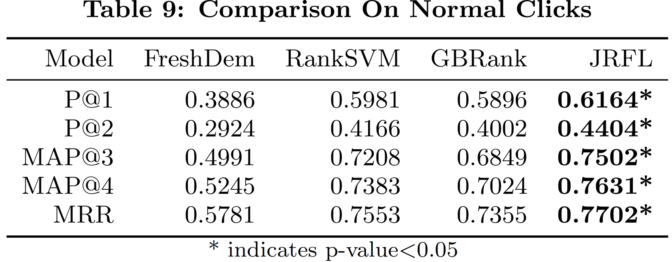
Quantitative Comparison
Ranking performance
Normal clicks
Notes:
We can observe similar improvement from JRFL over other ranking methods in the normal clicks.
Besides, from the results on both of these two click data sets, we can clearly observe that the click-preference-trained models generally outperform the freshness-demotion-trained GBRank model: JRFL's improvement on P@1 against the freshness-demotion-trained GBRank model is 16.2% and 58.6% on the random bucket click set and normal click set respectively. We have already analyzed the reason for this degenerated results previously that a static grade demotion strategy can hardly guide the learning algorithm to achieve the optimal ranking results.

Slide 27
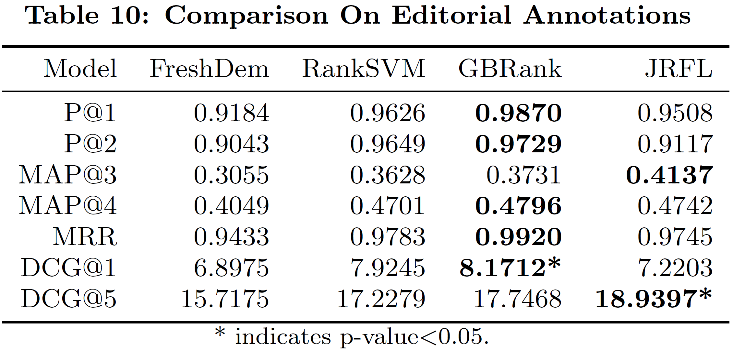
Quantitative Comparison
Ranking performance
Editorial annotations
Notes:
From the result on the editor’s annotation data set, we find that the freshness-demotion-trained GBRank model did not achieve the best performance on such ``grade demoted'' testing set either. This might be caused by the time gap between different annotations: \cite{dong2010towards}'s annotations were generated more than one year ago (February to May, 2009). The out-of-date annotation might contain inconsistent relations between queries and document as in the new annotations.

Slide 28
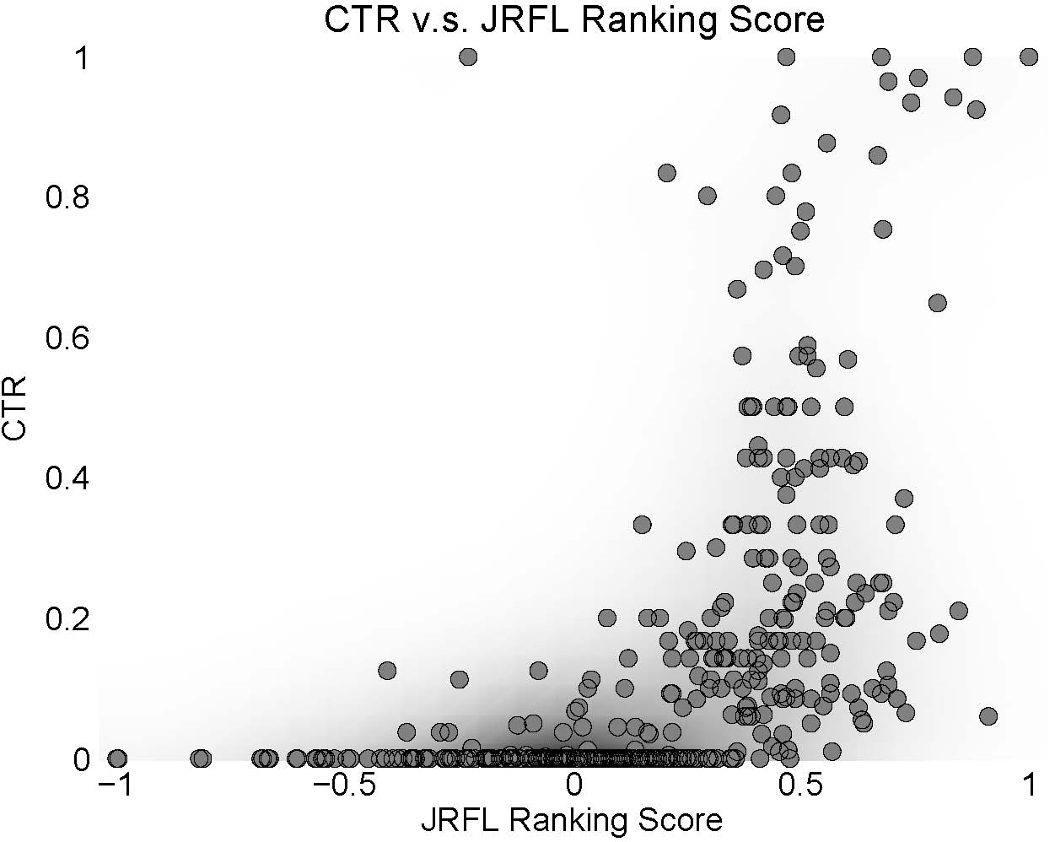
Qualitative Comparison
CTR distribution revisit
Correlation: 0.7163±0.1673
Notes:
In the end, we want to revisit the relationship between the predicted orders given by JRFL and CTR as we have done in the introduction part. This time, we draw the scatter plot between the JRFL predicted ranking scores and CTRs on the same set of URLs as before.
The monotonic relationship between the predicted ranking and CTRs is much more evident than the one given by the demoted grades: URLs with lower CTRs concentrate more densely in the area with lower prediction scores, and the average Pearson correlation between the predicted ranking score and CTR across all the queries is 0.7163 with standard deviation 0.1673, comparing to the average of 0.5764 and standard deviation of 0.6401 in the demoted grades.

Slide 29
Conclusions
Joint Relevance and Freshness Learning
Query-specific preference
Learning from query logs
Temporal features
Future work
Personalized retrieval
Broad spectral of user’s information need
E.g., trustworthiness, opinion
Notes:
In this work, we proposed a joint learning framework, Joint Relevance Freshness Learning, for modeling the topical relevance and freshness, and the query-specific relative preference between these two aspects based on the clickthroughs for the news search task. A set of novel temporal features are proposed to capture freshness of the URLs and the trade-off the user’s has posited according to their information need.
Experiments on large-scale query logs and editorial annotations validate the effectiveness of the proposed learning method.
Besides, in our current setting, the preference between relevance and freshness is assumed to be only query-dependent. It would be interesting to extend this to user-dependent, i.e., personalized search. By defining a proper set of user-related features, or profiles, the proposed JRFL can be easily applied in such user-centric retrieval environment. What is more, the proposed model can also be flexibly extended to other retrieval scenarios, where usefulness judgment is beyond pure topical relevance, such as opinions in blog search and distance in location search.

Slide 30
References
[Efron 2011] M. Efron and G. Golovchinsky. Estimation methods for ranking recent information. In SIGIR, pages 495–504, 2011.
[Li 2003] X. Li and W. Croft. Time-based language models. In CIKM, pages 469–475, 2003.
[Dong 2010] A. Dong, Y. Chang, Z. Zheng, G. Mishne, J. Bai, R. Zhang, K. Buchner, C. Liao, and F. Diaz. Towards recency ranking in web search. In WSDM, pages 11–20, 2010.
[Dai 2011] N. Dai, M. Shokouhi, and B. D. Davison. Learning to rank for freshness and relevance. In SIGIR, pages 95–104, 2011.
[Li 2011] L. Li, W. Chu, J. Langford, and X. Wang. Unbiased offline evaluation of contextual-bandit-based news article recommendation algorithms. In Proceedings of ACM WSDM '11, pages 297–306, 2011.
[Joachims 2005] T. Joachims, L. Granka, B. Pan, H. Hembrooke, and G. Gay. Accurately interpreting clickthrough data as implicit feedback. In SIGIR, pages 154–161, 2005.

Slide 31
Thank you!
Q&A

