Slide 1
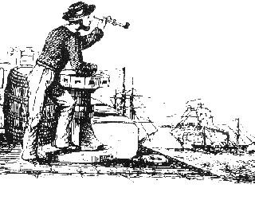

A Task-based Framework for User Behavior Modeling and Search Personalization*
Hongning Wang
Department of Computer Science
University of Illinois at Urbana-Champaign
Urbana IL, 61801 USA
wang296@illinois.edu
*work is done when visiting Microsoft Research

Slide 2




Search Logs Provide Rich Context for Understanding Users’ Search Tasks
85% information maintenance tasks and 52% information gathering tasks will span multiple queries ^{[Agichtein et al. SIGIR’12]}
5/29/2012
5/29/2012 14:06:04 | coney island Cincinnati
5/29/2012 14:11:49 | sas
5/29/2012 14:12:01 | sas shoes
5/30/2012
5/30/2012 12:12:04 | exit #72 and 275 lodging
5/30/2012 12:25:19 | 6pm.com
5/30/2012 12:49:21 | coupon for 6pm
5/31/2012
5/31/2012 19:40:38 | motel 6 locations
5/31/2012 19:45:04 | Cincinnati hotels near coney island
5/29/2012
5/29/2012 14:06:04 | coney island Cincinnati
5/29/2012 14:11:49 | sas
5/29/2012 14:12:01 | sas shoes
5/30/2012
5/30/2012 12:12:04 | exit #72 and 275 lodging
5/30/2012 12:25:19 | 6pm.com
5/30/2012 12:49:21 | coupon for 6pm
5/31/2012
5/31/2012 19:40:38 | motel 6 locations
5/31/2012 19:45:04 | Cincinnati hotels near coney island
a good chance to customize the results!
Task: an atomic information need that may result in one or more queries ^{[Jones et al. CIKM’08]}

Slide 3




Query-based Analysis: An Isolated View
stock market
insurance market place
health insurance
MSFT
FB
fruit smoothie
free medication
chicago bulls
apple
obama care
orange
health reform bill
affordable healthcare
fruit receipt
nutrition
banana
NBA game schedule
Chicago bulls tickets
insurance plan
Healthcare
obamacare
Beyonce
medicare
Grammy Awards
Rihanna
low cost insurance
health reform
pop music
AAPL
Shakira
financial news
Lady Gaga
NBA allstar time
Search log mining approaches:
Query categories ^{[Jansen et al. IPM 2000]}
Temporal query dynamics ^{[Kulkarni et al. WSDM’11]}
survey: [Silvestri 2010]
Notes:
However, the search log mining approaches so far have mostly focused on analyzing the intent behind a single query in a somewhat isolated way, thus they cannot capture the whole picture of a user’s information need.

Slide 4
Task-based Analysis: A Comprehensive View
Task: read financial news
Task: inquire health insurance
Task: find NBA game schedule
Task: download pop music

Slide 5
Task-based Analysis: A Comprehensive View
Task: read financial news
Task: inquire health insurance
Task: find NBA game schedule
Task: download pop music
in-task personalization

Slide 6
Task-based Analysis: A Comprehensive View
Task: read financial news
Task: inquire health insurance
Task: find NBA game schedule
Task: download pop music
Cross-user: collaborative ranking

Slide 7


Task-based Analysis: A Comprehensive View
task satisfaction prediction
Task: read financial news
SAT?
DSAT?
Task: inquire health insurance
Task: find NBA game schedule
Task: download pop music

Slide 8
Research Questions
How to effectively extract search tasks from search logs?
How to represent and organize search tasks?
How to model users’ in-task search behaviors?
How to optimize search services based on the identified search tasks?
How to interactively assist users to perform search tasks?
….
Notes:
In this talk, I will present our recent effort to build a task-based framework for user behavior modeling and search personalization.

Slide 9
Research Questions
How to effectively extract search tasks from search logs?
How to represent and organize search tasks?
How to model users’ in-task search behaviors?
How to optimize search services based on the identified search tasks?
How to interactively assist users to perform search tasks?
….
Notes:
In this talk, I will present our recent effort to build a task-based framework for user behavior modeling and search personalization.

Slide 10


A Task-based Framework
Long-term task extraction
In-task Personalization
BM25
q₂
q₃
q₅
q₆
q₀
q₁
q₂
q₃
q₄
q₅
q₆
PageRank
Cross-user collaborative ranking
Search-task satisfaction prediction
_
_
+
+
q₂
q₃
q₅
q₆
SAT?
_
_
d₂₁
d₂₁
DSAT?
+
d₂₁
Notes:
In the next 40 mins, I will present our recent effort in building a task-based framework for user behavior modeling and search personalization. In particular, we addressed the problems of 1) extracting search tasks from search log data; 2) exploring users’ in-task search behaviors for search personalization; 3) task-based cross-user collaborative ranking; and 4) search task satisfaction prediction.

Slide 11
A Task-based Framework
Long-term task extraction
In-task Personalization
BM25
q₂
q₃
q₅
q₆
q₀
q₁
q₂
q₃
q₄
q₅
q₆
PageRank
Cross-user collaborative ranking
Search-task satisfaction prediction
_
_
+
+
q₂
q₃
q₅
q₆
SAT?
_
_
d₂₁
d₂₁
DSAT?
+
d₂₁

Slide 12




How to Extract Search Tasks?
Expensive to acquire
Step 1: Train binary classifier on pairwise human annotations
Step 2: Apply classifier on every pair of queries
q₁
q₂
Structure is lost
Existing solutions:
Binary classification [Jones et al. CIKM’ 08, Lucchese et al. WSDM’11, Kotov et al. SIGIR’ 11, Liao et al. WWW’11]
q₃
q₆
q₄
q₅
Not in the same task
In the same task

Slide 13
Discovering Search Task Structure
Best-link as task structure
Latent!
q₀
q₁
q₂
q₃
q₄
q₅
q₆
q₁
q₂
q₃
q₄
q₅
q₆

Slide 14

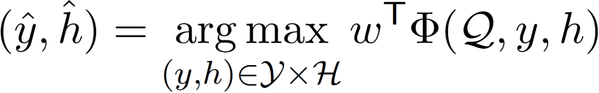
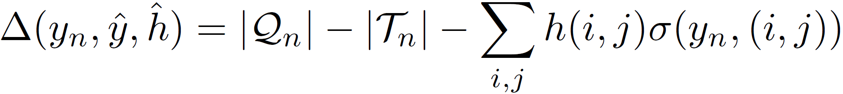
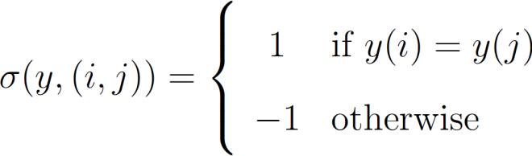
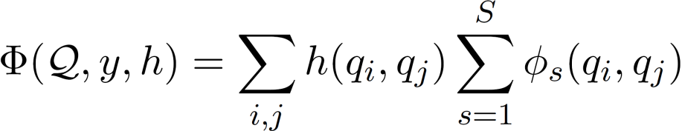
A Structured Learning Approach ^{[WWW’2013a]}
bestlink SVM
  A linear model parameterized by
Query features (9)
Cosine similarity
Edit distance
URL features (14)
Overlapped URLs
ODP similarity
Session features (3)
Same session
First query in session
Margin
space of task partitions
space of best-links
feature vector
q₀
q₁
q₂
q₃
q₄
(dis)agreement on the best links
q₅
q₆
Notes:
We define a feature vector to describe the quality of task partition together with the latent bestlink structure.
Query clustering problem becomes a searching problem in the whole space of task partitions and best-link structures, which clearly distinguish bestlink SVM from existing binary classification based solution.

Slide 15
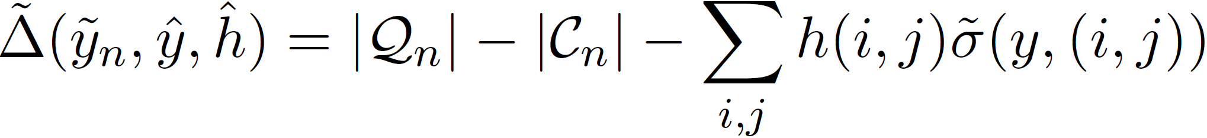
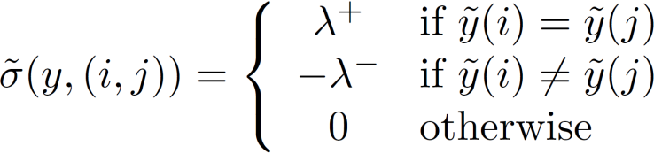
Explore Domain Knowledge for Automating Model Learning
5/30/2012
5/30/2012 9:12:14 | airline tickets
5/30/2012 9:20:19 | rattlers
5/30/2012 9:42:21 | charlize theron snow white
5/30/2012 21:13:34 | charlize theron
5/30/2012 21:13:54 | charlize theron movie opening
5/31/2012
5/31/2012 8:56:39 | sulphur springs school district
5/31/2012 9:10:01 | airline tickets
5/30/2012
5/30/2012 9:12:14 | airline tickets
5/30/2012 9:20:19 | rattlers
5/30/2012 9:42:21 | charlize theron snow white
5/30/2012 21:13:34 | charlize theron
5/30/2012 21:13:54 | charlize theron movie opening
5/31/2012
5/31/2012 8:56:39 | sulphur springs school district
5/31/2012 9:10:01 | airline tickets
5/30/2012
5/30/2012 9:12:14 | airline tickets
5/30/2012 9:20:19 | rattlers
5/30/2012 9:42:21 | charlize theron snow white
5/30/2012 21:13:34 | charlize theron
5/30/2012 21:13:54 | charlize theron movie opening
5/31/2012
5/31/2012 8:56:39 | sulphur springs school district
5/31/2012 9:10:01 | airline tickets
  A generalized margin
Sub-query
Same-query
Sub-query
# queries
# connected components

Slide 16
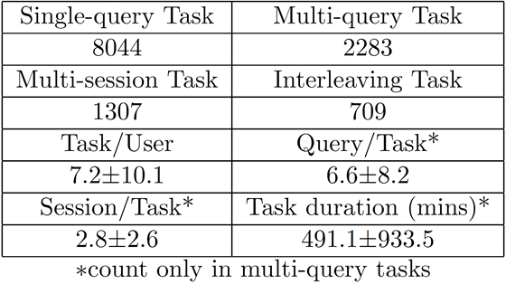
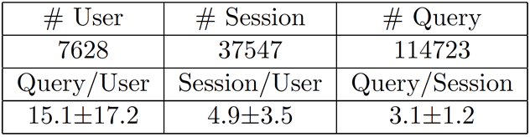
Experimental Results
Query Log Dataset
  Bing search log: May 27, 2012 – May 31, 2012
  Human annotation
    3 editors (inter-agreement: 0.68, 0.73, 0.77)

Slide 17
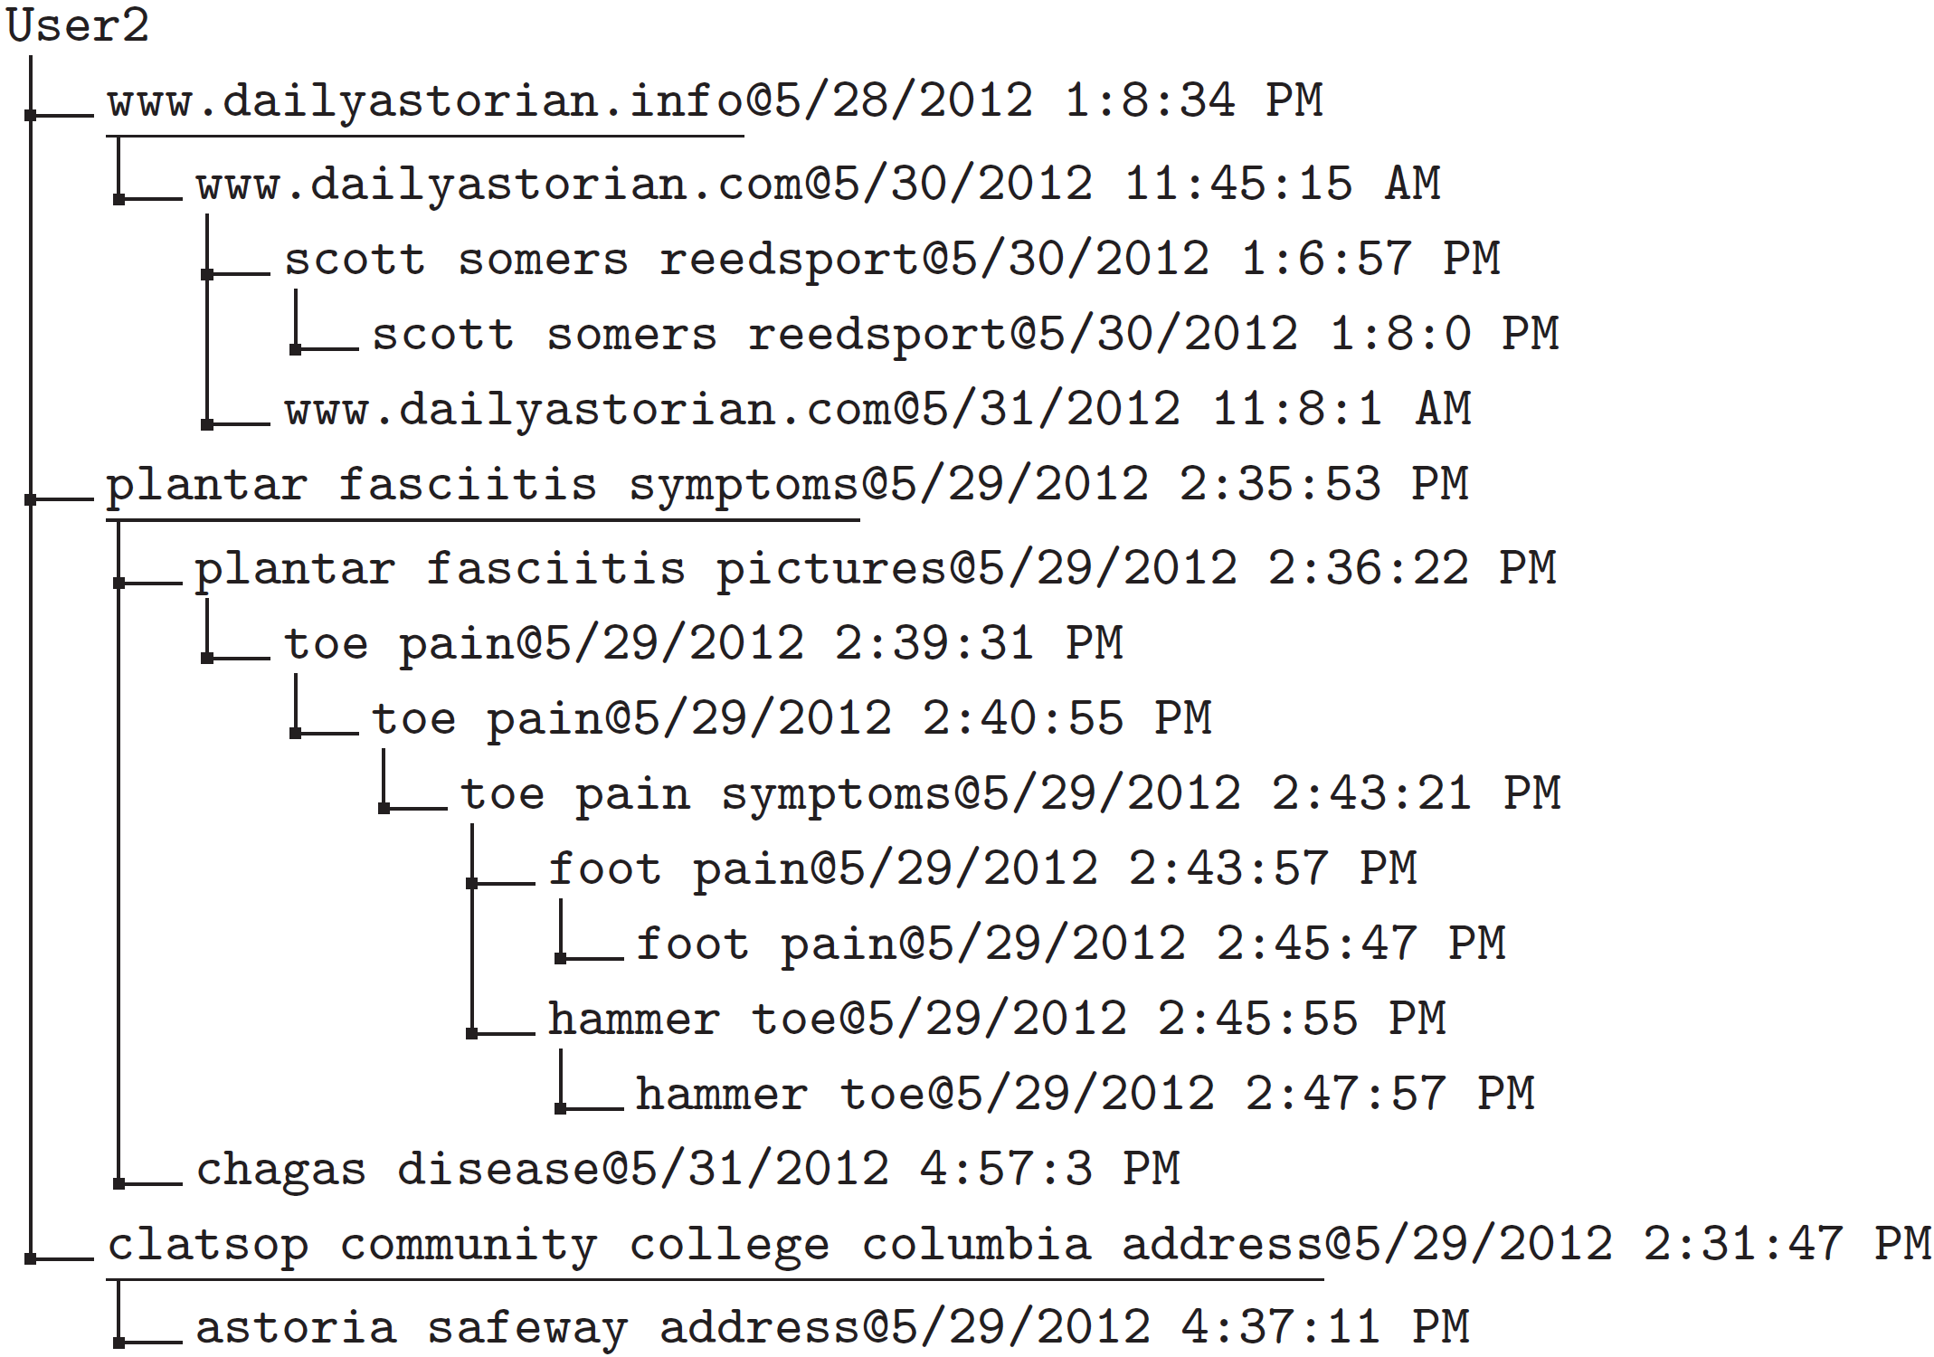
Example of Identified Search Tasks

Slide 18
Search Task Extraction Methods
Baselines
  QC_wcc/QC_htc [Lucchese et al. WSDM’ 11]
    Post-processing for binary same-task classification
  Adaptive-clustering [Cohen et al. KDD’02]
    Binary classification + single-link agglomerative clustering
  Cluster-SVM [Finley et al. ICML’05]
    All-link structural SVM
Binary classification based solution
Structured learning solution

Slide 19
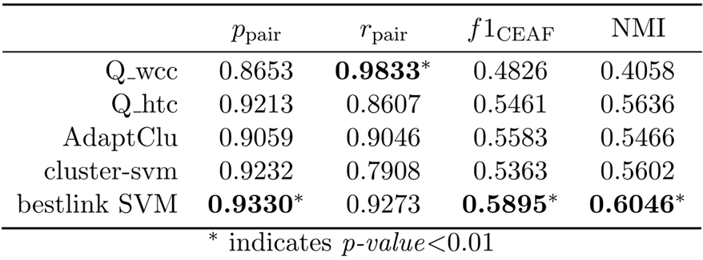
Search Task Extraction Performance
No structures, different post-processing
Different structural assumption

Slide 20
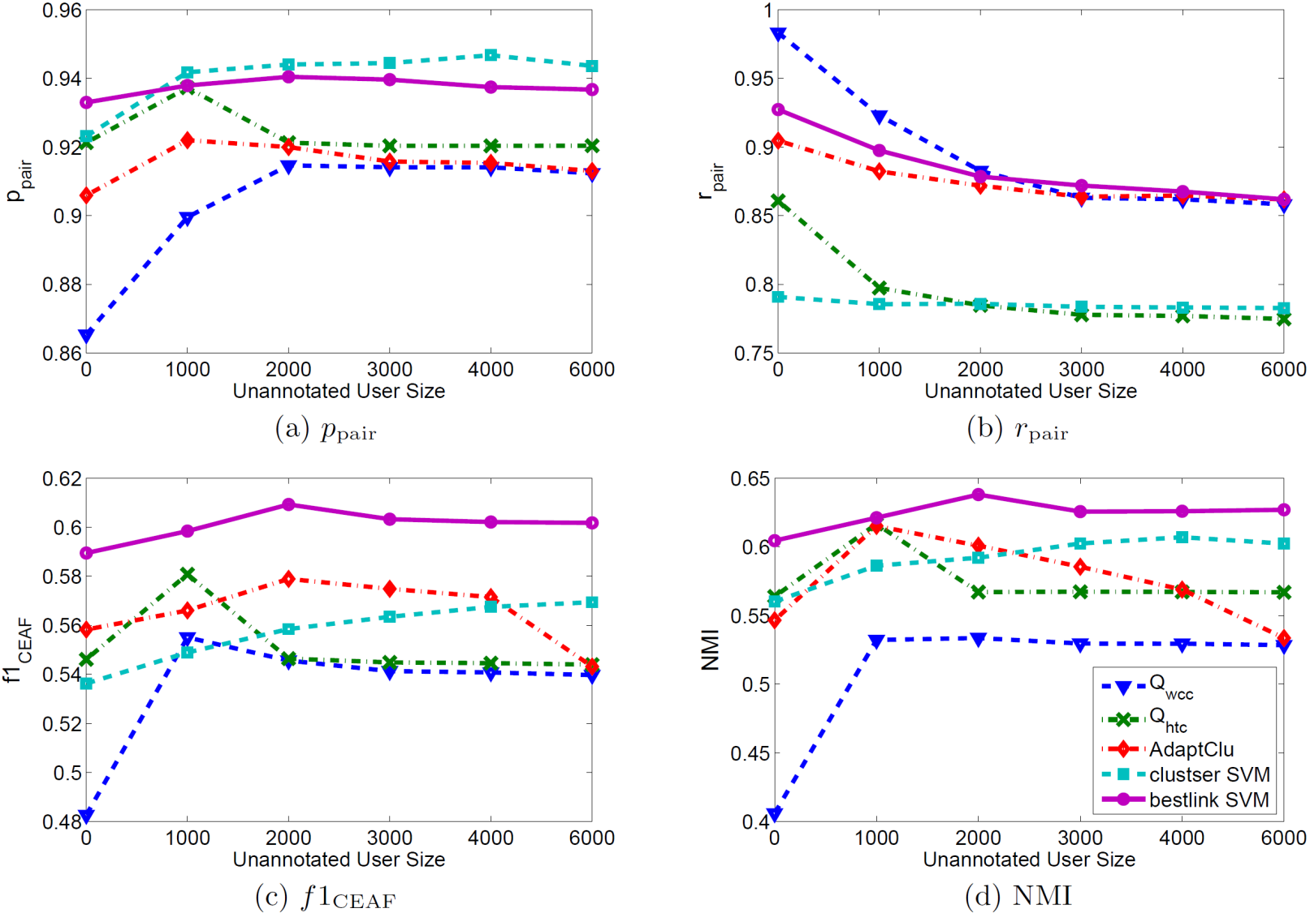
Automating Modeling Learning with Domain Knowledge

Slide 21
A Task-based Framework
Long-term task extraction
In-task Personalization
BM25
q₂
q₃
q₅
q₆
q₀
q₁
q₂
q₃
q₄
q₅
q₆
PageRank
Cross-user collaborative ranking
Search-task satisfaction prediction
_
_
+
+
q₂
q₃
q₅
q₆
SAT?
_
_
d₂₁
d₂₁
DSAT?
+
d₂₁

Slide 22




In-task Search Personalization
Search log:
Timestamp | Query | Clicks
5/29/2012 14:06:04 | coney island Cincinnati
5/30/2012 12:12:04 | drive direction to coney island
5/31/2012 19:40:38 | motel 6 locations
5/31/2012 19:45:04 | Cincinnati hotels near coney island
Document relevance
Existing solutions:
Extracting user-centric features [Teevan et al. SIGIR’05]
Memorizing user clicks [White and Drucker WWW’07]
Site authority

Slide 23
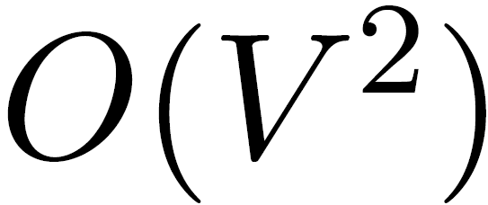
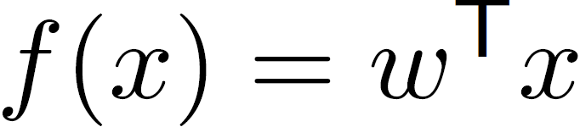




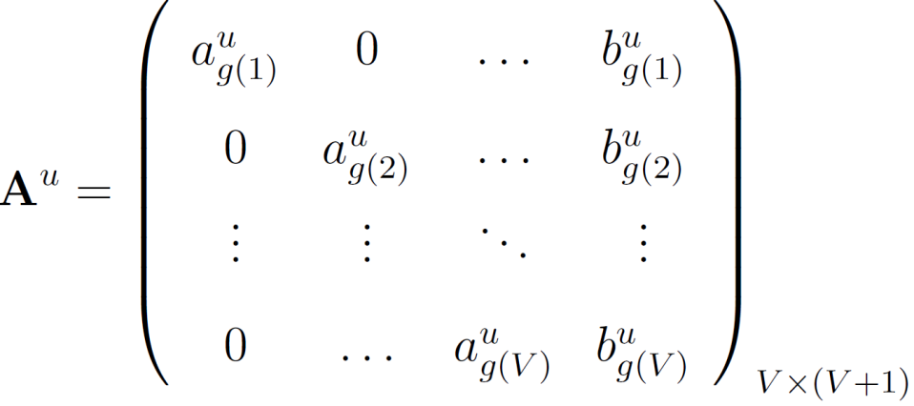
Personalized Ranking Model Adaptation ^{[SIGIR’13]}
Adjust the generic ranking model’s parameters with respect to each individual user’s in-task ranking preferences
Timestamp | Query | Clicks
5/29/2012 14:06:04 | coney island Cincinnati
5/30/2012 12:12:04 | drive direction to coney island
5/31/2012 19:40:38 | motel 6 locations
5/31/2012 19:45:04 | Cincinnati hotels near coney island
Notes:
Then we assume that the personalized ranking adaptation can be achieved via the linear transformation of the model parameters, i.e., we can scale, shift and rotate the generic ranking model to fit each individual user’s ranking preference. However, one problem of such linear transformation is that we need to estimate about o v square number of parameters to get such a transformation matrix (where v is the number of total number of ranking features). This number is even larger than the number of parameters that we need to estimate for get a new ranking model. So we make a further assumption that only the scaling and shifting operation is necessary to perform personalized ranking model adaptation.

Slide 24
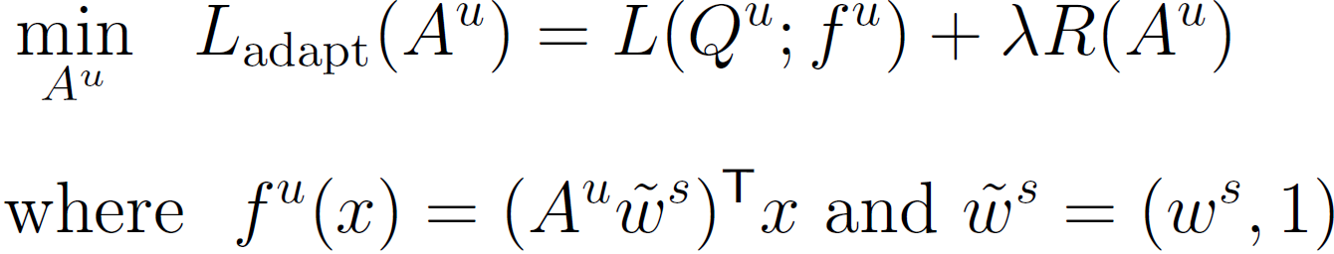
Linear Regression Based Model Adaptation
Adapting global ranking model for each individual user
Loss function from any linear learning-to-rank algorithm, e.g., RankNet, LambdaRank, RankSVM
Complexity of adaptation

Slide 25
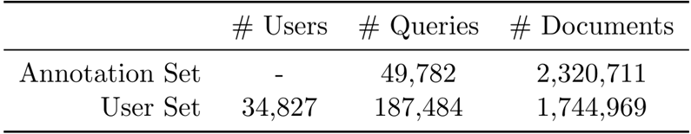
Experimental Results
Dataset
  Bing.com query log: May 27, 2012 – May 31, 2012
  Manual relevance annotation
    5-grade relevance score
  1830 ranking features
    BM25, PageRank, tf*idf and etc.

Slide 26
User-level improvement analysis
Adapted-LambdaRank against global LambdaRank model
per-user basis adaptation baseline
User Class | Method | ΔMAP | ΔP@1 | ΔP@3 | ΔMRR
Heavy | RA | 0.1843 | 0.3309 | 0.0120 | 0.1832
 | Cross | 0.1998 | 0.3523 | 0.0182 | 0.1994
Medium | RA | 0.1102 | 0.2129 | 0.0025 | 0.1103
 | Cross | 0.1494 | 0.2561 | 0.0208 | 0.1500
Light | RA | 0.0042 | 0.0575 | -0.0221 | 0.0041
 | Cross | 0.0403 | 0.0894 | -0.0021 | 0.0406
[10, ∞) queries
[5, 10) queries
(0, 5) queries
Use cross-training to determine feature grouping
Notes:
We further analyze which type of users benefit the most from our personalization method.

Slide 27
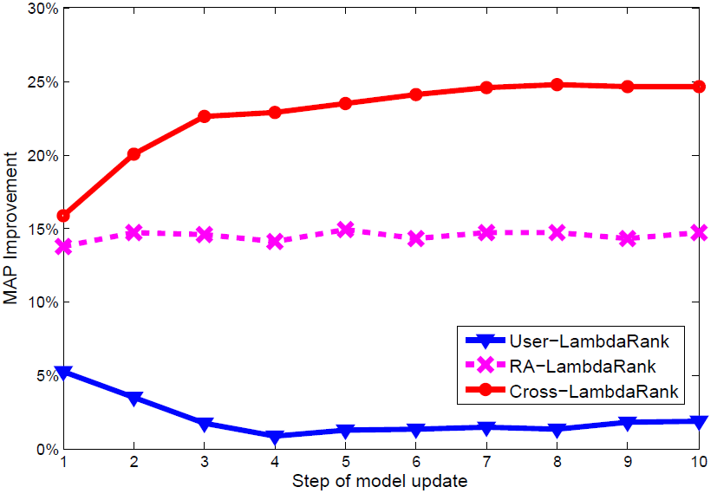
Adaptation Efficiency
Against global model
Adapting from global model and sharing transformation
Cannot deal with sparsity in limited data
Cannot deal with variance in user clicks
Notes:
As we can observe that if train an independent ranking model for user’s each adaptation query, the adaptation performance fluctuates a lot and hardly achieve improved performance. And the performance of the best baseline adaptation method saturate in a very early stage. Only our method can constantly improve the ranking performance by exploring users’ in-task search behaviors.

Slide 28
A Task-based Framework
Long-term task extraction
In-task Personalization
BM25
q₂
q₃
q₅
q₆
q₀
q₁
q₂
q₃
q₄
q₅
q₆
PageRank
Cross-user collaborative ranking
Search-task satisfaction prediction
_
_
+
+
q₂
q₃
q₅
q₆
SAT?
_
_
d₂₁
d₂₁
DSAT?
+
d₂₁

Slide 29
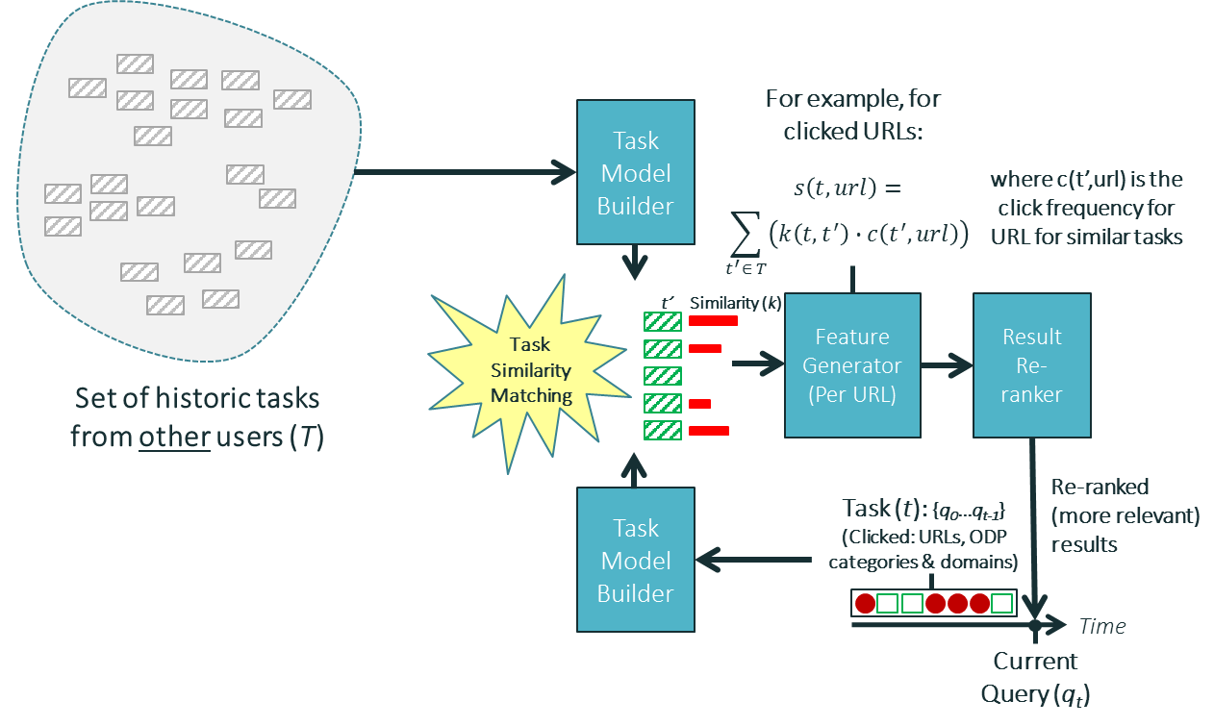
Task-Based Groupization ^{[WWW2013b]}
Find other users engaged in similar task

Slide 30
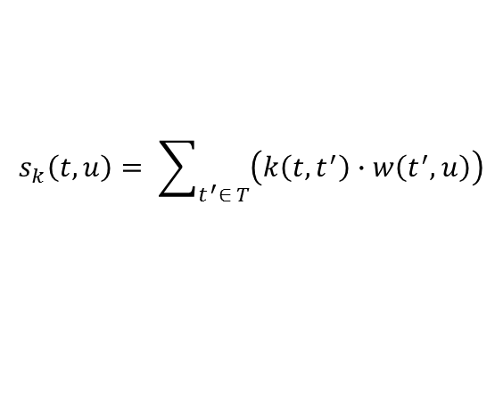
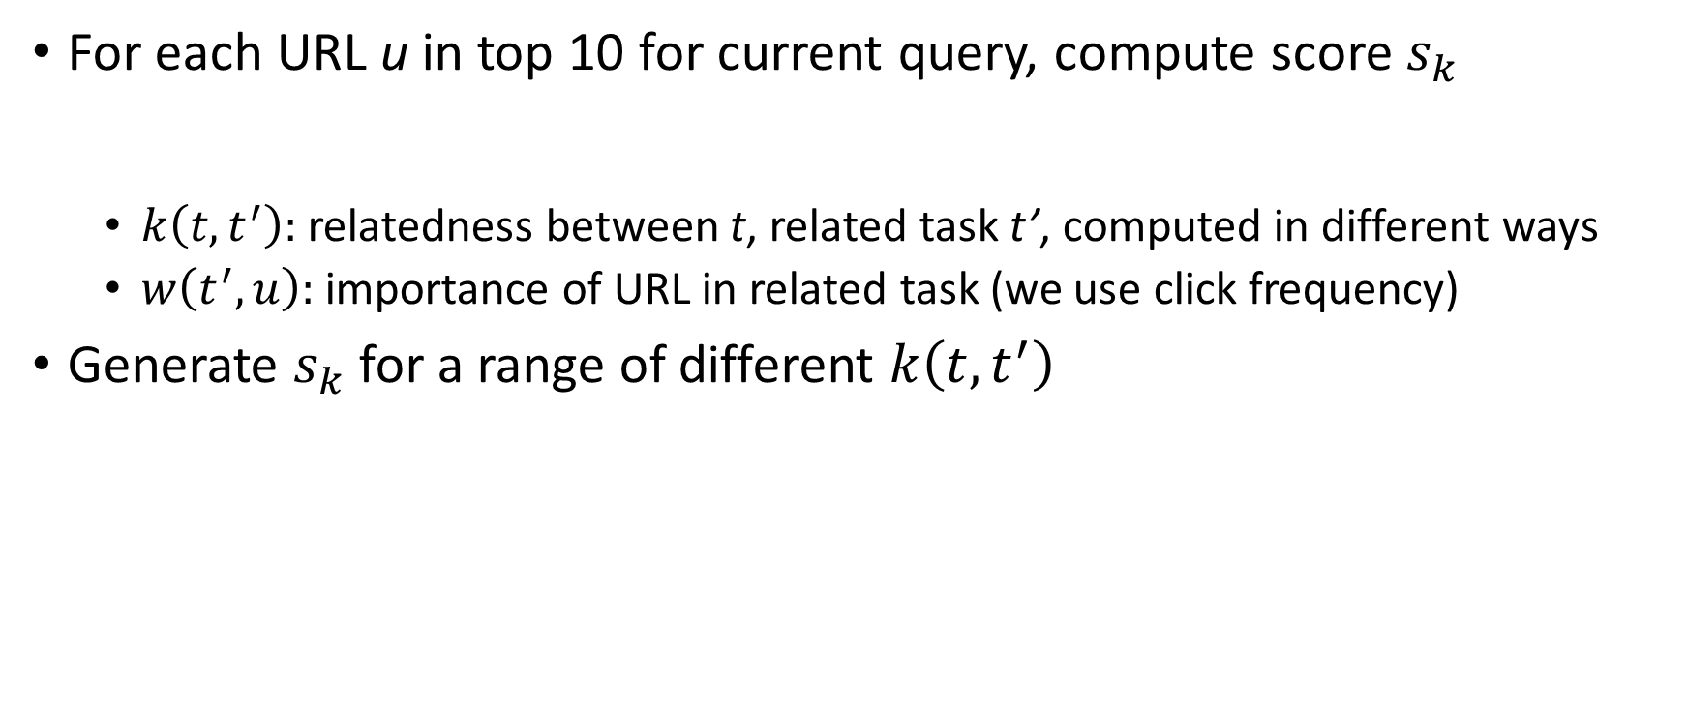
Learn from Related Tasks
For each URL u in top 10 for current query, compute score $s_{k}$
  $k\left(t,t^{′}\right):$relatedness between t, related task t’, computed in different ways
  $w\left(t^{′},u\right):$importance of URL in related task (we use click frequency)
Generate $s_{k}$ for a range of different $k\left(t,t^{′}\right)$
$$s_{k}\left(t,u\right)= \sum_{t^{′}∈ T}{\left(k\left(t,t^{′}\right)∙w\left(t^{′},u\right)\right)}$$
Syntactic similarity, URL similarity, topical similarity, etc.

Slide 31
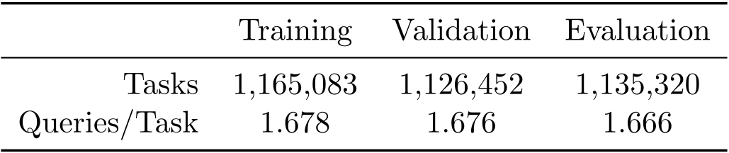
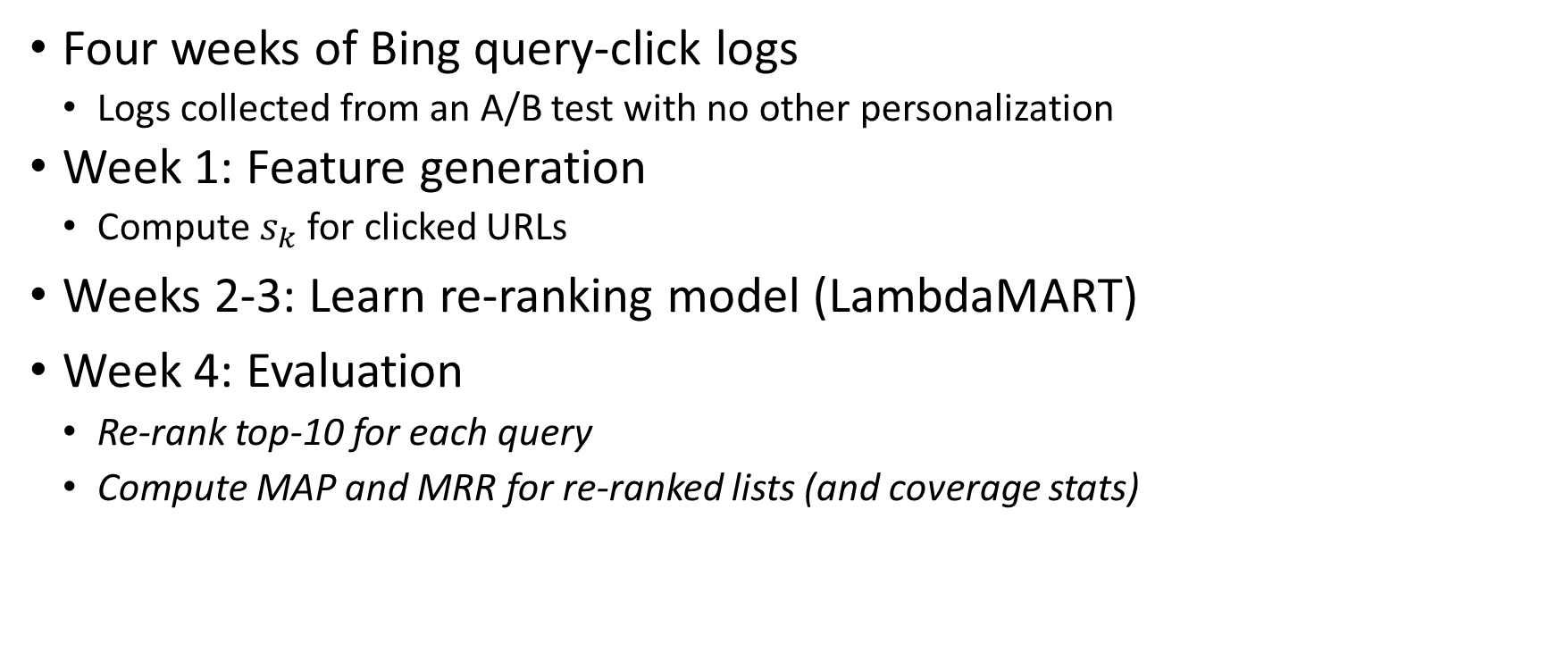
Experimental Results
Four weeks of Bing query-click logs
    Logs collected from an A/B test with no other personalization
  Week 1: Feature generation
    Compute $s_{k}$ for clicked URLs
Weeks 2-3: Learn re-ranking model (LambdaMART)
Week 4: Evaluation
Re-rank top-10 for each query
Compute MAP and MRR for re-ranked lists (and coverage stats)

Slide 32
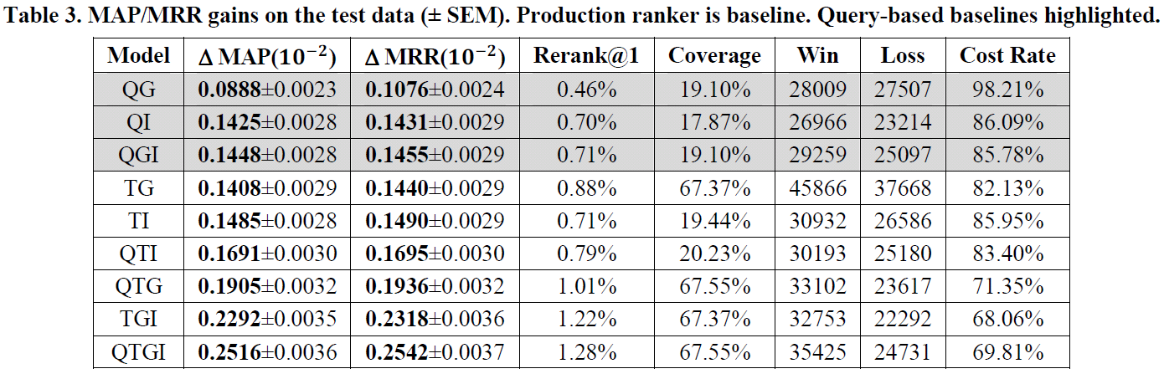
Task Match vs. Query Match
QG: same query, all users
QI: same query, same user
QGI: QG + QI
MAP/MRR gains on the test data, production ranker is the baseline.
Some key findings:
Both query and task match get gains over baseline
Task match better, especially when both feature groups used (TGI)
Task match better coverage (> 3x) – re-rank@1 ~2x results as query

Slide 33
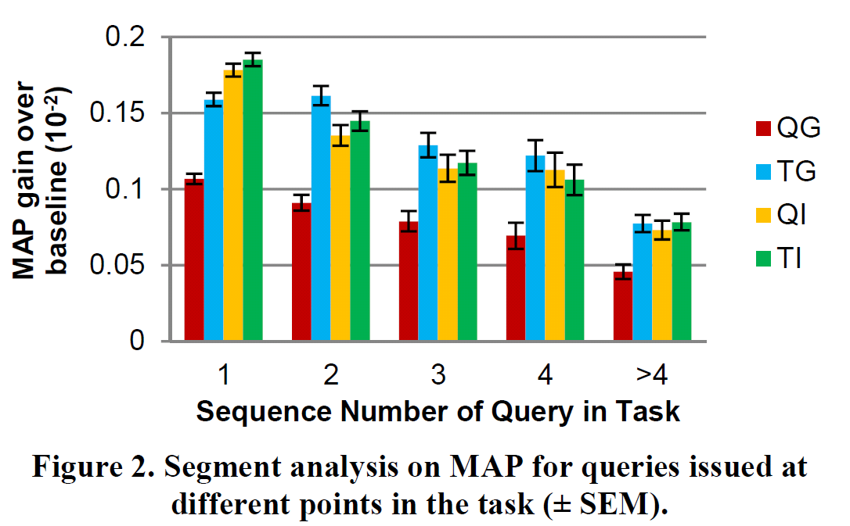

Effect of Query Sequence in Task
QG: Query-based Global Features
TG: Task-based Global Features
QI: Query-based Individual Features
TI: Task-based Individual Features

Slide 34
A Task-based Framework
Long-term task extraction
In-task Personalization
BM25
q₂
q₃
q₅
q₆
q₀
q₁
q₂
q₃
q₄
q₅
q₆
PageRank
Cross-user collaborative ranking
Search-task satisfaction prediction
_
_
+
+
q₂
q₃
q₅
q₆
SAT?
_
_
d₂₁
d₂₁
DSAT?
+
d₂₁

Slide 35
Modeling Latent Action Satisfaction for Search-task Satisfaction Prediction
Hypothesis: satisfaction attained during the search-task contributes to the overall search satisfaction
-
+
-
+
+
formalized as a latent structural learning problem
-
-
+
+
-

Slide 36
Recent work in search-task mining
Task-aware query recommendation [Feild, H. & Allan, J. , SIGIR’13]
  Study query reformulation in tasks
Click modeling in search tasks ^{[Zhang, Y. et al., KDD’11]}
  Model users’ click behaviors in tasks
Query intent classification ^{[Cao H. et al., SIGIR’09]}
  Explore rich search context for query classification

Slide 37
Conclusions
A task-based framework for user behavior modeling and search personalization
  Bestlink: an appropriate structure for search-task identification
  In-task personalization: exploiting users’ in-task behaviors
  Cross-user collaborative ranking: leveraging search behaviors among different users
  Search-task satisfaction prediction: modeling detailed action-level satisfaction

Slide 38
Future Directions
Explore rich information about users for search-task identification
  In-search, out-search behaviors
From query-based search engine optimization to task-based
  Optimize a user’s long-term search utility
Game-theoretic models for interacting with users
  Machine and user collaborate to finish a task

Slide 39
References I
Hongning Wang, Yang Song, Ming-Wei Chang, Xiaodong He, Ryen White and Wei Chu. Learning to Extract Cross-Session Search Tasks. The 23rd International World-Wide Web Conference (WWW'2013), p1353-1364, 2013.
Hongning Wang, Xiaodong He, Ming-Wei Chang, Yang Song, Ryen White and Wei Chu. Personalized Ranking Model Adaptation for Web Search. The 36th Annual ACM SIGIR Conference (SIGIR'2013), p323-332, 2013.
Ryen White, Wei Chu, Ahmed Hassan, Xiaodong He, Yang Song and Hongning Wang. Enhancing Personalized Search by Mining and Modeling Task Behavior. The 23rd International World-Wide Web Conference (WWW'2013), p1411-1420, 2013.

Slide 40
References II
R. Jones and K. L. Klinkner. Beyond the session timeout: automatic hierarchical segmentation of search topics in query logs. CIKM’08, pages 699–708. ACM.
C. Lucchese, S. Orlando, R. Perego, F. Silvestri, and G. Tolomei. Identifying task-based sessions in search engine query logs. WSDM’11, pages 277–286. ACM.
A. Kotov, P. N. Bennett, R. W. White, S. T. Dumais, and J. Teevan. Modeling and analysis of cross-session search tasks. SIGIR2011, pages 5–14, ACM.
Z. Liao, Y. Song, L.-w. He, and Y. Huang. Evaluating the effectiveness of search task trails. WWW’12, pages 489–498. ACM.
Teevan, Jaime, Susan T. Dumais, and Eric Horvitz. "Personalizing search via automated analysis of interests and activities." Proceedings of the 28th annual international ACM SIGIR conference on Research and development in information retrieval. ACM, 2005.
White, Ryen W., and Steven M. Drucker. "Investigating behavioral variability in web search." Proceedings of the 16th international conference on World Wide Web. ACM, 2007.
Shen, Xuehua, Bin Tan, and ChengXiang Zhai. "Context-sensitive information retrieval using implicit feedback." Proceedings of the 28th annual international ACM SIGIR conference on Research and development in information retrieval. ACM, 2005.
Zhang, Y., Chen, W., Wang, D., & Yang, Q. User-click modeling for understanding and predicting search-behavior. In SIGKDD'11, (pp. 1388-1396). ACM.
Feild, H., & Allan, J. Task-aware query recommendation. In SIGIR'13, (pp. 83-92). ACM.
Cao, H., Hu, D. H., Shen, D., Jiang, D., Sun, J. T., Chen, E., & Yang, Q. Context-aware query classification. In SIGIR'09, (pp. 3-10). ACM.

Slide 41
Acknowledgements
ChengXiang Zhai and team members in TIMAN group
Yang Song, Xiaodong He, Ming-Wei Chang, Ryen W. White and Kuansan Wang from Microsoft Research

Slide 42

Thank you!
Task: a new perspective for us to understand users’ search intent
q₀
q₁
q₂
q₃
q₄
q₅
q₆
Q&A

