Slide 1
User Modeling in Search Logs via A Non-parametric Bayesian Approach
Hongning Wang¹, ChengXiang Zhai¹, Feng Liang² ¹Department of Computer Science ²Department of Statistics University of Illinois at Urbana-Champaign Urbana, IL 61801 USA {wang296,czhai,liangf}@Illinois.edu
Anlei Dong, Yi Chang Yahoo! Labs 701 First Avenue, Sunnyvale CA, 94089 USA {anlei, yichang}@yahoo-inc.com

Slide 2
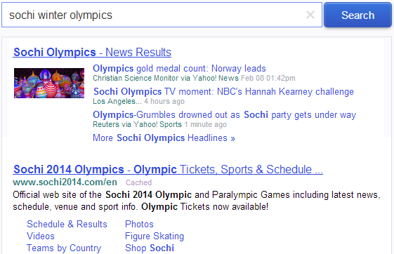
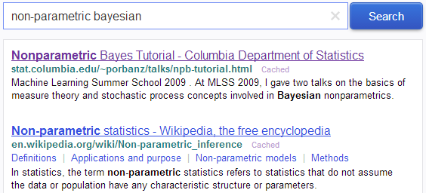
Need to understand users’ search intent!
any news event for the Olympics
schedule of the games on Sunday
what is non-parametric Bayes?
what is non-parametric Bayes?
Notes:
Given such a huge diversity of search engine users’ information needs, accurate understanding of a user’s search interests and preferences is arguably one of most critical research challenges in information retrieval studies.

Slide 3
Mining search logs provides the opportunity
User | Query | Documents | Clicks
 | sochi winter Olympics
 | obamacare
 | affordable health care plan
 | super bowl 2014
 | sochi winter Olympics
 | health care reform
Click-centric analysis:
Interpreting clickthrough data [Joachims, et al. SIGIR’05, Agichtein, et al. SIGIR’06]
Click modeling [Dupret and Piwowarski SIGIR’08, chalell and Zhang WWW’09]
Query-centric analysis:
Isolated analysis
Holistic view
Query categories ^{[Jansen et al. IPM 2000]}
Temporal query dynamics ^{[Kulkarni et al. WSDM’11]}
Notes:
In literature, various ways have been proposed to analyze users’ search behaviors in the search logs.
Studying the distribution of queries and query categories that users frequently search for and recognizing temporal dynamics of search topics.
They try to analyze the implicit feedback from the aggregated users’ clickthroughs to interpret the generic ranking preferences over the retrieved documents.
A major limitation of those aforementioned existing work is that the analysis of a user’s query distribution and that of his/her associated click behaviors is isolated. We should note that both queries and clickthroughs covey useful signals about a user’s search intent.
Properly characterizing the heterogeneity among the users’ observed search behaviors is the key to accurately understanding their respective search intents and to further predicting their behaviors.

Slide 4
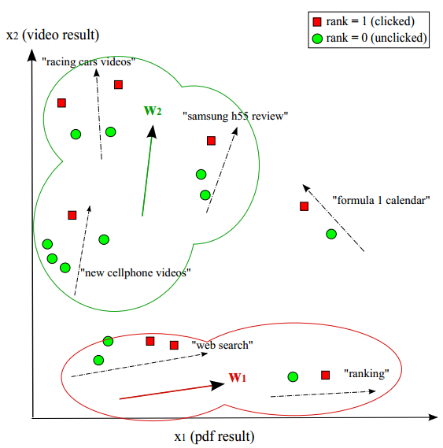
Prior art
No user-specific information is considered
Queries and clicks are still separately analyzed
Query-cluster-based approaches
Ranking Specialization for Web Search
Bian et al. WWW’10
Learning to rank user intents
Giannopoulos et al. CIKM’11
Divide-and-Conquer strategy
Group queries into clusters
Estimate independent ranking models for
each cluster
Giannopoulos et al. CIKM’11

Slide 5
Road map
Motivation
Our solution: dpRank
Experimental results
Conclusions
Notes:
In this work, we propose a joint modeling approach to characterize the heterogeneity in each individual user’s queries and corresponding clicks in a principled way.

Slide 6
Latent user group: a homogenous unit of query and clicks
Our Contribution
p(Q)
Modeling of search interest
q₁
Modeling of result preferences
q₂
q₃
f₁
f₂
Group k
Notes:
To model the joint distribution of queries and clicks, and capture the homogeneity among all the users, we introduce a novel concept of latent user groups. Each latent user group is modeled as a unique distribution over the queries and clicks. For example, in our solution, we model the queries as being presented by the specific query features, and which are drawn from a multi-variate Normal distribution, and the click preference in each latent user group is characterized by the corresponding relative importance of the ranking features, which leads to distinct click patterns over the returned documents. In particular, in order to avoid position bias in user’s clicks, in our solution, we focus on modeling a user’s pairwise preference over the returned document list.
As a result, the homogeneity among the users in the same latent user group can be fully captured by the parameter settings of the corresponding probabilistic distributions.

Slide 7
User: a heterogeneous mixture over the latent user groups
Our Contribution
Stock market
market report
FB
p(Q)
p(Q)
fruit smoothie
AAPL
apple
orange
apple
fidelity online login
GOOG
fruit receipt
TWTR
nutrition
banana
…
q₁
q₁
q₂
q₃
BM25
q₂
q₃
BM25
BM25
Group₂
Group_{k}
Group₁
f₂
f₂
Stock market
Nutrition of fruits
PageRank
Notes:
Based on the latent user groups, the heterogeneity among the queries and clickthroughs in a particular user’s search history is characterized as a mixture over those latent user groups, where the mixing proportion governs each user’s unique search behavior pattern.

Slide 8
Generation of latent user groups: Dirichlet Process priors ^{[Ferguson, 1973]}
Our Contribution
p(Q)
p(Q)
p(Q)
……
……
q₁
q₁
q₃
q₁
q₃
q₂
q₃
f₁
q₂
f₁
q₂
f₁
Group k
f₂
Group c
Group 1
f₂
f₂
Notes:
As a mixture model, the number of mixture components, which is usually manually set, determines the granularity of the model. However, due to the dynamic nature and scale of search logs, it is infeasible for us to manually exhaust the optimal number of latent user groups. In dpRank, we adopt an appealing alternative by postulating Dirichlet process priors over the mixture components to exploit the clustering property of users' search behaviors. Specifically, we assume the parameters characterizing each latent user group are drawn from a shared Dirichlet process. As a result, the number of latent user groups can be automatically determined based on the data characteristics.

Slide 9
Another layer of DP to support infinite mixture of latent user groups ^{[Teh et al., 2006]}
Our Contribution
p(Q)
p(Q)
p(Q)
q₁
q₂
q₃
……
q₁
q₂
q₃
……
q₁
q₂
q₃
f₁
f₁
f₁
Group k
f₂
Group c
Group 1
f₂
f₂
…
…
…
Group₁
Group₂
Group_{k}
Group₁
Group₂
Group_{k}
Group₁
Group₂
Group_{k}
Notes:
In order to accommodate such infinite number of latent user groups for each user, we further assume the mixing proportion of the latent user groups is drawn from another Dirichlet process, which can be intuitively explained by the stick breaking metaphor. That is, for each user, there is always an amount of unallocated interest, which can be used to cover the newly generated groups in the corpus.

Slide 10
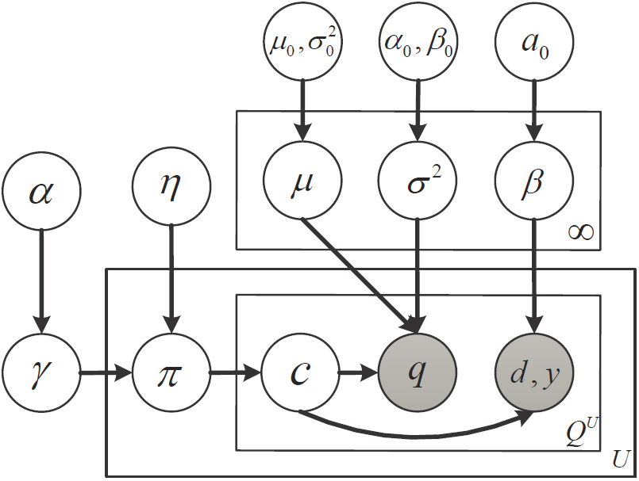
dpRank model
Our Contribution
A fully generative model for users’ search behaviors
1. Draw latent user groups from DP:
2. Draw group membership for each user from DP:
3. To generate a query in user u:
3.1 Draw a latent user group c:
3.2 Draw query q_{i} for user u accordingly:
3.3 Draw click preferences for q_{i} accordingly:

Slide 11
Latent variables of interest
and
characterize the generation of queries in a latent user group
depicts users’ result ranking preferences in a latent user group
profiles a user’s search intent over the latent user groups
Gibbs sampling for posterior inference

Slide 12
Road map
Motivation
Our solution: dpRank
Experimental results
Conclusions

Slide 13
Data collection
Yahoo! News search logs
May to July, 2011
65 ranking features for each query-URL pair
e.g., document age, site authority, query matching in title
Aggregate URL features for query features ^{[Bian et al. WWW’10]}
In each user, chronologically, first 60% query for training, rest 40% for testing

Slide 14
Query distribution in latent user groups
Group | Top Ranked Queries
1 | iran, china, libya, vietnam, syria
2 | selena gomez, lady gaga, britney spears, jennifer aniston, taylor swift
3 | fake tupac story, pbs hackers, alaska earthquake, southwest pilot, arizona wildfires
4 | joplin missing, apple icloud, sony hackers, google subpoena, ford transmission
5 | casey anthony trial, casey anthony jurors, casey anthony, crude oil prices, air france flight 447
6 | tree of life, game of thrones, sonic the hedgehog, world of warcraft, mtv awards 2011
7 | the titanic, the bachelorette, cars 2, hangover 2, the voice
8 | los angeles lakers, arsenal football, the dark knight rises, transformers 3, manchester united
9 | miami heat, los angeles lakers, liverpool football club, arsenal football, nfl lockout
10 | today in history, nascar 2011 schedule, today history, this day in history
country names
celebrities
breaking news events
entertainment
sports

Slide 15
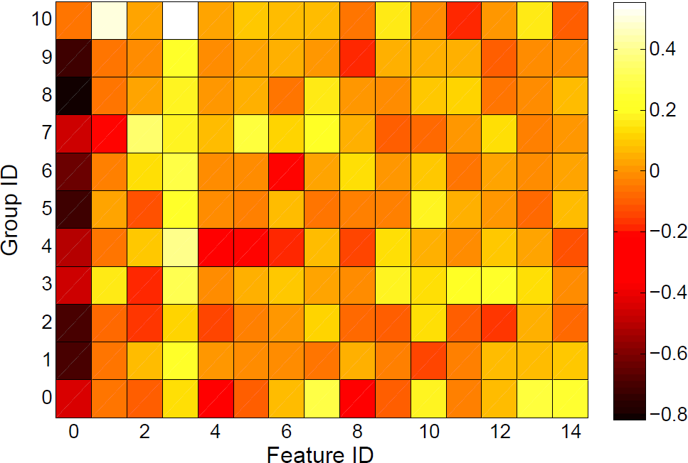
Click preferences in latent user groups
document age
query match in title
proximity in title
site authority
“today in history”
sports
entertainment
breaking news events
celebrities
country names
Global model
Notes:
From above results, it is evident that users’ search intents are distinct, and dpRank captures such diversity and properly groups them by jointly modeling the users’ issued queries and corresponding clicks in the search log data.

Slide 16
Document ranking
Rank prediction in dpRank
Baselines
URSVM: independent SVM for each user
GRSVM: a global SVM for all users
TRSVM: Bian et al.’s Topical RankSVM
IRSVM: Giannopoulos et al.’s Intent RankSVM
posterior samples
cluster size k determined by cross-validation
Notes:
Then in this experiment, we are going to quantitatively evaluate our main hypothesis in our work, that is the joint modeling of users’ queries and clicks is better than those isolated modeling approaches. To achieve so, we compare our joint model with those isolated models in the task of document ranking.

Slide 17
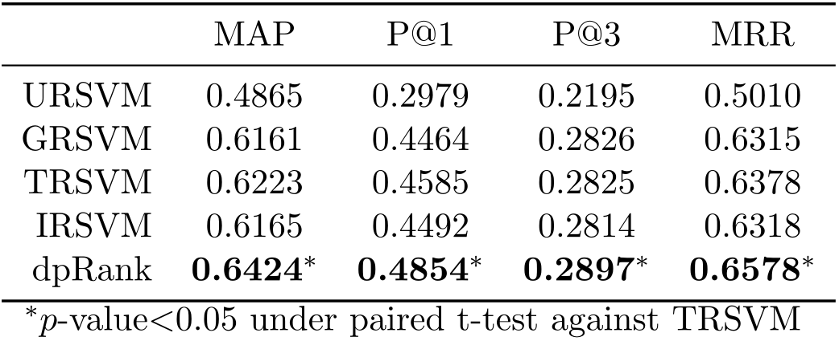
Document ranking
Quantitative comparison results
user-centric
query-centric
Notes:
In the query-centric baselines, no user-specific information is explored in query clustering, and thus the same query from users with distinct ranking preference will be ranked in the same way. dpRank solves this problem by jointly exploring user-specific heterogeneity in their search behaviors, which provides more accurate ranking for each individual user.
While this baseline can also explore the user-specific information by training independent ranking functions from each individual user’s history queries. However, sparsity prevents it to get accurate estimate of model parameters in each user.

Slide 18
Collaborative document re-ranking
Computer user similarity based on group membership
dpRank:
TRSVM & IRSVM:
QuerySim: treat each unique query as a user group
search interest profile
Notes:
The proportion of latent user groups in each user naturally serves as a profile of user’s search intent. It can be used as a proxy to measure similarity between the users in many personalized applications. In order to study the quality of such user profile generated by our joint modeling approach, we test it in the application of collaborative document re-ranking.

Slide 19
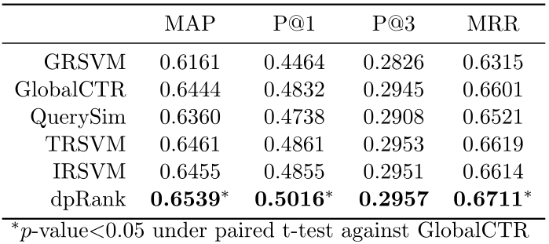
Collaborative document re-ranking
Promote candidate documents by
From M most similar users to the target user u
Accumulate the clicks
default ranker
query-centric
Notes:
The user profile generated by the user’s queries in history performed much worse than the simple GlobalCTR baseline, which validates our hypothesis that only modeling a user’s queries alone cannot well explain her search intent. Comparing to performance achieved by the query-centric solutions, the profile generated by our dpRank performed significantly better than the globalCTR method. Because in dpRank, the identified latent user groups explicitly encode different users’ click preferences, so that when we weight the clicks from similar users by such profiles, we can get more accurate click prediction for the target users.

Slide 20
Road map
Motivation
Our solution: dpRank
Experimental results
Conclusions

Slide 21
Conclusions
dpRank: a unified modeling approach for users’ search behaviors
Latent user group: a homogenous unit of query and clicks
User: a heterogeneous mixture over the latent user groups
Non-parametric Bayesian: deal with dynamic nature and scale of search logs
Future work
Incorporating more types of information about searchers
Gender, location, age, social networks
Dependency among the queries
Queries for the same search-task

Slide 22
References
Jansen, B. J., Spink, A., & Saracevic, T. Real life, real users, and real needs: a study and analysis of user queries on the web. Information processing & management, 36(2), 207-227, 2000.
Kulkarni, A., Teevan, J., Svore, K. M., & Dumais, S. T. Understanding temporal query dynamics. In WSDM’11, pp. 167-176, 2011.
Joachims, T., Granka, L., Pan, B., Hembrooke, H., & Gay, G. Accurately interpreting clickthrough data as implicit feedback. In SIGIR’05, pp. 154-161, 2005.
Agichtein, E., Brill, E., Dumais, S., & Ragno, R. Learning user interaction models for predicting web search result preferences. In SIGIR’06, pp. 3-10, 2006.
Dupret, G. E., & Piwowarski, B. A user browsing model to predict search engine click data from past observations. In SIGIR’08, pp. 331-338, 2008.
Chapelle, O., & Zhang, Y. A dynamic bayesian network click model for web search ranking. In WWW’09, pp. 1-10, 2009.
Bian, J., Li, X., Li, F., Zheng, Z., & Zha, H. Ranking specialization for web search: a divide-and-conquer approach by using topical RankSVM. In WWW’10, pp. 131-140, 2010.
Giannopoulos, G., Brefeld, U., Dalamagas, T., & Sellis, T. Learning to rank user intent. In CIKM'11, pp. 195-200, 2011
Ferguson, T. S. A Bayesian analysis of some nonparametric problems. The annals of statistics, 209-230, 1973.
Y. W. Teh, M. I. Jordan, M. J. Beal, and D. M. Blei., Hierarchical dirichlet processes. Journal of the American, Statistical Association, 101(476):1566-1581, 2006.

Slide 23
Thank you!
dpRank: a unified modeling approach for users’ search behaviors
Q&A

Slide 24
Wanted: a unified modeling approach
Healthcare
insurance plan
obamacare
Beyonce
medicare
Grammy Awards
Rihanna
low cost insurance
Modeling of search interest
health reform
pop music
Shakira
Lady Gaga
BM25
Modeling of result preferences
PageRank

Slide 25
Wanted: a model capturing heterogeneity in users’ search behaviors
Stock market
market report
p(Q)
p(Q)
FB
fruit smoothie
AAPL
apple
orange
apple
fidelity online login
GOOG
fruit receipt
TWTR
nutrition
banana
apple
nutrition
fruit receipt
stock market
apple
market report
BM25
BM25
BM25
PageRank
PageRank
PageRank
nutrition of fruits
stock market

Slide 26
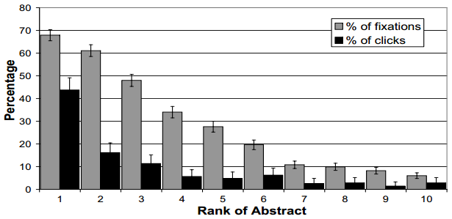
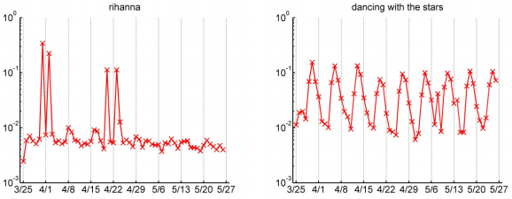
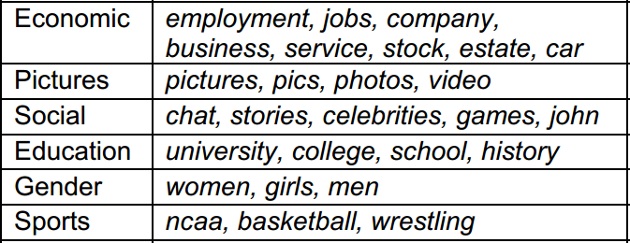
Search log mining provides an opportunity
User | Query | Documents | Clicks
 | sochi winter Olympics
 | obamacare
 | affordable health care plan
 | super bowl 2014
 | sochi winter Olympics
 | health care reform
Click-centric analysis:
Interpreting clickthrough data, Joachims, et al. SIGIR’05
Query-centric analysis:
Isolated analysis
Holistic view
Query categories, Jansen et al. IPM 2000
Temporal query dynamics, Kulkarni et al. WSDM’11

Slide 27
Both queries and clicks reflect an individual user’s search intent
Healthcare
insurance plan
Healthcare
health insurance
obamacare
obamacare
Beyonce
medicare
super bowl
Grammy Awards
Rihanna
NBA all star
medicare
NASCAR
low cost insurance
affordable insurance
health reform
pop music
health policy
sports events
Shakira
Lionel Messi
Lady Gaga
Sochi
BM25
BM25
PageRank
PageRank

Slide 28
Our solution
Latent user group: a homogenous unit of query and clicks
p(Q)
p(Q)
Modeling of search interest
…
q₁
q₂
q₃
q₁
Modeling of result preferences
f₁
q₂
q₃
f₁
f₂
f₂
Group 1
Group k

Slide 29
Gibbs sampling for posterior inference
Sampling
Latent user group assignment of q_{i} in u
Sampling
Conjugacy leads to analytical solutions for and
Metropolis hasting sampling for
global group proportion
current group assignment in u
data generation likelihood

Slide 30
Discussion
Query-cluster based solution:
1) => 2)
User-centric joint modeling of search behaviors
dpRank reveals information at
aggregated level, i.e., the shared latent user groups
e.g., describes users common result ranking preference in group k
individual level, i.e., user-specific mixing proportions
profiles an individual user’s search intent
global group proportion
current group assignment in u
data generation likelihood

Slide 31
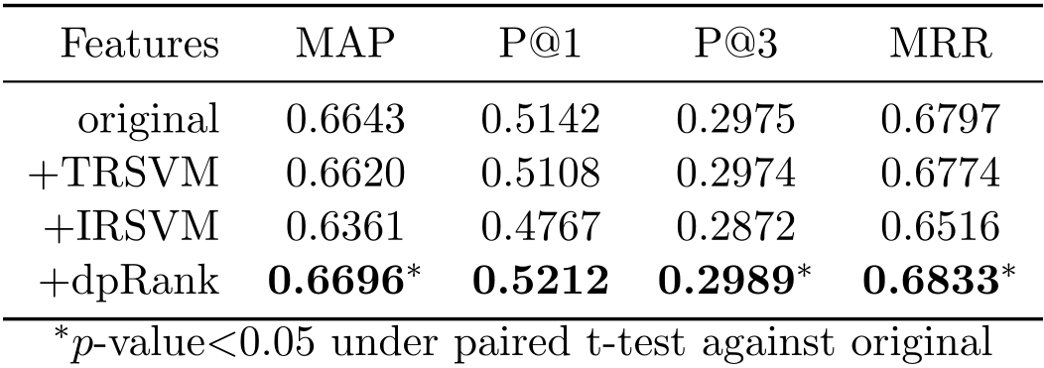
Document ranking II
Output as additional ranking features for LambdaMART
dpRank:
TRSVM & IRSVM:

Slide 32
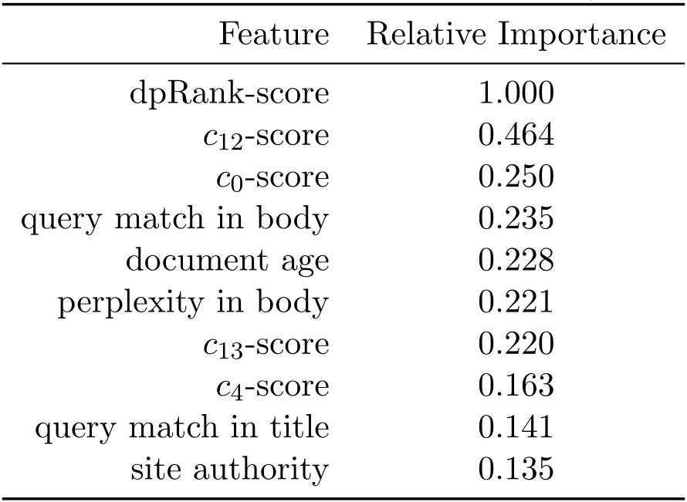
Document ranking II
Feature importance in LambdaMART

Slide 33
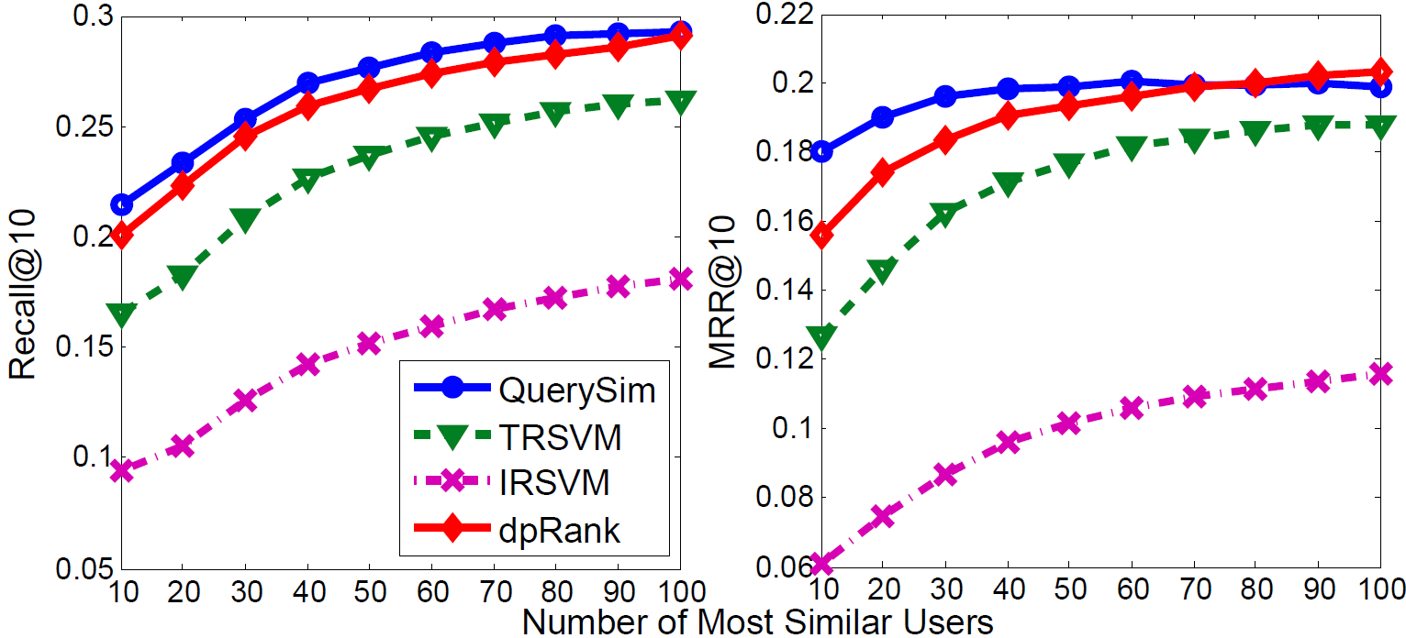
Collaborative query recommendation
Promote candidate queries by
From M most similar users to the target user u
Select top 10 queries according to

Slide 34
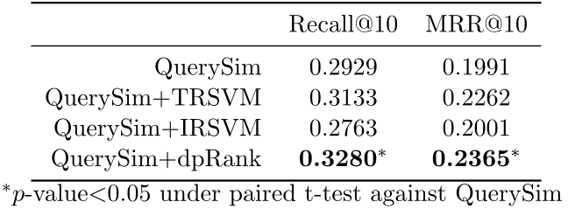
Collaborative query recommendation
Promote candidate queries by
From M most similar users to the target user u
Select top 10 queries according to

