Slide 1
Latent Aspect Rating Analysis on Review Text Data: A Rating Regression Approach
Hongning Wang, Yue Lu, ChengXiang Zhai
Department of Computer Science
University of Illinois at Urbana-Champaign
Urbana IL, 61801, USA

Slide 2
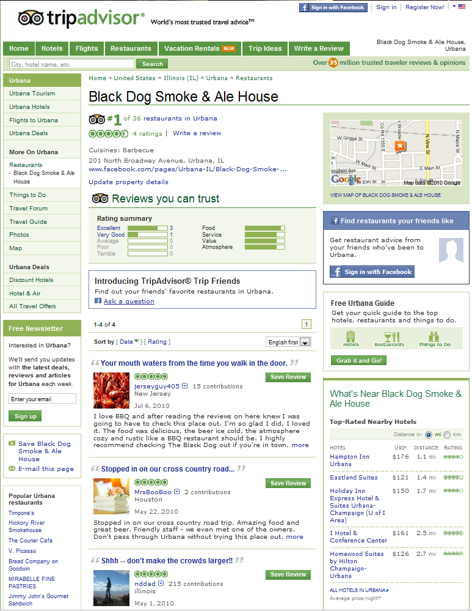
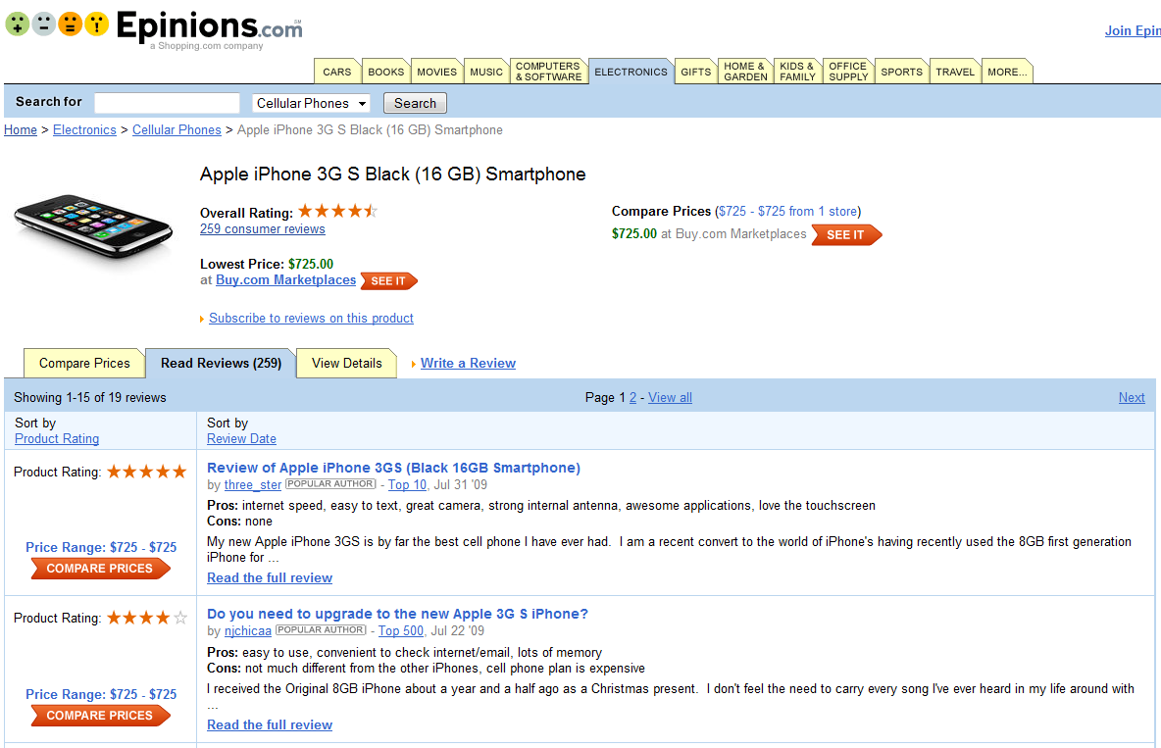
Needs for automatic analysis!
An important information repository– online reviews
various
abundant
informative
Notes:
But we should emphasize that 2 problems should be solved before performing the automatic processing.

Slide 3
Needs for analyzing opinions at fine grained level of topical aspects!
Problem 1. Different reviewers give the same overall ratings for different reasons
How do we decompose overall ratings into aspect ratings?
Notes:
If we could provide users with the detailed ratings in aspect level, it would greatly help the users understand the reviewers’ opinion without look into the detailed contents. In this case, the challenge would be

Slide 4
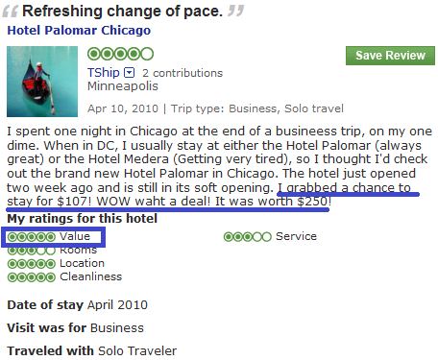
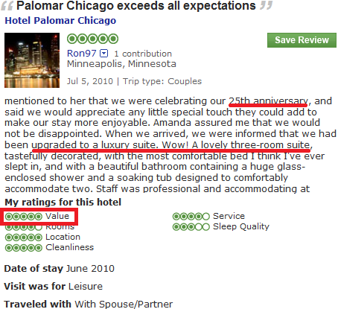
Needs for further analyzing aspect emphasis of each reviewer!
Problem 2. Same rating means differently for different reviewers
How do we infer aspect weights the reviewers have put onto the ratings?

Slide 5
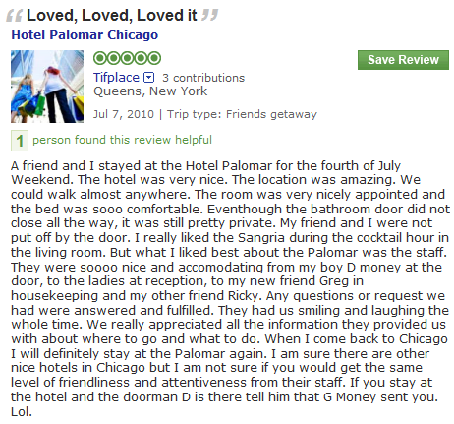
Latent Aspect Rating Analysis
Aspect Segmentation
+
Latent Rating Regression
Reviews + overall ratings
Aspect segments
Term Weights
Aspect Rating
Aspect Weight
location:1
amazing:1
walk:1
anywhere:1
0.0
2.9
0.1
0.9
3.9
0.2
room:1
nicely:1
appointed:1
comfortable:1
0.1
1.7
0.1
3.9
4.8
0.2
nice:1
accommodating:1
smile:1
friendliness:1
attentiveness:1
2.1
1.2
1.7
2.2
0.6
5.8
0.6
Boot-stripping method
Latent!
Notes:
Taking those two problems into consideration, in this paper, we study a new opinionated text data analysis problem called latent aspect rating analysis. We proposed a 2-stage approach to solve this novel review mining problem. Given the reviews with overall ratings as input. ……
In the second stage, we apply a novel Latent Rating Regression model to analyze the latent aspect ratings and weights. In our LRR model, ratings on each aspect is determined by the sentiments of words the reviewer used to discuss the aspect; then, the overall rating is depended on a weighted sum of all the aspect ratings, and the weights reflect the relative emphasis among the aspects.

Slide 6
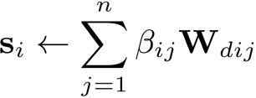
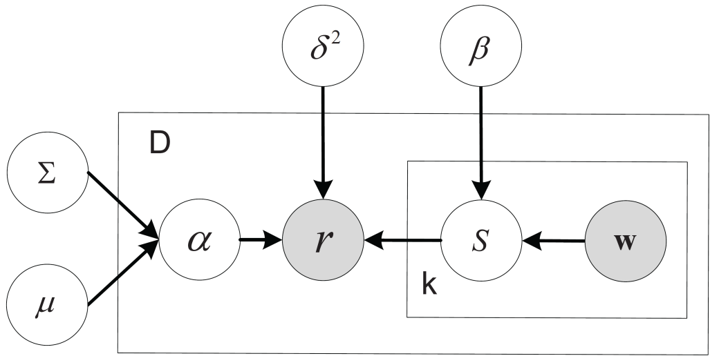
Latent Rating Regression (LRR)
Aspect segments
Term Weights
Aspect Rating
Aspect Weight
location:1
amazing:1
walk:1
anywhere:1
0.0
0.9
0.1
0.3
1.3
0.2
room:1
nicely:1
appointed:1
comfortable:1
0.1
0.7
0.1
0.9
1.8
0.2
nice:1
accommodating:1
smile:1
friendliness:1
attentiveness:1
0.6
0.8
0.7
0.8
0.9
3.8
0.6
Joint probability
Notes:
Our LRR model could be described in the language of graphical model like this. Let’s take the case in the last slide as an example to illustrate the notions in our LRR model. In LRR, aspect rating is assumed to be a weighted sum over the words in the corresponding aspect segments, and the overall rating is drawn from a Gaussian distribution with weighted sum of aspect ratings as mean value. To take the diversity of reviewers and the dependency among the aspects into consideration, we further assume aspect weights for each review are drawn from a multivariate Gaussian distribution.

Slide 7
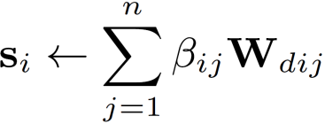
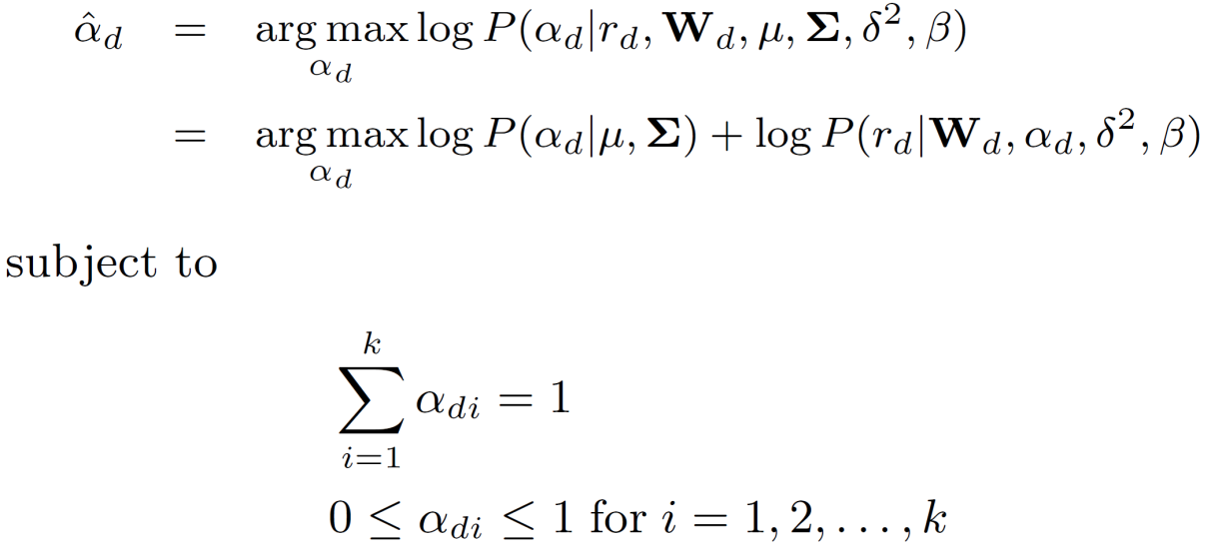
Inference in LRR
Aspect rating
Aspect weight
Maximum a posteriori estimation
prior
likelihood
Notes:
The key problem in applying LRR model with given model parameters is to infer the latent aspect ratings and weights in each review. According to the definition, aspect ratings are simply a weighted sum of all the words in the aspect segment. However, we have to apply maximum a posterior estimation to infer the most probable setting of aspect weights in the given reviews.

Slide 8
Model Estimation
Maximum Likelihood Estimation
EM-style algorithm
E-step: infer aspect rating s_{d} and weight a_{d} based on current model parameter
M-step: update model parameter by maximizing the complete likelihood
Notes:
When we are given a new collection of reviews, we employ maximum likelihood estimation to find the most probable set of model parameters. Since there are latent variables involved, we appeal to EM algorithm to estimate the model parameters.

Slide 9
Discussions in LRR
v.s. Supervised learning
v.s. Topic Modeling
v.s. Unsupervised learning
Notes:
Here we want to distinguish our model from other existing methods: 1) first LRR model is not a supervised learning method, because we are trying to predict the aspect ratings and weights that are hidden in the training data; 2) second LRR model is not a traditional unsupervised method, since we have indirect supervision from the overall ratings; 3) and it would be interesting to compare our LRR model with topic models. Topic models focus on the word distributions, or latent topics, while LRR attempts to discover word weights that characterize the linguistic patterns associated with aspect ratings.

Slide 10
Qualitative Evaluation
Aspect-level Hotel Analysis
Hotels with the same overall rating but different aspect ratings
A better understanding in the finer-grain level
Hotel | Value | Room | Location | Cleanliness
Grand Mirage Resort | 4.2(4.7) | 3.8(3.1) | 4.0(4.2) | 4.1(4.2)
Gold Coast Hotel | 4.3(4.0) | 3.9(3.3) | 3.7(3.1) | 4.2(4.7)
Eurostars Grand Marina Hotel | 3.7(3.8) | 4.4(3.8) | 4.1(4.9) | 4.5(4.8)
(All 5 Stars hotels, ground-truth in parenthesis.)
Notes:
To confirm the effectiveness of the propose method, we crawled more than 200k hotel reviews from TripAdvisor. First we would demonstrate how the identified aspect ratings could help users understand the reviews in a finer-grain level.

Slide 11
Qualitative Evaluation
Reviewer-level Hotel Analysis
Different reviewers’ ratings on the same hotel
Detailed analysis of reviewer’s opinion
Reviewer | Value | Room | Location | Cleanliness
Mr.Saturday | 3.7(4.0) | 3.5(4.0) | 3.7(4.0) | 5.8(5.0)
Salsrug | 5.0(5.0) | 3.0(3.0) | 5.0(4.0) | 3.5(4.0)
(Hotel Riu Palace Punta Cana)
Notes:
Even though different reviewers give the same hotel the same overall rating, they hold different perspectives.

Slide 12
Quantitative Comparison with Other Methods
Results
Method
Local prediction* | 0.588 | 0.136 | 0.783 | 0.131
Global prediction* | 0.997 | 0.279 | 0.584 | 0.000
SVR-O | 0.591 | 0.294 | 0.581 | 0.358
LRR | 0.896 | 0.464 | 0.618 | 0.379
SVR-A | 0.306 | 0.557 | 0.673 | 0.473
* Lu et.al WWW2009
Notes:
We employ 4 different criterions from the perspective of square error, correlation and ranking performance to quantitatively evaluate the proposed model.
We could find that our LRR model possesses superior performance in aspect-level correlation and hotel-level ranking, which are two most important criterion in aspect analysis task. And to some extend, its performance is close to the fully supervised regression model, which could be treated as a upper bound of this task.

Slide 13
Applications
User Rating Behavior Analysis
Reviewers focus differently on ‘expensive’ and ‘cheap’ hotels
 | Expensive Hotel |  | Cheap Hotel
 | 5 Stars | 3 Stars | 5 Stars | 1 Star
Value | 0.134 | 0.148 | 0.171 | 0.093
Room | 0.098 | 0.162 | 0.126 | 0.121
Location | 0.171 | 0.074 | 0.161 | 0.082
Cleanliness | 0.081 | 0.163 | 0.116 | 0.294
Service | 0.251 | 0.101 | 0.101 | 0.049
Notes:
Besides the performance evaluations, we also want to demonstrate the various applications enabled by the proposed LRR model. We divide the hotels into expensive and cheap hotels according to their actual price. We could find that people give expensive hotels 5 stars mainly because of their excellent service while cleanliness is the bottle neck. And for the cheap hotels, value is the most important factor for higher ratings, at the mean time cleanliness is still the major concerns for the lower ratings.

Slide 14
Applications
User Rating Emphasis Analysis
Reviewers emphasize ‘value’ aspect would prefer ‘cheap’ hotels
City | AvgPrice | Group | Val/Loc | Val/Rm | Val/Ser
Amsterdam | 241.6 | top-10 | 190.7 | 214.9 | 221.1
 |  | bot-10 | 270.8 | 333.9 | 236.2
San Francisco | 261.3 | top-10 | 214.5 | 249.0 | 225.3
 |  | bot-10 | 321.1 | 311.1 | 311.4
Florence | 272.1 | top-10 | 269.4 | 248.9 | 220.3
 |  | bot-10 | 298.9 | 293.4 | 292.6
Notes:
It would be interesting to analyze the user’s rating emphasis via the identified aspect weights. We rank the hotels according to weight ratio between value and other aspects, and calculate the price for the top 10 and bottom 10 hotels according to this ranking. We could find that hotels with higher emphasis on value aspect usually possess lower price than then average, and vice versa.

Slide 15
Applications
Aspect-based Comparative Summarization
Aspect | Summary | Rating
Value | Truly unique character and a great location at a reasonable price Hotel Max was an excellent choice for our recent three night stay in Seattle. | 3.1
 | Overall not a negative experience, however considering that the hotel industry is very much in the impressing business there was a lot of room for improvement. | 1.7
Location | The location, a short walk to downtown and Pike Place market, made the hotel a good choice. | 3.7
 | When you visit a big metropolitan city, be prepared to hear a little traffic outside! | 1.2
Business Service | You can pay for wireless by the day or use the complimentary Internet in the business center behind the lobby though. | 2.7
 | My only complaint is the daily charge for internet access when you can pretty much connect to wireless on the streets anymore. | 0.9
(Hotel Max in Seattle)
Notes:
Another interesting application of LRR model is to perform aspect-based comparative summarization. We use the inferred aspect ratings to select the most contradictive comments from the reviews, and treat this as a good overview of reviews’ opinions.

Slide 16
Conclusions
Novel text mining problem
Latent Aspect Rating Analysis
Latent Rating Regression model
Infer finer-grain aspect rating and weight
Enable further applications
To be improved
Apply on other types of data
Incorporate rich features
Rating factors discovery
Notes:
Our LRR model is not strictly limited to the word features, we could incorporate other features to better indentify the aspect ratings and weights.
It would be meaningful to discover the latent rating factors, or aspects, in addition to the latent ratings and weights.

Slide 17
Thank you!
Any questions?
See you in the poster session
Poster #51

