Slide 1
Latent Aspect Rating Analysis without Aspect Keyword Supervision
Hongning Wang, Yue Lu, ChengXiang Zhai
{wang296,yuelu2,czhai}@cs.uiuc.edu
Department of Computer Science University of Illinois at Urbana-Champaign Urbana IL, 61801 USA

Slide 2
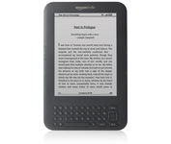
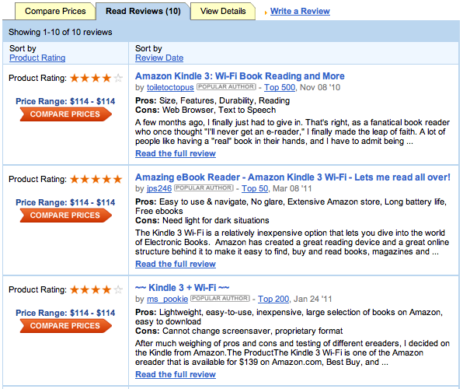
<
V.S.
Kindle 3
iPad 2

Slide 3
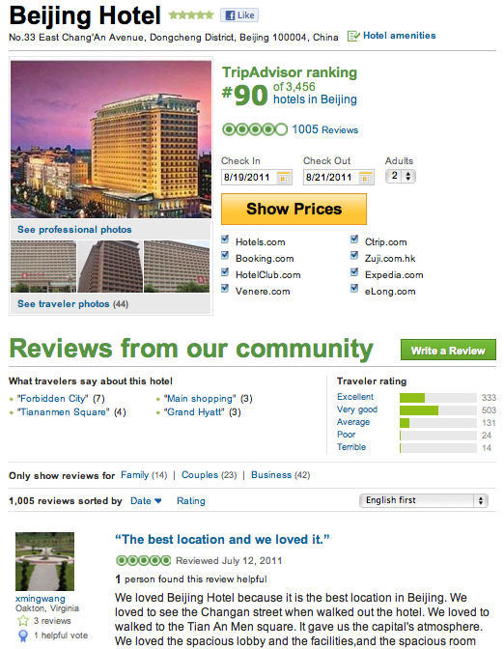
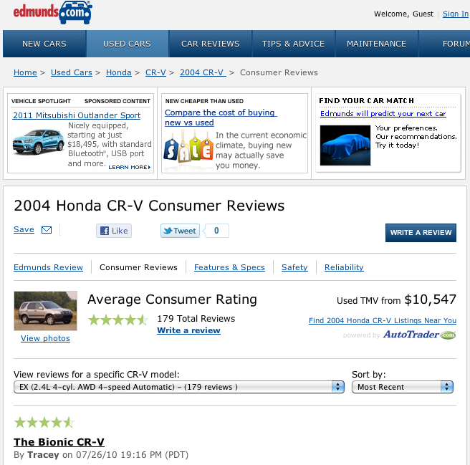
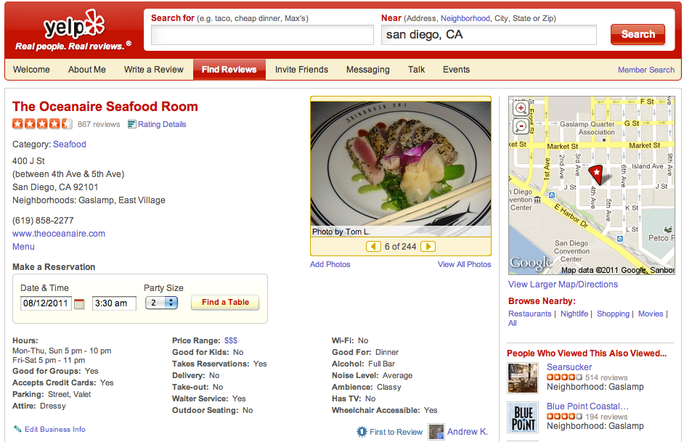
Reviews: helpful resource

Slide 4
Opinion Mining in Reviews
Sentiment Orientation Identification
e.g., Pang et.al 2002, Turney 2002

Slide 5
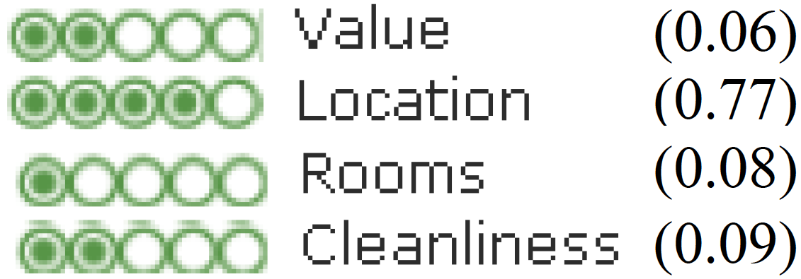
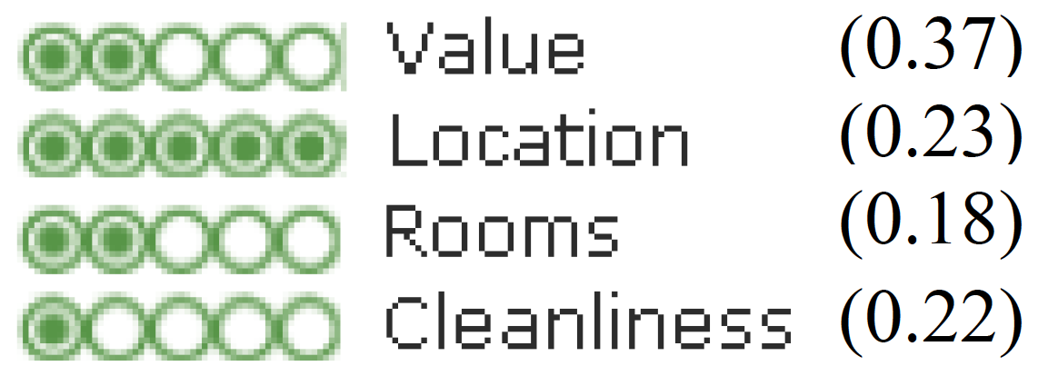
Information buried in text content

Slide 6
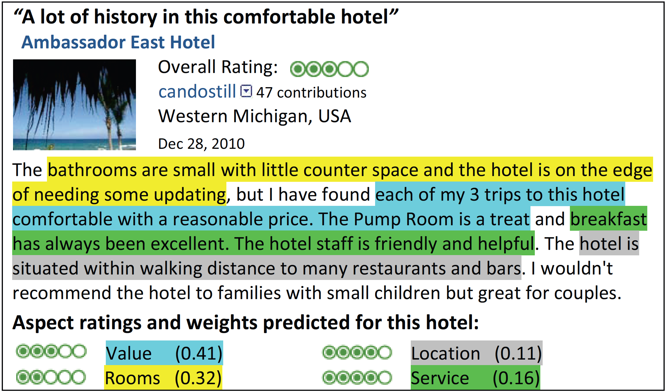
Latent Aspect Rating Analysis
Wang et.al, 2010
Overall Rating
Text Content
Aspect Segmentation
Aspect Rating Prediction
Aspect Weight Prediction

Slide 7
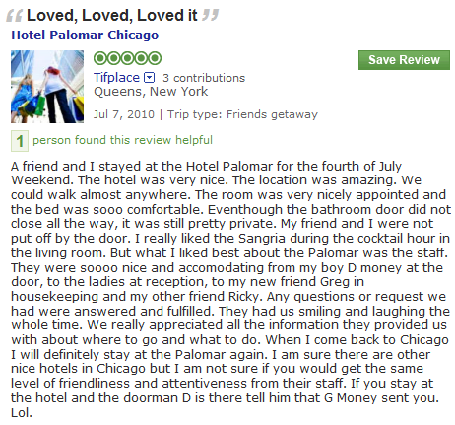
Previous Two-step Approach
+
Latent Rating Regression
Aspect Segmentation
Reviews + overall ratings
Aspect segments
Term Weights
Aspect Rating
Aspect Weight
location:1
amazing:1
walk:1
anywhere:1
0.0
2.9
0.1
0.9
3.9
0.2
room:1
nicely:1
appointed:1
comfortable:1
0.1
1.7
0.1
3.9
4.8
0.2
nice:1
accommodating:1
smile:1
friendliness:1
attentiveness:1
2.1
1.2
1.7
2.2
0.6
5.8
0.6
Gap ???

Slide 8
Comments on Two-step Solution
Pros
Users can easily control the aspects to be analyzed
Cons
Hard to specify aspect keywords without rich knowledge about the target domain
engine?
MPG??
traction control??
passenger safety??
transmission??
navigation??

Slide 9
A Generative Model for LARA
Entity
Aspects
Review
Aspect Rating
Aspect Weight
Location
location
amazing
walk
anywhere
Excellent location in walking distance to Tiananmen Square and shopping streets. That’s the best part of this hotel! The rooms are getting really old. Bathroom was nasty. The fixtures were falling off, lots of cracks and everything looked dirty. I don’t think it worth the price. Service was the most disappointing part, especially the door men. this is not how you treat guests, this is not hospitality.
0.86
Room
room
dirty
appointed
smelly
0.04
Service
terrible
front-desk
smile
unhelpful
0.10

Slide 10
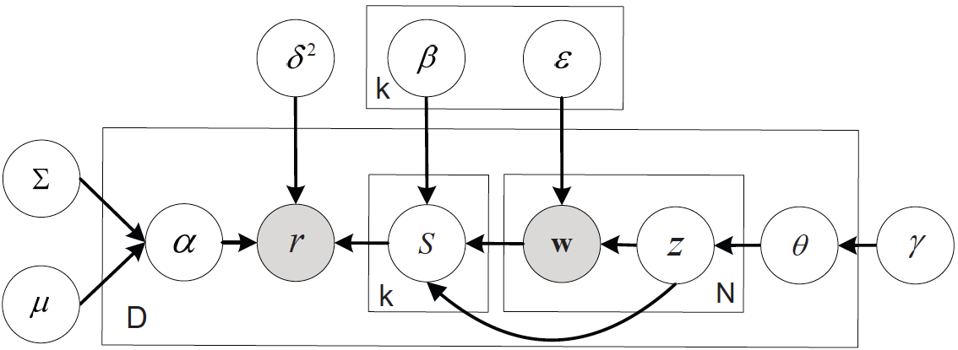
Latent Aspect Rating Analysis Model
Unified framework
Excellent location in walking distance to Tiananmen Square and shopping streets. That’s the best part of this hotel! The rooms are getting really old. Bathroom was nasty. The fixtures were falling off, lots of cracks and everything looked dirty. I don’t think it worth the price. Service was the most disappointing part, especially the door men. this is not how you treat guests, this is not hospitality.
Rating prediction module
Aspect modeling module

Slide 11
Model Discussion
Aspect modeling part
Identify word usage pattern
Leverage opinion ratings to analyze text content
Rating analyzing part
Model uncertainty from aspect segmentation
Informative feedback for aspect segmentation
bridge

Slide 12
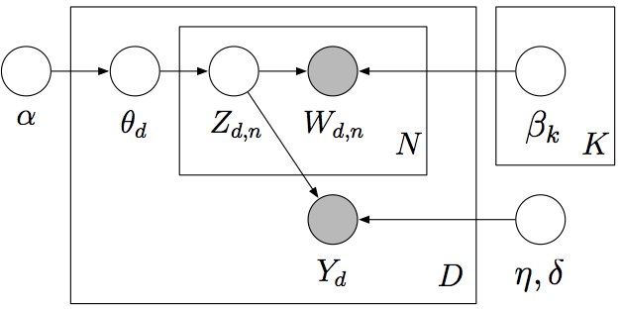
Model Discussion
LARAM
sLDA (Blei, D.M. et al., 2002)
Predict aspect ratings
Predict overall ratings

Slide 13
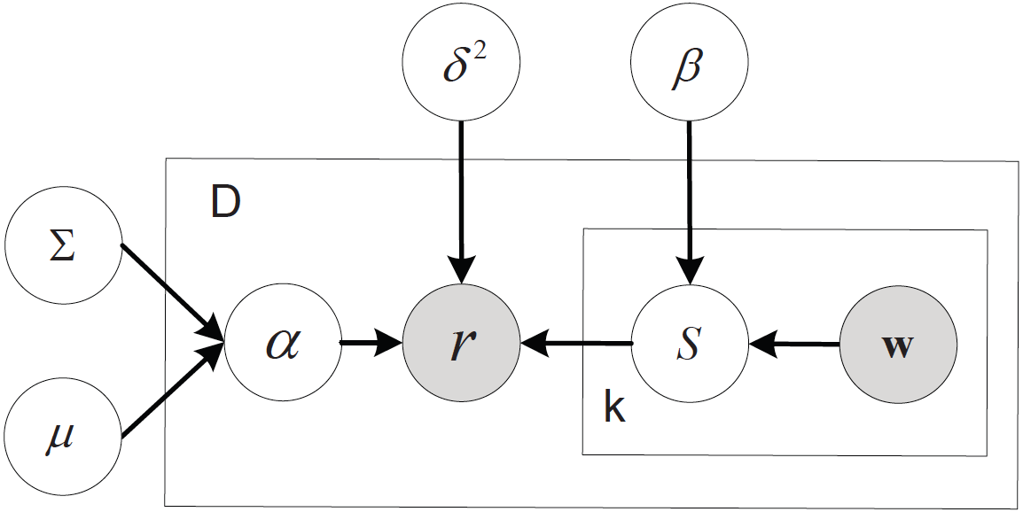
Model Discussion
LARAM
LRR (Wang et al., 2010)
Jointly model aspects and aspect rating/weights
Segmented aspects from previous step

Slide 14
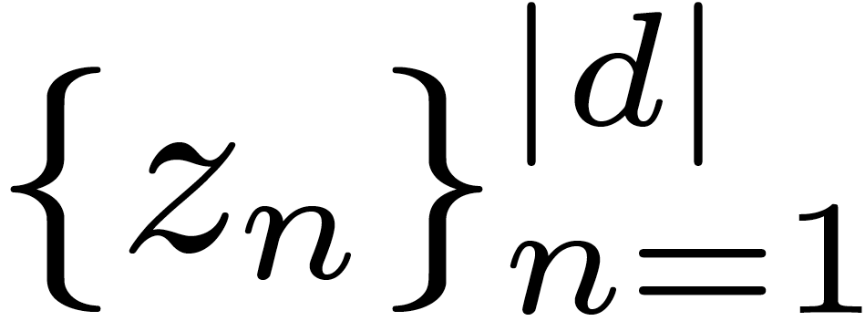
Posterior Inference
Variational inference
Maximize lower bound of log-likelihood function
Bridge: topic assignment
Aspect modeling part
Rating analyzing part

Slide 15
Model Estimation
Posterior constrained expectation maximization
E-step: constrained posterior inference
M-step: maximizing log-likelihood of whole corpus
Note
Consistency with overall rating
Uncertainty in aspect rating

Slide 16
Experiment Results
Data Set
Hotel reviews from tripadvisor
MP3 player reviews from amazon

Slide 17
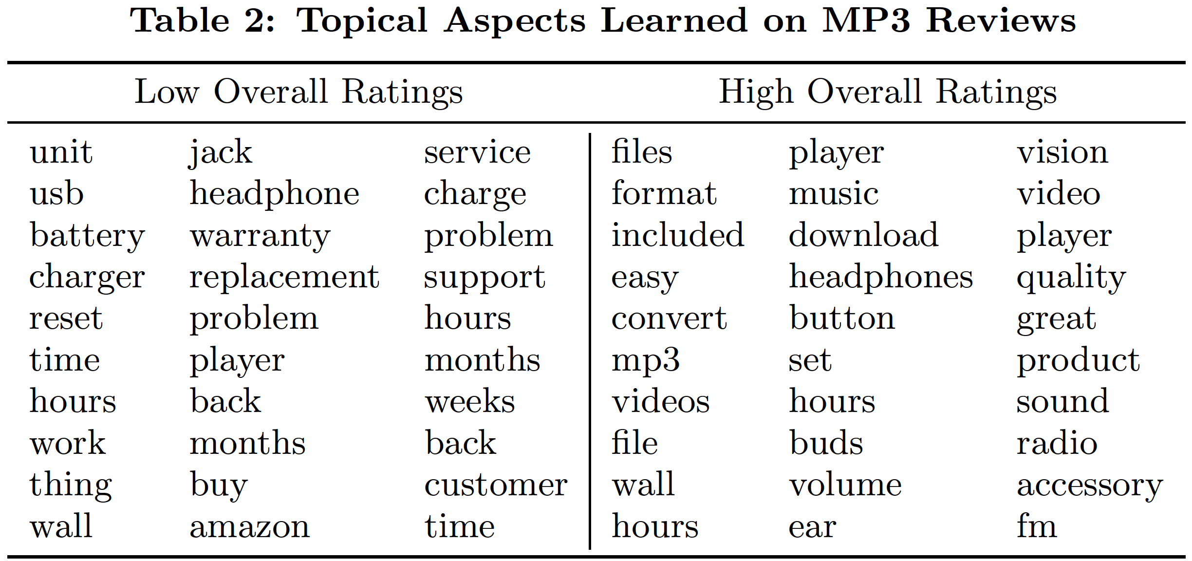
Aspect Identification
Amazon reviews: no guidance
battery life
accessory
service
file format
volume
video

Slide 18
Quantitative Evaluation of Aspect Identification
Ground-truth: LDA topics with keywords prior for 7 aspects in hotel reviews
Baseline: no prior LDA, sLDA

Slide 19
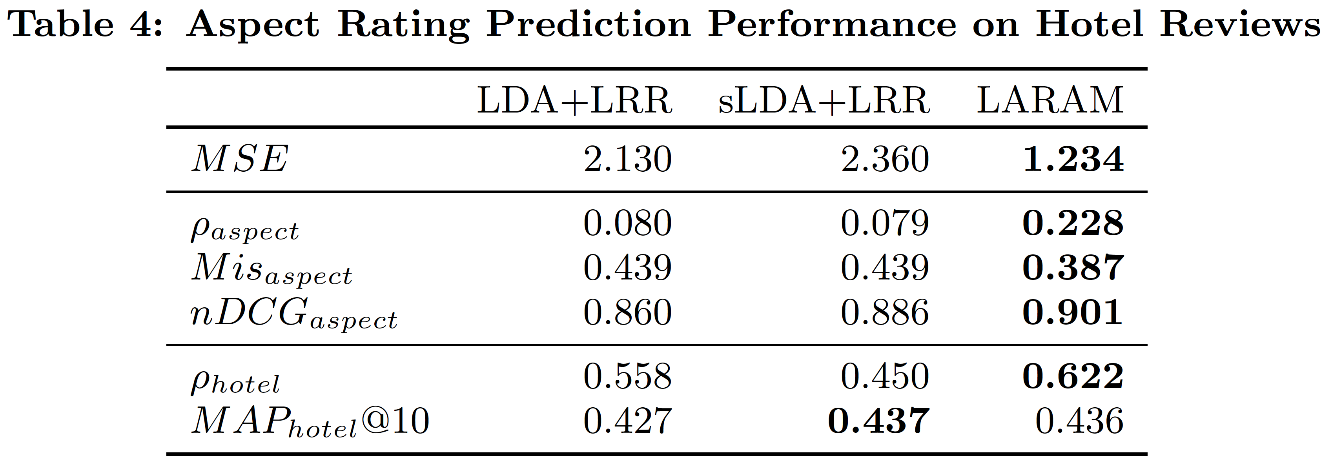
Aspect Rating Prediction I
Ground-truth: aspect rating in hotel reviews
Baseline: LDA+LRR, sLDA+LRR

Slide 20
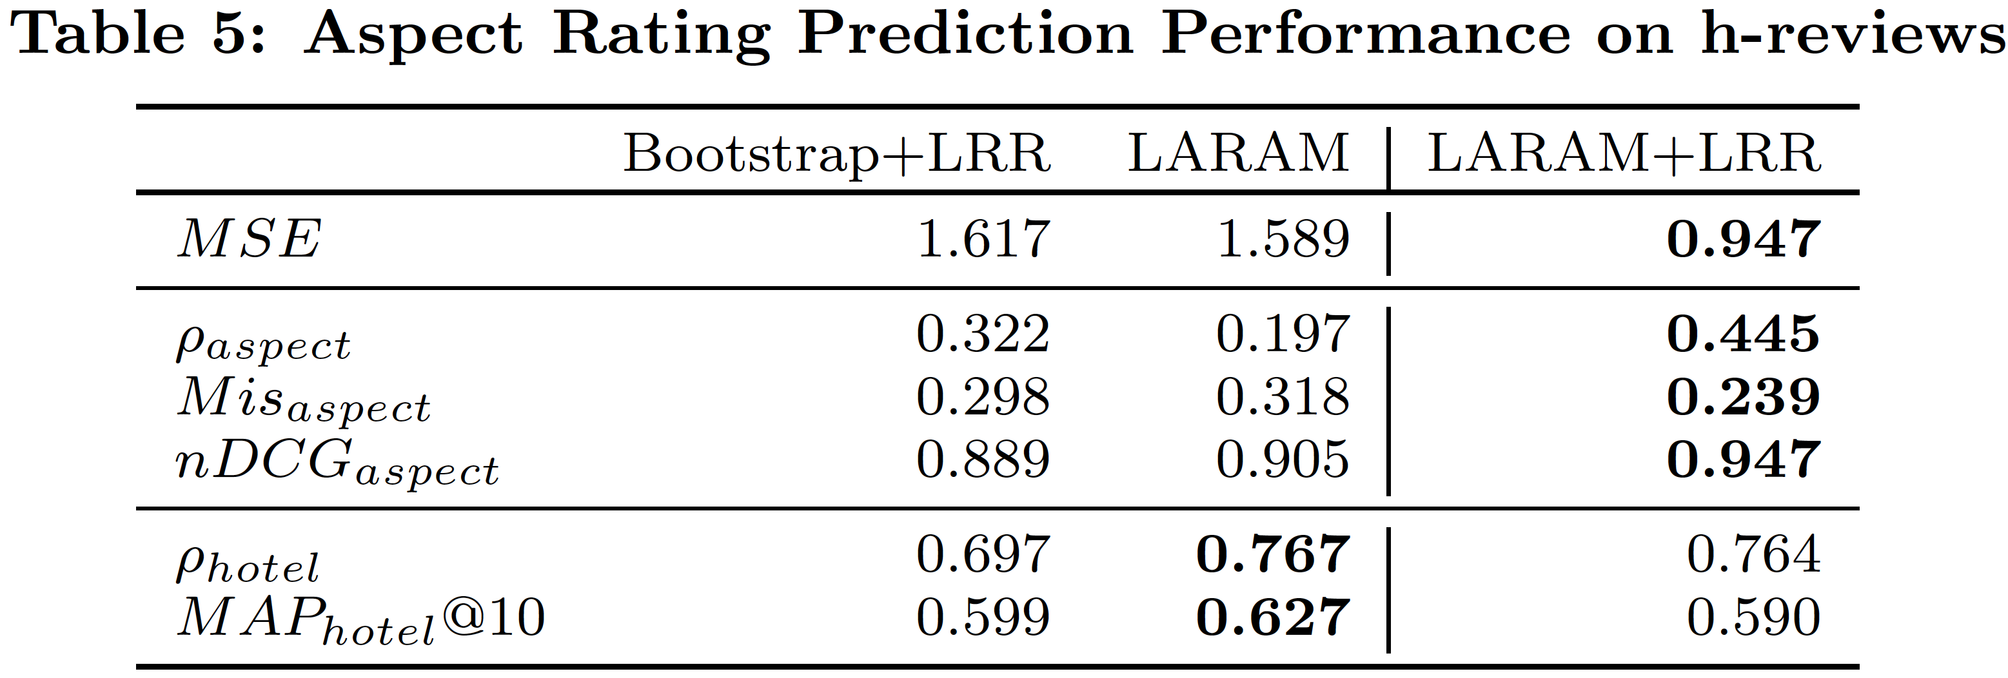
Aspect Rating Prediction II
Baseline: Bootstrap+LRR

Slide 21
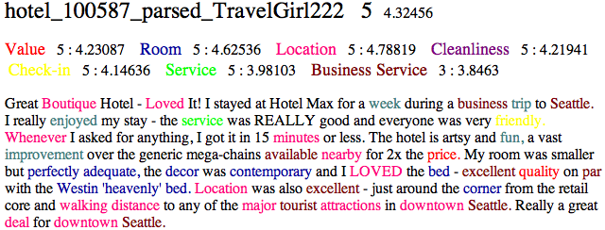
Analysis
Limitation: bag-of-word assumption

Slide 22
Aspect Rating Prediction II
Baseline: Bootstrap+LRR

Slide 23
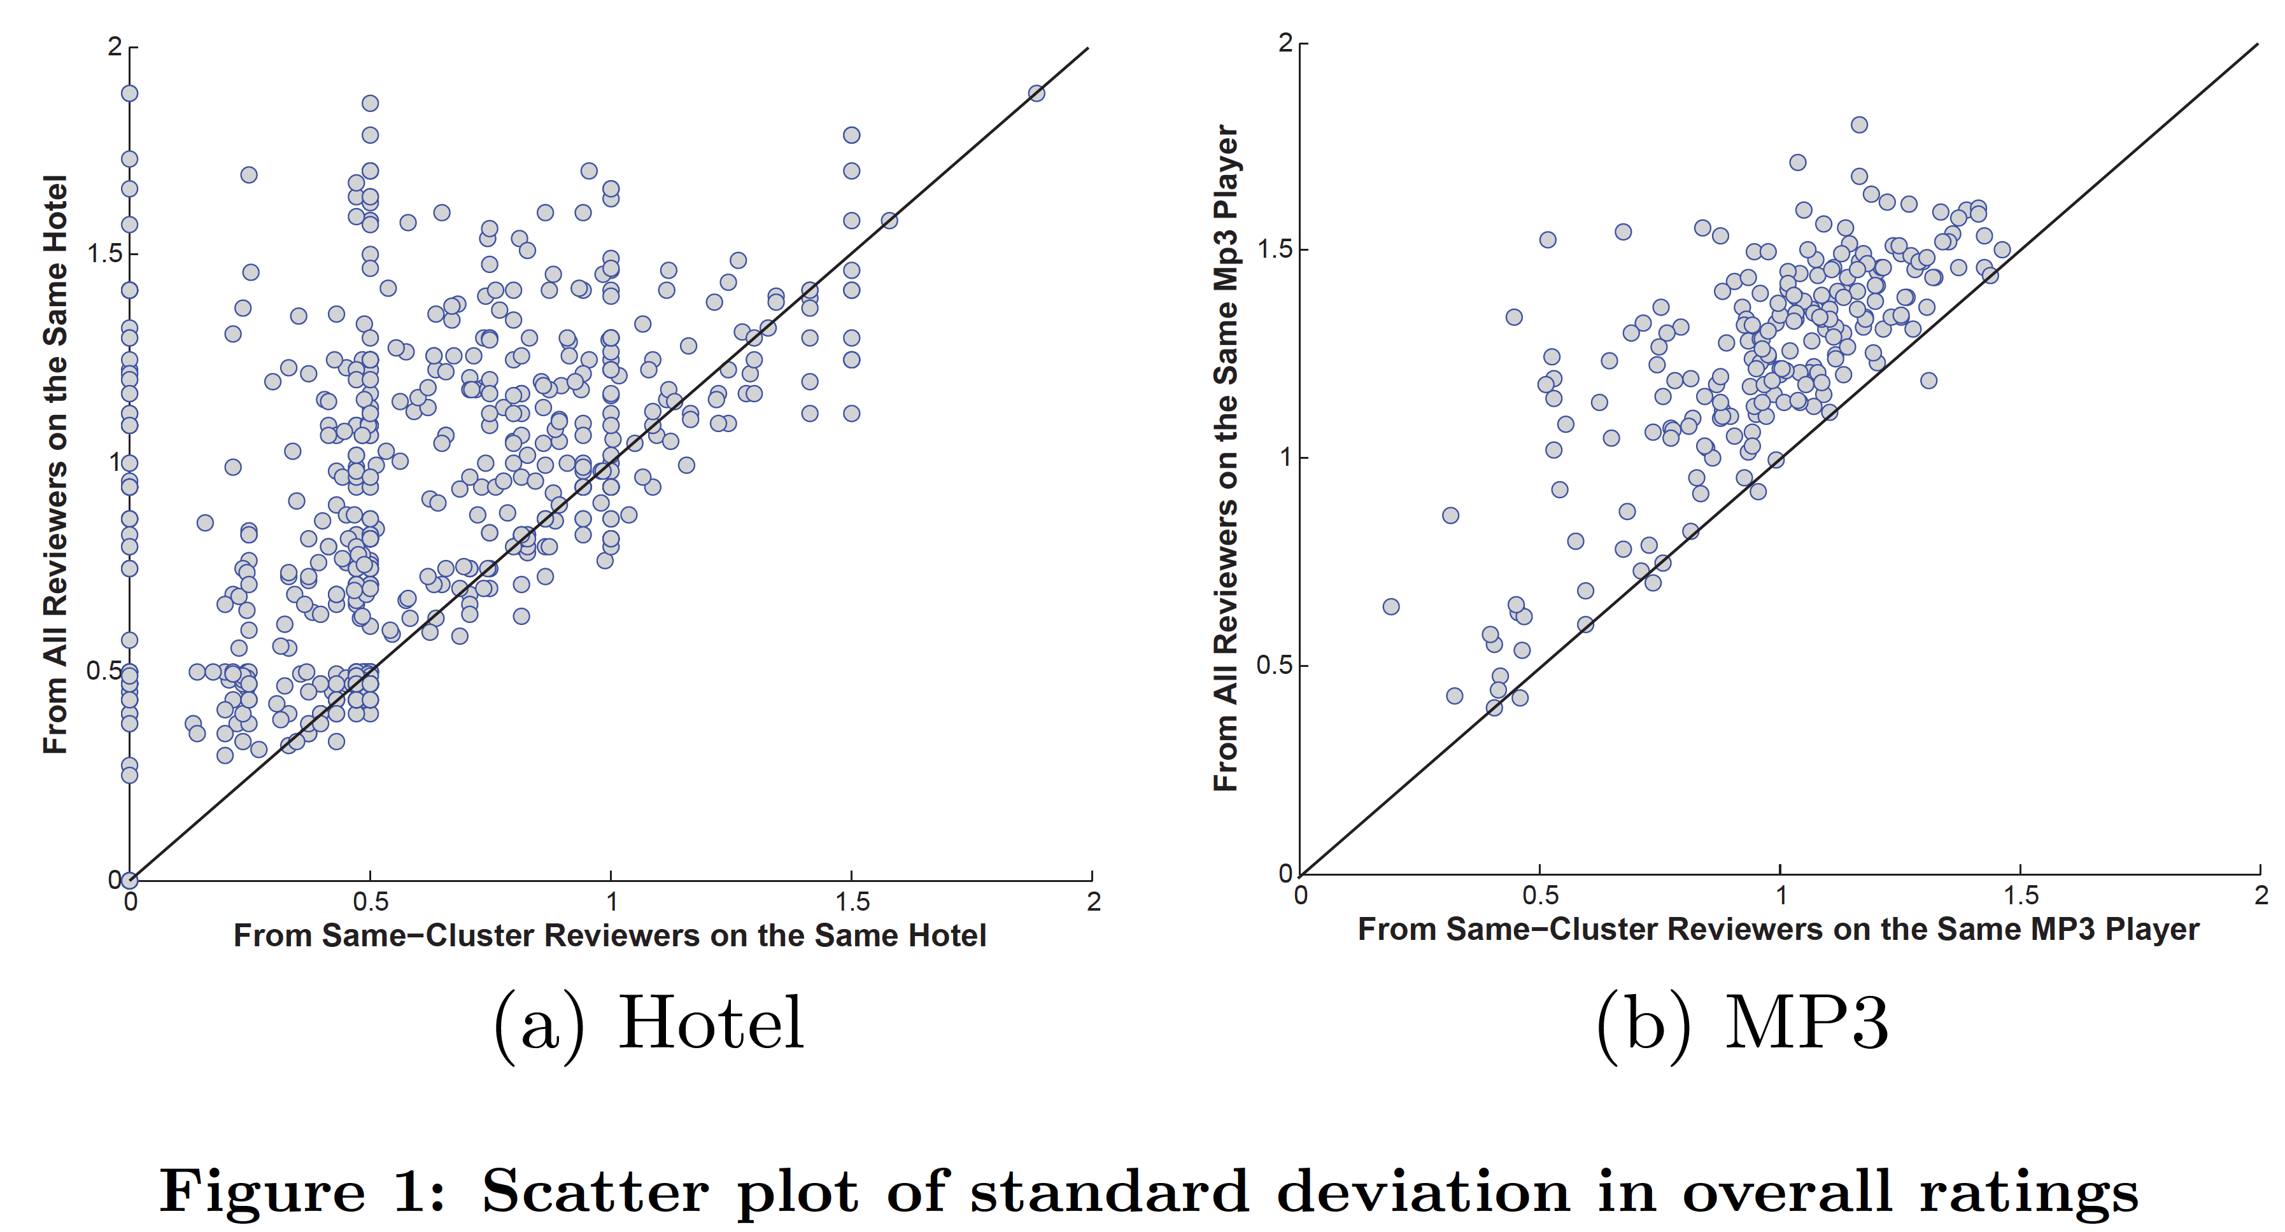
Aspect Weight Prediction
Aspect weight: user profile
Similar users give same entity similar overall rating
Cluster users by the inferred aspect weight

Slide 24
Conclusions
Latent Aspect Rating Analysis Model
Unified framework for exploring review text data with companion overall ratings
Simultaneously discover latent topical aspects, latent aspect ratings and weights on each aspect
Limitation
Bag-of-word assumption
Future work
Incorporate sentence boundary/proximity information
Address aspect sparsity in review content

Slide 25
References
Pang, B., Lee, L. and Vaithyanathan, S., Thumbs up?: sentiment classification using machine learning techniques. In Proceedings of the ACL-02 conference on Empirical methods in natural language processing, P79-86, 2002.
Turney, P., Thumbs up or thumbs down? Semantic orientation applied to unsupervised classification of reviews. In Proceedings of the 40th Annual Meeting of the Association for Computational Linguistics, P417-424, 2002.
Wang, H., Lu, Y. and Zhai, C., Latent aspect rating analysis on review text data: a rating regression approach, In Proceedings of the 16th ACM SIGKDD, P783-792, 2010
Blei, D.M. and McAuliffe, J.D., Supervised topic models, Advances in Neural Information Processing Systems, P121-128, 2008
J. Graca, K. Ganchev, and B. Taskar. Expectation maximization and posterior constraints. In Advances in Neural Information Processing Systems, volume 20. MIT Press, 2007.

Slide 26
Thank you

