Slide 1
Hidden Topic Sentiment Model
Md Mustafizur Rahman and Hongning Wang
Department of Computer Science
University of Virginia, Charlottesville,
Virginia, VA 22903
Notes:
Good afternoon everyone, my name is Yizhou Sun, but I am not a co-author of this paper. Because of VISA issue, neither of these two authors can come to Montreal.
I am going to present the paper “hidden topic sentiment model” on behalf of them.
This paper develops a generative sentiment topic model to capture the topic and sentiment jointly from the unstructured text documents.

Slide 2
Motivation
Observation
Method
Experimental
Analysis
Conclusion
Motivation
Overall Rating or classification
does not give enough information
I especially like its portability (3 pounds with a small
footprint) and the speed of its solid state drive. When it come
looks you have to give it to the Inspiron. It definitely has the
sleek look of an ultrabook . The combination of brushed aluminum
with black trim, keys and bezel make for a very classy,
“corporate” presence. The fit and finish are first
rate. However, the sound sucks . I have owned 10 notebook
and laptop computers over the past two decades and this
Inspiron has the worst sound of any before it. It is weak, tinny
and what low end it has is muddy and indistinct. While we’ve
all come to expect pretty lousy sound from notebooks, this
is subpar even considering those low standards.
What do we need?
Sentiment topic models
Aspect Level Sentiment Analysis
Figure 1: A review from Amazon
Notes:
User-generated opinionated reviews provide a gold mine for the research of sentiment analysis. Information extracted from such data is invaluable for the merchants to provide their competitiveness and for the customers to make informed decisions. To understand the challenges in review analysis, let us first take a look at this sample review of a Dell Inspiron laptop. The reviewer is very happy about the aspects of portability, hard disk, appearance but he/she is quite annoyed about its sound quality. As a result, the overall sentiment rating 4 only gives us some high-level idea that this laptop is generally good, but it cannot tell us which aspects of it is good. But most users are specially interested to know those details in practice.
As a result, aspect level sentiment analysis becomes necessary and important. Nowadays, topic models have become a very prominent tool to identify the aspects/topic from this kind of unstructured text review documents, due to its flexibility in capturing dependency between various types of observations. Many topic model based sentiment analysis solutions emerged, and they are developed to jointly capture the aspect and sentiment in an opinionated text document.

Slide 3
Sentiment-Topic Models : Assumptions
Motivation
Observation
Method
Experimental
Analysis
Conclusion
Topic 1
sleek
fit
low
Topic 2
worst
solid
sound
A document is a mixture of latent sentiment [1][2]
Each sentiment is a mixture of latent topics [1][2]
Given the sentiment label, selection of the topics are
independent over words [1][2]
By: Kindle Customer Date: June 25, 2014
I especially like its portability (3 pounds with a small
footprint) and the speed of its solid state drive. When it come
looks you have to give it to the Inspiron. It definitely has the
sleek look of an ultrabook . The combination of brushed aluminum
with black trim, keys and bezel make for a very classy,
“corporate” presence. The fit and finish are first
rate. However, the sound sucks . I have owned 10 notebook
and laptop computers over the past two decades and this
Inspiron has the worst sound of any before it. It is weak, tinny
and what low end it has is muddy and indistinct. While we’ve
all come to expect pretty lousy sound from notebooks, this
is subpar even considering those low standards.
Topic 3
weak
comput
small
Topic 4
suck
movie
half
Limitations
Sentence is structured & coherent
Topic independency assumption fails to capture topic coherence
Sentence independency assumptions cannot handle sentiment consistency
Figure 2: Result of applying Joint Sentiment Topic model [1]
Notes:
However, most of those topic model based sentiment analysis solutions are limited by their basic assumptions, and therefore with inferior performance in practice. To understand this, let us review what are the basic assumptions made in existing sentiment topic models, like joint sentiment topic model (JST) [1] and Aspect Sentiment Unification Model (ASUM) [2].
The first assumption is that a document is modeled as a mixture of sentiments. For example a reviews wants to cover 60% about positive sentiment and 40% about negative sentiment in his/her generated text content.
The second assumption is that each sentiment consists of a set of topics. For example, under positive sentiment, user might cover the aspects of batter life and picture quality of a camera, and under the negative sentiment he might want to cover customer service quality.
And another usually made assumption is that given the sentiment label, the assignment of topic over the words are independent from each other.
Now let’s apply a typical sentiment topic model, JST, on the laptop review we just showed. We can clearly find that many content words are assigned to different topics highlighted with different colors, even though they are nearby in the review content. For example, as we highlighted the word “weak” is assigned to one topic and the word “low” is assigned to another topic, although both of them are talking about the laptop’s poor sound quality.
Clearly those overly simplified assumptions prevent existing sentiment topic models to capture the rich structure embedded in a text document, such as topic coherence. Furthermore, from this sample review and our experience, we can also find that users rarely express contradictive sentiment polarities towards the same topic in one review document. We refer to this as sentiment consistence. Unfortunately, sentiment consistence is also missing under such overly simplified assumptions.

Slide 4
Hidden Topic Sentiment Model
Motivation
Observation
Method
Experimental
Analysis
Conclusion
Assumptions
Sentence is the basic structure unit
All the words in a sentence share the same topic
Enforces topic coherence
Topic and sentiment of current sentence influence the topic and sentiment of the next sentence
Enhances topic coherence
Captures sentiment consistency
Notes:
Based on the observations in the previous example, enhancing the independence assumptions in a sentiment topic model to capture the topic coherence and sentiment consistency urges us to develop a new sentiment topic model in this paper. We name our model as Hidden Topic Sentiment Model, or HTSM in short.
As we have discussed that document exhibits rich internal structure and sentences are related and coherent, our first assumption is that sentence is the basic structure of the topic model.
Next, in order to ensure topic coherence, i.e. words in close proximity share the same topic, we assume that the all the words in a sentence share the same topic.
Based on these two assumption, we further assume that the topic and sentiment of current sentence influence the topic and sentiment of the next sentence. Constraints about this transitional structure can therefore be added to ensure that users only express consistent sentiment towards the same topic, which further enhances the topic coherence.

Slide 5
Motivation
Observation
Method
Experimental
Analysis
Conclusion
Generative Explanation of HTSM
Document-topic proportion θ
Portability,+ | Appearance,+ | Sound,-
0.25 | 0.25 | 0.50
Portability,+
Portability
Small
…
Appearance,+
look
classy
...
Sound,-
sound
Worst
…
P(w|z,β)
Ψ = 0, τ = 0 | Keep same topic and sentiment
Ψ = 0, τ = 1 | Keep previous sentiment, change topic
Ψ = 1, τ = 1 | Change both topic and sentiment
Aspect switch ψ
Sentiment switch τ
Hidden
Z₁
Z₂
Z₃
Z₄
I especially like its portability (3 pounds with a small
footprint) ^{{portability,+}} .
P,+
P,+
P,+
P,+
It definitely has the sleek look of an
ultrabook ^{{appearance,+}} .
Sentiment Consistency
However, the sound sucks ^{{sound,-}} .
A+
A+
A+
A+
I have owned 10 notebook and laptop computers over the past two decades and this Inspiron has the worst sound of any before it ^{{sound,-}} .
S,-
S,-
S,-
S,-
Observable
Topic Coherence
Sentence position
Hidden
Notes:
Let’s illustrate the generative process of HTSM.
In HTSM, a topic is modeled as a tuple of aspect and sentiment, which is characterized by a multinomial distribution over words.
When generating a review document, a user first needs to decide the proportion of topics he/she wants to cover in this review. Here for example this reviewer wants to use 25% of content to cover the positive aspect about the portability, 25% of content for the positive aspect about the appearance, and the rest for the negative aspect about the sound.
Now he will start generating sentences. To generate the first sentence, he/she can randomly pick any of the three topics. Suppose he/she randomly picked the portability topic and sample the words from that topic to generate the first sentence “I especially like its portability.”
Next, to generate the second sentence, he/she needs to transit to three possible topics. However, special considerations have to be given here: he/she needs to consider whether he/she will keep the previous topic or switch to a new one. Such transition is controlled by two indicator variables \psi and \tau.
The legitimate transition in HTSM is defined in this table. \psi equals to 1 means switch aspect, otherwise stays with the same aspect. The same meaning applies to the value of \tau.
There are only 3 rows of this table, and the combination of \psi equals to one and \tau equals to zero is invalid in HTSM, because this combination means the user changes sentiment but keeps the same aspect. This contradicts to our sentiment consistency assumption.
Let us assume that user wants to change the topic but keep the previous sentiment to continue generating this review. As a result, at the second sentence he/she can only choose the topic about appearance. So he/she picks that and randomly sample word from it to generate the second sentence.
Now similarly for the third sentence, he/she again consults to \psi and \tau, and makes decision to change both topic and sentiment. This sampling procedure just keeps going until the user has generated the last sentence of this review.
We should note that during this generative process, we can only observe the review content generated by the users, but we do not have any knowledge about the topic distribution and transitional structure. We need to estimate those parameters and structure during model training and posterior inference, which will be discussed later.

Slide 6
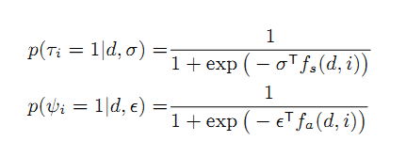
Motivation
Observation
Method
Experimental
Analysis
Conclusion
Can we do better
than coin tossing?
It definitely has the sleek look of an ultrabook ^{{appearance,+}} . However, the sound sucks ^{{sound,-}} .
ε
σ
Observable
ψ
τ
SentiWordNet
P,+
P,+
Sentence 1 | It definitely has the sleek look of an ultrabook | Positive Sentiment
Sentence 2 | However, the sound sucks | Negative Sentiment
A+
A+
S,-
S,-
Sentiment Transition Feature f_{s}(d,i)
Bias Term
Content-based cosine similarity
sentiWordNet score
Jaccard coefficient between POS tag
Negation count
Topic Transition Feature f_{a}(d,i)
Bias Term
Content-based cosine similarity
Length ratio
Relative position of sentence
Notes:
In HTSM, the user makes decisions about sentiment and topic transitions by two parameters \epsilon and \sigma. And this can be simply modeled coin tossing. But we can definitely do better than this, since we already have the sentences observed.
To understand this, let’s take a look at these two just generated sentences. We can find that the first sentence contains the word “sleek” and the next sentence contains the word “sucks”. So definitely, these two sentences contain two different kinds of sentiment, and there must be a sentiment transition and aspect transition between them.
This signal can be easily recognized by a sentiment lexicon, such as sentiWordNet. This is just one feature for sentiment transition incorporated in HTSM, and we have utilized many other features from observed sentence content for both sentiment and aspect transition as depicted in these two tables.
To encode such rich observations about the transitional structure, we employed a parameterized logistic regression, and EM algorithm is used to estimate the features weight for these two transition probabilities.

Slide 7
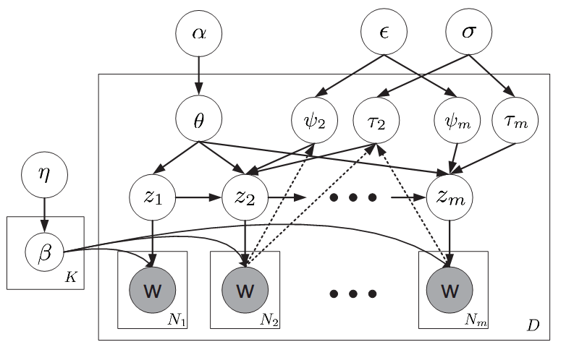
Motivation
Observation
Method
Experimental
Analysis
Conclusion
Topic and sentiment transition selector
First order
Markov model
Ensure Topic Coherence & Sentiment Consistency
One sentence contains one topic :
Topic coherence
Sentence the basic unit of HTSM
7
Notes:
To formally describe the proposed solution, we represent our model in the plate notation.
The hyper-parameters in this model are \alpha and \eta, which are priors on document-topic proportion \theta and word-topic probability matrix \beta respectively.
As we can see that all the words in a sentence are sampled from the same topic and in this way we are enforcing the topic coherence.
And we enforce sentiment consistence by introducing the first order Markov model between topics in nearby sentences.
And finally to more accurately model the transitional structure among aspects and sentiments, we introduce two parameterized logistic functions, which incorporate features extracted from text content of adjacent sentences.

Slide 8
Posterior Inference ($z$, $θ$)
Motivation
Observation
Method
Experimental
Analysis
Conclusion
Sentence-level topic assignment $z$ (discrete random variable)
Document-level topic proportion $θ$ (continues random variable)
Exact posterior inference is not feasible!
Solution
approximate posterior inference via coordinate ascent
will converge to a local maximum of data likelihood function of the document d
Notes:
To utilize the newly proposed model, we have to infer topic assignments in each document.
However due to the coupling between the discrete random variable z and continuous random variable \theta, exact inference is computationally infeasible.
We have developed an approximate posterior inference procedure based on coordinate ascent.
In particular, the posterior distribution of topic assignments z are computed via the forward-background algorithm. Given \theta, this inference is exact, and it guarantees our coordinate ascent between z and \theta will converge to a local maximum of data likelihood function in each document.

Slide 9
Parameter Estimation
Motivation
Observation
Method
Experimental
Analysis
Conclusion
Model Parameters (β, ε, σ)
Expectation Maximization (EM) algorithm
Randomly initialize (β^{t}, ε^{t} σ^{t}) at time t
Expectation Step (E step):
Approximate inference for (z, θ) is computed for each document with model parameters (β^{t}, ε^{t} σ^{t})
Maximization Step (M step):
maximum likelihood estimator is used to compute the model parameters at time T+1 (β^{T+1}, ε^{T+1}, σ^{T+1})
Some review websites
(i.e. newegg.com) provides the sentiment switch explicitly (σ), where our model can be trained in a semi-supervised manner
Notes:
We appeal to the EM algorithm for parameter estimation in HTSM.
Especially, based on the expectation about the topic and aspect transition inferred in E-step, the feature weights in the logistic functions for transition probability can be efficiently estimated via gradient descent.
However, due to time limitation, we will not illustrate the details in parameter estimation, and more details can be found in our paper.
It is to be noted that some review websites, such as newegg.com, provide the detailed sentence level sentiment information explicitly. In such case we do not need to infer the sentiment transitions, and we can train our model in a semi-supervised setting instead. We will discuss this special case in our experiment section.

Slide 10
Dataset
Motivation
Observation
Method
Experimental
Analysis
Conclusion
Product review dataset from 2 different websites
Amazon and NewEgg website
Four (4) different products (Camera, Phone, Tablet, and TV)
Table 1: Description of Dataset
Dataset | Amazon | NewEgg | Vocabulary Size
Camera | 6919 | 3020 | 1406
Tv | 4729 | 1662 | 1410
Tablet | 6147 | 407 | 1515
Phone | 6899 | 268 | 1282
Notes:
To empirically evaluate our model, we have collected user-generated reviews from two online shopping websites, Amazon and NewEgg.
We collected four different categories: camera, tablet, phone and tv. The number of reviews under each category is depicted in the Table 1.
We collected data from newEgg because it provides reviews with dedicated pros and cons section, which can be used as groundtruth in our sentiment classification experiment.

Slide 11
Performance Metrics
Motivation
Observation
Method
Experimental
Analysis
Conclusion
Topic Evaluation
Perplexity
In Information theory, perplexity is a measurement of how well a probability distribution or probability model predicts a sample
Sentiment Classification
F-1 measure
Notes:
As a sentiment topic model, we need to quantitatively measure the quality of inferred topic and sentiment from our model.
We compute perplexity to assess how well our model can predict unseen documents. According to information theory, perplexity is the number of bits required to encode information under a given distribution, so that the lower the perplexity is on a testing set, the more predictive a probabilistic model is.
And for sentiment classification, we have used standard F-1 measure, which is defined as a harmonic mean of precision and recall.

Slide 12
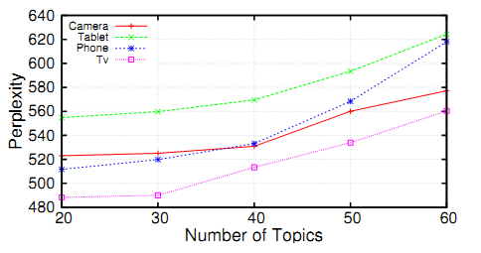
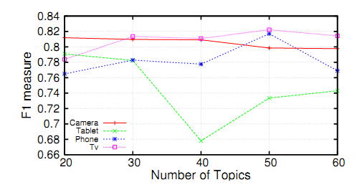
Motivation
Observation
Method
Experimental
Analysis
Conclusion
Number of Topics: Empirical Evidence
Figure 3: Effects of varying the number of topics on perplexity (left) and F-1 measure (right)
Table 2 : Number of Topics
Category | Camera | Phone | Tablet | Tv
# topics | 26 | 26 | 30 | 16
Notes:
We first performed an empirical evaluation on all four data sets to determine the proper setting of the number of topics in HTSM on these datasets. We varied the number of topics from 20 to 60 and calculated both perplexity and F-1 measure for all four different categories.
From the Figure 3, we can find that that once we exceed 30 topics, the performance of HTSM in both perplexity and sentiment classification starts to degenerate. Based on these results, we set the number of topics under each category as shown in Table 2 for all the following experiments.

Slide 13
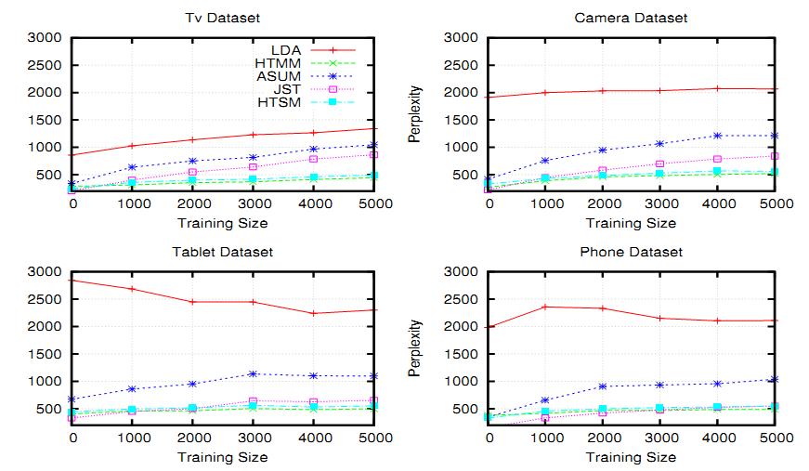
Motivation
Observation
Method
Experimental
Analysis
Conclusion
Topic Evaluation
Figure 4 : Perplexity with increasing training size on four different review document sets
Notes:
We first compared the predictive power of different topic models on unseen documents measured by perplexity.
As our baselines, we used Latent Dirichlet Allocation (LDA), Hidden Topic Markov Model (HTMM), Joint Sentiment Topic Model (JST) and Aspect Sentiment Unification Model (ASUM).
From Figure 4, we get the overview that our model outperformed LDA, JST and ASUM by large margins for all the four categories.
The only exception is HTMM, and it is to be noted that HTMM is a pure topic model whereas our model is a sentiment-topic models. As a result, our model has more constraints in assigning a word into different topics than HTMM. Although HTMM has slightly better performance in predicting an unseen document’s content, it cannot predict sentiment polarity in a document and therefore it is of limited utility in practice.

Slide 14
Motivation
Observation
Method
Experimental
Analysis
Conclusion
Word Intrusion Experiment [4]
Model generated topics
Merged test topic
Annotators have to find out which two words are intruding.
Topic 1 | Probability
Charge | 0.150
Recharge | 0.135
Battery | 0.124
Life | 0.105
…
Dock | 0.003
Topic 2 | Probability
Lens | 0.161
Screen | 0.159
Display | 0.157
Touch | 0.142
View | 0.125
Topic 1
Battery
Dock
Life
Screen
Recharge
Charge
Inter-topic
Intruding Word
Intra-topic
Intruding Word
Successful identification of intruding words means the model can generate topics that are human interpretable
Notes:
Perplexity only measures a probabilistic model’s quality in terms of likelihood. It is hard to interpret how significant the result improvement could be to a human being. From practical perspective, we are more interested to understand whether the topics identified by a probabilistic model are actually human interpretable. Hence we decided to perform the word intrusion experiment to investigate on this perspective.
We selected the word which has relatively low probability as an intra-topic intruding word and a word which has a higher probability in other topic (for example topic 2 here) but not in the current topic as an inter-topic intruding word. Then we randomly mixed these two kind of words with the top five words from topic 1 and present the results to an human annotator.
The annotator is asked to identify these two intruding words. If they can successfully identify the words, it implies that the tested model can generate topics that are human interpretable

Slide 15
Motivation
Observation
Method
Experimental
Analysis
Conclusion
Topic Evaluation (Word Intrusion)
Performance Metric
Table 3: Word intrusion measurement across different topic
models of four categories of product reviews
Inter-topic MR
Category | LDA | HTMM | ASUM | HTSM
Camera | 0.167 | 0.218 | 0.218 | 0.282
Tablet | 0.356 | 0.256 | 0.244 | 0.389
Phone | 0.192 | 0.179 | 0.231 | 0.333
Tv | 0.188 | 0.188 | 0.271 | 0.313
Intra-topic MR
Category | LDA | HTMM | ASUM | HTSM
Camera | 0.474 | 0.385 | 0.436 | 0.346
Tablet | 0.478 | 0.533 | 0.456 | 0.522
Phone | 0.551 | 0.500 | 0.487 | 0.346
Tv | 0.625 | 0.646 | 0.563 | 0.500
Notes:
As the performance metric of this experiment, we computed the proportion of intruding words that have been successfully identified by the annotators. The higher this value is, the more interpretable the learned topics are.
From Table 3, we can clearly find that HTSM outperformed all baselines in all the four categories for inter-topic intrusion measurement.
However, for the intra-topic intrusion evaluation, there is no single winner. We believe that the selection process of intra-topic intrusion words and the way annotators interpret this might be the contributing factors for relatively low performance of HTSM.

Slide 16
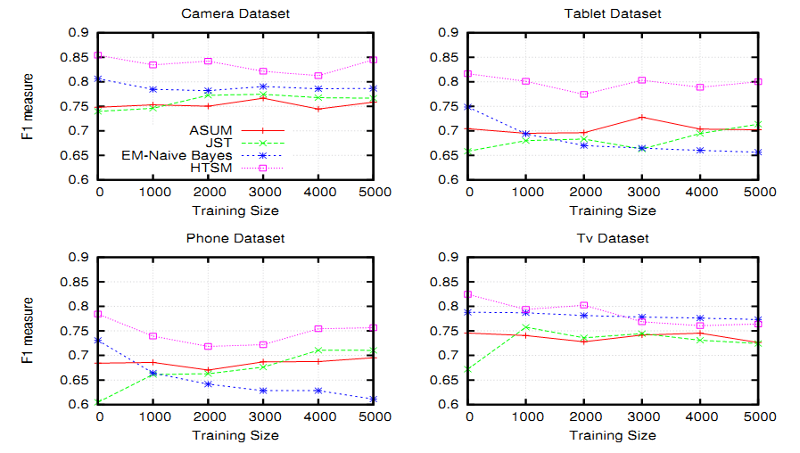
Motivation
Observation
Method
Experimental
Analysis
Conclusion
Sentiment Classification
Figure 5 : Sentiment classification performance with increasing training size on four different review document sets
Notes:
In terms of sentiment classification comparison, we compared our model against some state-of-the-art topic-sentiment models, like JST, ASUM and EM-Naïve Bayes, which is a semi-supervised algorithm text classification.
We performed five-fold cross validation by splitting the newegg data set, since it has user provided sentence-level sentiment annotations. Because amazon reviews do not have sentiment labels on the sentences, we gradually added them to the training set to investigate its effect for model training.
In figure 5, the x-axis represents the number of reviews in the training set. At the starting point, we only have newegg reviews for training purpose. From the results, it is evident that HTSM achieved almost 10% improvement over all baseline models, and some medium amount of amazon reviews improves the model’s classification performance. However, we can also notice that adding more Amazon data has mixed impact on the performance.

Slide 17
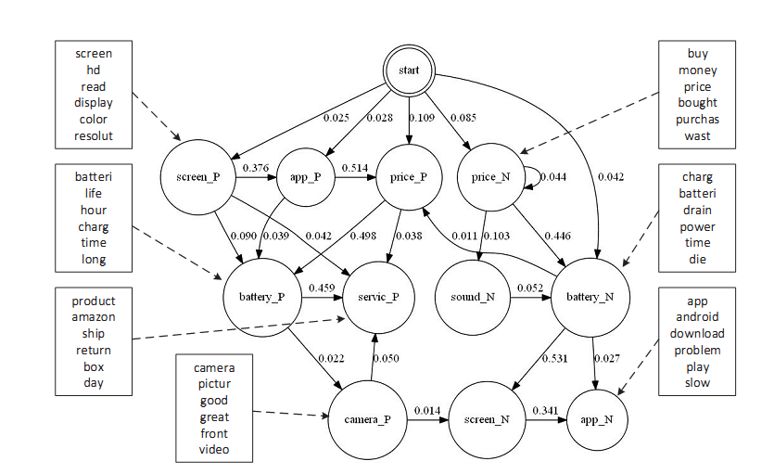
Motivation
Observation
Method
Experimental
Analysis
Conclusion
Topic Evaluation (Topic Transition)
When users have negative sentiment
When users have positive sentiment
Figure 6 : Estimated topic transition and top words under selected topic on tablet data set
Notes:
The transitional structure estimated in HTSM unveils how an user makes transitions from one topic to another when he/she writes a review. We generated a topic transition diagram for the Tablet category based on the inferred topics in HTSM.
For example, when users are happy about their tablet purchases, it is likely that they would start with something positive the price, e.g. “the tablet is worth of the money”, then they might move onto discussing the positive side of battery live, which might be followed by the customer service of that tablet.
Similarly when the users are not satisfied about the purchase, it is highly likely that they will complain about the price first, then give negative comments on the battery charge, and then switch to the negative side of screen etc.

Slide 18
Motivation
Observation
Method
Experimental
Analysis
Conclusion
Aspect-Based Contrastive Summary
Table 4 : Aspect-based contrastive summarization on tablet dataset
Topic | Samsung Galaxy Note 10.1 | Amazon Kindle Fire HDX
(+, battery) | Battery life is very good, it is easily an all day device with wifi on and high brightness while taking notes | Battery life is ok - probably need to recharge every other day with normal use
(-, battery) | My only issue is that it takes a long time to take a full charge and does not charge rapidly enough to use while charging, but the battery life is not bad | Everything works great, but the battery life is not nearly as long as advertised
(+, sound) | it has pretty good battery life, it also has an excellent quality sounding speakers, which I wasn't expecting on any tablet | Sound is really good (not home theater quality or anything) but better than any phone I've heard
(-, sound) | The audio became occasionally inoperative and the headphone jack would crackle when using my ear buds | Users can get confused with volume buttons on the other side
Notes:
The inferred sentence-level aspect and sentiment assignments enable us to perform aspect-based contrastive summarization. The idea is to select the most typical sentences from a collection of reviews, given a particular aspect and sentiment.
For example, suppose that a user wants to compare Samsung galaxity Note 10.1 against Amazon Kindle Fire HDX. Before buying the tablet, he/she wants to know about the battery life and sound quality of these two tablets. So the input from him/her will be those two aspects. Then the model will pick the most representative sentences for each of these two aspects under each product and return them to the user.
From summary generated by HTSM shown in table 4, the user can easily get the basic idea that the battery life of this Kindle Fire is not that good as it is advertised by the merchant, however, the battery of Samsung Galaxy table is good but it takes long time to charge. Based on this kind of contrastive summary, the users can make more informed decisions about which product they should choose.

Slide 19
Motivation
Observation
Method
Experimental
Analysis
Conclusion
User Study for Summarization
Interleave the summarized sentences from all models
Reduce position bias
Ask annotators
E.g. Pick two sentences POSITIVE about PRICE Aspect
Performance Metric
Annotators selection of a sentence generated from a topic model, means it can pick more informative sentence than other models
Table 5: Interleaved document summarization quality test
Category | ASUM | HTMM | HTSM
Camera | 0.078 | 0.362 | 0.560
Tablet | 0.153 | 0.370 | 0.477
Phone | 0.118 | 0.439 | 0.443
Tv | 0.173 | 0.338 | 0.489
Notes:
We want to quantitatively investigate whether the contrastive summary generated before is actually helpful to an ordinary user.
So for this experiment, we have tested three models HTSM, HTMM and ASUM. We selected the top 2 most probable sentences from each of these three models for a particular product with specific aspect and sentiment of interest. Then we present those selected sentences to the annotators after interleaving, which is a common practice in information retrieval to reduce position bias in result display. The annotators are asked to pick only two sentences that are most informative about the queried aspect and sentiment. Because of interleaving, the annotators have no information about which model generated which sentences.
If an annotators picks a sentence that is selected by a particular model, that means that model is generating a more informative sentence than other models. So based on this intuition, we have defined the performance metric as how many sentences selected by the annotators are generated by a particular model.
From Table 5, it is evident that our model is clearly selecting more informative sentences than the other two models. It is to be noted that ASUM is also a sentiment topic model, however since ASUM is built upon overly simplified independence assumptions, neither topic coherence nor sentiment consistence can be capture. Its performance is the worst here. HTMM is performing relatively better than a sentiment-topic model here, because HTMM is trying to capture the topic coherence by introducing binomial distribution in switching of topic between tow consecutive sentence.

Slide 20
Motivation
Observation
Method
Experimental
Analysis
Conclusion
Summary of Contributions
A unified topic model to explicitly capture
topic coherence
By enforcing the constraint that the sentence can have one topic
sentiment consistency
Using the constraint that the sentiment and topic of previous sentence affects the sentiment and topic of the next sentence
capture the sentiment and topic switch from observable text reviews
Flexible modeling assumption enables both unsupervised and semi-supervised estimation of model parameters
Notes:
Now let’s summarize the contributions of this paper.
We have introduced a unified topic model call Hidden Topic Sentiment Model, which imposes topic coherence and sentiment consistency via a set of generative assumptions about text documents.
The topic coherence is enforced by the constraint that a sentence can only have one topic and it is further enhanced by the first order markov model structure.
And sentiment consistency is ensured by the condition that the sentiment and aspect of previous sentence affects the sentiment and aspect of the next sentence.
Besides, the our model is flexible enough to be estimated in both unsupervised and semi-supervised settings.
Promising empirical results confirmed the effectiveness of our proposed solution.

Slide 21
Motivation
Observation
Method
Experimental
Analysis
Conclusion
Future Works
Capture long-term dependency
Skip-chain
Incorporate document-level rating
Overall rating from 1 to 5 star rating
Value of the product user care about
Notes:
There are several lines of future work based on HTSM.
First it is evident that our model currently cannot capture long-term dependency due to computational complexity. However, we can introduce the skip-chain structure to capture this long term dependency based on some observed syntax cues, for example if two sentences talking about the same aspect with the same keywords, they can linked to enforce sentiment consistence.
Second, we have not utilized the document-level overall rating in our sentiment modeling, though it is directly available in many review documents. This document-level sentiment rating provides informative signals about sentiment switch. For example, a five-star review is less likely to be associated with transitions to negative sentiments. Besides, incorporating this overall judgment can help us further infer a reviewer’s emphasis about the aspect of a particular product, such as if the overall rating is biased by a specific aspect, that aspect is usually more important to the reviewer. This can be incorporated in the future development of HTSM.

Slide 22
References
[1] C. Lin and Y. He. Joint sentiment/topic model for sentiment analysis. In Proceedings of the 18th ACM conference on Information and knowledge management , pages 375–384. ACM, 2009.
[2] Y. Jo and A. H. Oh. Aspect and sentiment unification model for online review analysis. In Proceedings of the fourth ACM international conference on Web search and data mining , pages 815–824. ACM, 2011.
[3] D. M. Blei, A. Y. Ng, and M. I. Jordan. Latent dirichlet allocation. the Journal of machine Learning research, 3:993–1022, 2003.
[4] J. Chang, S. Gerrish, C. Wang, J. L. Boyd-Graber, and D. M. Blei. Reading tea leaves: How humans interpret topic models. In Advances in neural information processing systems, pages 288–296, 2009.
[5] A. Gruber, Y. Weiss, and M. Rosen-Zvi. Hidden topic markov models. In International Conference on Artificial Intelligence and Statistics , pages 163–170, 2007
[6] T. Hofmann. Probabilistic latent semantic analysis. In Proceedings of the Fifteenth conference on Uncertainty in artificial intelligence , pages 289–296. Morgan Kaufmann Publishers Inc., 1999
[7] Mei, Qiaozhu, et al. "Topic sentiment mixture: modeling facets and opinions in weblogs." Proceedings of the 16th international conference on World Wide Web. ACM, 2007.
Notes:
Here are the references of this presentation

Slide 23
Thank you!
Contact: mr4xb@virginia.edu
Notes:
Thank you for your patience during this presentation.
If you have any questions about this work, please direct them to the authors of this paper.

