Slide 1



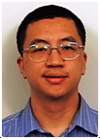

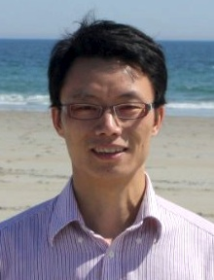

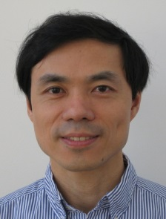
A Two-Dimensional Click Model for Query Auto-Completion
Yanen Li¹, Anlei Dong², Hongning Wang¹, Hongbo Deng², Yi Chang², ChengXiang Zhai¹
¹University of Illinois at Urbana-Champaign
² Yahoo Labs at Sunnyvale, CA
at SIGIR 2014

Slide 2
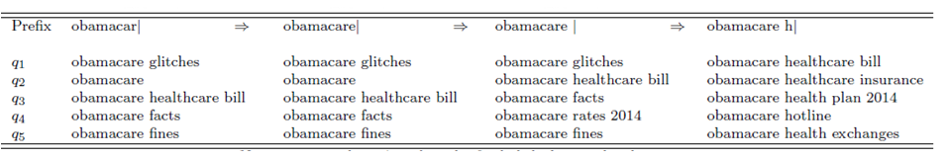
Query Auto-Completion (QAC)
Keystroke
Sugg List
Clicked Query
QAC vs. Document Retrieval
 | QAC | Document Retrieval
Query: | prefix | query
Objects: | query | document
Method: | learning -to-rank | learning -to-rank
Labels: | user clicks only | editor labels
Notes:
The task of query auto-completion is to predict user’s intended query by a prefix in real time. The user enters a series of key stroke, and examines a series of suggested queries before she finally clicks on a query.
It shares similarity with document retrieval.

Slide 3
Existing Work on Relevance Modeling for QAC
[Shokouhi SIGIR’13] use all simulated columns
Only last column on current query log
[Arias PersDB’08] [Bar-Yossef WWW’11]
No work has used real QAC log
Questions:
Can we do better with real QAC log?
What’s the best way of exploiting QAC log?

Slide 4
New QAC Log: From Real User Interaction at Yahoo!. High Resolution: Record Every Keystroke in Milliseconds
1. Keystroke
2. Cursor Pos
3. Sugg List
4. Clicked Query
5. Previous Query
6. Timestamp
Potential uses:
-- improve QAC relevance ranking
-- understand user behaviors in QAC
… …
7. User ID
Notes:
Because there is no such data existed. We take the first step to collect a new QAC log. This log is of high resolution, recording every keystroke in milliseconds. The information includes ….
We expect that there are much usage of this new log. For example, we can use it to improve relevance ranking. And we can also utilize the real user interactions to decipher user behaviors in QAC.

Slide 5

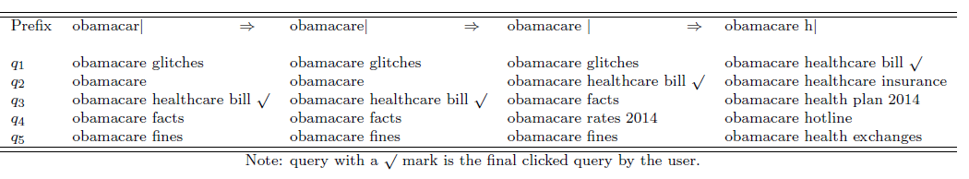
First attempt on exploiting QAC log
Experiment on Yahoo! QAC log
Method | MRR
RankSVM – Last | 0.514
RankSVM – All | 0.436

Slide 6
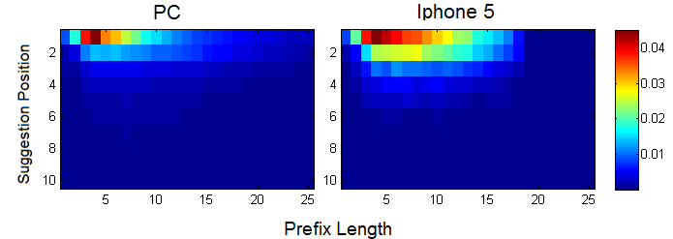
A closer look at QAC log: 2-Dimensional Click Distribution
Notes:
After collecting this log. We have conducted some interesting user behavior analysis on the QAC process.

Slide 7
User behavior observation 1: vertical position bias
PC
iPhone 5
Vertical Position
Vertical Position Bias Assumption
A query on higher rank tends to attract more clicks regardless of its relevance to the prefix

Slide 8
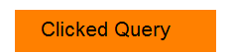
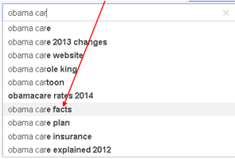
Implications for Relevance Ranking
Should emphasize clicks at lower positions

Slide 9

User behavior observation 2:
horizontal skipping (user skips relevant results)
happens in 60% of all sessions
Horizontal Skipping Bias Assumption
A query will receive no clicks if the user skips the suggested list of queries, regardless of the relevance of the query to the prefix

Slide 10
Implications for Relevance Ranking
Train on examined columns

Slide 11
Our Goal: Develop a unified generative model to account for positional bias and horizontal skipping
better models of horizontal skipping bias and vertical position bias => better relevance model
P(C) = P(Relevance)∙P(Horizontal)∙P(Vertical)
Notes:
We want to decompose the click model into three components, (1) Relevance Model (2) H model, (3) D model,. Better modeling of H and D models would lead to better relevance model. Eventually we will use the relevance model to rank the candidate completions.

Slide 12
Starting point: Existing Click Models for document retrieval
Several click models
-- UBM [Dupret SIGIR’08],
-- DBN [Chapelle WWW’09],
-- BSS [Wang WWW’13]
No existing click model is suitable:
1. horizontal skipping behavior is not modeled
2. not content-aware. They can’t handle unseen prefix-query pairs (67.4% in PC and 60.5% in iPhone 5).
Notes:
because UBM
and DBN rely on counting the prefix-query pairs. However, in the
dynamic enjoinment of QAC, users constantly change the prefix.
Thus the percentage of unseen prefix-query pairs is large (67.4%
in PC and 60.5% in Iphone 5)

Slide 13

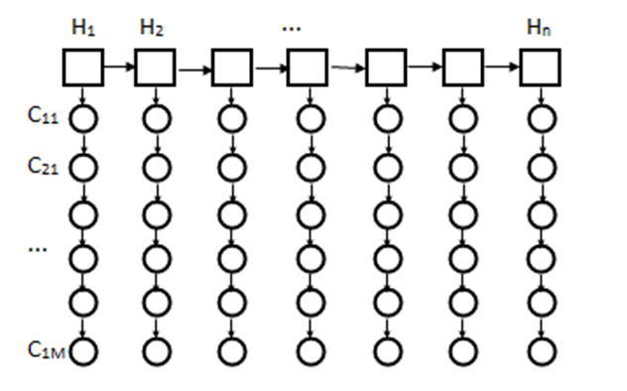
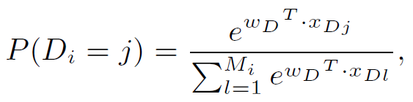



New Model: Two-Dimensional Click Model (TDCM)
Features:
Typing speed
isWordBoundary
Current position
C Model: Relevance
C_{i,j} = 1: a click at position (i,j)
H Model: Horizontal Skipping Behavior
H_{i}=1: stop and examine
H_{i}=0: skip
D Model: Vertical Position Bias
D_{i} = j: examine to depth j
Notes:
For this regard, we propose a novel two dimensional click model to model the QAC process. There are 3 components: (1) H model, which models the horizontal skipping behavior, (2) D model, which models the vertical position bias, and (3) R model, which models the intrinsic relevance between a prefix and query. The process of observing a click is the following: (1) suppose a user in typing a character, after typing, she decides whether to stop and examine a list of suggestions. If she doesn’t want to stop, she will skip the list and continue to type. This behavior is modeled by the H model. On the other hand, if she decides to examine the list, the D model models how deep she will examine down to the list. Finally, if she has examine a particular query, the probability of observing a click is modeled by the R model.
Features in the H model include: typingSpeed, wordBoundaries, currentPositions, query type,
Right: relations among the hidden variable. We want to decompose the click model into three components, (1) H model, (2) D model, (3) Relevance Model. Better modeling of H and D models would lead to better relevance model. Eventually we will use the relevance model to rank the candidate completions.

Slide 14





Disambiguate “no clicks”: Multiple scenarios
No click
H_{i}=1
D_{i}=4
H_{i}=1
D_{i}=4
No click
H_{i}=1
D_{i}=4
Click
No click
H_{i}=1
D_{i}=2
H_{i}=0
Skip
Stop
examine
relevant
irrelevant
clicked
Only when examined and relevant, a click happens

Slide 15
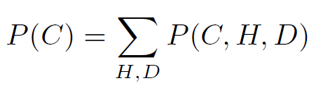
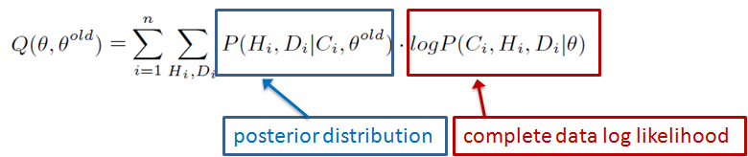
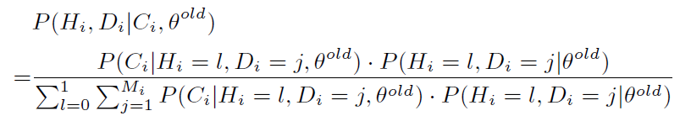
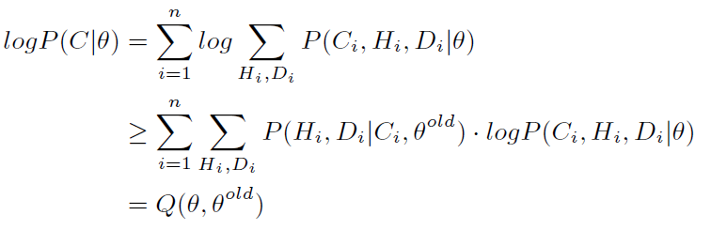

Solving the Model by E-M Algorithm
E Step: evaluate the Q function by:
M Step: maximize , while

Slide 16
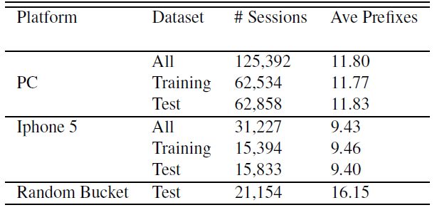
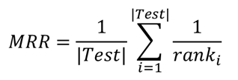
Experiments: Data and Evaluation Metric
Data
Random Bucket: shuffle query lists for each prefix;
unbiased evaluation of R model with vertical position bias removed
Metric
MRR@All: average MRR across all columns

Slide 17
Experiments: Models Evaluated
Comparison Method | Description
MPC | Most Popular Completion
UBM-last [Dupret SIGIR’08] | User Browsing Model
UBM-all [Dupret SIGIR’08] | User Browsing Model
DBN-last [Chapelle WWW’09] | Dynamic Bayesian Network model
DBN-all [Chapelle WWW’09] | Dynamic Bayesian Network model
BSS-last [Wang WWW’13] | Bayesian Sequential State model
BSS-all [Wang WWW’13] | Bayesian Sequential State model
TDCM | Our model
non content-aware models
Content-aware models

Slide 18
MRR on Normal Bucket
Results
Method | PC MRR@All | iPhone 5 MRR@All
MPC | 0.447 | 0.542
UBM-last | 0.416 | 0.409
UBM-all | 0.445 | 0.431
DBN-last | 0.418 | 0.405
DBN-all | 0.454 | 0.435
BSS-last | 0.515‡ | 0.510
BSS-all | 0.495 | 0.480
TDCM | 0.525‡ | 0.580‡
MRR on Random Bucket (PC data only)
Method | MRR@All
MPC | 0.429
UBM-last | 0.381
UBM-all | 0.397
DBN-last | 0.373
DBN-all | 0.388
BSS-last | 0.471‡
BSS-all | 0.460
TDCM | 0.493‡
Note: ‡ indicates p-value<0.05 compared to MPC

Slide 19
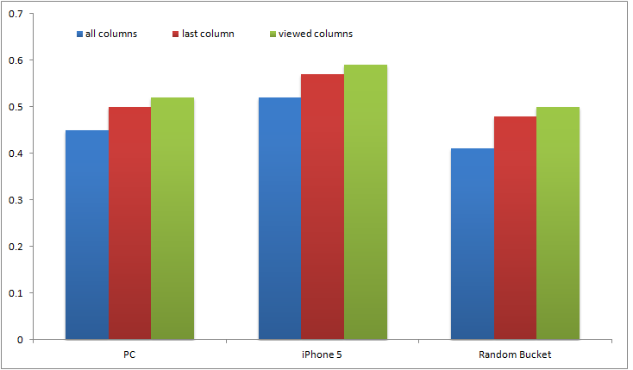
Validating the H Model: Using inferred p(H=1) to Enhance other Methods
RankSVM Performance
MRR@All
Viewed columns: P(H_{i} = 1) > 0.7

Slide 20
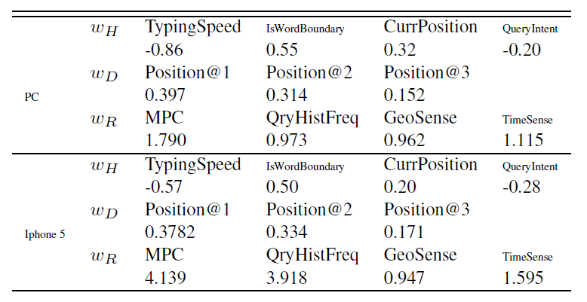
Understanding User Behavior
via Feature Weights
Feature Weights Learned by TDCM
H Model: TypingSpeed is negatively proportional to p(H=1)
IsWordBoundary is also important
D Model: Top 3 positions occupy most of the examine probability
R Model: QryHistFreq is important: user uses QAC as a memory
GeoSense and TimeSense have valid contributions

Slide 21
Conclusions and Future Work
Collect the first set of high-resolution query log specifically for QAC
Analyze horizontal skipping bias and vertical position bias: implications for relevance modeling
Propose a Two-Dimensional Click Model to model these user behaviors in a unified way,
  Outperforming existing click models
  Revealing interesting user behavior
Future Work
  More accurate component models (H, D, R)
  Exploiting the model to character user groups (clustering users based on inferred model parameters)

Slide 22
Questions?
A Two-Dimensional Click Model for Query Auto-completion
Contact:
Yanen Li
University of Illinois at Urbana-Champaign
yanenli2@illinois.edu

