Slide 1
Logical Foundations of AI
Planning as Satisfiability
Clause Learning
Backdoors to Hardness
Henry Kautz

Slide 2
SATPLAN
encoder
cnf
formula
STRIPS
problem
description
mapping
length
interpreter
SAT
engine
plan
satisfying
model

Slide 3
Translating STRIPS
Ground action = a STRIPS operator with constants assigned to all of its parameters
Ground fluent = a precondition or effect of a ground action
operator: Fly(a,b)
  precondition: At(a), Fueled
  effect: At(b), ~At(a), ~Fueled
constants: NY, Boston, Seattle
Ground actions: Fly(NY,Boston), Fly(NY,Seattle), Fly(Boston,NY), Fly(Boston,Seattle), Fly(Seattle,NY), Fly(Seattle,Boston)
Ground fluents: Fueled, At(NY), At(Boston), At(Seattle)

Slide 4
Translating STRIPS
Ground action = a STRIPS operator with constants assigned to all of its parameters
Ground fluent = a precondition or effect of a ground action
operator: Fly(a,b)
  precondition: At(a), Fueled
  effect: At(b), ~At(a), ~Fueled
constants: NY, Boston, Seattle
Ground actions: Fly(NY,Boston), Fly(NY,Seattle), Fly(Boston,NY), Fly(Boston,Seattle), Fly(Seattle,NY), Fly(Seattle,Boston)
Ground fluents: Fueled, At(NY), At(Boston), At(Seattle)

Slide 5
Clause Schemas

Slide 6
Existential Quantification

Slide 7
Named Sets

Slide 8
SAT Encoding
Time is sequential and discrete
  Represented by integers
  Actions occur instantaneously at a time point
  Each fluent is true or false at each time point
If an action occurs at time i, then its preconditions must hold at time i
If an action occurs at time i, then its effects must hold at time i+1
If a fluent changes its truth value from time i to time i+1, one of the actions with the new value as an effect must have occurred at time i
Two conflicting actions cannot occur at the same time
The initial state holds at time 0, and the goals hold at a given final state K

Slide 9
SAT Encoding
If an action occurs at time i, then its preconditions must hold at time i
operator: Fly(a,b)
  precondition: At(a), Fueled
  effect: At(b), ~At(a), ~Fueled
cities: NY, Boston, Seattle

Slide 10
SAT Encoding
If an action occurs at time i, then its preconditions must hold at time i
operator: Fly(a,b)
  precondition: At(a), Fueled
  effect: At(b), ~At(a), ~Fueled
cities: NY, Boston, Seattle

Slide 11
SAT Encoding
If an action occurs at time i, then its effects must hold at time i+1
operator: Fly(a,b)
  precondition: At(a), Fueled
  effect: At(b), ~At(a), ~Fueled
constants: NY, Boston, Seattle

Slide 12
SAT Encoding
If an action occurs at time i, then its effects must hold at time i+1
operator: Fly(a,b)
  precondition: At(a), Fueled
  effect: At(b), ~At(a), ~Fueled
constants: NY, Boston, Seattle

Slide 13
SAT Encoding
If a fluent changes its truth value from time i to time i+1, one of the actions with the new value as an effect must have occurred at time i
operator: Fly(a,b)
  precondition: At(a), Fueled
  effect: At(b), ~At(a), ~Fueled
cities: NY, Boston, Seattle

Slide 14
SAT Encoding
If a fluent changes its truth value from time i to time i+1, one of the actions with the new value as an effect must have occurred at time i
operator: Fly(a,b)
  precondition: At(a), Fueled
  effect: At(b), ~At(a), ~Fueled
cities: NY, Boston, Seattle

Slide 15
SAT Encoding
If a fluent changes its truth value from time i to time i+1, one of the actions with the new value as an effect must have occurred at time i
Change from true to false:
operator: Fly(a,b)
  precondition: At(a), Fueled
  effect: At(b), ~At(a), ~Fueled
cities: NY, Boston, Seattle

Slide 16
Action Mutual Exclusion
Two conflicting actions cannot occur at the same time
  Actions conflict if one modifies a precondition or effect of another
operator: Fly(a,b)
  precondition: At(a), Fueled
  effect: At(b), ~At(a), ~Fueled
cities: NY, Boston, Seattle

Slide 17
Action Mutual Exclusion
Two conflicting actions cannot occur at the same time
  Actions conflict if one modifies a precondition or effect of another
operator: Fly(a,b)
  precondition: At(a), Fueled
  effect: At(b), ~At(a), ~Fueled
cities: NY, Boston, Seattle

Slide 18
Satplan Demo (blackbox)

Slide 19
The IPC-4 Domains
Airport: control the ground traffic [Hoffmann & Trüg]
Pipesworld: control oil product flow in a pipeline network [Liporace & Hoffmann]
Promela: find deadlocks in communication protocols [Edelkamp]
PSR: resupply lines in a faulty electricity network [Thiebaux & Hoffmann]
Satellite & Settlers [Fox & Long], additional Satellite versions with time windows for sending data [Hoffmann]
UMTS: set up applications for mobile terminals [Edelkamp & Englert]

Slide 20
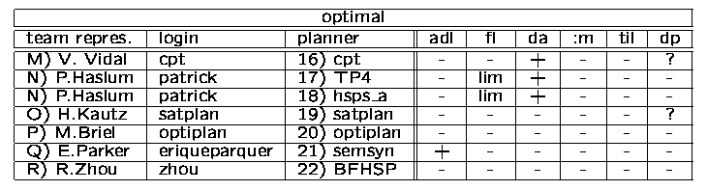
The Competitors: Optimal planners

Slide 21
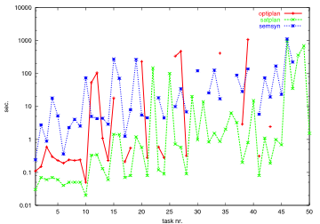
PSR

Slide 22
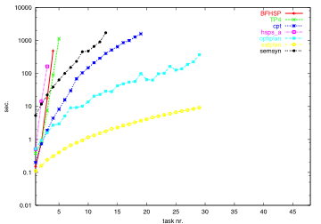
Dining Philosophers

Slide 23
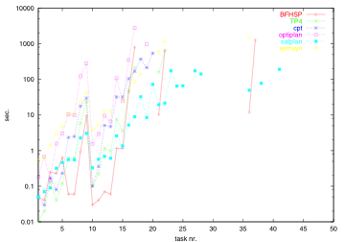
Airport

Slide 24



Hosted at
International Conference on Automated Planning and Scheduling
Performance Award:
1st Prize, Optimal Track
Henry Kautz, David Roznyai, Farhad Teydaye-Saheli,
Shane Neth and Michael Lindmark
$ 200
“SATPLAN04”
Stefan Edelkamp Jörg Hoffmann
IPC-4 Co-Chairs Classical Part
Whistler, June 6, 2004

Slide 25
Power of Modern DPLL Solvers
Branching heuristics
    Choose variable to assign that would causes the greatest amount of simplification
    Simple frequency heuristic: choose variables by the frequency with which they occur in original formula
    Current frequency heuristic: branch on a variable that occurs most frequently in the current set of clauses
    "MOMS" heuristics: branch on a variable that maximum number of occurrences in clauses of the shortest length in the current set of clauses

Slide 26
Power of Modern DPLL Solvers
Clause Learning
    DPLL only finds tree-shaped proofs
    There might be much smaller DAG proofs
    Idea: when DPLL backtracks, determine the particular choices that resulted in [ ]
    Record these choices as a derived clause, add it back to the set of clauses
    Result: proof corresponding to DPLL search tree becomes DAG-ish

Slide 27
How: Clause Learning
Idea: backtrack search can repeatedly reach an empty clause (backtrack point) for the same reason
A
B
B
C
C
✗
✗
Example: Propagation from B=1 and C=1 leads to empty clause

Slide 28
How: Clause Learning
If reason was remembered, then could avoid having to rediscover it
A
B
B
I had better set C=0 immediately!
C
D
✗
Example: Propagation from B=1 and C=1 leads to empty clause

Slide 29
How: Clause Learning
The reason can be remembered by adding a new learned clause to the formula
A
B
B
Set C=0 by unit propagation
C
D
✗ learn (~B V ~C)
Example: Propagation from B=1 and C=1 leads to empty clause

Slide 30
How: Clause Learning
Savings can be huge
A
B
B
C
C
D
E
D
E
✗
✗
✗
✗
✗
✗
✗
✗
Example: Setting B=1 is the root cause of reaching an empty clause

Slide 31
How: Clause Learning
Savings can be huge
Have learned unit clause (~B)
A
B
C
C
D
E
✗
✗
✗
✗
Example: Setting B=1 is the root cause of reaching an empty clause

Slide 32
Determining Reasons
The reason for a backtrack can be found by (incrementally) constructing a graph that records the results of unit propagations
Cuts in the graph yield learned clauses

Slide 33
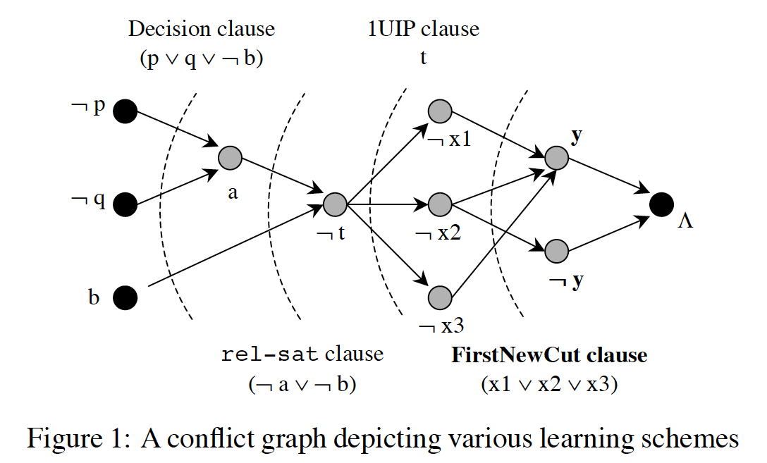

Slide 34
Scaling Up Clause Learning
Clause learning greatly enhances the power of unit propagation
Tradeoff: memory needed for the learned clauses, time needed to check if they cause propagations
Clever data structures enable modern SAT solvers to manage millions of learned clauses efficiently

Slide 35
Why Do These Techniques Work So Well?
"Backdoors" to Complexity
    SAT encodings of problems in planning, verification, and other real-world domains often contain 100,000's of variables
    However: it is often the case that setting just a few variables dramatically simplifies the formula
      Branching heuristics: choosing the right variables
      Clause learning: increases amount of simplification performed by unit propagation

Slide 36
Backdoors can be surprisingly small:
Most recent: Other combinatorial domains. E.g. graphplan planning,
near constant size backdoors (2 or 3 variables) and log(n) size
in certain domains. (Hoffmann, Gomes, Selman ’04)
Backdoors capture critical problem resources (bottlenecks).

Slide 37
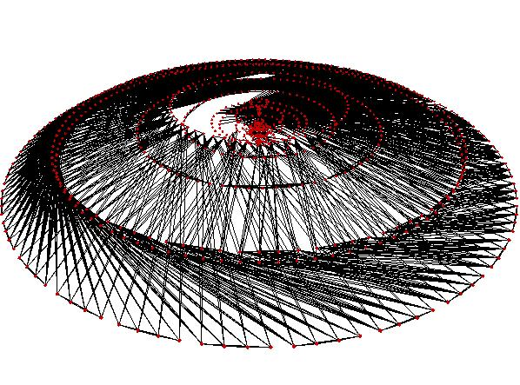
Backdoors --- “seeing is believing”
Constraint graph of
reasoning problem.
One node per variable:
edge between two variables
if they share a constraint.
Logistics_b.cnf planning formula.
843 vars, 7,301 clauses, approx min backdoor 16
(backdoor set = reasoning shortcut)

Slide 38
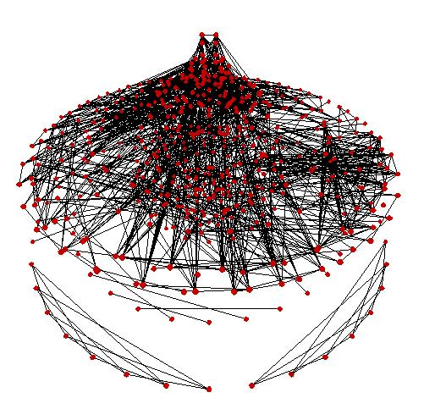
Logistics.b.cnf after setting 5 backdoor vars.

Slide 39
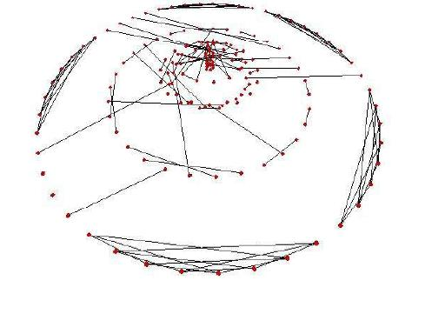
After setting just 12 (out of 800+) backdoor vars – problem almost solved.

Slide 40
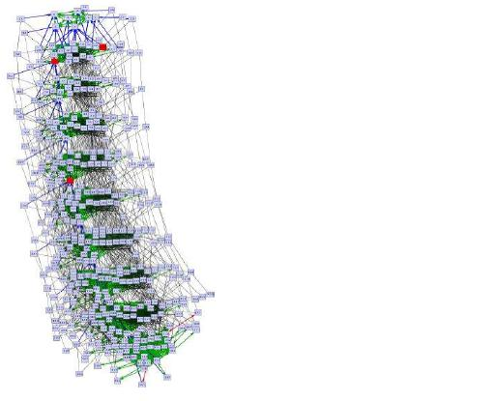
Another example
MAP-6-7.cnf infeasible planning instances. Strong backdoor of size 3.
392 vars, 2,578 clauses.

Slide 41

After setting 2 (out of 392) backdoor vars. ---
reducing problem complexity in just a few steps!

Slide 42
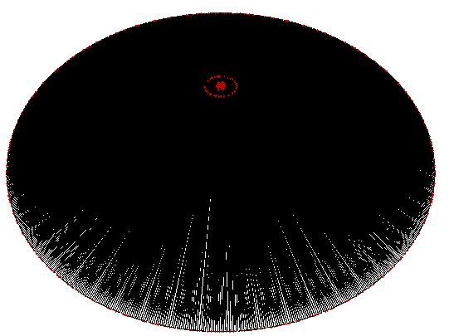
Last example.
Inductive inference problem --- ii16a1.cnf. 1650 vars, 19,368 clauses.
Backdoor size 40.

Slide 43
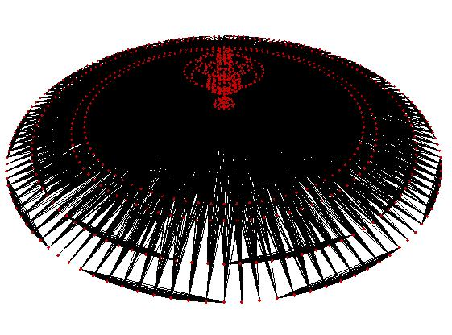
After setting 6 backdoor vars.

Slide 44
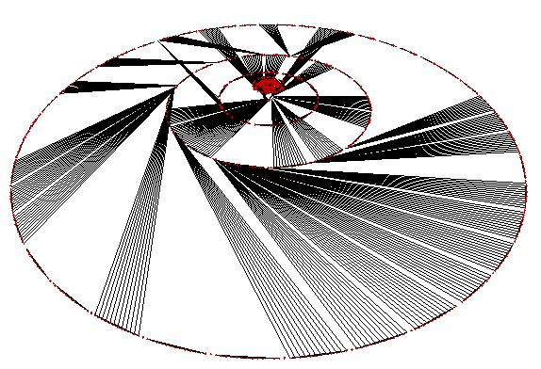
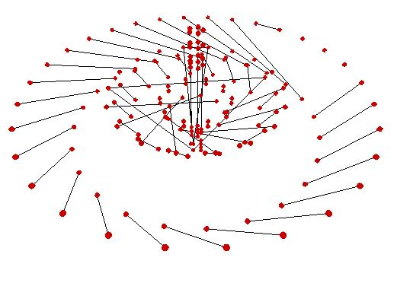
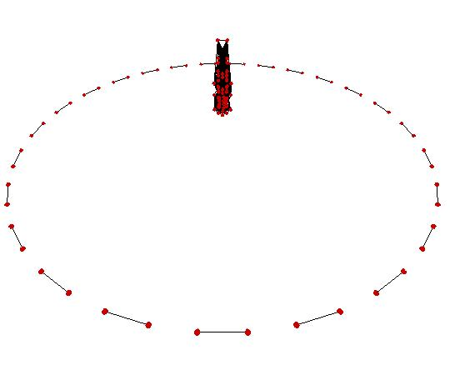
Some other intermediate stages:
After setting 38 (out of 1600+) backdoor vars:
So: Real-world structure
hidden in the network.
Can be exploited by
automated reasoning
engines.

