Slide 1
Knowledge, Representation, and Reasoning
CSC 244/444: Logical Foundations of Artificial Intelligence
Henry Kautz

Slide 2
Questions
What is Knowledge?
What is Representation?
What is Reasoning?

Slide 3
What is Knowledge?
A relationship between a knower and a proposition.
  John knows it is raining.
  John hopes it is raining.
  John thinks it may be raining.
Belief: a judgment by an agent about the state of the world.
  John believes it is raining
Knowledge -> True Belief
  John knows it is raining.
  John believes it is raining, and it is in fact raining.

Slide 4
Knowledge = True Belief ?
Are there cases where a person has a true belief, but we would not ordinarily say they have knowledge?
Are there cases where a person has a justified true belief, but we would not ordinarily say they have knowledge?

Slide 5
What is a Representation?
A relationship between two domains, where the first is meant to stand for the second
Representor domain is more concrete and accessible than the represented domain
  numerals: numbers
  names: objects
  sentences: propositions
The mapping from the representor to the represented is the semantics of the representation

Slide 6
Kinds of Representations
Images
Sentences

Slide 7
Kinds of Representations
Images
  Analog
  Concrete
  2 or 3 dimensional
Sentences
  Discrete
  Abstract
  Linear (surface level)

Slide 8
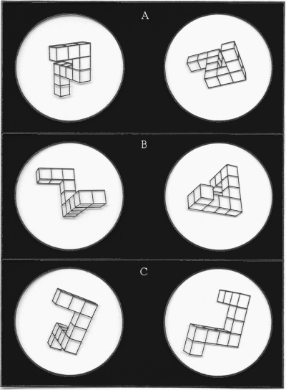
Mental Rotation
Shepard & Metzlar (1971)
Kosslyn (1994)

Slide 9
Representation Languages
Natural language as a representation language
Pro:

Slide 10
Representation Languages
Natural language as a representation language
Pro:
  Expressive
  Well known

Slide 11
Representation Languages
Natural language as a representation language
Con:

Slide 12
Representation Languages
Natural language as a representation language
Con:
  Syntactic ambiguity
  "I saw the man on the hill with the telescope"

Slide 13
Representation Languages
Natural language as a representation language
Con:
  Syntactic ambiguity
  "I saw [the man on the hill] with the telescope"

Slide 14
Representation Languages
Natural language as a representation language
Con:
  Syntactic ambiguity
  "I saw [the man on the hill] with the telescope"
  Context dependent
  "John met Sam. He gave him a shove."

Slide 15
Representation Languages
Natural language as a representation language
Con:
  Syntactic ambiguity
  "I saw [the man on the hill] with the telescope"
  Context dependent
  "John met Sam. He_{John} gave him_{Sam} a shove."

Slide 16
Representation Languages
Natural language as a representation language
Con:
  Syntactic ambiguity
  "I saw [the man on the hill] with the telescope"
  Context dependent
  "John met Sam. He_{John} gave him_{Sam} a shove."
  (Apparently) non-compositional
  "John kissed Mary." vs "John kissed [all the girls]."

Slide 17
Hard Example
Every man who owns a donkey beats it.
[Every man who owns a donkey] beats [it].
[Every man who owns a donkey] beats [a donkey].
[Every man who owns a donkey] beats [the donkey that he owns].
[Every man who owns a donkey] beats [the donkey that [every man who owns a donkey] owns].

Slide 18
What is Reasoning?
Making implicit knowledge explicit.
B&L: The formal manipulation of the symbols representing a collection of believed propositions in order to produce representations of new ones.
What kinds of manipulations are justified?
Ones that respect the meanings of the symbols.

Slide 19
Logical Entailment
A set of sentences S logically entails a proposition p when the truth of p is implicit in the sentences of S
If the world is such that S is true (each proposition in S is true), then it must be case that p is also true.

Slide 20
Other Forms of Reasoning
Abduction
Probabilistic
Default
Analogical

Slide 21
Knowledge-Based Systems
Why might be it be desirable to explicitly represent knowledge in a program?
Can reuse knowledge to solve different tasks.
Can extend existing behavior by adding new knowledge.
Can debug faulty behavior by locating erroneous beliefs.
Can explain and justify behavior of the system

Slide 22
Cognitive Penetrability
To what extent are humans knowledge-based systems?
Cognitive penetrability: ability of our actions to depend on our explicit beliefs
Are dogs knowledge-based?
Is USAir's flight reservation system?
Is an amoeba?

Slide 23
Intention vs. Intension
Intention: one's determination to act in a specific way for a specific purpose
Intension: the set of properties expressed by a given word or symbol
  "I want to meet the instructor for CS 244"

Slide 24
The Language of First-Order Logic
Read Brachman & Levesque, Chapter 2
Due 10:00pm Monday Sept 13:
  What is the difference between a "logical symbol" and a "non-logical symbol"?
  What is an "interpretation" of logic?
  What does it mean for a FOL sentence A to be a logical consequence of another sentence B?
  Write two specific sentences such that one is a logical consequence of the other, and explain in detail (using the definition of logical consequence) why that is the case.
Due 10:00pm Wed Sept 15:
  Describe the relationship between logical consequence, unsatisfiability, and validity.
  What is the relationship between the entailment symbol "|=" and the logical connective "=>"?
Note: Class will be held Tuesday Sept 21

