Slide 1
Expressing Knowledge
CSC 244/444: Logical Foundations of Artificial Intelligence
Henry Kautz

Slide 2
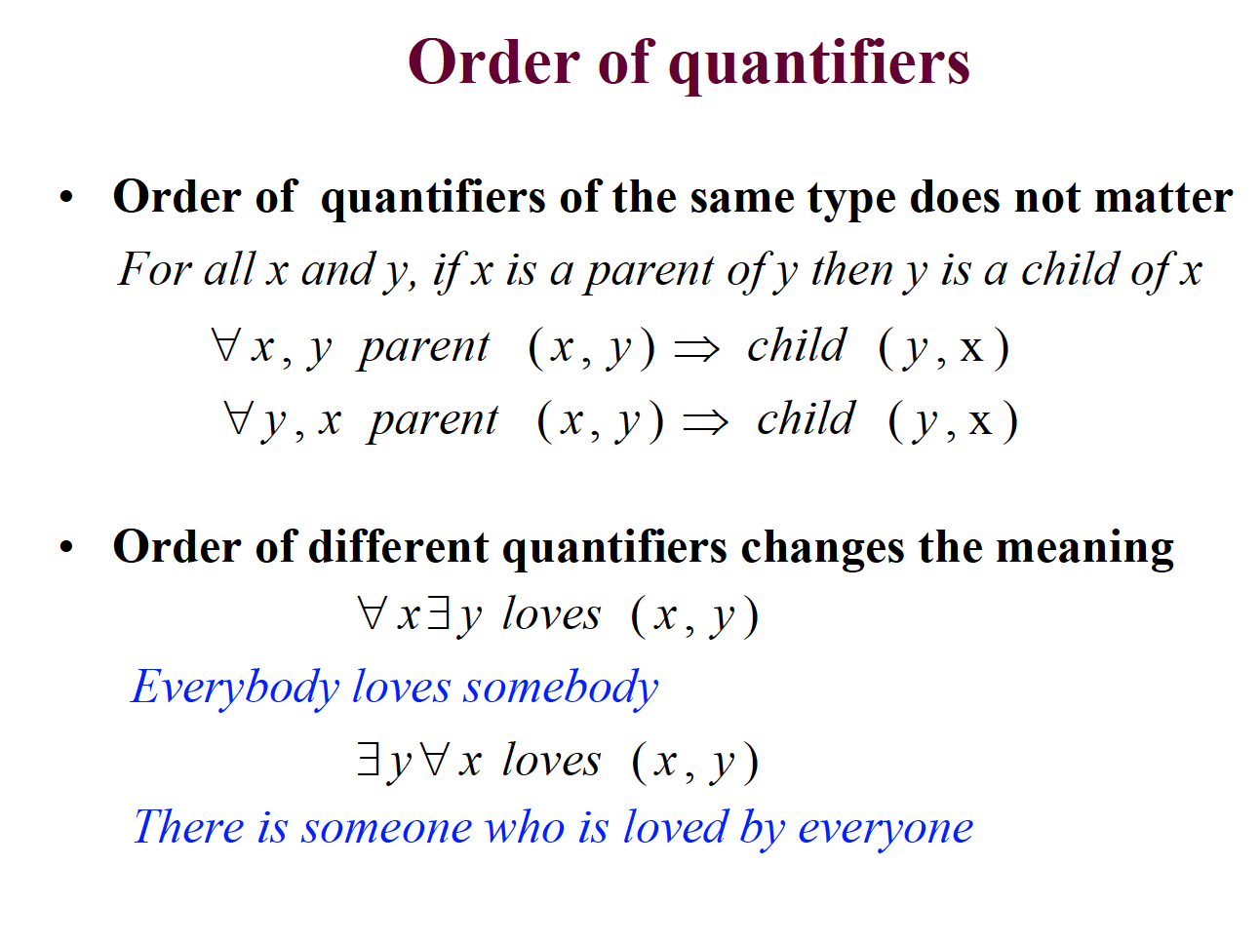

Slide 3
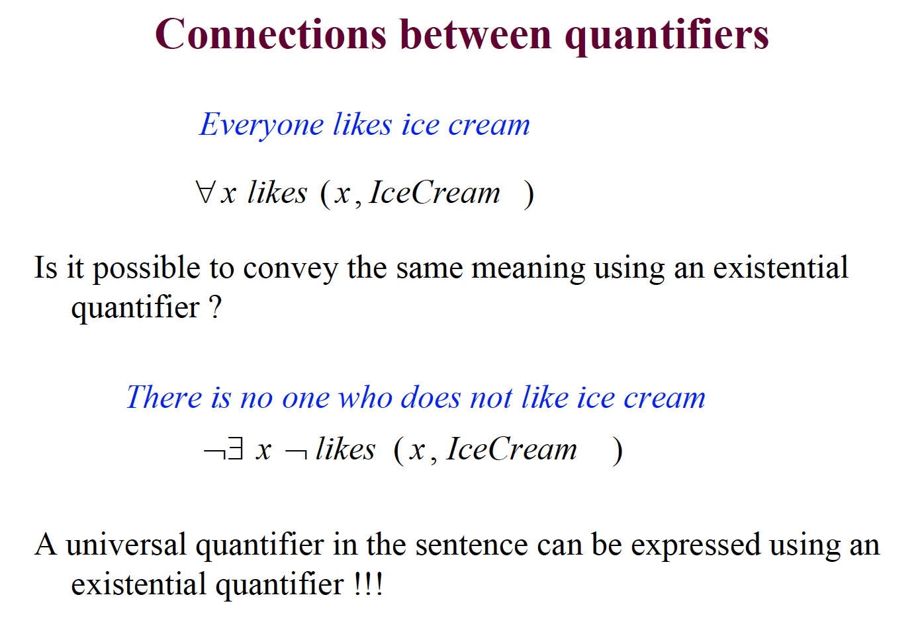

Slide 4
Are These Equivalent?

Slide 5
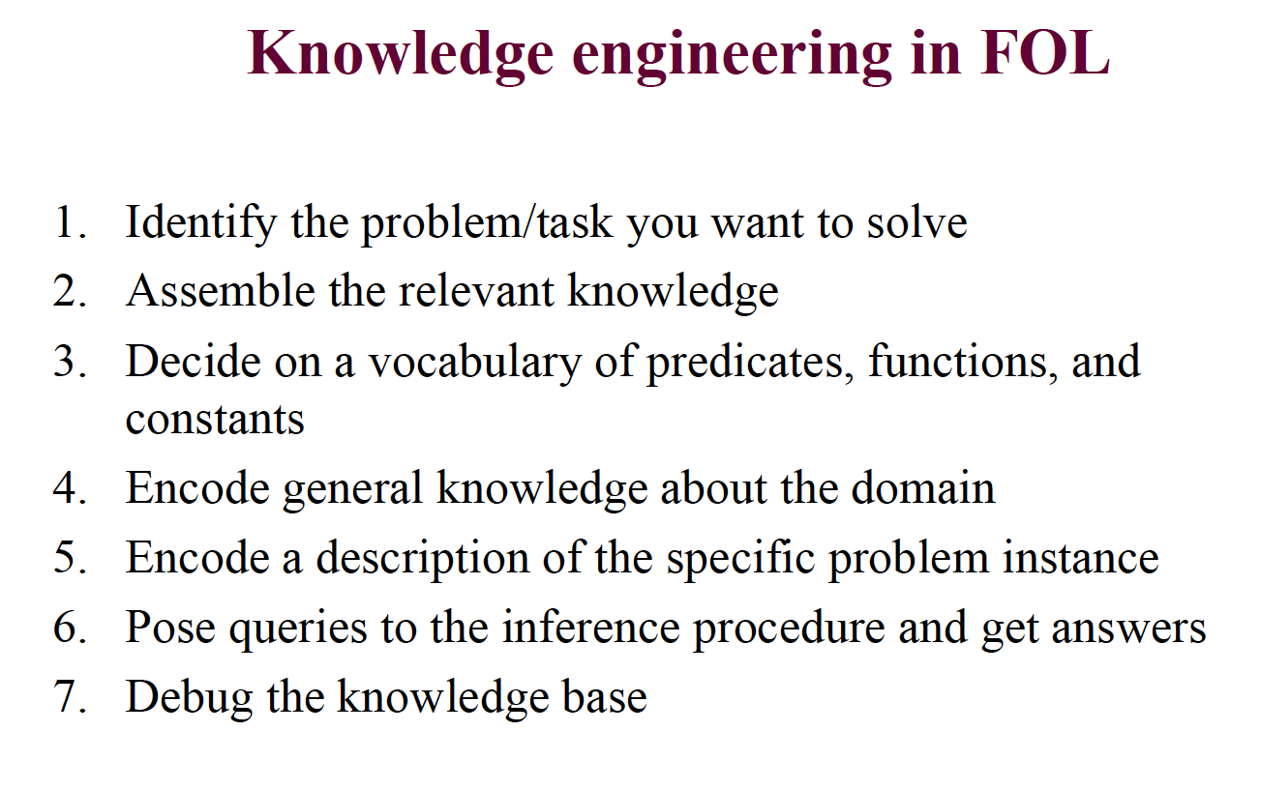

Slide 6
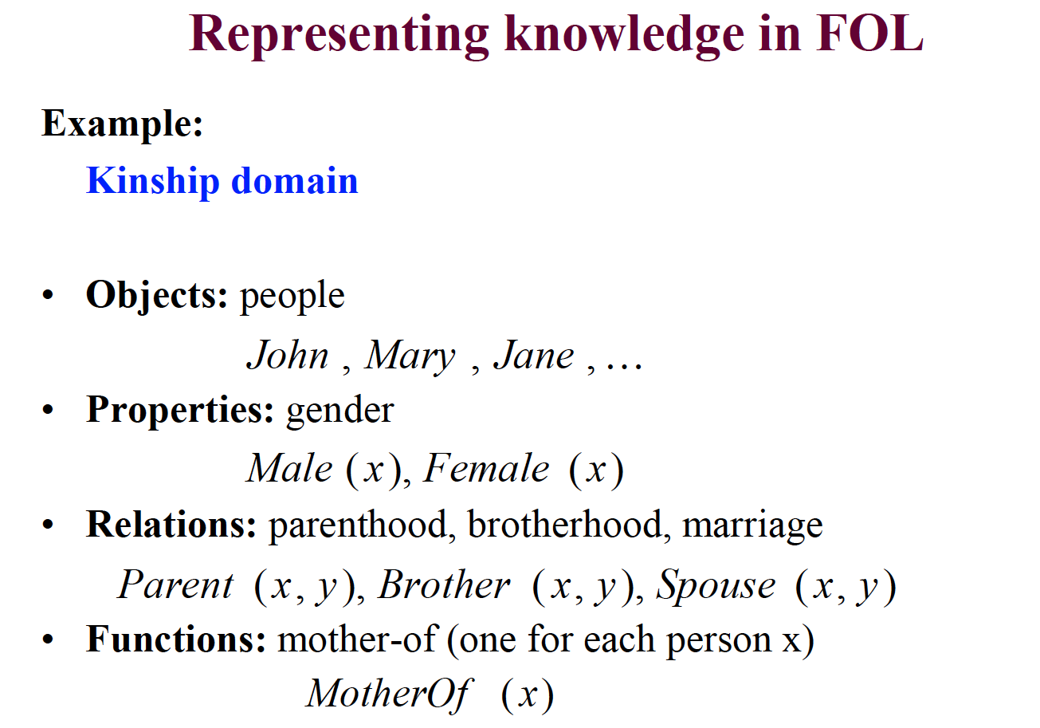

Slide 7
Exercise
In groups of 3, axiomatize the kinship domain that would allow you to infer FirstCousinOnceRemoved relationships starting with Spouse and Child.
  Cousin (a.k.a "first cousin") Your first cousins are the people in your family who have two of the same grandparents as you. In other words, they are the children of your aunts and uncles.
  Second Cousin Your second cousins are the people in your family who have the same great-grandparents as you., but not the same grandparents.
  Removed When the word "removed" is used to describe a relationship, it indicates that the two people are from different generations. You and your first cousins are in the same generation (two generations younger than your grandparents), so the word "removed" is not used to describe your relationship.
  The words "once removed" mean that there is a difference of one generation. For example, your mother's first cousin is your first cousin, once removed. This is because your mother's first cousin is one generation younger than your grandparents and you are two generations younger than your grandparents. This one-generation difference equals "once removed."

Slide 8
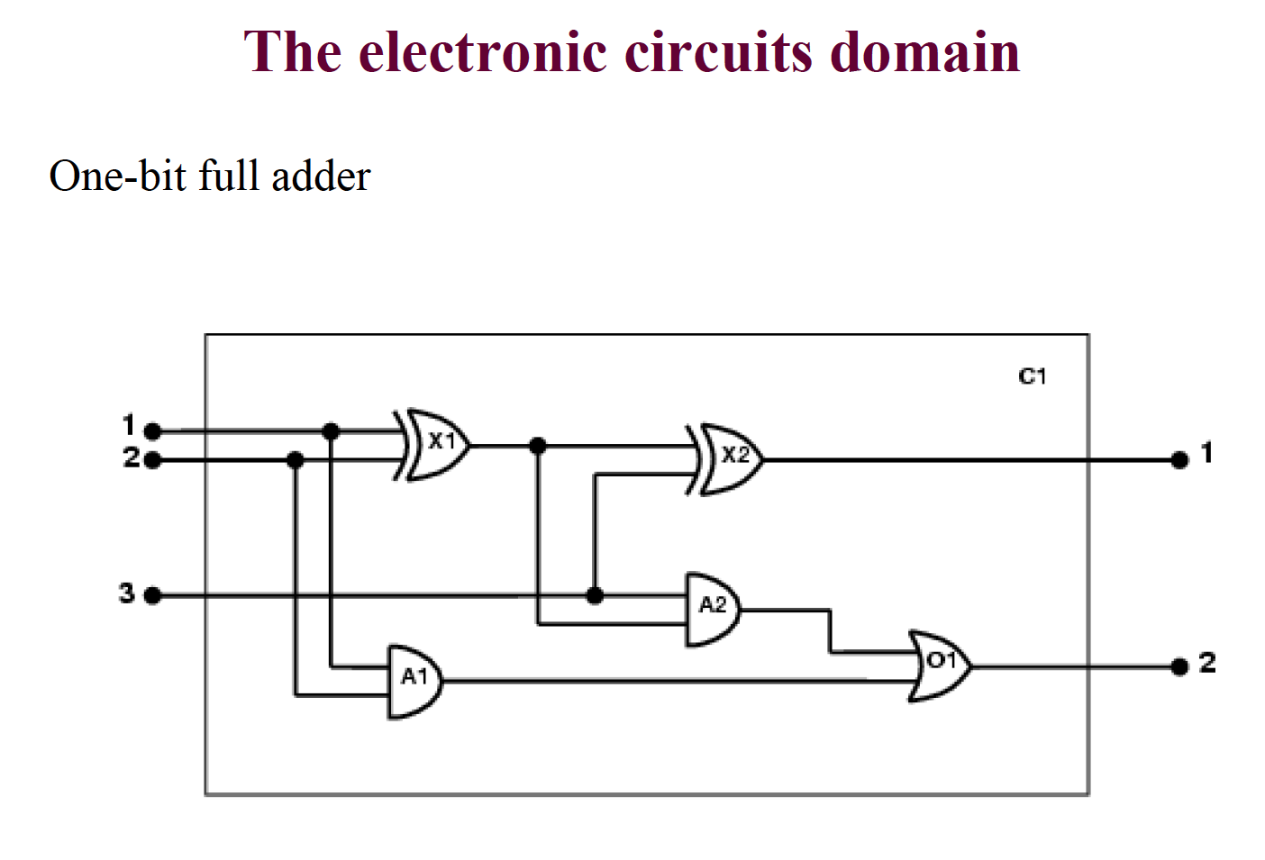

Slide 9
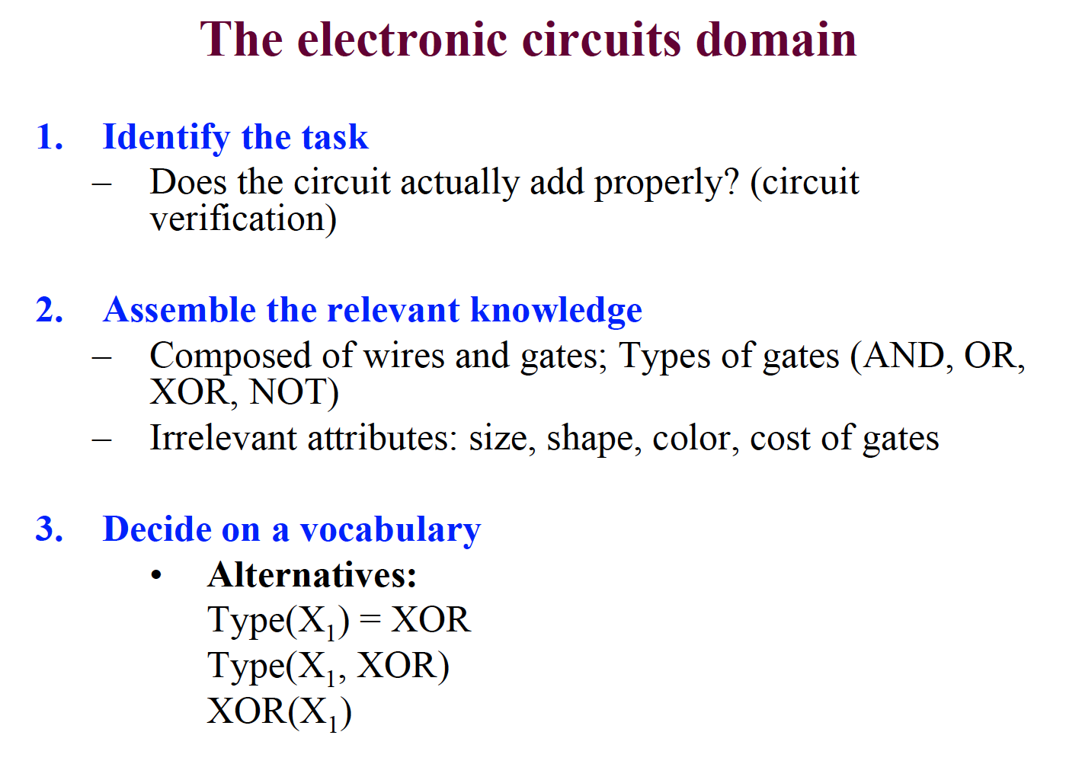

Slide 10
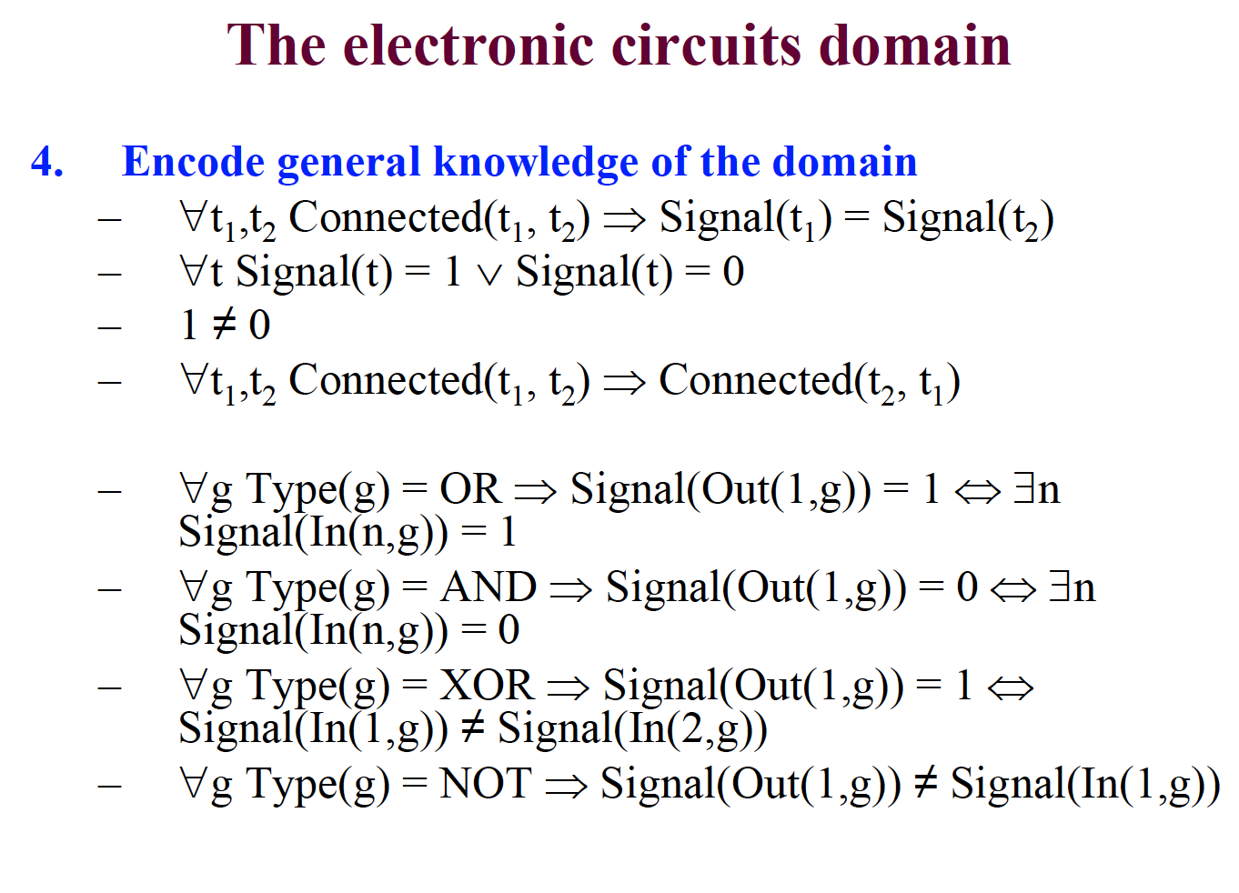

Slide 11
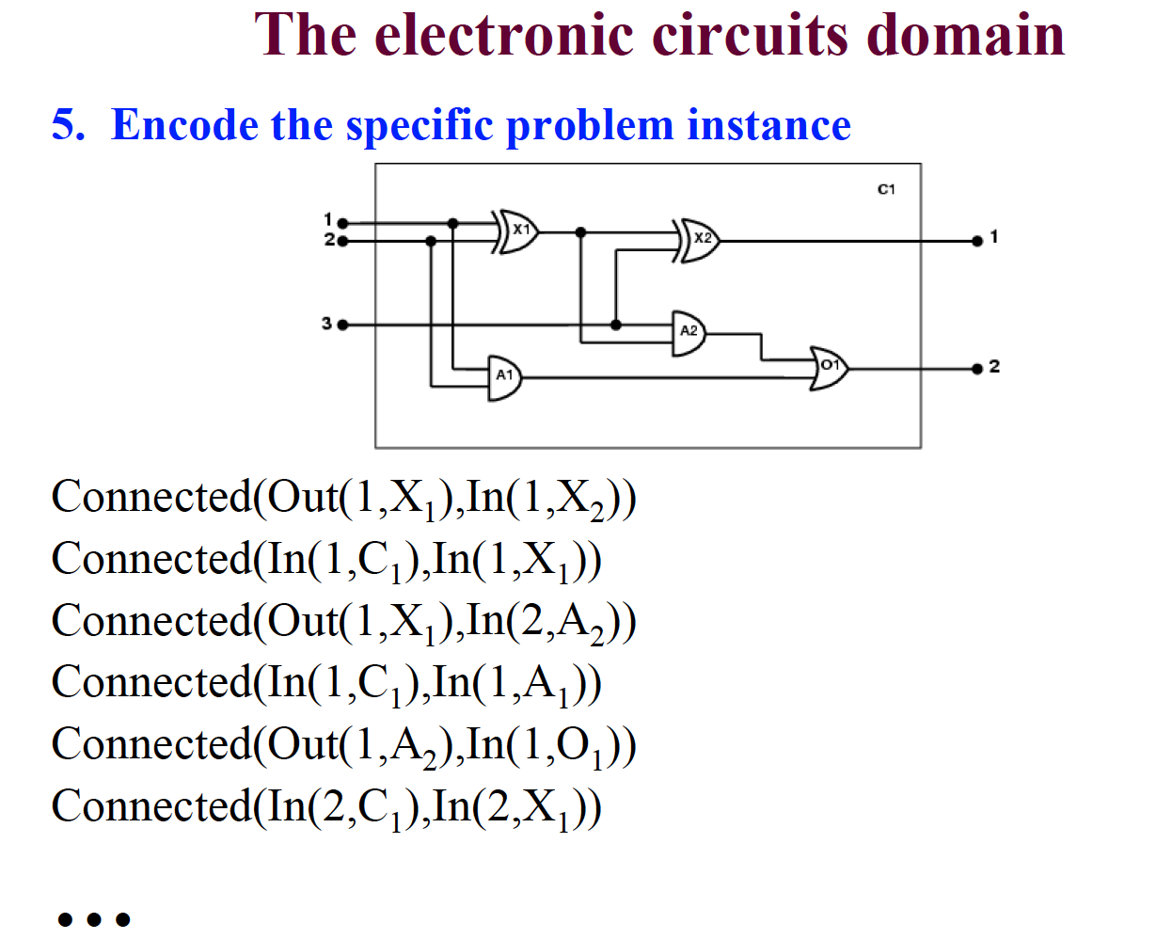

Slide 12
Queries

Slide 13
A different approach: Suppose we represented only the wires explicitly?

Slide 14
Representational Issues
Abstract individuals
Ontologies and inheritance of properites
Open versus closed worlds
The problem of transitive closure
Are functions necessary?
Conversion to CNF

