Slide 1
“Using Weighted MAX-SAT Engines to Solve MPE”
-- by James D. Park
Shuo (Olivia) Yang

Slide 2
MPE and MAX-SAT
MPE (Most Probable Explanation)
  The problem of finding the variable instantiation of a Bayesian network that has the highest probability given some evidence.
  NP-complete problem
Weighted MAX-SAT
  The problem of taking a set of clauses with associated weight, and finding the instantiation that produces the largest sum of the weights of satisfied clauses.
  Resolve conflicts in a knowledge base.

Slide 3
Using Weighted MAX-SAT to solve MPE
Reduce MPE to weighted MAX-SAT
Apply incomplete methods for MAX-SAT to produce solution (Local search algorithms)
  Discrete Lagrangian Multiplier
  Guided Local Search
MAX-SAT algorithms proved to me more powerful in solving large problems.

Slide 4
MPE and MAX-SAT
Instantiation
  An instantiation of a set of variable s is a function that assigns a value to each variable in the set.
Compatible
  Two instantiation are compatible if they agree on the assignment of all the variables that they have in common.
Eg:
  A={a1,a2,a3}, B={b1,b2}
  Instantiation {a1} is compatible with instantiations (a1,b2),(a1,b1),(b1),(b2), but not with (a2,b1) and (a2,b2)

Slide 5
MPE and MAX-SAT
Conditional probability table (CPT)
  A conditional probability table T for a variable V with a set of parent variables P is a function that maps each instantiation of V U P to real value in [0,1] such that for any instantiation p of P, ∑_{v} T({v}Up) = 1 where v ranges over the values of V.
Eg: the CPT for Bayesian network A->B is
A | B | Pr(B|A)
a1 | b1 | 0.2
a1 | b2 | 0.8
a2 | b1 | 1
a2 | b2 | 0
a3 | b1 | 0.6
a3 | b2 | 0.4
A | Pr(A)
a1 | 0.3
a2 | 0.5
a3 | 0.2

Slide 6
MPE and MAX-SAT
Bayesian network
  A pair (G,P), where G is a directed acyclic graph whose nodes are variables, and P is a set which consists of the CPT of each variable in G, where the parents of each CPT correspond to the parents of the corresponding variable in the graph.
  The probability of a complete instantiation is the product of the entry of each CPT that is compatible with the instantiation.
  Eg:
    The probability of the instantiation (a3, b1) in the given example is Pr(a3)*Pr(a3|b1) = 0.2*0.6 = 0.12

Slide 7
MPE and MAX-SAT
Literal
  a variable or its negation
Clause
  Disjunction of literals and a weighted clauses
Weighted CNF formula
  A set of weighted clauses
  the weight of a completed instantiation of a weighted CNF formula is the sum of the weight of the satisfied clauses.
  Eg:
  Given weighted CNF : (x v ~y v ~z)³ ^ (~x)^{10.1} ^ (y) ^{0.5}
  The instantiation (x, y, ~z) has weight: 3+0.5 = 3.5

Slide 8
MPE
Given a Bayesian Network and an instantiation of a subset of the variables (the evidence), find the (not necessarily unique) complete instantiation with the highest probability that is compatible with the evidence.

Slide 9
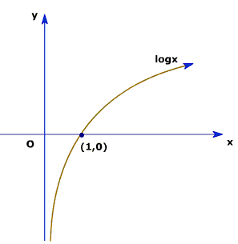
Reduce MPE to MAX-SAT
Weight clauses
  The only instantiations that do not satisfy the clauses l1 v l2 v … v ln are the instantiations in which each literal in the clause evaluates to false.
  Each row in the CPT generates a weighted clauses which contains the negation of each variables in the row and is weighted with the negative log of the conditional probability.

Slide 10
Reduce MPE to MAX-SAT
Theorem 1
  for any instantiation I of a positive Bayesian Network which contains only binary variables, the sum of the weights of the clauses that I leaves unsatisfied in the induced weighted CNF entry is compatible with instantiation.
Maximizing the weight of the SAT clauses, minimizes the sum of the UNSAT clauses which is equivalent to maximizing the probability in the original network.
Notes:
UNSAT clauses are those in which every literal evaluates to FALSE.
A clauses is not satisfied iff the corresponding CPT entry is compatible with the instantiation
The sum of the weights of unsatisfied clauses is the sum of the negative logs of the compatible CPT entries.
Since the probability of a complete instantiation I is the product of the CPT entries compatible with I,
The sum of the weights of the unsatisfied clauses is –logPr(I)

Slide 11
Reduce MPE to MAX-SAT
Weight clauses (eg.)
  Given network C->D with CPT:
  Induces the weighted CNF expression
  (~c)^{-log.3} ^ (c)^{-log.7} ^ (~c v ~d)^{-log.2} ^ (~c v d)^{-log.8} ^ (c v ~d)^{-log.1} ^ (c v d)^{-log.9}
  Given instantiation c, ~d.
  Unsatisfied clauses: (~c)^{-log.3} and (~c v d)^{-log.8}
  Sum of weights of unsatisfied clauses is –log.24
  = negative log of the probability of (c, ~d)
C | D | Pr(D|C)
c | d | 0.2
c | ~d | 0.8
~c | d | 0.1
~c | ~d | 0.9
C | Pr(C)
c | 0.3
~c | 0.7

Slide 12
Reduce MPE to MAX-SAT
Handling Zero
  Log of zero is undefined
  Weight –log0 with a sufficiently large value w₀
  Theorem 2
    Let w₀ be a greater than the sum of the negative logs of the non-zero CPT entries of a Bayesian network with binary variables. Let the weight of the clauses whose associated CPT entries are zero have weight w₀ , with the other weights as before. Then, any positive probability instantiation I have a higher score for the weighted CNF expression than any zero probability instantiation. Additionally, the sum of the weights of the unsatisfied clauses for I remains –logPr(I)

Slide 13
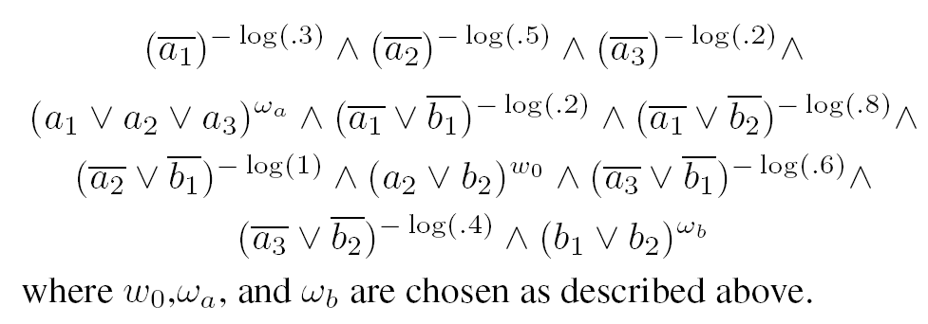
Reduce MPE to MAX-SAT
Beyond binary variables
  Any locally maximal instantiation of the induced weighted CNF expression satisfies the constraint that exactly one of the indicator variables is true for each variable. Additionally, the weight of the unsatisfied clauses for positive probability instantiation I remains –logPr(I).
  Eg:
Notes:
Exactly one: a1 means, a1 is true, and a2 = a3 = false

Slide 14
Reduce MPE to MAX-SAT
Entering evidence
  Replacing the propositional variables that correspond to the evidence to their appropriate values
  Dropping any clause that contains true, and removing false from all clauses.
  Eg:
    Entering evidence (a1), then a1=true, a2 = a3 = false
    The weighted CNF formula
    ()^{-log.3} ^ (~b1)^{-log.2} ^ (~b2)^{-log.8}
Notes:
Any clause that would not be satisfied by an instantiation compatible with the evidence would still not be satisfied for a compatible instantiation over the new problem.
The sum of the unsatisfied clauses remains the same.

Slide 15
MAX-SAT Algorithms
Local search
  general optimization technique
Hill climbing
  works by repeatedly improving the current solution by moving the a better neighboring solution.
Neighbors of an instantiation
  Those instantiations produced by changing which indicator corresponding to a particular network variable is set
Eg:
  The neighbors of (a1, ~a2, ~a3,b1, ~b2) are
  (a1,~a2,~a3, ~b1,b2), (~a1, a2, ~a3, b1,~b2),
  and (~a1, ~a2, a3, b1, ~b2)

Slide 16
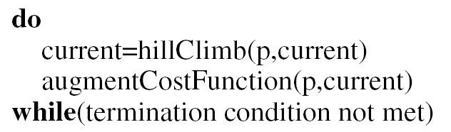
MAX-SAT Algorithms
p: problem instance,
hillClimb: routine iterates through the variables, selecting the best change for each until a local minimum is reached
Also compute the true score at each step and remembers the best state encountered
The MAX-SAT algorithm is considered differ only in the way in which they generate the objective functions.

Slide 17
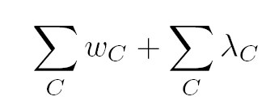


MAX-SAT Algorithms
Discrete Lagrangian Multipliers
  Cost function:
    C ranges over the unsatisfied clauses.
    Initially, each is zero, each time a local minimum is encountered the corresponding to the unsatisfied clauses are increased by adding a constant.

Slide 18

MAX-SAT Algorithms
Guided Local Search
  Heuristically developed method for solving combinatorial optimization problems.
  Initial coast function: number of un satisfied clauses
  Objective function , where C ranges over the unsatisfied clauses
  When a local minimum is reached the weights of some of the unsatisfied clauses are increases.
  GLS provided the best overall performance in the experimental test comparing with SLS and DLM.

