Slide 1

Evolutionary Code
Generation
AlphaEvolve · AVO · EvoSkill
AI Agents Course · 20-Minute Lecture

Slide 2





Learning Goals
Describe the evolutionary search loop and the role of the variation operator
Explain AlphaEvolve's architecture, achievements, and key limitation
Articulate the design shift AVO makes — agent as variation operator
Understand how EvoSkill evolves skills rather than code
Connect all three systems back to the ReAct loop you already know

Slide 3
1
Background: Evolutionary Search
Where the idea comes from — and why LLMs change it

Slide 4


The Evolutionary Search Loop
Population
P_t
▶
Vary
P_t → x_{t+1}
▶
Evaluate
f(x_{t+1})
▶
Select
& Update
Scored candidates
Mutation / crossover
Automated scorer
Keep the best
↺ Loop repeats: each iteration t → t+1 until budget exhausted or convergence
The variation operator is everything.
Classical EA: hand-coded bit flips, crossover, grammar rules FunSearch (2023): LLM generates a new Python function — one shot per step AlphaEvolve (2025): LLM generates diffs over entire codebases — still one shot per step AVO (2026): Full agent loop replaces the entire Vary step

Slide 5
2
AlphaEvolve
Google DeepMind, 2025 · arXiv:2506.13131

Slide 6
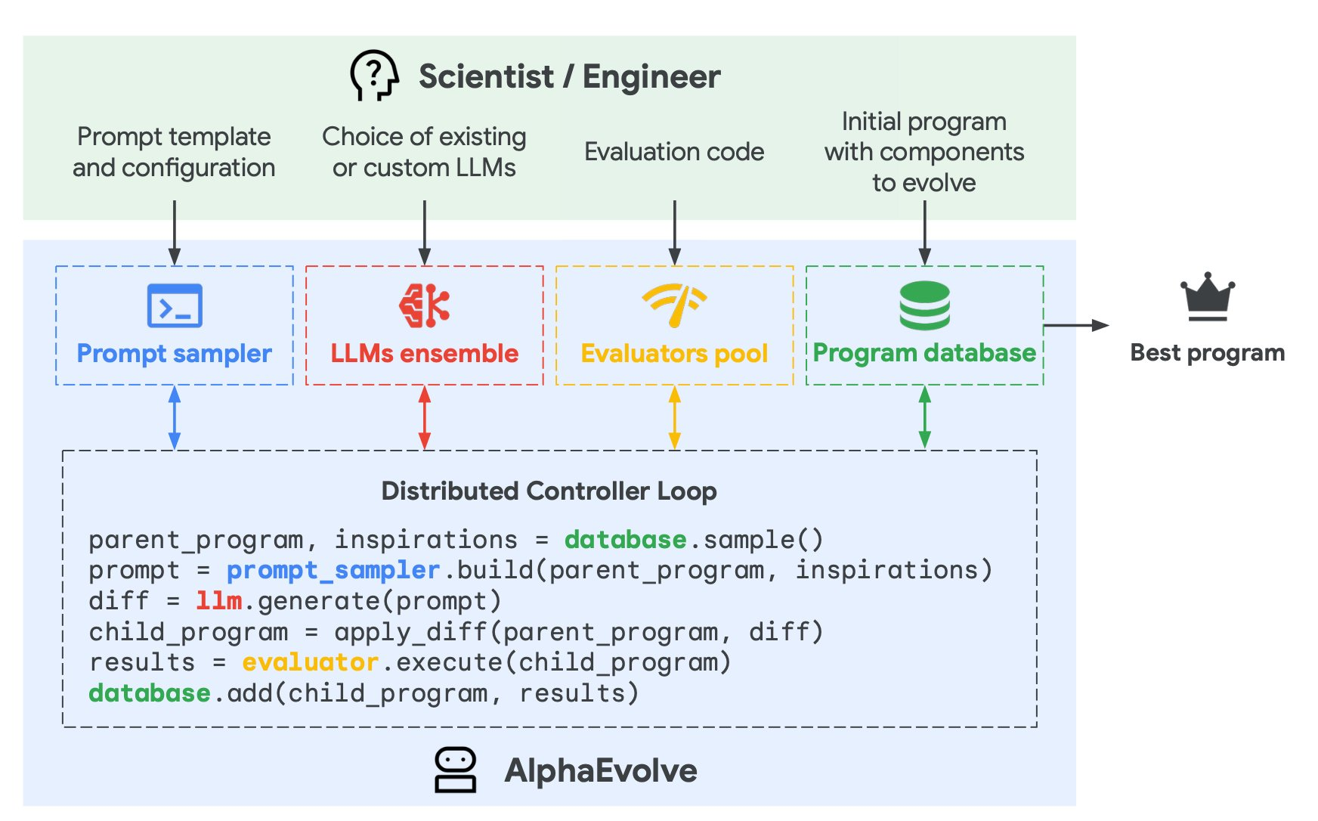
AlphaEvolve: Architecture
Program database
MAP-Elites style archive; tracks all solutions + scores; maintains diversity
Prompt sampler
Selects parent + inspiration programs; builds rich context for LLM
LLMs ensemble
Gemini Flash (volume) + Pro (quality); outputs SEARCH/REPLACE diffs
Evaluators pool
Runs code automatically; handles hours-long evals on GPU/TPU

Slide 7
The AlphaEvolve Controller Loop
# Distributed Controller Loop — runs asynchronously at scale
parent_program, inspirations = database.sample()
prompt = prompt_sampler.build(parent_program, inspirations)
diff = llm.generate(prompt)
child_program = apply_diff(parent_program, diff)
results = evaluator.execute(child_program)
database.add(child_program, results)
Sample
Generate
Evaluate
MAP-Elites selects parents weighted by score + diversity
LLM outputs SEARCH/REPLACE diffs — targeted, not full rewrites
Runs automatically — can take hours on GPU/TPU clusters

Slide 8
AlphaEvolve vs. FunSearch
Dimension
FunSearch (2023)
AlphaEvolve (2025)
Evolves
Single function
Entire codebase
Code volume
10–20 lines
Hundreds of lines
Language
Python only
Any language
Evaluation time
≤ 20 min on 1 CPU
Hours on GPU/TPU
LLM
Small, code-only
Frontier (Gemini 2.0)
Context
Prior solutions only
Solutions + problem desc + eval feedback
Optimization target
Single metric
Multiple simultaneous metrics

Slide 9



What AlphaEvolve Achieved
Matrix Multiplication
Gemini Kernel Engineering
48
First improvement over Strassen's 1969 algorithm in 56 years — for 4×4 complex matrices. SOTA improved for 14 matrix sizes total.
23%
Tiling heuristic for a key matmul kernel → 1% reduction in Gemini training time. Optimization time: months → days.
vs. Strassen's 49
kernel speedup
Data Center Scheduling
FlashAttention Optimization
0.7%
Deployed to production in Borg. Chosen over deep RL for interpretability. Recovers stranded resources continuously.
32%
Applied to XLA compiler-generated IR — not intended for human editing. Also sped up pre/postprocessing by 15%.
fleet compute recovered
kernel speedup

Slide 10

AlphaEvolve's Core Limitation
Despite the results — the LLM is still confined:
Vary(P_t) = Generate(Sample(P_t))
What the LLM does
What the LLM cannot do
Sees the prompt once
Generates a diff (SEARCH/REPLACE)
Returns the diff
Done.
Test its edit before committing
Run the profiler & diagnose a bottleneck
Consult documentation mid-generation
Try multiple hypotheses and compare
Iterate on a failure
For near-limit optimization of hand-tuned GPU kernels, single-shot generation is the bottleneck. This is exactly what AVO fixes.

Slide 11
3
AVO: Agentic Variation Operators
NVIDIA, March 2026 · arXiv:2603.24517

Slide 12
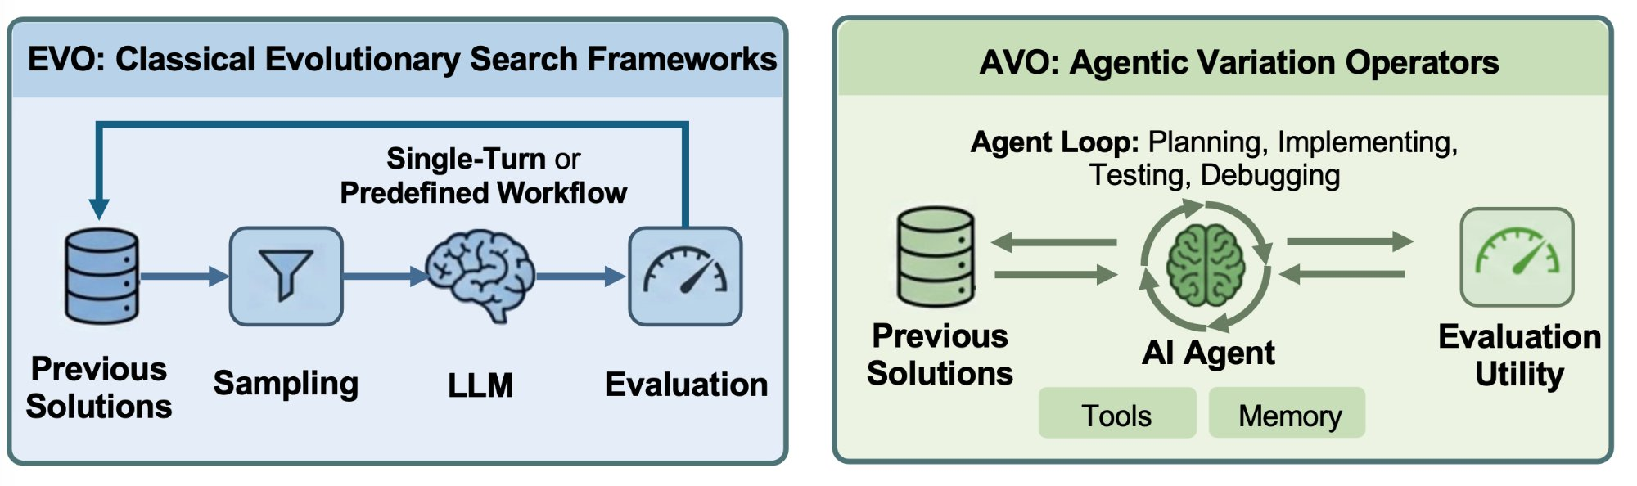
AVO: The Agent as Variation Operator
AlphaEvolve / FunSearch:
AVO:
Vary(P_t) = Generate(Sample(P_t))
Vary(P_t) = Agent(P_t, K, f)
LLM = single-shot candidate generator
Agent = full autonomous loop per variation step

Slide 13

What the AVO Agent Can Do
Within a single variation step, the agent has:
Full lineage P_t
Knowledge base K
Evaluation function f
Iterative repair
Persistent memory
Compare all 40 prior kernel versions, study what worked and what didn't
CUDA guides, PTX ISA docs, Blackwell architecture specs, FA4 source code
Run the benchmark multiple times — compile, execute, profile, measure TFLOPS
Diagnose correctness failures, revise strategy, try again before committing
Accumulate profiling results, compiler outputs, and reasoning across iterations

Slide 14
AVO Results on NVIDIA Blackwell B200
500+
40
+10.5%
+3.5%
30 min
optimization
directions explored
kernel versions
committed
over FlashAttention-4
(causal MHA)
over cuDNN
(causal MHA)
to adapt MHA
→ GQA
Three representative agent-discovered optimizations:
Branchless Accumulator Rescaling (v19→v20)
+8.1% non-causal
Replaced a conditional branch in the online softmax with a branchless speculative path. Eliminated warp divergence → enabled lighter non-blocking memory fence.
Correction/MMA Pipeline Overlap (v29→v30)
+1.1% non-causal
Correction warp sat idle during second PV GEMM. Agent restructured pipeline so correction of stage 1 overlaps with stage 2 GEMM.
Register Rebalancing Across Warp Groups (v32→v33)
+2.1% non-causal
Correction warp spilled to local memory (80-register budget). Agent redistributed 8 registers from softmax group → 184/88/56 allocation.

Slide 15
4
EvoSkill
Alzubi et al. · Virginia Tech / Sentient · arXiv:2603.02766

Slide 16


EvoSkill: Evolve Skills, Not Code
Three collaborating agents:
Executor
Runs tasks with current skill set
Proposer
Analyzes failures → proposes new skill or edit
Skill Builder
Materializes proposal into SKILL.md + helper scripts
Results
OfficeQA +7.3% 60.6% → 67.9% exact match · ~12–24 training examples
SealQA +12.1% 26.6% → 38.7% · noisy web retrieval
BrowseComp +5.3% Zero-shot transfer — skill evolved on SealQA, no modification

Slide 17
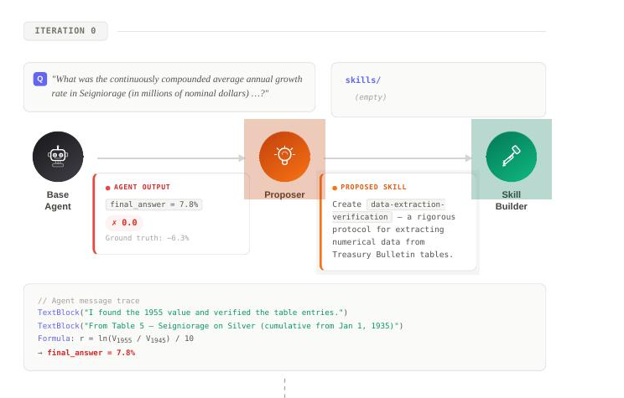

Slide 18
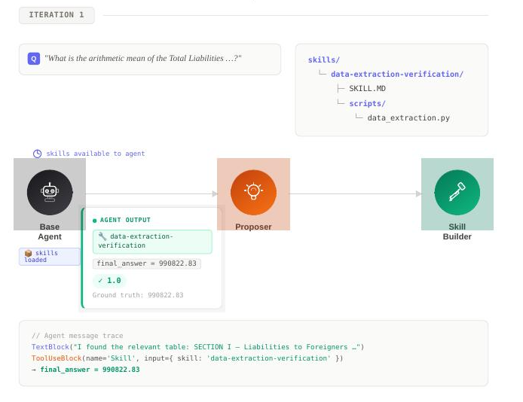

Slide 19

The Arc: How the Variation Operator Evolved
AlphaEvolve
AVO
EvoSkill
▶
▶
2025
2026
2026
Vary:
Vary:
Vary:
Generate(Sample(P_t))
Agent(P_t, K, f)
Agent(skills, failures)
LLM generates a diff in one shot — no iteration
Full agent loop — plan, implement, test, debug, commit
Same agent loop, but evolving skills — not code artifacts
Unifying insight: the more autonomy you give the variation operator, the deeper the optimizations it can discover — at the cost of more compute per step.

