Slide 1
Topic 3: Exploring Tools
Workshop on Building AI Agents
Henry Kautz
Spring 2026

Slide 2
Show Off Your Topic 3 Tools & Queries!
https://virginia.zoom.us/j/94558247994
Passcode 152379
Note: this is not a remote class, only for sharing desktops for a few minutes
Notes:
Ask for volunteers. If no one volunteers, then just pick some people at random! Have at least 3 people show off their work from last week. If there are more volunteers, then let them all have a turn.

Slide 3
Levels of Abstraction
Running an open LLM using Hugging Face API
Low level access to gransformer and tokenizer
Running an open LLM using Ollama
Models are quantized and optimized for running on your own server
Running an LLM in LangGraph using the OpenAI API
Can run OpenAI models as well as most Ollama models
Handles tool schemas
LangGraph @tool, llm.bind_tools, llm.invoke
Creates the tool schemas from the @tool definitions
Better decoding of response – Python data structures rather than JSON
LangGraph ToolNode
Handles tool dispatch loop
Supports parallel tool calls
LangChain create_react_agent
Creates LangGraph reasoning and acting agent
Less general but requires less coding

Slide 4
Understanding ToolNode and React Agent
Find your new partner on the page linked to today's lesson - go sit together and introduce yourselves
Complete Task 3
Notes:
Work break for 20 minutes.

Slide 5
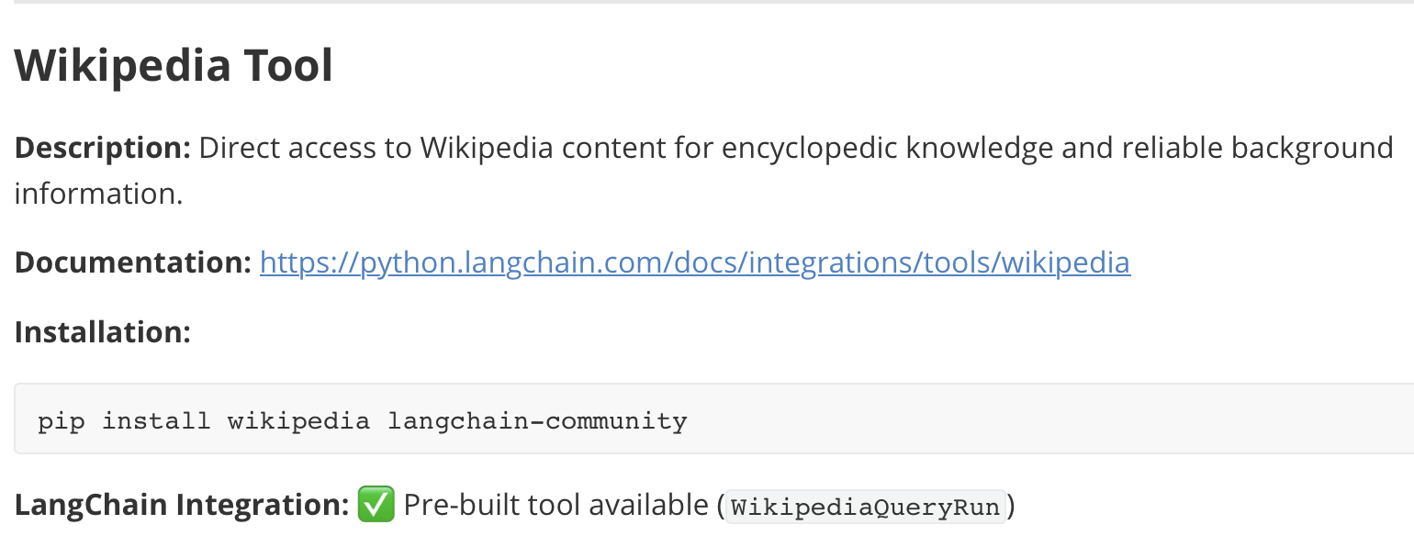
Task 4: Skim through Agent Tools Reference
Free tools that run locally
Free tools that run remotely using Oauth
Paid tools with a limited free use tier
Some tools come with LangGraph integration,
Others require you to wrap them in an @tools function
Notes:
No break yet

Slide 6
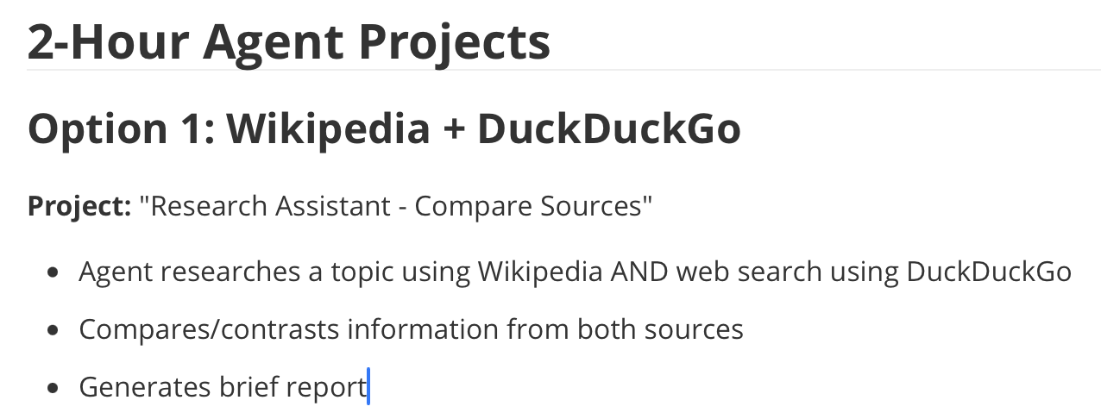
Task 5: Create a Tool-Using Agent
Tools might be called deterministically in program nodes, and/or by the response of an LLM
Choose one of the 2 Hour Agent Projects
Start simple, get it working, add features
Aim to have it working by the end of the next class!
Notes:
Work break for the test of the class period.

