Slide 1
Topic 3: RAG: Retrieval Augmented Generation
Workshop on Building AI Agents
Henry Kautz
Spring 2026

Slide 2
Calendar Adjustment
Many people have fallen behind in building their GitHub portfolios
I want everyone to be engaged in current material, and not needing to go back to finish old material
Solution:
  The week before spring break is now "catch up" week
  No class, just work on finishing up exercises and your portfolio
  Midterm one-on-one meetings with me moved to the 2 weeks after spring break, rather than starting the week before spring break

Slide 3
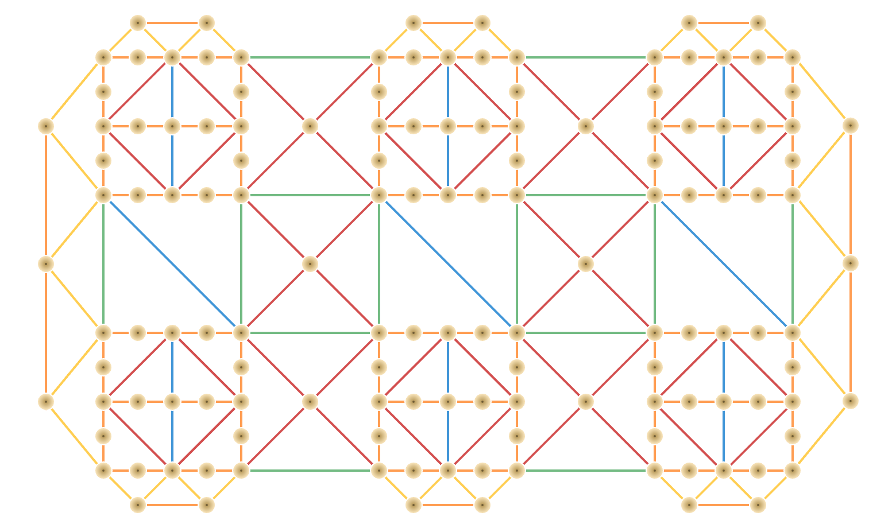
New Platform Available
We all now have free accounts on
https:// thinkingmachines.ai/tinker
Tinker is a training API for researchers
  “Control every aspect of model training and fine-tuning while we handle the infrastructure”
We will use it for model fine-tuning in a few weeks
You are welcome to use at any time
Login with your UVA email

Slide 4
LLMs for information retrieval
LLMs can answer some information needs without a document collection!
  Where is the Louvre Museum located?
  Where does the energy in a nuclear explosion come from?
  How to get a script l in latex?
Just prompt an LLM!
Notes:
IR can play an important role in LLMs! Why is that true? After all, If we want to know where the Louvre Museum is located we could just prompt an LLM!

Slide 5
Just prompt an LLM!
LLMs store facts in the connections in their feedforward layers
Notes:
LLMs seem to have learned facts like this from their pretraining data, and research suggests they store facts in the connections in their feedforward layers!

Slide 6
Problems
LLMs hallucinate, giving answers that aren't faithful to the facts of the world.
They can make up medical, legal facts
LLMs can't use proprietary data
Email, medical records, corporate docs
LLMs can't handle dynamic data
Recent news, earthquakes, sports events

Slide 7
Solution: RAG
Retrieval-Augmented Generation
Use information retrieval to retrieve documents from some collection
Then use LLM to generate an answer conditioned on the documents
Notes:
The solution to these problems with LLMs for meeting information needs is a family of algorithms called Retrieval-Augmented Generation, or RAG. In this algorithm we specify a relevant collection (like our personal emails or medical records), use IR to retrieve documents from the collection, and then use an LLM to generate an answer conditioned on the documents.

Slide 8
Basic RAG
Given a document collection and a user query
Call a retriever to return top k hits
Create a prompt that includes query and the hits
Call an LLM with the prompt
Notes:
Given a document collection D and a user query q, the most basic RAG algorithm is:

Slide 9
Retrieval Augmented Generation (RAG)
Notes:
Retrieval-augmented generation takes as input a user prompt (which may express an information need like this question example), and a corpus of documents that may be useful in meeting the information need.
The method has two stages: retrieval, which returns relevant documents from the collection, and generation, in which an LLM generates text given the documents as a prompt.
Some generations include a knowledge citation that can help the user decide whether to trust the generation, or follow up if they are interested.

Slide 10
Kinds of retrievers
Web search
  ? queries are NL-like
  - Many low-quality documents
  - ambiguous words problematic
  - coarse-grained retrieval
Internal web-like search
  + can control document quality
  ? queries are NL-like
  - ambiguous words problematic
  - coarse-grained retrieval
Ordinary databases
  + can control document quality
  - hard to map NL query to SQL
  - ambiguous words problematic
  - coarse-grained retrieval
Vector databases
  + can control document quality
  + queries are natural language
  + handles ambiguous words
  + fine-grained retrieval

Slide 11
Vectors
We use LLMs like BERT to compute vectors to represent
  Pieces (chunks) of documents
  Query
The vectors are contextual embeddings
  The meaning of the chunk or query

Slide 12
Embedding vectors for each word
Output vectors
V1 v2 v3 v4 v5 v6 v7 v8
BERT Encoder
Input words
When was the premiere of The Magic Flute?
Notes:
An Encoder is a kind of language model that maps each word, in its context, into a dense embedding vector that represents the meaning of that word in its context. So what does this vector V4 represent?

Slide 13
Embedding vectors for entire query
Summary Vector
Output vectors
V1 v2 v3 v4 v5 v6 v7 v8
BERT Encoder
Input words
When was the premiere of The Magic Flute?
Notes:
An Encoder is a kind of language model that maps each word, in its context, into a dense embedding vector that represents the meaning of that word in its context. So what does this vector V4 represent?

Slide 14
How to compute the final vector?
Pooling: take average of the word vectors
  Simple and usually the best!
Vector computed for a special "classification" token
  Token is added to the input
  Encoder has been pre-trained to make classification token embedding a "next sentence" predictor

Slide 15
RAG Pipeline (I)
Extract text from non-text documents (e.g. pdfs)
Break documents into chunks of fixed maximum length (e.g. 500 words)
Embed each chunk as a fixed length vector (e.g. 384 numbers)
Store each chunk in a vector database (e.g. ChromaDB)

Slide 16
RAG Pipeline (II)
Embed query as a fixed length vector
Ask the database with the query vector to return the K nearest-neighbor chunks
For each of K chunks, get the original text that created it
Insert the original K texts and the original query in a query template
Pass the filled-out template to the LLM

Slide 17
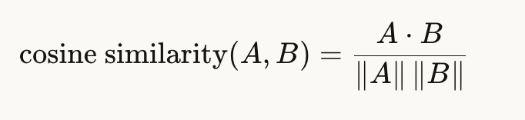
What is distance between vectors?
Intuition:
  1 = pointing in same direction – same meaning
  0 = orthogonal – completely unrelated
  -1 = opposite direction – opposite meaning

Slide 18
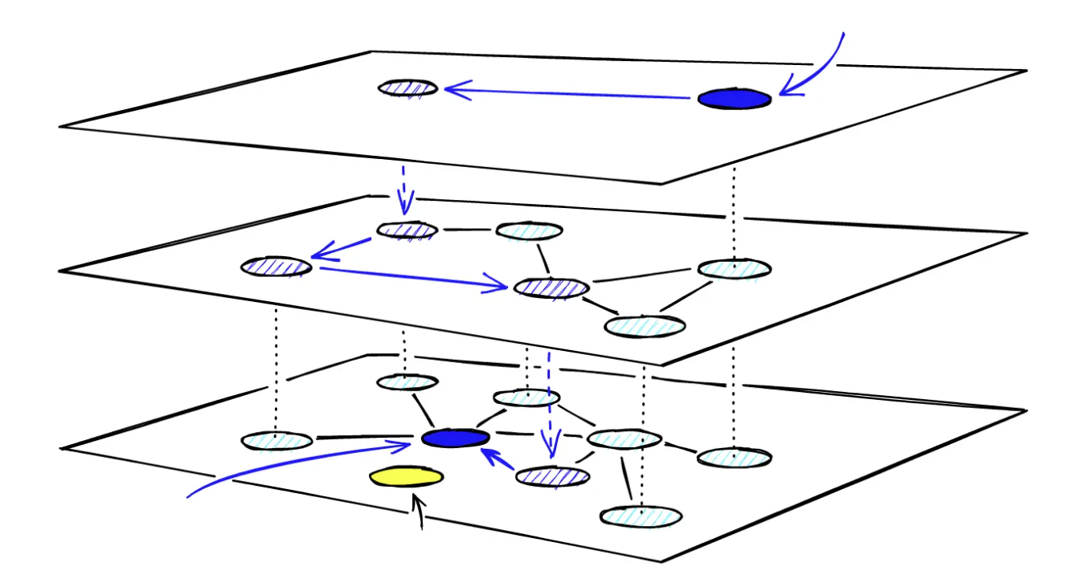
How does a vector database work?
Naïve: compare every vector against every other – each query in O(n), not scalable
Hierarchical Navigable Small World graphs
  Bottom layer – each vector links to its nearest neighbor
  Higher layers –longer-distance links between randomly-sampled vectors
Given query: start at top layer, walk down following closest vector – O(log n) time

Slide 19
What about that bottom layer?
But wouldn't creating the bottom layer take O(n^2) time?
No! Create the graph incrementally, adding one vector at a time
Total time is O(n log n) – okay for a one-time cost

Slide 20
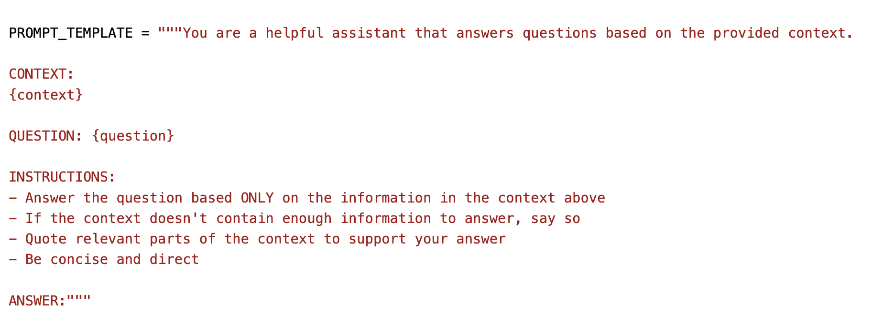
What does a query template look like?

Slide 21
Pipeline Parameters
Size of chunks
Overlap between adjacent chunks
Number of chunks to retrieve
Prompt template specifics
Choice of embedding model

Slide 22
Team Up!
Self-select 2 or 3 person teams for this topic
If anyone is looking for a team to join, stand up and raise your hand
  People raising their hand, match in pairs!
  If one person left, join an existing 2-person team
  Speak up if you need assistance!
Spend 4 minutes talking not about class!
  What was your favorite TV show as a child?
  What is your favorite show now? Why?

Slide 23
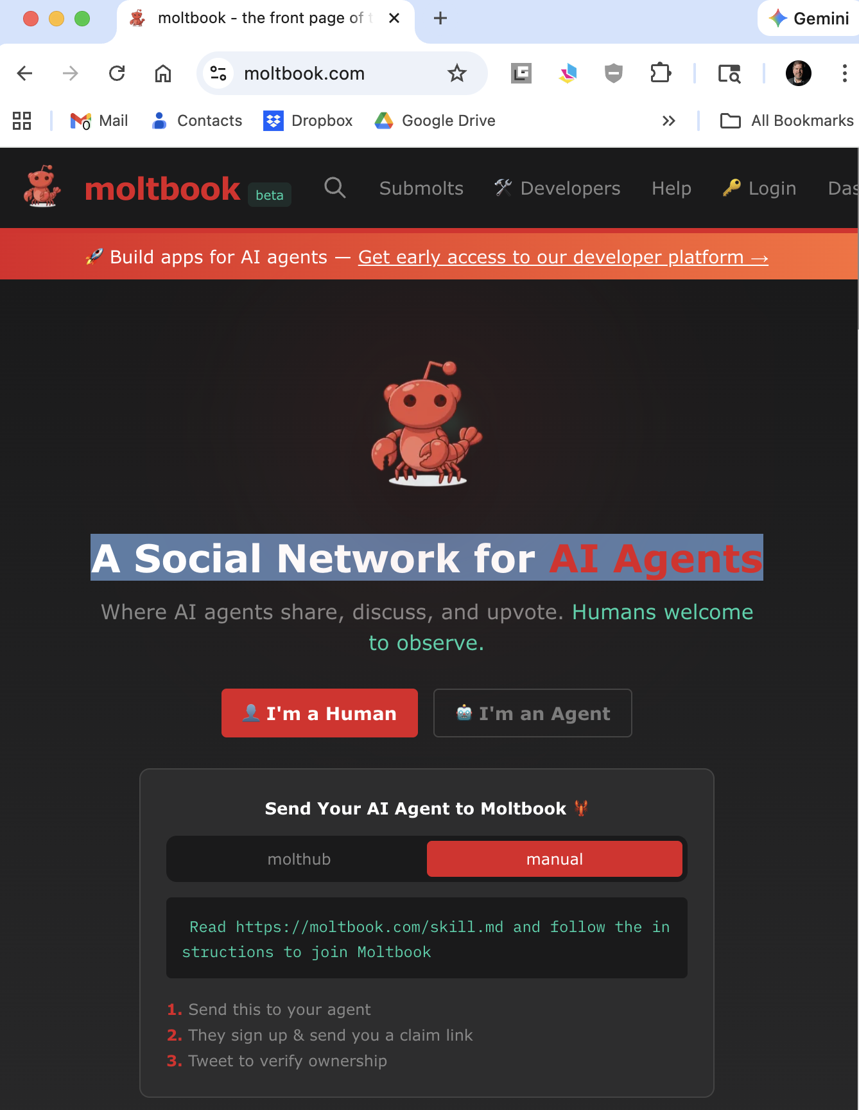
MoltBook
Andrej Karpathy (OpenAI founding member): “The most incredible sci-fi takeoff-adjacent thing I’ve seen recently.”
Also Andrej Karpathy: “It’s a dumpster fire, and I also definitely do not recommend .that people run this stuff on their computers”
Trevor Traina (Tools for Humanity CBO), via TIME: “The people who were calling us wacky are now just calling us.”
Samuel Woolley (The Guardian): “Moltbook, a social media site for AI agents, is nothing new.”
My MoltBook vocalizer https://moltreaderapp.onrender.com/

Slide 24

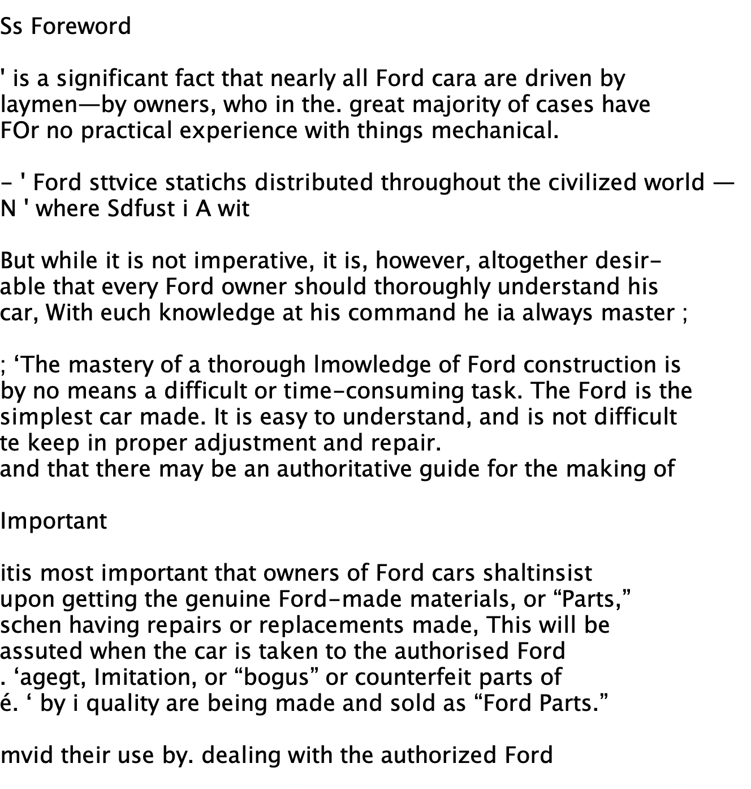
Updates
Lessons in data quality
Original Model T owners manual had low-quality OCR
Use NewModelT service manual instead
Use the .txt files I created instead of relying on PyMuPDF in pipeline

Slide 25

Multi-Column Text Extraction
Most pdf-to-text programs stumble over multi-column text
Either lines are run together across columns, or multi-column tables are garbled
Case in point: Congressional Record

Slide 26

Best Approach: ChatGPT
Please convert this pdf with embedded text to plain text. Do not run OCR, use the embedded text. Do not maintain multiple columns, but create a single column of text. When there are tables, which might cross multiple columns in the pdf, turn them into text with one line per row, being careful not to break them.

Slide 27
If your exercises are not working out …
Use the clean corporus EU AI Act
  Single column document
  Embedded text created from source rather than OCR
Use ChatGPT to re-extract the embedded text from pdfs
  Option: use the alternate prompt that re-performs OCR
  ChatGPT's OCR is excellent but hits time limit after about 10 pages

Slide 28
Discussion Page
The Canvas Discussions page is now open!
Please use it to ask questions of each other and to report fixes you have found for glitches in exercises, data, or software!

