Slide 1
Computing with
Numbers
CSC 161: The Art of Programming
Prof. Henry Kautz
9/14/2009

Slide 2
Course Status
Readings
  Completed: Chapters 1 and 2, pre-reading of Chapter 3
  To do:
    Read Chapter 3
    Pre-read Sections 11.1 – 11.2 (Data Collections: Lists)
Assignments
  Completed: Assignment 1, Using IDLE (only steps 1 – 5)
    Turn in hardcopy today, if you have not already
  To do: Assignment 2, Newton & Kepler
    Work on with a partner during the lab sections this week
    Turn in by uploading to Blackboard no later than 10:00am Saturday 19 Sept
Workshops
  In progress Sun-Tue this week: Origami

Slide 3
Labs
Some students are concerned about amount of time required by labs + workshops + lectures
Good things about labs:
  Can complete assignments much more quickly when help is available – one hour versus an all-nighter
  Time & place to work with a partner (“eXtreme programming”)
But: not all students will need two full lab sessions to complete the week’s assignment
How to maximize learning & minimize burden?

Slide 4
Lab Policy
Attend at least one lab session each week
No need to attend sessions for assignments that you have completed and turned in
Some sessions will require attendance for organizational and/or informational purposes
  These will be announced & noted on Calendar page
You need to attend lab tomorrow (Tuesday 15 Sept) in order to choose your (first) lab partner
  Everyone will change partners partway through the semester

Slide 5
Changing Sections
Need to change your Workshop section?
  Contact the head workshop leader:
  Ben Hopkins bhopkin3@u.rochester.edu
Need to change your Lab section?
  Complete a Drop/Add form at the Registrar’s Office
What should you do while waiting for a change to be processed?
  Go ahead and start attending the section to which you intend to change

Slide 6
Topics this Class
Loops
Numeric data types
The Math library
Converting between numeric data types

Slide 7
Indefinite Loops
while num != guess:
  if guess < num:
  print "Too Low!”
  else:
  print "Too High!”
General form:
  while <expression>:
  <indented lines of code>

Slide 8
Definite Loops
Suppose we repeat an operation exactly 10 times
One approach:
    n = 0
    while n < 10:
      print n, "squared is", n*n
      n = n + 1
This pattern is so common that there is a shorthand way of writing it
    for n in range(10)
      print n, "squared is", n*n

Slide 9
Definite Loops
General form:
    for <variable> in <sequence>:
        <lines of code>
Try typing to the Python shell
    >>> range(10)
    [0, 1, 2, 3, 4, 5, 6, 7, 8, 9]

Slide 10
Definite Loops
What will this do?
    for n in [0, 1, 2]
      print n, "squared is", n*n
    0 squared is 0
    1 squared is 1
    2 squared is 4

Slide 11
Definite Loops
What will this do?
    for n in [8, 1, 5]
      print n, "squared is", n*n
    8 squared is 64
    1 squared is 1
    5 squared is 25

Slide 12
Data Types
Type: A category or set of data values.
  Constrains the operations that can be performed on the data
  Examples: integer, real number, text string
Python is relaxed about types
  A variable's type does not need to be declared.
  A variable can change types as a program is running.
Value | Python type
42 | int
3.14 | float
"ni!" | str

Slide 13
Numeric Types
Python function type tells us the data type of any expression
    >>> type(3)
    <type 'int'>
    >>> type(3.14)
    <type 'float'>
    >>> type(3.0)
    <type 'float'>
    >>> type(932.684)
    <type 'float'>
Why do you think that "float" is used for the type of numbers that have a decimal point?

Slide 14
Arithmetic Operators
expression: A value or operation(s) to compute a value.
  Example: 1 + 4 * 3
Arithmetic operators:
  + - * / add, subtract/negate, multiply, divide
  ** exponentiate
  % modulus, a.k.a. remainder
precedence: Order in which operations are computed.
  * / % ** have a higher precedence than + -
  1 + 3 * 4 is 13
  (1 + 3) * 4 is 16

Slide 15
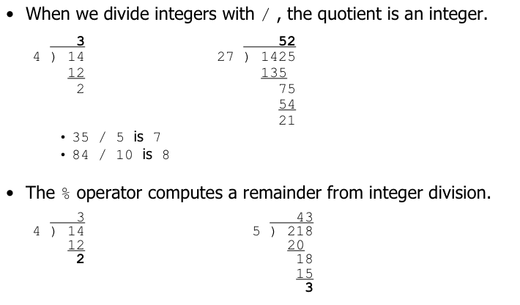
Integer division
What is 218 % 100 ?
Notes:
Dividing by 0 crashes the program.

Slide 16
Mixed Expressions
Mixing integers and floats yields floats
    >>> type( 6 * 3.14 )
    <type 'float'>
Why does that make the most sense
Changing a float back to an integer:
  round(3.6) == 4
  int(3.6) == 3

Slide 17
Logic
Operator | Meaning | Example | Result
== | equals | 1 + 1 == 2 | True
!= | does not equal | 3.2 != 2.5 | True
< | less than | 10 < 5 | False
> | greater than | 10 > 5 | True
<= | less than or equal to | 126 <= 100 | False
>= | greater than or equal to | 5.0 >= 5.0 | True
  Logical expressions can be combined using logical operators:
Operator | Example | Result
and | (9 != 6) and (2 < 3) | True
or | (2 == 3) or (-1 < 5) | True
not | not (7 > 0) | False

Slide 18
True or False?
(17 / 4) * 4 == 17
(17 / 4.0) * 4 == 17
(17 / 4) * 4.0 == 17

Slide 19
The Math Library
Many more mathematical functions can be accessed by importing the math library
Two ways to import a library:
  >>>import math
  >>> math.sqrt(81)
  9
  >>> from math import *
  >>> sqrt(81)
  9

Slide 20
Mini-Exercise
Task: computer the distance between two points on the plain (x1, y1) and (x2, y2)
What is the formula for distance?
Write a Python expression for the distance, using the exponentiation operator ** and the math library function math.sqrt(x) (square root)

Slide 21
Why Bother with Both Integers and Floats?
Why not only use floats?
  Integers: represented by a 32 bit binary number
    Largest value is 2**31 – 1 == 2,147,483,647
    Fast
    Exact
  Floats: represented internally using scientific notation
    4200000000 == 4.2×10⁹
    0.0000000042 == 4.2×10⁻⁹
    Much slower
    Value might be approximate, not exact

Slide 22
Computer Math
>>> 10000000000.1 == 10000000000.0
False
>>> 100000000000.1 == 100000000000.0
False
>>> 1000000000000.1 == 1000000000000.0
True

Slide 23
Long Integers
Sometimes you may want to represent a very big number exactly
Python has a special data type to do this: long integers
Long integers can have any number of digits (until your computer runs out memory)!

Slide 24
More Computer Math
>>> 1000000000000000002.0 == 1000000000000000001.0
True
>>> 1000000000000000002 == 1000000000000000001
False
>>> type(1000000000000000002)
<type 'long'>

Slide 25
Assignment 2
Kepler & Newton
  Calculating Planetary Orbits

