Slide 1
Numerical Methods or Two Recipes for Pi
CSC 161: The Art of Programming
Prof. Henry Kautz
9/16/2009

Slide 2
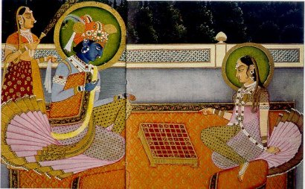
A Fable
The Maharaja of India was so pleased with one of his palace wise men, who had invented the game of chess, that he offered him a reward of his own choosing.
The wise man told his Master that he would like just one grain of rice on the first square of the chess board, double that number of grains of rice on the second square, and so on: double the number of grains of rice on each of the next 62 squares on the chess board.
This seemed to the ruler to be a modest request, so he called for his servants to bring the rice.

Slide 3
Rice
def rice():
print "Square", "Grains"
amount = 1
for s in range(1,64):
print s, amount
amount = amount * 2
1 is starting value

Slide 4
Minute Rice
How can we compute the amount of rice on the last square in one line?
2 ** 63

Slide 5
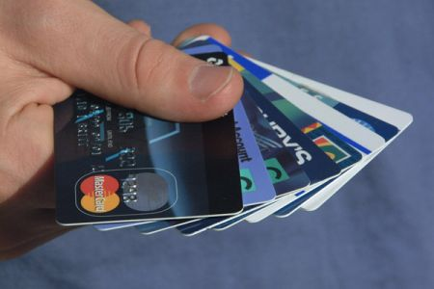
Compound Interest
def compound_interest(principle, \ yearly_rate, months):
print "Month", "Principle"
monthly_rate = yearly_rate / 12.0
for m in range(months):
print m, principle
principle = principle + \ monthly_rate * principle

Slide 6
Compound Interest with Fixed Payment
def compound_interest(principle, \ yearly_rate, months, monthly_payment):
print "Month", "Principle"
monthly_rate = yearly_rate / 12.0
for m in range(months):
print m, principle
principle = principle + \ monthly_rate * principle – \ monthly_payment

Slide 7
Compound Interest Until Paid Off
def compound_interest(principle, yearly_rate, \ monthly_payment):
print "Month", "Principle"
monthly_rate = yearly_rate / 12.0
m = 0
while principle >= 0:
print m, principle
principle = principle + monthly_rate * \ principle - monthly_payment
m = m + 1

Slide 8
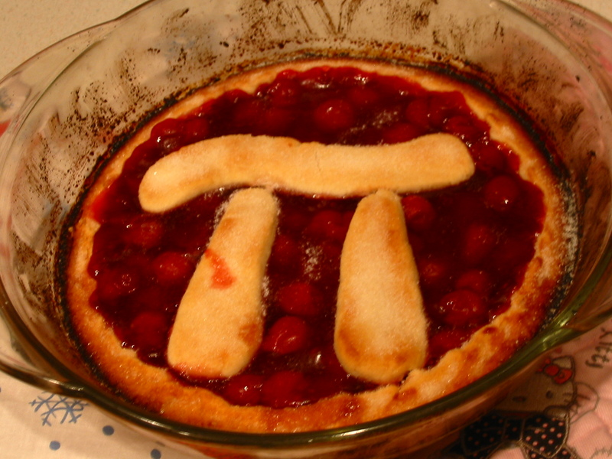
Two Recipes for Pi

Slide 9
Recipe the First: the Gregory-Leibniz Series
What ingredients do we need to make Pi?

Slide 10
Gergory-Leibniz Pi
from 1 to terms-1 by 4
def make_pi(terms):
print "Terms", "Estimate"
p = 0
for d in range(1,terms,4):
p = p + (4.0/d) - (4.0/(d+2))
print d, p

Slide 11
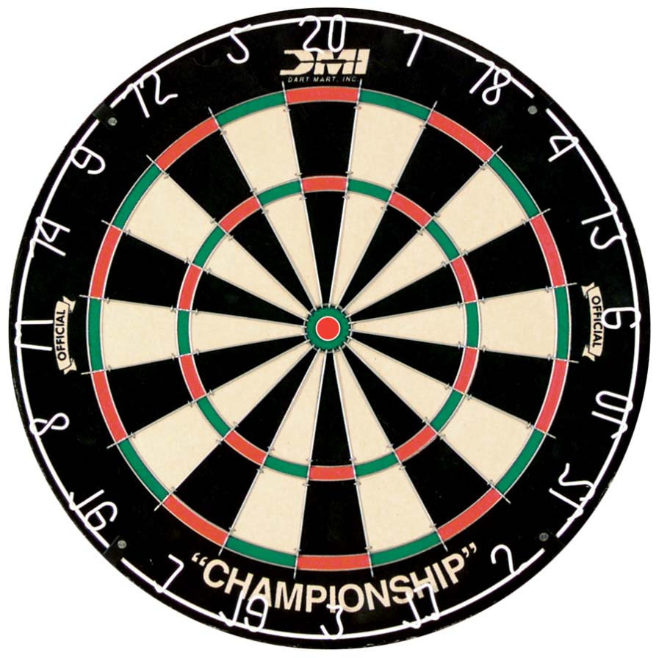
Recipe the Second: Dartboard Pi

Slide 12
Dartboard Pi
Suppose circular dartboard fit exactly into a 1 foot square
Suppose you throw darts that are equally likely to hit any spot in the square
The proportion of darts that hit the circle is proportional to the area of the circle

Slide 13
Dartboard Pi
The proportion of darts that hit the circle is proportional to the area of the circle

Slide 14
Dartboard Pi
import math
import random
def make_pi(darts):
hits = 1
for i in range(darts):
dx = random.random()
dy = random.random()
if math.sqrt((0.5-dx)**2 + \ (0.5-dy)**2) < 0.5:
hits = hits + 1
print "I think Pi is", (4.0*hits)/darts

Slide 15
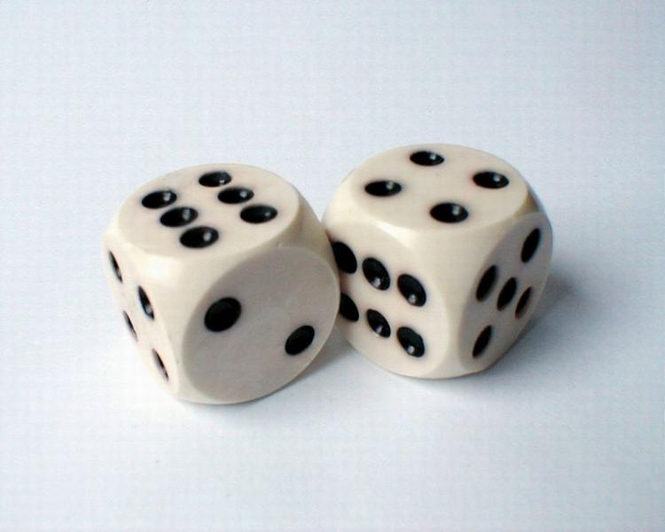
Monte-Carlo Algorithms
This is an example of what is called a Monte-Carlo Algorithm
One that uses random samples to estimate some value
These kinds of algorithms are used throughout
Chemistry
Biology
Physics
Economics
Wherever you need to estimate some quantity that is hard to determine exactly!

Slide 16
Course Status
Assignment 2: Turn in by 10:00am Saturday
Pre-read: Zelle, Chapter 4
Workshop: Mystery Topic

