Slide 1
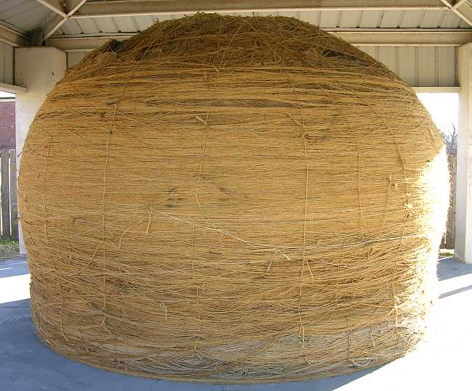
Computing with Strings
CSC 161: The Art of Programming
Prof. Henry Kautz
9/16/2009

Slide 2
Some of My Favorite Things
Things made of strings
Human language
Web pages
Databases
Programs
...
Things to do with strings
Translate
Compose
Format
Analyze
...

Slide 3
String Data Type
The <string> data type:
Sequence of characters of any length
In expressions, enclose in single or double quotes:
"Henry A. Kautz"
'Henry A. Kautz'
Can be assigned to a variable:
>>> name = Henry
>>> print name
Henry
Not the same a number, even if they print the same!
>>> x = "99"
>>> y = 99
>>> print x == y
False

Slide 4
Reading Strings
Reading a string is little bit trickier than reading numbers
Python input() function
Reads a line of text
Evaluates it as a Python expression
Returns the value
This is why typing a number (or any numeric expression) gives a number, not a string
>>> x = input("Enter number:")
Enter number: 99
>>> print x == 99
True
>>> print x == "99"
False

Slide 5
Reading Strings
In fact, input() accepts any legal expression:
>>> x = input("Enter number:")
Enter number: 99 / 3
>>> print x
33
>>> y = 25
>>> x = input("Enter number:")
Enter number: y
>>> print x
25

Slide 6
Reading Strings
Why does this fail?
>>> name = input("Enter first name: ")
Enter first name: Henry
Traceback (most recent call last):
File "<pyshell#5>", line 1, in <module>
name=input("Enter first name:")
File "<string>", line 1, in <module>
NameError: name 'Henry' is not defined
>>>

Slide 7
Reading Strings
Clumsy solution:
>>> name = input("Enter first name: ")
Enter first name: "Henry"
>>>
Better solution:
Use raw_input()
Like input(), but does not evaluate: always returns a string
>>> name = raw_input("Enter first name: ")
Enter first name: Henry
>>> type(name)
<type 'string'>

Slide 8
Operations on Strings
Indexing
Just like lists, can use square brackets to pick out characters within a string
>>> course = 'Art of Programming'
>>> course[0]
'A'
Slices of strings can be addressed
>>> course[0:3]
'Art'
>>> course[7:]
'Programming'
>>> course[7:len(course)]
'Programming'

Slide 9
Operations on Strings
Concatenation
>>> city = 'Rochester'
>>> state = 'NY'
>>> address = city + state
>>> address
RochesterNY
>>> address = city + ' ' + state
>>> address
Rochester NY
>>> zip = 14627
>>> address = city + ' ' + state + ' ' + zip
TypeError: cannot concatenate 'str' and 'int' objects
>>> address = city + ' ' + state + ' ' + str(zip)
>>> address
Rochester NY 14627
str() converts almost anyththing to a string

Slide 10
Strings and Lists
Compare string and list:
mystring = "Cat"
mylist = ['C', 'a', 't']
Can index elements or slices
mystring[0:2] == 'Ca'
mylist[0:2] == ['C', 'a']
Can concatenate
mystring + 's' == 'Cats'
mylist + ['s'] == ['C', 'a', 't', 's']

Slide 11
Differences Between Strings & Lists
You can change an element of a list:
mylist[0] = 'B'
mylist == ['B', 'a', 't']
You cannot change a character in a string:
mystring[0] = 'B'
ERROR
Instead, slice and concatenate to create a new string:
'B' + mystring[1:3] == 'Bat'

Slide 12
String Library
import string
string.split('To be, or not to be, that is the question.')
['To', 'be,', 'or', 'not', 'to', 'be,', 'that', 'is', 'the', 'question']
string.split('To be, or not to be, that is the question.', ',')
['To be', ' or not to be', ' that is the question.']
string.join(['To', 'be,', 'or', 'not', 'to', 'be,', 'that', 'is', 'the', 'question'])
'To be, or not to be, that is the question.'

Slide 13
Converting Between Strings & Lists
list('cat')
['c', 'a', 't']
str(['c', 'a', 't'])
"['c', 'a', 't']"
string.join(['c', 'a', 't'])
'c a t'
string.join(['c', 'a', 't'], "")
'cat'

Slide 14
More Library Functions
Finding the position of one string within another string
string.find('To be or not?', 'be')
3
Replacing a string with another string
string.replace('Sigh. I wish. To sleep.', '.', '!')
'Sigh! I wish! To sleep!'
See the textbook many more string functions

Slide 15
In Class Exercise
With a person sitting next to you, write Python to reverse the string stored in the variable S.
Left side of class: do NOT use lists, only strings.
Right side of class: convert to list, reverse, then convert back to a string.

Slide 16
Course Status
Quiz Wednesday in class
for, if, logical expressions, range, lists
15 minutes
Assignment 3: RNA Secondary Structure Prediction
Design solution in your workshop this week
Implement & debug in lab Tuesday or Thursday
Turn in by 10:00am Saturday
Read: Zelle, Chapter 4

