Slide 1
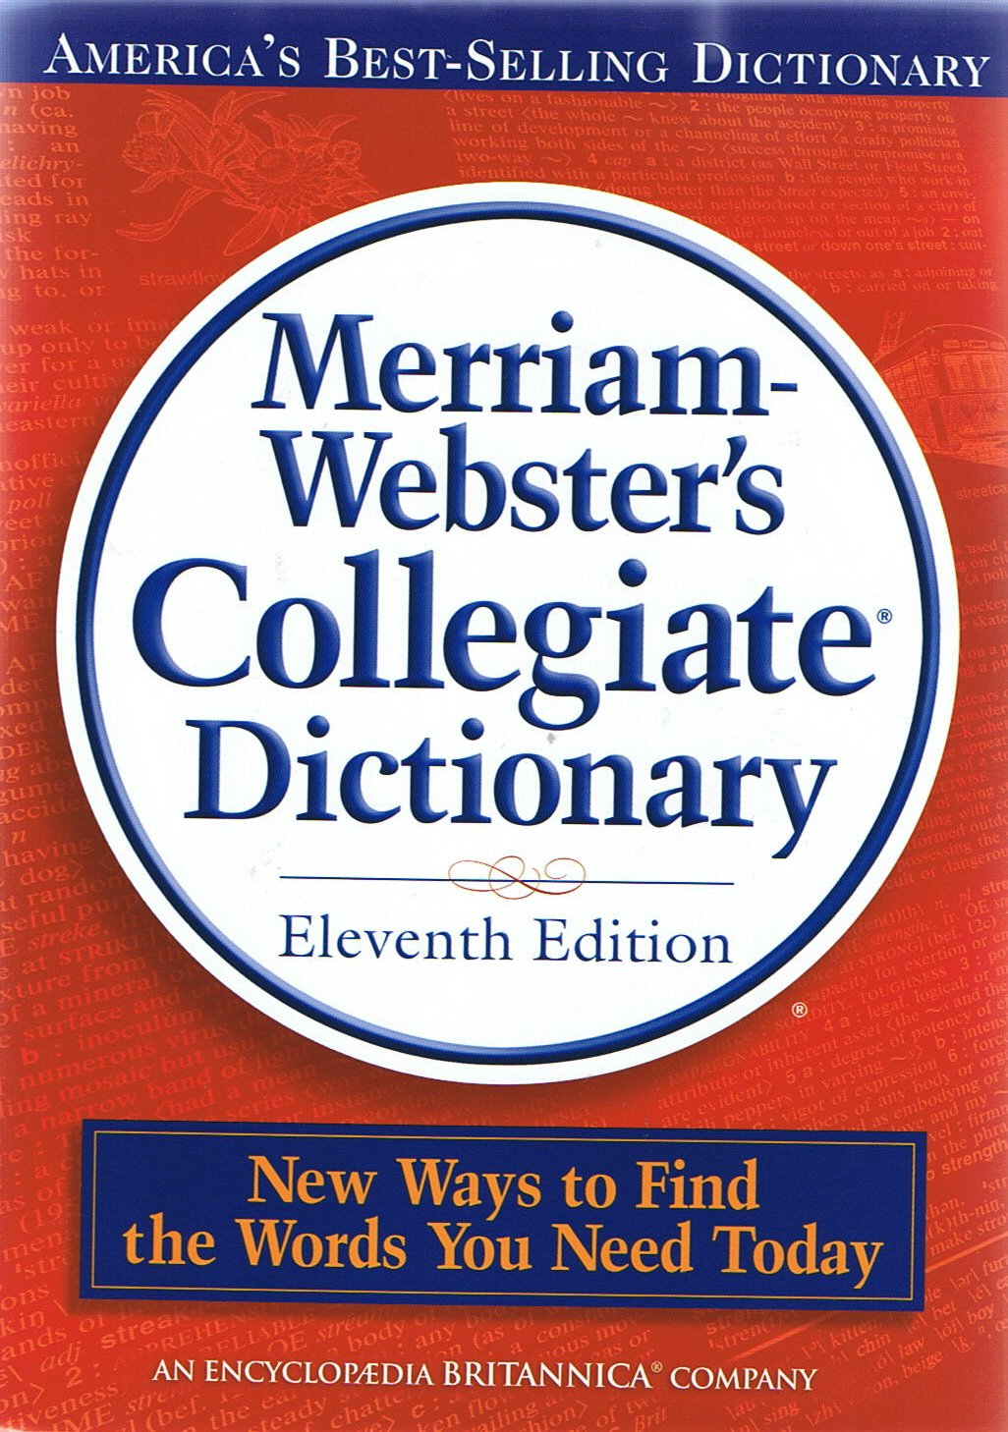
Files and Dictionaries
CSC 161: The Art of Programming
Prof. Henry Kautz
9/16/2009

Slide 2
Today
Working with files
A new data type: Dictionaries
Top-down design example

Slide 3
Files
Files can contain ...
Text
Program Source Code
def compound_interest(principle, yearly_rate, monthly_payment):
print "Year", "Principle"
monthly_rate = yearly_rate / 12.0
m = 0
while principle >= 0:
print m, principle
principle = principle + monthly_rate * principle - monthly_payment
m = m + 1

Slide 4
Files
Files can contain ...
Text
Natural Language
It was the best of times, it was the worst of times, it was the age of wisdom, it was the age of foolishness, it was the epoch of belief, it was the epoch of incredulity, it was the season of Light, it was the season of Darkness, it was the spring of hope, it was the winter of despair, we had everything before us, we had nothing before us, we were all going direct to Heaven, we were all going direct the other way--in short, the period was so far like the present period, that some of its noisiest authorities insisted on its being received, for good or for evil, in the superlative degree of comparison only.

Slide 5
Files
Files can contain ...
Text
Web pages

Slide 6
Files
Files can contain ...
Text
Some kinds of data, e.g.: "CSV" (comma separated value) spreadsheet files
year,brand,model,options,price
1997,Ford,E350,"ac, abs, moon",3000.00 1999,Chevy,"Venture "Extended Edition",4900.00 1996,Jeep,Grand Cherokee,"air, moon roof, loaded",4799.00

Slide 7
Files
Files can contain ...
Binary Numbers
Compiled programs
Compressed files (.zip)
Binary data files (e.g. .xls)
Sounds (e.g. .mp3)
Images (e.g. .jpeg)

Slide 8
I/O with Text Files
Today we will learn how to perform I/O with text files
I/O = "Input / Output"
In Python, text = strings
Reading strings from files
Formatting strings
Writing strings to files

Slide 9
Text Input
From the terminal:
story = raw_input('Enter your story: ')
From a file:
Associate a file object with the given file name
Read from the file object one or more times
Try:
dickens = open('two-cities.txt', 'r')
dickens.readline()
dickens.read()

Slide 10
Text Input
General form:
<filevar> = open(<filename>, <mode>)
<mode> is 'r' for reading text files
<filevar>.readline()
Reads one line from the return, returns that line as a string
Next call to readline() will return the next line of file
<filevar>.read()
Reads entire file, returns entire text as one long string
Special characters '\r' or '\n' (or both) separate lines

Slide 11
Text Input
Special Python shortcut for iterating over the lines of a file
for line in <filevar>:
do something with line
Try: [ex1.py]
dickens = open('two-cities.txt','r')
count = 0
for line in dickens:
print line
count = count + 1
print "The number of lines is ", count

Slide 12
Text Input
Why do I call this a shortcut?
for line in dickens:
print line
count = count + 1
is equivalent to writing:
line = dickens.readline()
while line != "":
print line
count = count + 1
line = dickens.readline()

Slide 13
Text Output
Terminal output:
print "Hello, world!"
File output:
Associate a file object with the given file name
Write from the file object one or more times
Close the file, to tell the computer you are done with it
Try:
henry = open('mystory.txt', 'w')
henry.write('It was the stupidest of times.\n')
henry.close()

Slide 14
Text Output
General form:
<filevar> = open(<filename>, <mode>)
<mode> is 'w' for writing text files
if <filename> already exists, it is erased
<filevar>.write(<string>)
Writes <string> to (end of) file
In <string>, the special notation '\n' stands for a single end of line character
<filevar>.close()
Tells the computer you are done using <filevar>
If you leave it out, your file might not be saved

Slide 15
Dictionaries
Dictionary: like a list, but items are associated with key words rather than with numeric indexes
A regular dictionary:
cat: a feline pet
gnat: an annoying insect
hat: a head covering
Try:
d = { } # creates an empty dictionary
d['cat'] = 'a feline pet'
d['gnat'] = 'an annoying insect'
d['hat'] = 'a head covering'

Slide 16
Course Status
Read: Zelle, Section 11.6 (Dictionaries)
Assignment 3: RNA Secondary Structure Prediction
Turn in by 10:00am Saturday
Next workshop: measuring literary style
Programming assignment 4: will be given out on Tuesday

