Slide 1
Animation II:
Revenge of the Clones
CSC 161: The Art of Programming
Prof. Henry Kautz
10/16/2009

Slide 2
Status
Programming assignment 6: Graphics
  Part I: Due 10:00am, Sat 24 October
  Part II: Due 10:00am, Sat 31 October
  To be completed in teams of two assigned by Lab TA
Next class: Midterm Exam
  You may bring and consult your text book
  Also bring 1 page of written notes (good practice!)
  Study guide
  Be sure to bring pencil & calculator
For Monday Oct 26: pre-read Chapter 6

Slide 3
Today
Graphics bits & pieces
Animation examples
Q & A

Slide 4
Coordinate Systems
Default GraphWin Coordinates
  One unit == one pixel
  (0,0) is upper left corner
Drawbacks:
  Using a larger or smaller window requires program to be rewritten
  Familiar geometry notation has (0,0) in lower left
Graphwin method setCoord(xLL, yLL, xUR, yUR)
  Sets lower left corner to coordinate (xLL, yLL)
  Sets upper right corner to coordinate (xUR, yUR)
  All object coordinates are automatically scaled to pixels

Slide 5
Examples
  w = GraphWin('test', 800, 400)
  w.setCoords(0, 0, 8, 4)
  c = Circle(Point(4,2), 1)
  c.draw(w)
  Circle is rendered at pixel location (400,200) with radius 100

Slide 6
Examples
  w = GraphWin('test', 800, 400)
  w.setCoords(0, 0, 8, 4)
  c = Circle(Point(6.5,2.5), 0.75)
  c.draw(w)
  Circle is rendered at pixel location (650,250) with radius 75

Slide 7
Examples
There are 801 units between 0 and 800, including 0 and 800! (Similarly for height)
  w = GraphWin('test', 801, 401)
  w.setCoords(0, 0, 800, 400)
  c = Circle(Point(400,200), 100)
  c.draw(w)
  Change (0,0) to lower left with no rescaling of units

Slide 8
Examples
  w = GraphWin('test', 800, 400)
  w.setCoords(0, 0, 400, 400)
  c = Circle(Point(200, 200), 100)
  c.draw(w)
  Non-uniform scaling

Slide 9
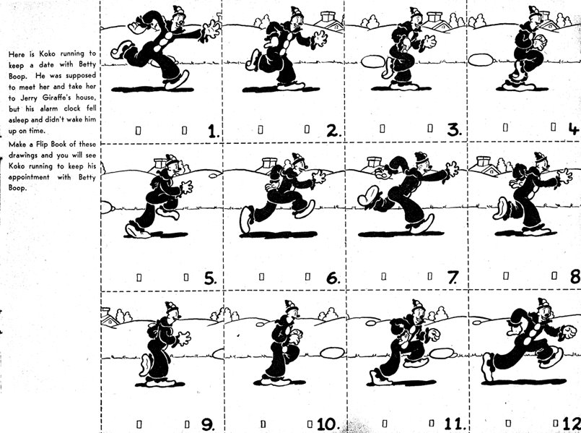
Animating Objects
In workshop, you have/will gain experience with animation
Animation = illusion of motion created by rapidly displaying still images

Slide 10
Example
  c = Circle(Point(20,200), 20)
  c.setFill(‘blue’)
  c.draw(w)
  speed = 1.0
  for x in range(200):
  c.move(speed,0)
  speed = 2.0
  for x in range(200):
  c.move(speed,0)
  speed = 0.5
  for x in range(200):
  c.move(speed,0)
Run
speed.py

Slide 11
Changing Speed with Constant Distance
  c = Circle(Point(20,200), 20)
  c.setFill(‘blue’)
  c.draw(w)
  speed = 1.0
  for x in range(int(200/speed)):
  c.move(speed,0)
  speed = 2.0
  for x in range(int(200/speed)):
  c.move(speed,0)
  speed = 0.5
  for x in range(int(200/speed)):
  c.move(speed,0)
Run
distance.py

Slide 12
Moving at an Angle
  from math import *
  D = 30
  for x in range(int(200/speed)):
  c.move(speed*cos(radians(D)), \
  speed*sin(radians(D)))
Run
diagonal.py
R
sine(R)
cosine(R)

Slide 13
Text Display & Entry
Entry class is like Text, but user can edit
Method getText() returns what (if anything) user has typed in the box
Need to know when to invoke getText(), e.g. after mouse click:
  label = Text(Point(200,300), 'Name:')
  label.setSize(24)
  label.draw(w)
  field = Entry(Point(200,200), 10)
  field.setSize(24)
  field.draw(w)
  w.getMouse()
  s = field.getText()
  label.setText('You entered:' + s)
Run
entry.py

Slide 14
Pausing
Pause the program:
  import time
  pauseDuration = 2
  time.sleep(pauseDuration)
Displaying dialog:
  dialog = Text(Point(200,200), ‘To be or not to be?’)
  dialog.draw(win)
  time.sleep(2)

Slide 15
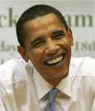
Displaying Image Files
Displaying GIF images:
  object = Image(centerpoint, filename)
Example
  b = Image(Point(200,200), 'barak.gif')
  b.draw(win)

Slide 16
Cloning
  b1 = Image(Point(200,200), 'barak.gif')
  b1.draw(w)
  time.sleep(0.5)
  b2 = b1.clone()
  b2.move(100,100)
  b2.draw(w)
  time.sleep(0.5)
  b3 = b2.clone()
  b3.move(100,100)
  b3.draw(w)
Run
clone.py

Slide 17
Animations
Heider & Simmel (1944): An experimental study of apparent behavior. American Journal of Psychology, 57, 243–259.
Chuck Jones (1965): The Dot and the Line
Henry Kautz (2009): A Heartbreaking Work of Staggering Genius*
    * title stolen from a book by David Eggers

