Slide 1
Working with Files
CSC 161: The Art of Programming
Prof. Henry Kautz
11/9/2009

Slide 2
What is Text?
By "plain text" we mean one of the standard methods for encoding characters as numeric values
ASCII
  Most common, uses 8-bits (one byte) per character
  Example: 'A' is
    01000001 in binary (base 2)
    101 in octal (base 8)
    65 in decimal (base 10)
    41 in hexadecimal (base 16)

Slide 3
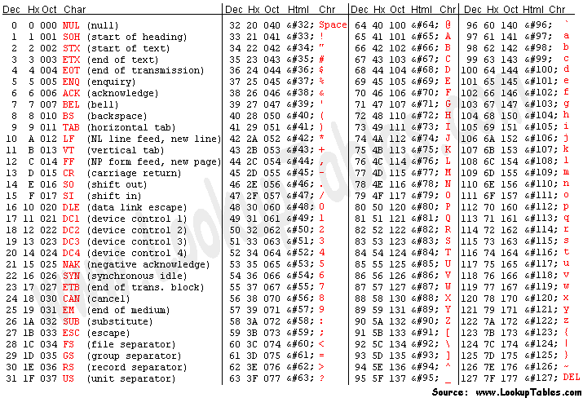

Slide 4
Beyond ASCII
Because ASCII uses an 8-bit code, there are 256 possible ASCII characters
How to handles languages with larger character sets (e.g. Chinese)? What if we want to mix languages on a page?
Unicode: international standard using 16-bit or 32-bit characters
  16-bits = 64,000 different characters
  32-bits = 4 million different characters
  Unique code for every character of every human language

Slide 5
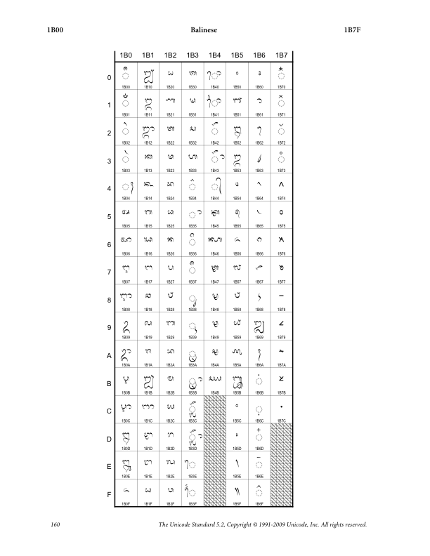
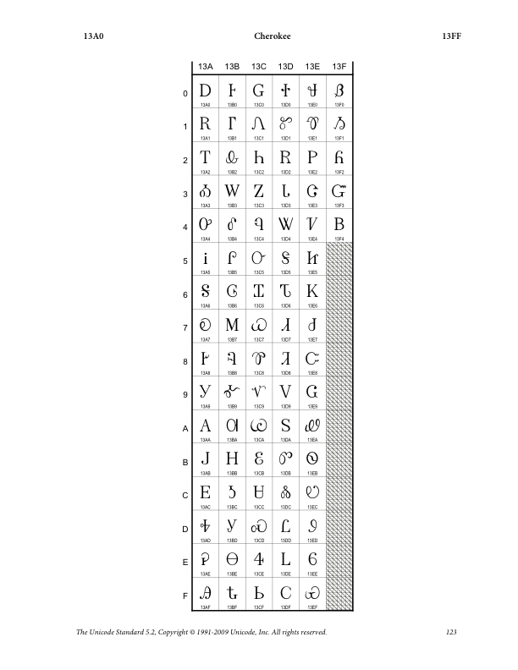
Unicode Examples

Slide 6
Review: Working with Text Files
f = open("My file.txt", "r")
  f gets a file object
  Mode is "r" for reading, "w" for writing an Ascii (8-bit) text file
contents = f.read()
  Reads entire file, returns entire text as one long string
  Special characters '\r' or '\n' (or both) separate lines
  Note: special characters are PRINTED as two characters, but are stored as one 8-bit character!

Slide 7
Reading a Text File Incrementally
f.readline()
    Reads one line from the return, returns that line as a string
    Next call to readline() will return the next line of file
Special Python shortcut:
    for line in <file object>:
    do something with line
Example:
    dickens = open('two-cities.txt','r')
    count = 0
    for line in dickens:
    count = count + 1
    print "The number of lines is ", count

Slide 8
Text Output
f = open("results.txt", "w")
  Mode is 'w' for writing text files
  if file already exists, it is erased
f.write(data)
  Writes data to (end of) file
f.close()
  Tells the computer you are done using file object f
  If you leave it out, your file might not be properly stored on the computer's hard disk

Slide 9
Performing String Operations on Files
Replacing a phrase in a file:

Slide 10
file-test.txt

Slide 11
file-result.txt

Slide 12
Performing Mathematical Operations on Files
Task: Take the average of 1,000,000 numbers
  Scientific data is often this large or larger
  Warning: Don't try this in Excel!

Slide 13
Result

Slide 14
Where Did the Data Come From?

Slide 15
More Complex Pattern Matching
Task: find telephone numbers in a file
  Example: 234-3208
Pattern: three digits, a dash -, four digits
Patterns like this can be written as what are called "regular expressions" in linguistics and computer science
  [0-9]{3}-[0-9]{4}
  [0-9] Match any character from '0' to '9'
  {3} Match previous part 3 times
  {4} Match previous part 6 times

Slide 16
Print Matching Lines

Slide 17
Python re Module
Almost any kind of text mangling can be easily programmed using the re module
Can find complicated patterns, pull out pieces of the match, replace with other string...
Many applications in both day to day data processing as well as linguistics, artificial intelligence, and (of course) literary analysis

Slide 18
Movies of the Day

Slide 19
Status
Wednesday:
  Quiz on Functions, Lists, & Dictionaries
  Lecture: Working with Audio
Saturday:
  Assignment 7 due

