Slide 1
Working with Sound
CSC 161: The Art of Programming
Prof. Henry Kautz
11/11/2009

Slide 2
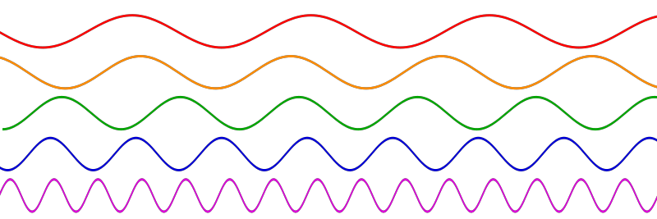
What is Sound?
Sound is a travelling wave which is an oscillation of pressure transmitted through a solid, liquid, or gas, composed of frequencies within the range of hearing and of a level sufficiently strong to be heard, or the sensation stimulated in organs of hearing by such vibrations.

Slide 3
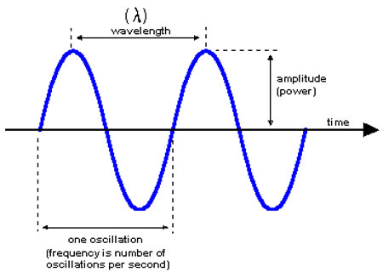
Properties of Waves
frequency: the number of occurrences of a repeating event per unit time
wavelength: the distance over which the wave's shape repeats
amplitude: the magnitude of change in the oscillating variable

Slide 4
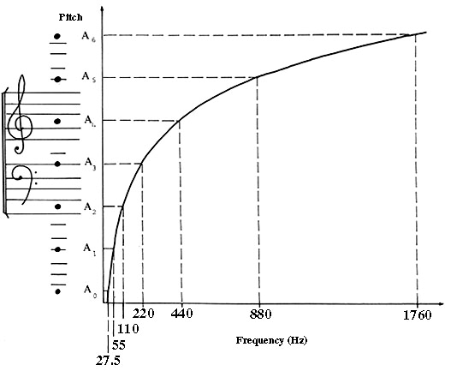
Frequency & Pitch

Slide 5
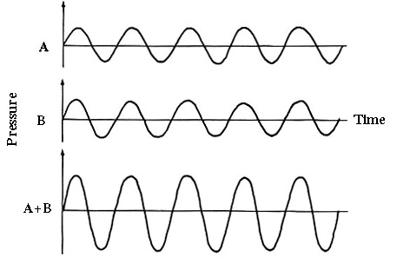
Combining Sounds
Combining sounds with same frequency & phase

Slide 6
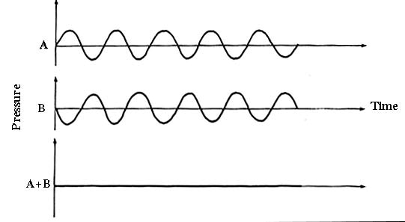
Combining Sounds
Combining sounds with same frequency & amplitude, but opposite phases

Slide 7
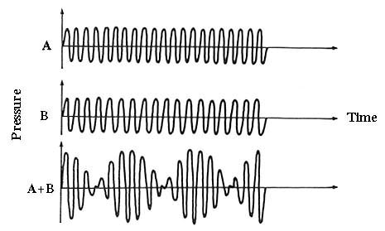
Combining Sounds
Different frequencies

Slide 8
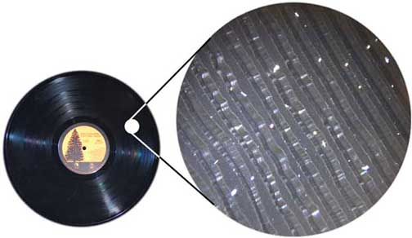
Digitizing Sound
Waves can be stored in an analog medium, such as an LP
Waves can't be stored in a purely digital medium, such as computer file
But: we can store a good approximation to a wave

Slide 9
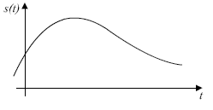
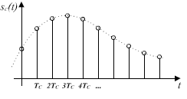
Sampling a Wave
Sampling rate: the number of samples per second (or per other unit) taken from a continuous signal to make a discrete signal

Slide 10
Sound Quality
Quality of the approximation depends upon
Sampling rate: higher == better (up to about 44kHz)
Twice limit of human hearing
Number of bits used to represent each sample
8 bits = telephone quality
12 bits = FM quality
16 bits = "near CD" quality
32 bits = CD quality
64 bits = "golden ears" quality

Slide 11
Sound Files
Some header information
Number of channels
Sampling rate
Sampling width
Number of samples
Compression scheme (if any)
Sequence of samples, called frames

Slide 12
Compression
Compression: ways to store the samples in less space
Common kinds of sound files:
WAV: no compression
Lossless: no information loss
E.g.: represent 1000 zeros in a row by 0x1000
CDs
Lossy: throws out information carefully
Huge compression possible before people notice
MP3, AAC

Slide 13
Working with Sound Files
Import one or more sound modules
Open the input file
Read the file header
Read the frames (samples)
Modify the frames in some way
Open the output file
Write the file header
Write the frames

Slide 14
Arrays
The frame data could be stored in a list...
But for efficiency, Python uses a special list-like object called an array
All elements of an array are numbers represented using a fixed number of bits
a=array.array('H')
The argument 'H' means "16 bits"
a.fromstring(d) – fill array a with numbers corresponding to d, a string containing the raw file contents
Otherwise, they work pretty much like lists

Slide 15
Reading in a WAV file

Slide 16
What Does This Do?

Slide 17
Challenge
Modify this part of the program to slow down the sound

Slide 18
Challenge
Modify this part of the program to make quieter the sound

Slide 19
Movie of the Day

Slide 20
Status
Saturday:
Assignment 7 due
Sunday – Tuesday: Workshop
MicroAmazon.com – using dictionaries & lists
Tuesday: Assignment 8
Sound Laboratory

