Slide 1
From Sound to Music
CSC 161: The Art of Programming
Prof. Henry Kautz
11/16/2009

Slide 2
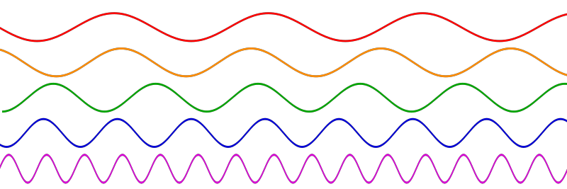
Last Class
Working with sound files
Example file sound.py
import wave
import array
from math import sin, pi

Slide 3
Fast

Slide 4
Slow

Slide 5
Concepts
Sound
Frequency
Amplitude
Sampling Rate
WAV file
Header
Frames
Sound data
Raw file contents: string of bytes
Array: sequence of 16 bit (or other size) numbers

Slide 6
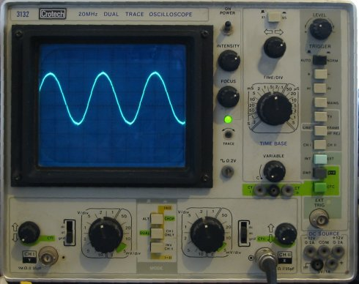
Common Ways to Manipulate Sound Waves
Speed up
Slow down
Combine
Add echo
Reverse ?!

Slide 7
Secret Message

Slide 8
Programming Assignment
Add the following two functions to sound.py:
backwards( ) should read the names of input and output WAV files, and create a backwards version of the input file in the output file.
Apply backwards( ) to secretMessage.wav
combine( ) should read the names of two input WAV files and one output file.
The output file should have the length of the shorter of the two input files, and contain the combination of the two input files.
Each sample in the output is the sum of the two corresponding samples in the inputs, divided by 2.
Use combine( ) to combine declaration.wav and BornToRun.wav

Slide 9
Part II (Optional, Extra Credit)
Implement the following functions:
amplify( ): Scale the amplitude of the samples in a file so that the absolute value of the largest (loudest) samples is 32767.
Note that samples may be positive or negative, and that your function will have to scan through all the frames first to discover the largest sample absolute value, in order to determine the scaling factor.
soften( ): Cut the maximum amplitude of a file in half.
echo( ): Add an echo effect to a file.
This is done by merging in a softer version of the file with itself delayed by a half second or so

Slide 10
Two Roads to Computer Music

Slide 11
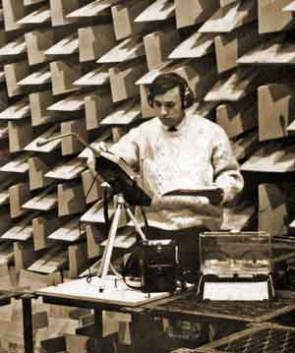
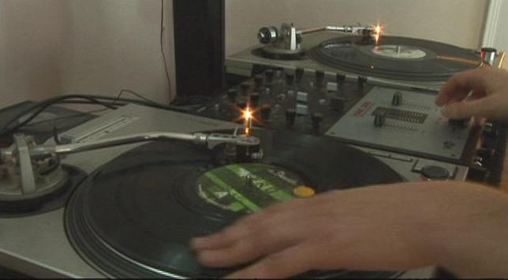
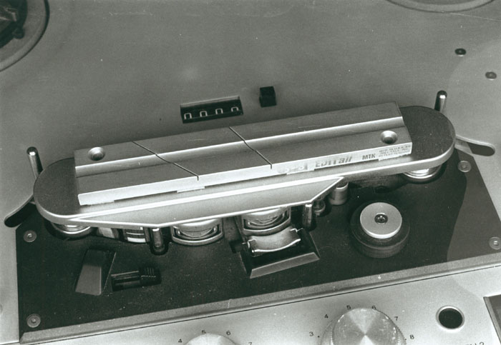
Sampling & Mixing
The first electronic music sampled, altered, and mixed sounds by physically cutting and manipulating audio tape!
Scratching: manipulating sound samples by changing speed / reversing vinyl records

Slide 12
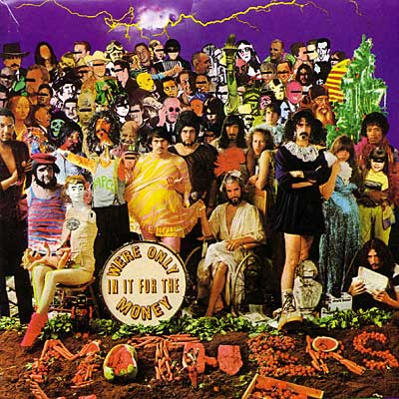
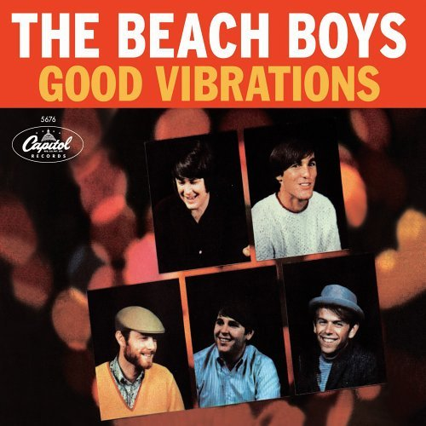
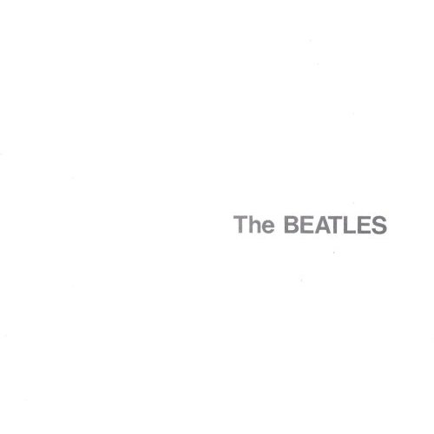
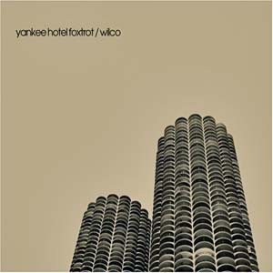
Sound Mix Artists
Rap often mixes in clips of other songs
In classical music, avant garde composers have long been fascinated with found sound
John Cage
Starting in the 1960’s, popular artists started to explore the possibilities of mixing arbitrary sound
Frank Zappa
Brian Wilson
The Beatles: Revolution 9
Wilco

Slide 13
Revolution 9

Slide 14
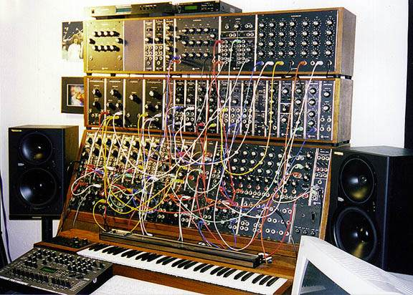
The Other Road: Synthesis

Slide 15
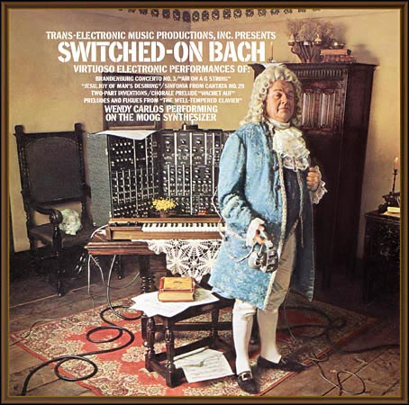
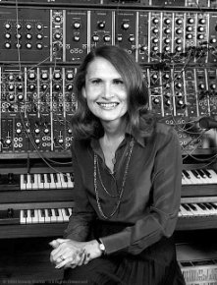
Wendy Carlos

Slide 16
Synthesizing Sound
How can we write a Python program to synthesize sound?
Let’s remember the key concepts of digital sound waves

Slide 17
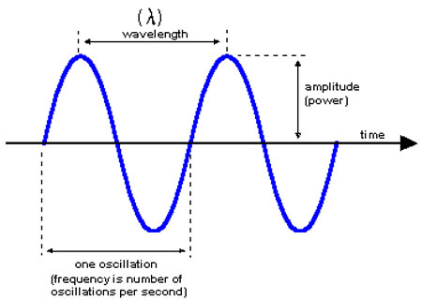
Key Concepts
frequency: the number of waves per second = pitch
amplitude: the height of each wave = loudness
sampling rate: the number of samples per second of the wave = quality

Slide 18
Formula for Pure Tones

Slide 19
Synth

Slide 20
Part III (Optional, Extra Credit): Music Synthesizer
Implement a program that reads in a text file containing musical notation and creates a WAV file of the music.
The musical notation:
Each note is specified by two characters separated by white space.
The first character is a letter specifying the pitch A, B, C, D, E, F, G, or the letter R to indicate a rest
The second character is the duration specified a W, H, Q, E (whole, half, quarter, eighth).

Slide 21
finally

Slide 22
Part IV (Optional, Extra Credit): Music Composition
Create an original musical composition using any or all of the functions you implemented
You can create your own input WAV files using any programs you like.
iTunes to rip samples from CDs
Sound Recorder to record from a microphone
You might run several different functions multiple times to create your final composition.

Slide 23
Movies of the Day

