Slide 1
Mining Social Media to Improve Public Health
Henry Kautz
Robin & Tim Wentworth Director
Goergen Institute of Data Science
University of Rochester

Slide 2
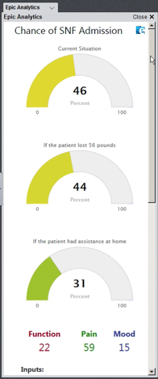
Data Science is Changing Healthcare
Predictive Healthcare
  Use information in electronic medical record to predict individual treatment outcomes
  Can employ a variety of well known models and methods –AI is not the bottleneck
  Social and engineering challenges:
    Institutional barriers to sharing EMR data
    Integration with provider practice – cannot require another screen!
URMC Orthopedic Surgery Advisor

Slide 3
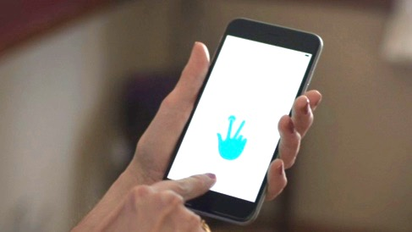
Data Science is Changing Healthcare
Employing Data from the Wild
  Physiological data captured by wearable devices and cell phones
  “Data exhaust” of online behavior
Ray Dorsey, Center for
Human Experimental
Therapuetics,
Parkinson's Disease App

Slide 4
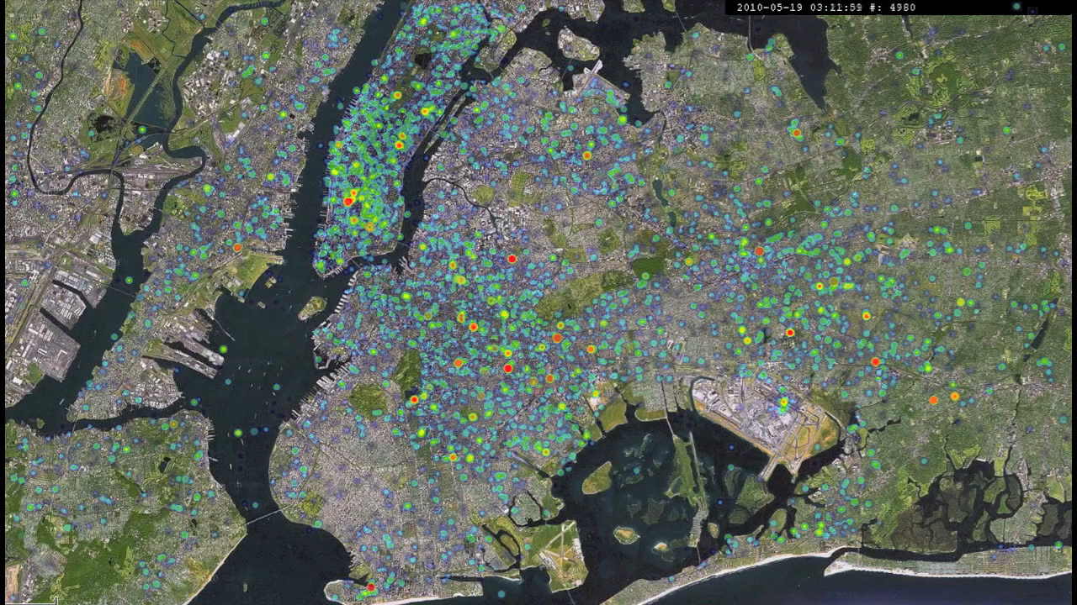
People on Smartphones: An Organic Sensor Network
Social media:
Population scale
No need to recruit
subjects
Fine granularity
Timely
Public health questions:
Who is likely to contract
disease?
What lifestyle factors influence health?
What are sources of disease?
24 Hour Heat Map of Tweets, NYC

Slide 5
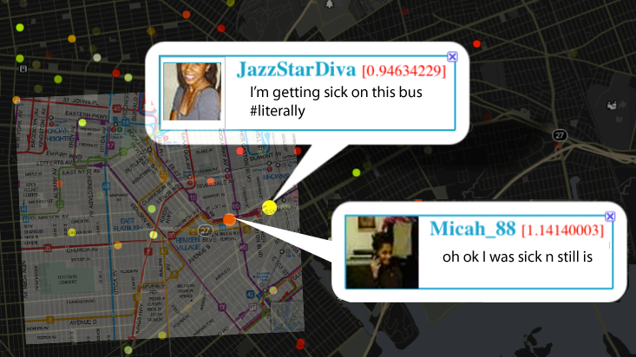
Twitterflu: Tracking Influenza
Public Twitter feeds can be mined for self-reports of flu symptoms – “sick tweets”

Slide 6


Analyzing Tweets
Goal: find tweets about disease symptoms
  Previous approach: keywords
  Problems: “sick of homework”, “under the weather”
Our approach: machine learning
  Use Mechanical Turk workers to train the system
  98% accuracy
Training Data
Sick Tweets
Contains
“sneeze”?
“sick”?
“tired”?
Machine Learning System

Slide 7
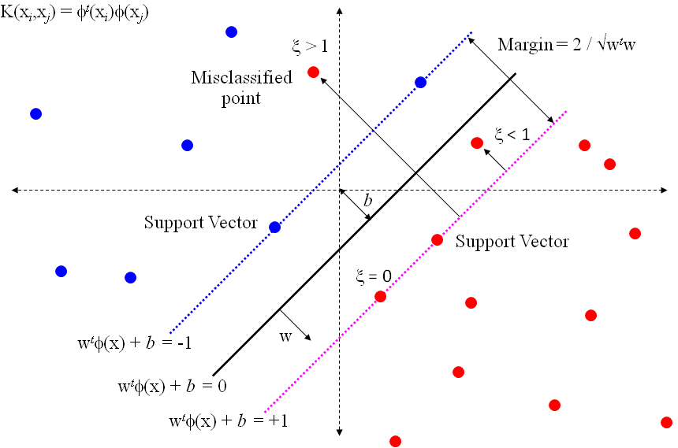
Each word, bigram or trigram is a feature (dimension)
Support vector machine: find a hyperplane that separates positive from negative examples

Slide 8

sick
+0.8
+0.8

Slide 9
sick and tired
+0.7
+0.8
+0.6
-0.7

Slide 10
sick and tired of
-0.1
+0.8
+0.6
-0.7
-0.8

Slide 11
sick and tired of flu
+0.6
+0.8
+0.6
+0.7
-0.7
-0.8
How do we get these numbers???

Slide 12
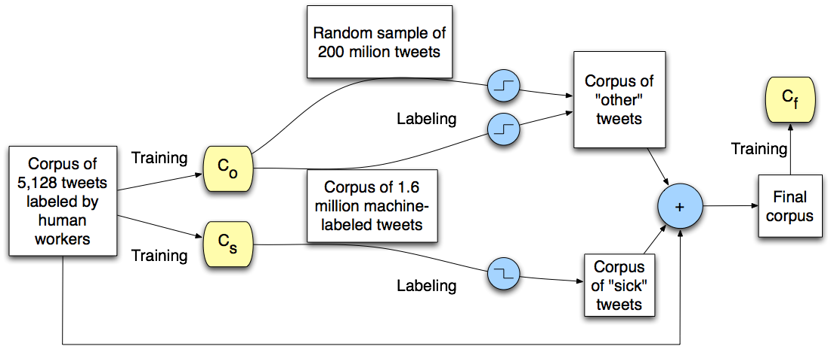
Semi-Supervised Learning
Notes:
5K & 1.6M corpora courtesy of [Michael J. Paul and Mark Dredze, 2011]

Slide 14
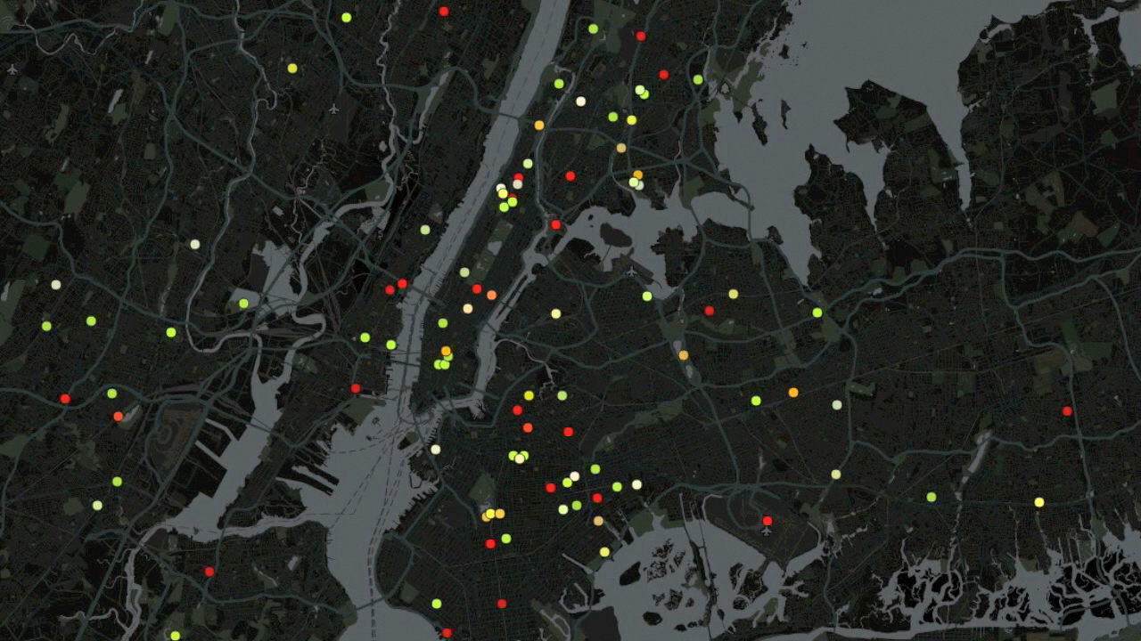

Slide 15
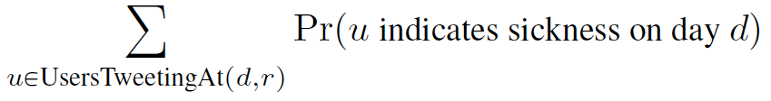
Validating the Twitter Health Signal Feature Tf
Computed weekly:
  Center for Disease Control flu measure Cf
  Google Flu measure Gf
Computed daily: Twitter Health measure Tf

Slide 16
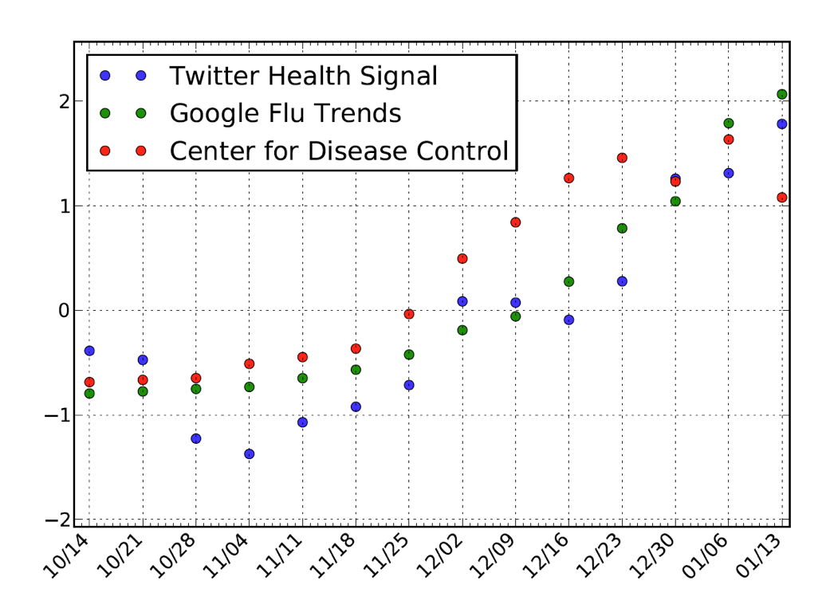
Validating Tf
NYC, Boston, Los Angeles, Seattle, San Francisco
Tf correlated with Cf (R=0.80, p=0.002)
Tf correlated with Gf (R=0.87, p=0.0002)

Slide 17
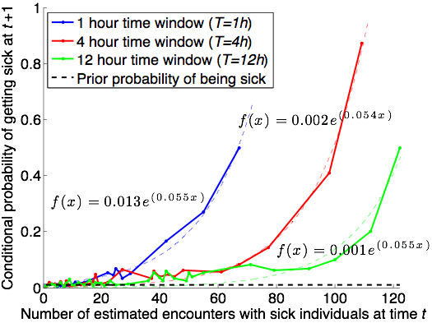
Impact of Co-Location
Impact of encountering 50+ sick users is strong

Slide 18
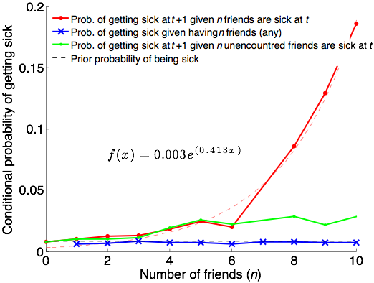
Impact of Friendships
Impact of encountering 8+ Twitter friends is strong
(Sadilek et al AAAI 2012)

Slide 19
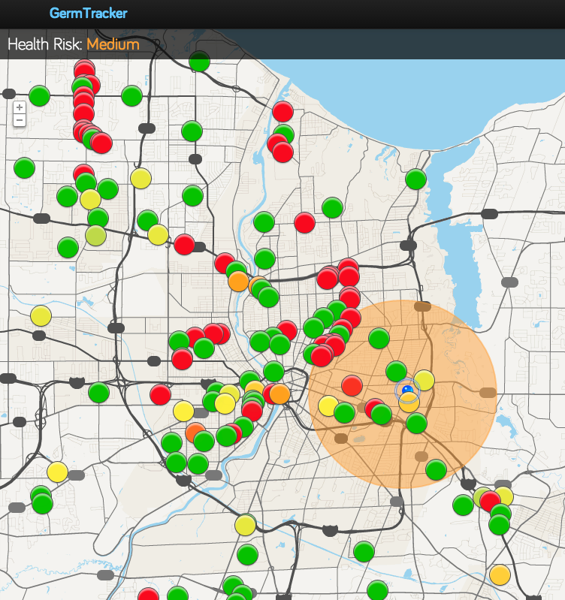

germtracker.org
Notes:
We are at an inflection point that enables novel applications that leverage the dynamic sensor networks each of us is a part of.

Slide 20
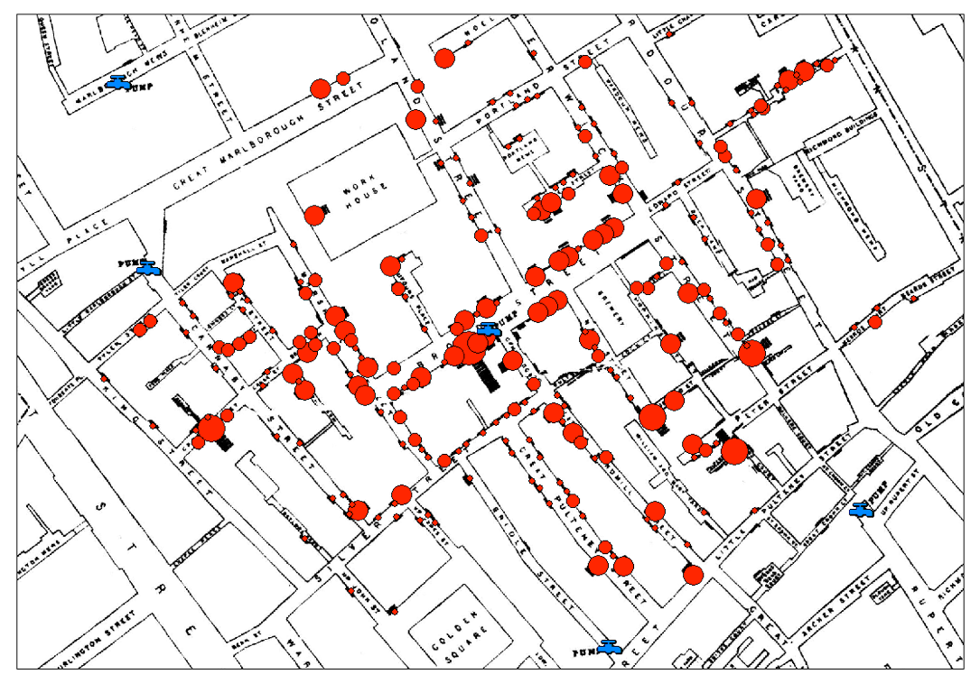
Health Insights
[Snow,1855]

Slide 21
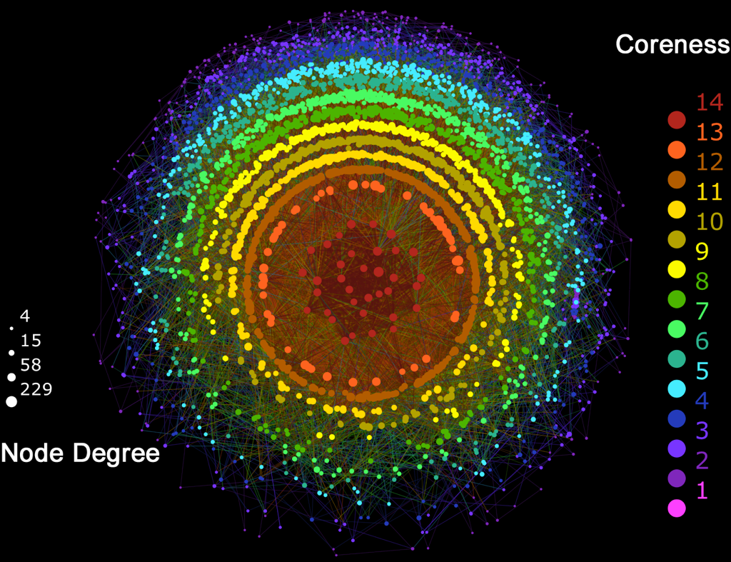
Notes:
The k-core of graph is a maximal subgraph in which each vertex has at least degree k. The coreness of a vertex is k if it belongs to the k-core but not to the (k+1)-core.

Slide 22
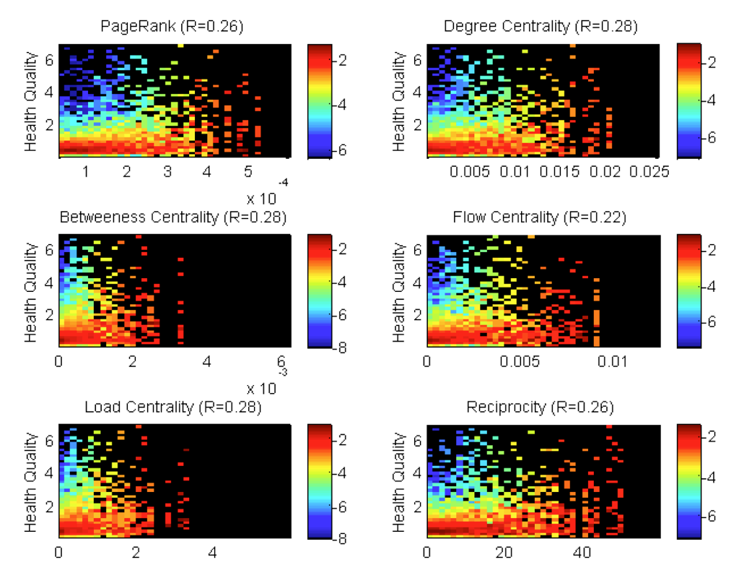
Social Network Centrality Correlates with Health

Slide 23
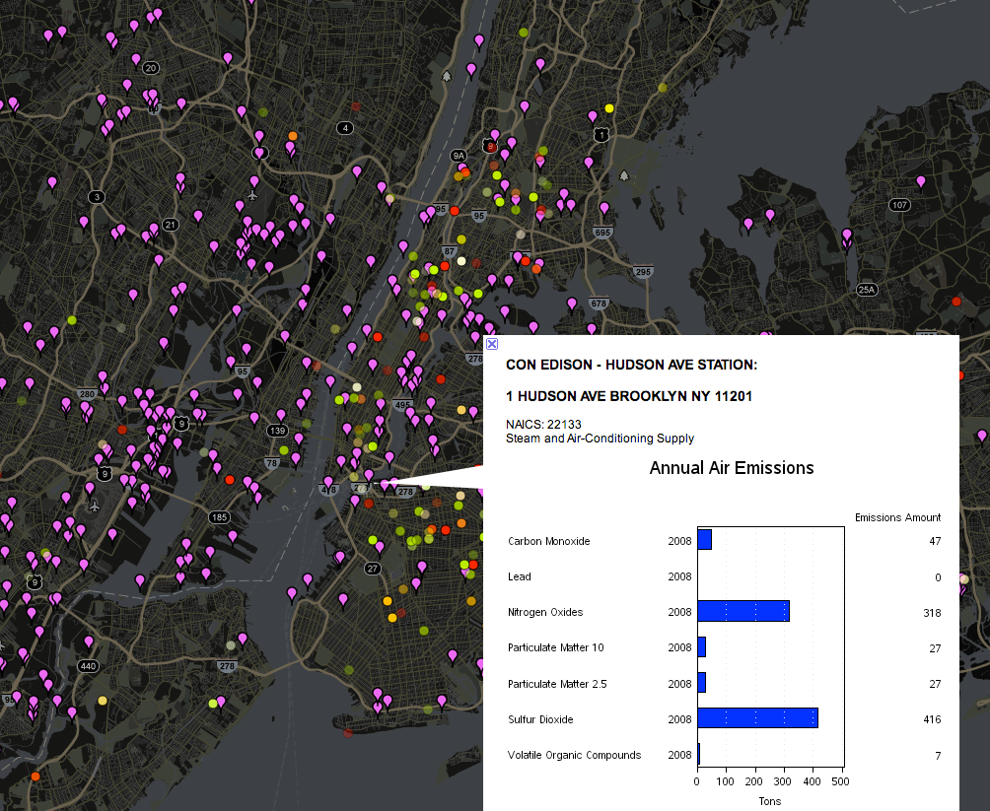

Slide 24
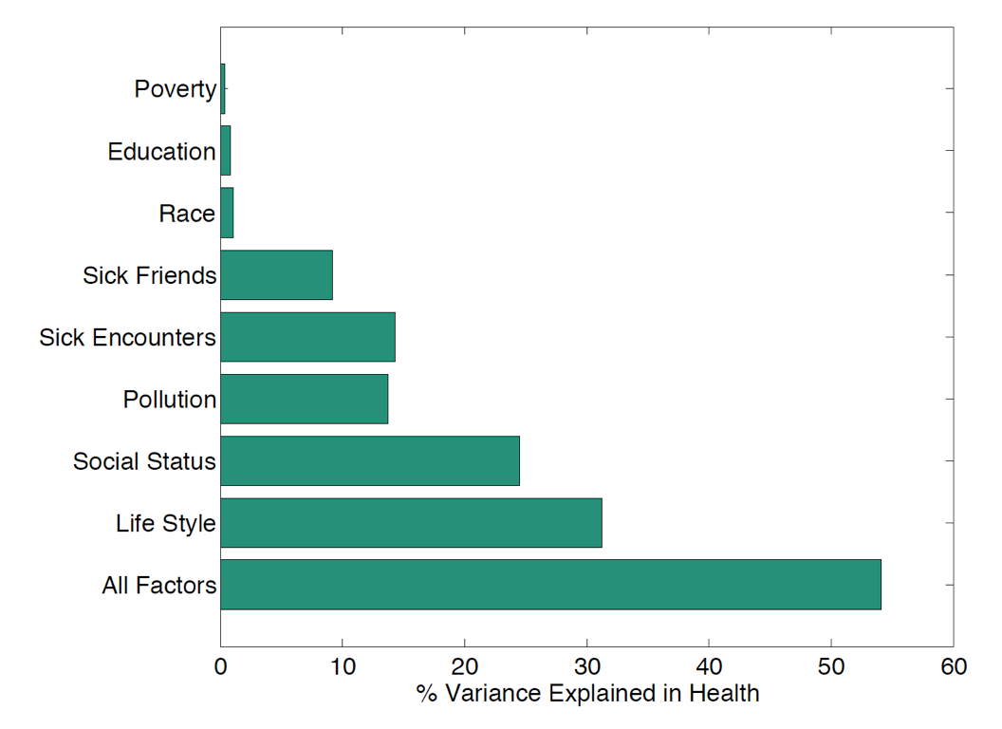
Factors Influencing Health

Slide 25
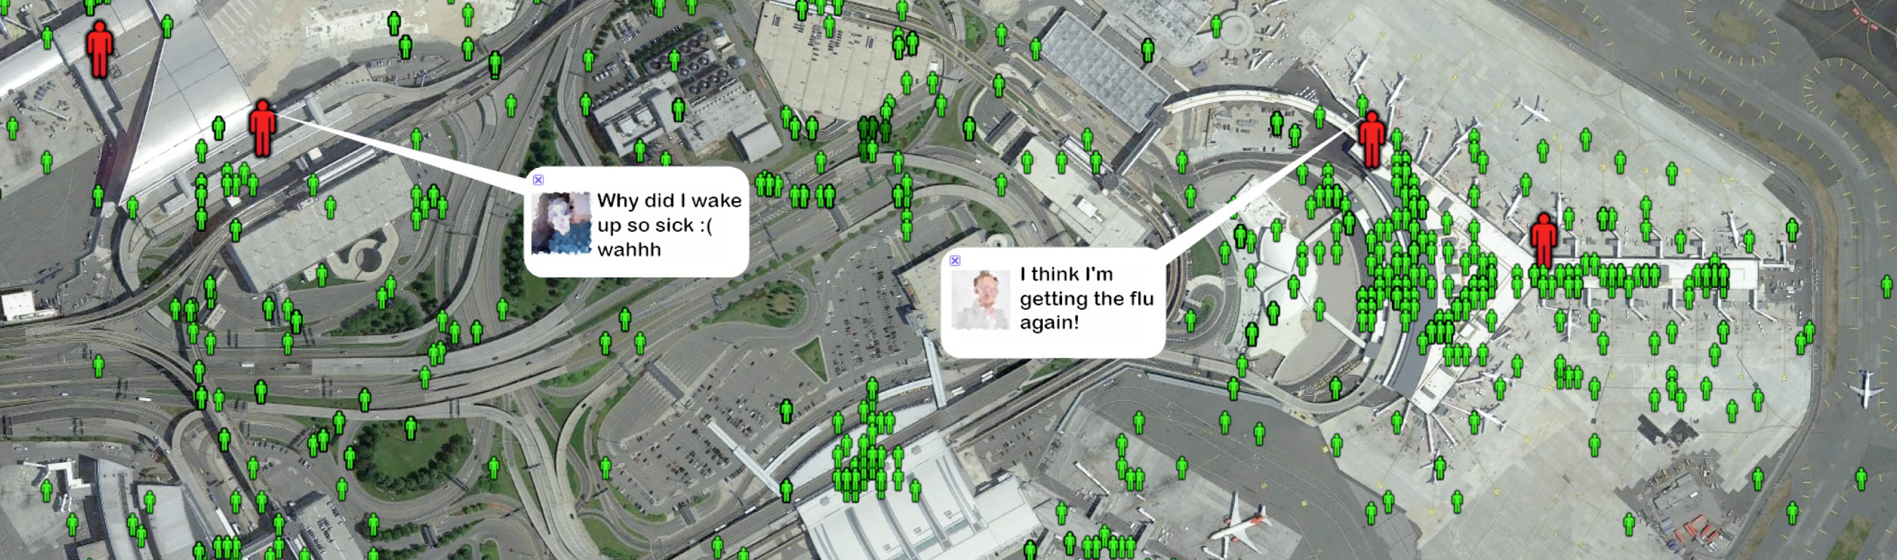
Disease Hubs & Vectors

Slide 26
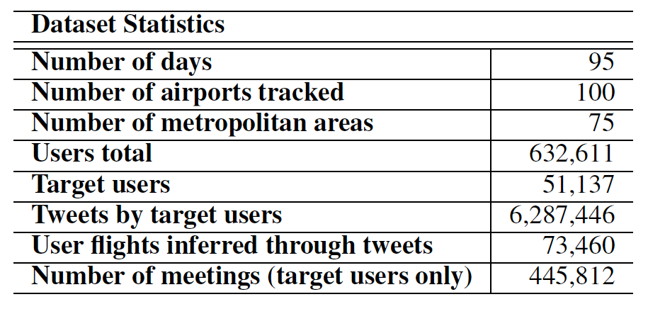
The Data
target users: tweeted from more than one airport

Slide 27
Volume and Sick Traveller Features
f(t, x→y) = # Twitter users who flew from airport x to airport y
  User tweeted from x on day t
  User tweeted from y earlier on day t or on day t-1
V(t,x) = # Twitters users who flew into x on day t
f ^{s}(t, x→y) = # sick Twitter users who flew from from airport x to airport y
  User made “sick” tweet on day t or t-1
S(t,x) = # sick Twitters users who flew into x on day t

Slide 28
Meeting Feature
Two users assumed to meet if they appear within 100 meters of each other within one hour
M(t,x) = # meetings that users traveling to airport x on day t had with sick users on days t or t-1
Captures number of exposed individuals traveling to x

Slide 29
Measuring Explanatory Power of Features
Goal: explain weekly change in Google Flu measure, ΔGf, in each city x
Linear regression over features from prior 7 days
features | explains % of ΔGf
V(t, x) | 56%
V(t, x), S(t,x) | 73%
V(t, x), S(t,x), M(t,x) | 78%

Slide 30
Prediction
Goal: predict Tf for city x on a given day using V(x,t), S(x,t), M(x,t) for 3 previous days
Single linear regression model for all cities
Our prediction of a city's flu index next week is within 7% of the true value 95% of the time

Slide 31
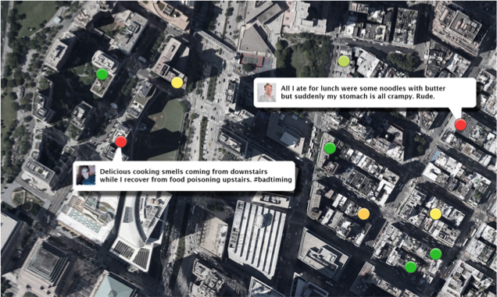
nEmesis: Foodborne Illness Surveillance

Slide 32

Foodborne Illness
Affects 48 million people annually in US
128,000 hospitalizations
3,000 deaths

Slide 33
Fighting Foodborne Illness
Primary tools
  Education of general public
  Inspections of food venues
Challenges
  Food venues inspected yearly: can predict and prepare for inspection
  Unlicensed venues
How can we target inspections more effectively?
Can we find problematic unlicensed venues?

Slide 34
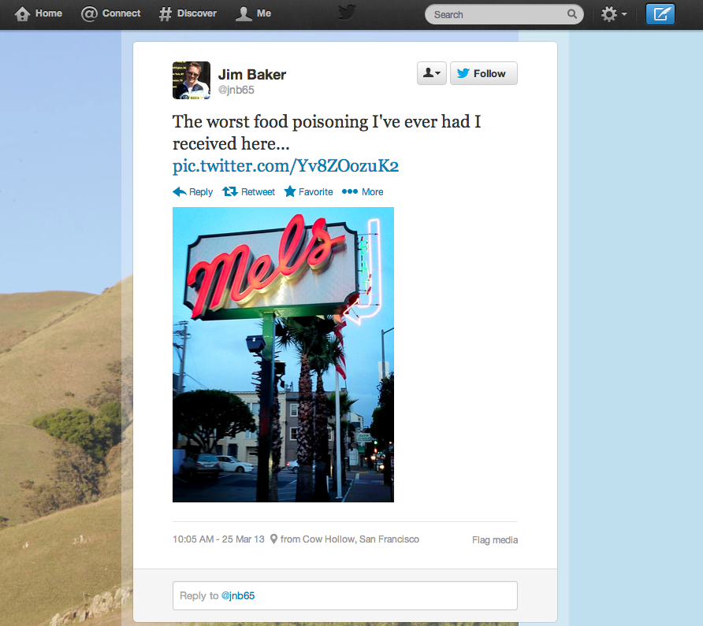

Slide 35
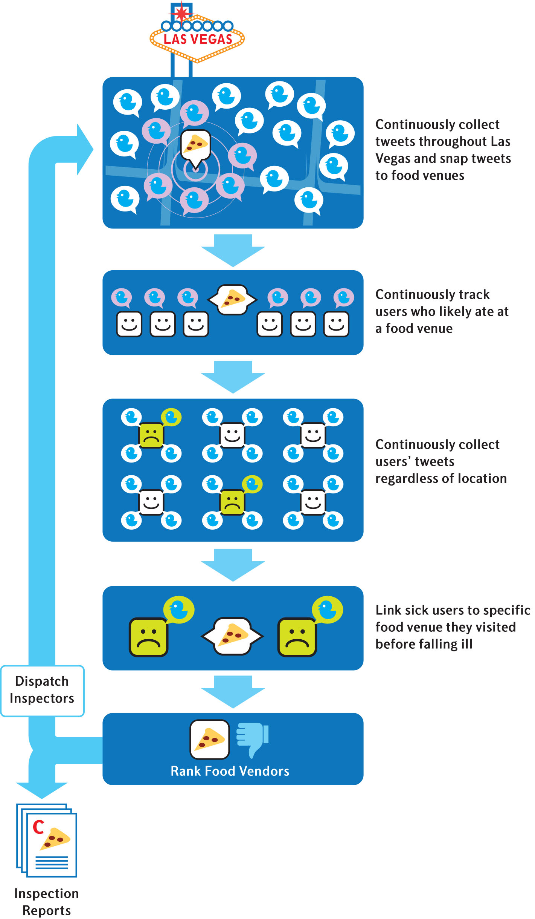

Slide 36
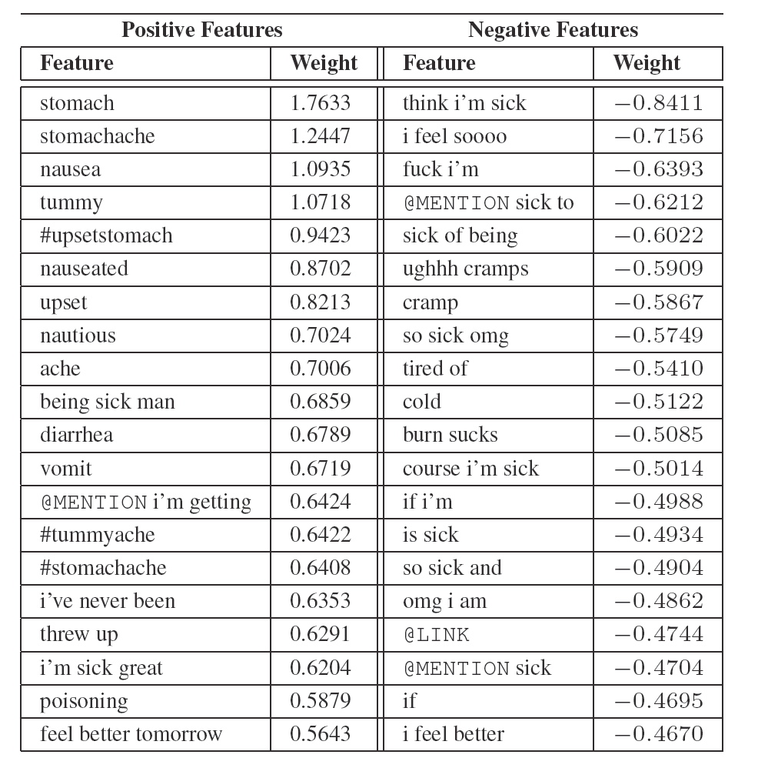

Slide 37
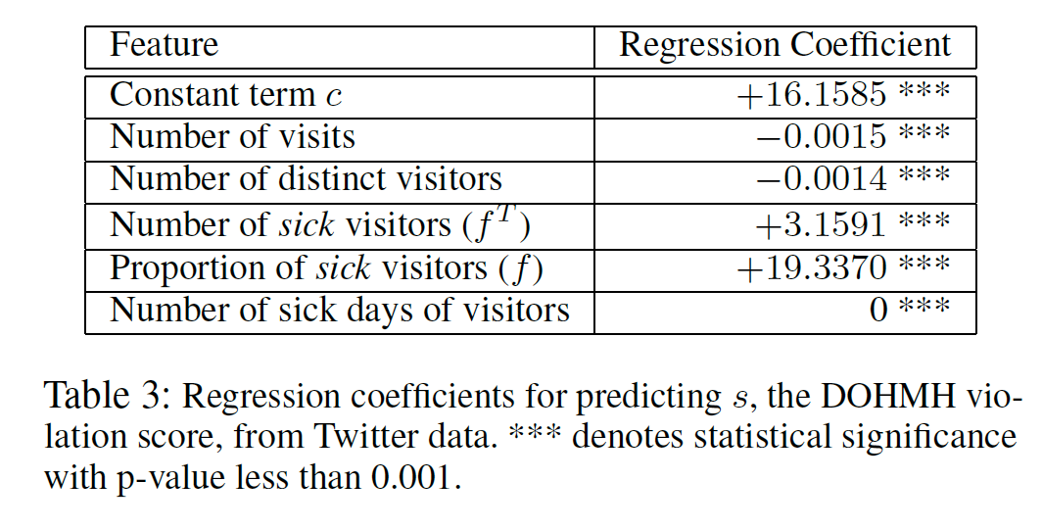
Regression Coefficients for Predicting Violation Score

Slide 38
Las Vegas Trial
3 month trial by Southern Nevada Health District (Las Vegas)
Venues with highest predicted risk flagged for inspection
  Paired control venue also inspected
  71 adaptive / 71 control inspections
  Inspectors blind to which are
  adaptive

Slide 40
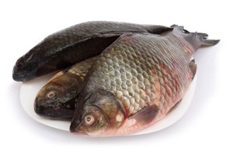
Results
Adaptive inspections uncover more violations
  9 demerits vs 6 demerits (p = 0.019)
  Significantly more “C grades” discovered: 11 vs 7
Adaptive inspections estimated to prevent 71 infections and 4.4 hospitalizations during trial
nEmesis alerted health department to an unlicensed seafood venue

Slide 41
Summary
Previous work (by ourselves and others) showed that social media analysis could track and predict disease
This is the first study that shows an effective intervention based on social media analysis
Led to CDC award with SNHD
Current work:
  Combining Twitter signal with other restaurant data to strength precision
  Alternatives to Twitter signal – e.g. search engine signal

Slide 42
Thanks!
Students
  Adam Sadilek (PhD, now at Google)
  Jack Teitel (Undergrad/MS, now at University of Rochester Health Lab)
  Sean Brennan (Undergrad, now at Microsoft)
Support
  National Science Foundation
  Centers for Disease Control
  Intel Science & Technology Center for Pervasive Computing
  New York State Center of Excellence in Data Science

