Slide 1
Unsupervised Alignment of Actions in Video with Text Descriptions
Young Chol Song, Iftekhar Naim, Abdullah Al Mamun,
Kaustubh Kulkarni†, Parag Singla†,
Jiebo Luo, Daniel Gildea, Henry Kautz
University of Rochester
†Indian Institute of Technology Delhi

Slide 2
Background and Motivation
Unsupervised alignment of parallel video and text
Examples:
In the kitchen
Text: Recipe
Video: Food preparation
In the laboratory
Text: Lab protocol
Video: Experiment
- Not all data is labeled!
The person takes out a knife
and cutting board
?
Example of parallel video and text
in a kitchen environment

Slide 3
Background and Motivation
Motivation
Generate labels from data (reduce burden of manual labeling)
Extend methods to include verbs and actions
Learn new actions from only parallel video+text
Contributions
Use of hyperfeatures to align motion features to verbs
Extension and evaluation of LCRF on action-verb pairs, with no object tracking
Matching Nouns to Objects
Limitations of Noun/Object
- Objects still need to be labeled
and tracked
- New and deformable objects
Assumptions for Alignment
- Video follows the same
sequential order as the text
Matching Verbs to Actions
The person takes out a knife
and cutting board
[Naim et al., 2015]

Slide 4
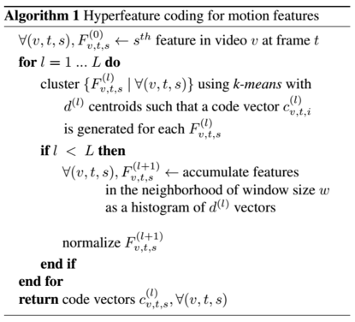
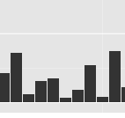
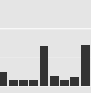
Hyperfeatures for Actions
High-level features required for alignment with text
→ Motion features are generally low-level
Hyperfeatures, originally used for image recognition extended for use with motion features
→ Use temporal domain instead of spatial domain for vector quantization
Originally described in “Hyperfeatures:
Multilevel Local Coding for Visual Recog-
nition” Agarwal, A. (ECCV 06), for images
Codebook of
Motion Features
Codebook of
Action Fragments
and Clusters
Verbs in
Language
Cluster 42
The person
removes
a carrot from
the refrigerator
The person
takes out
a large knife
and a cutting board
Cluster 19
Hyperfeatures for actions

Slide 5
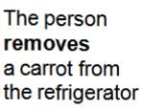
Hyperfeatures for Actions
From low-level motion features, create high-level representations that can easily align with verbs in text
Each color code
is a vector
quantized
feature point
Align hyperfeatures
with verbs from text
(using LCRF)
Feature Centroid
3, 5, …,5,20
= Hyperfeature 6
Accumulate over
frame at time t
& cluster
Conduct vector
quantization
of the histogram
at time t
Accumulate clusters over
window (t-w/2, t+w/2]
and conduct vector
quantization
→ first-level hyperfeatures
Feature
Centrioid 3
at time t
Vector quantized
STIP point histogram at time t

Slide 6
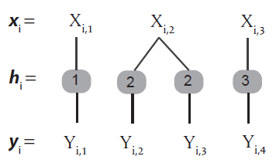
Latent-variable CRF Alignment
CRF where the latent variable is the alignment
N pairs of video/text observations {(x_{i}, y_{i})} _{i=1} (indexed by i)
X_{i,m} represents nouns and verbs extracted from the m^{th} sentence
Y_{i,n} represents blobs and actions in interval n in the video
Conditional likelihood
conditional probability of
Learning weights w
Stochastic gradient descent
N
where
feature function
(noun, blob), (verb, blob),
(verb, action), jump size
More details in our NAACL Paper (Naim et al. 2015):
Discriminative unsupervised alignment of natural language instructions with corresponding video segments

Slide 7
Experiments: Wetlab Dataset
RGB-Depth video with lab protocols in text
Compare addition of hyperfeatures generated from motion features to previous results (Naim et al. 2015)
Minor improvement over previous results
Activities highly correlated with object-use
Previous results using
object/noun alignment only
Addition of different types
of motion features
Hand and Object Tracking | Average Alignment Accuracy (%)
 | LCRF Naim et al. | LCRF +STIP | LCRF +DTraj² | LCRF +CNN
Vision Tracks | 65.59 | 66.55 | 67.77 | 66.91
Manual Tracks | 85.09 | 87.10 | 86.92 | 87.38
*Using hyperfeature window size w=150
Detection of objects in 3D space
using color and pointcloud
²DTraj: Dense trajectories

Slide 8
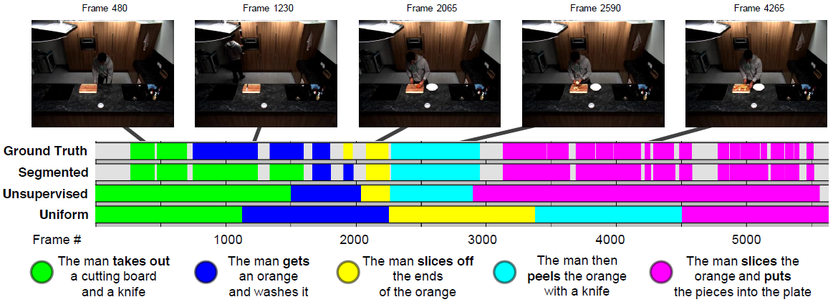
Experiments: TACoS Dataset
RGB video with crowdsourced text descriptions
Activities such as “making a salad,” “baking a cake”
No object recognition, alignment using actions only
Example of text and video alignment generated
by the system on the TACoS corpus for sequence s13-d28
Crowdsourced descriptions

Slide 9
Experiments: TACoS Dataset
RGB video with crowdsourced text descriptions
Segmented LCRF: Assume the segmentation of actions is known, infer only the action labels Unsupervised LCRF: Both segmentation and alignment are unknown
Effect of window size and number of clusters
Consistent with average
action length: 150 frames
Average Alignment Accuracy (%)
Uniform Unsupervised LCRF +STIP Unsupervised LCRF +CNN Segmented LCRF | 34.87 . 43.07 . 44.14 . 51.93 .
*Using hyperfeature
window size w=150
*d⁽²⁾=64
Centroids | Window Size w
 | 15 | 75 | 150 | 300 | 450
D⁽¹⁾ = 64 | 35.17 | 43.40 | 44.14 | 42.44 | 41.58
D⁽¹⁾ =128 | 37.65 | 42.52 | 42.85 | 43.01 | 42.01

Slide 10
Thank you!

