Slide 1
Inferring Multi-agent Activities from GPS Data
Henry Kautz & Adam Sadilek
Department of Computer Science
University of Rochester

Slide 2
Activity Recognition from GPS
Most work to date on human activity recognition from GPS data has focused on
  Activities by individuals
    E.g.: Life-logging
  Aggregate activities of groups
    E.g.: Infer popular places for tour guide apps

Slide 3
Example: Route Prediction
Given a user's GPS history and current GPS data, infer
  The user's destination
  The route the user will take
  The user's transportation plan (foot, bus, car?)
Applications
  Provide just-in-time information
  Smart GPS devices – e.g., assist with use of public transportation

Slide 4
DBN Model of Transportation Plans
Liao, Patterson, Fox, & Kautz 2003
g_{k-1}
g_{k}
Goal
t_{k-1}
t_{k}
Trip segment
m_{k-1}
m_{k}
Transportation mode
x_{k-1}
x_{k}
Edge, velocity, position
θ_{k-1}
θ_{k}
Data (edge) association
z_{k-1}
z_{k}
GPS reading
Time k-1
Time k

Slide 5
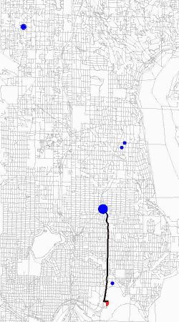
Route Prediction
Predicted goal
Predicted path

Slide 6


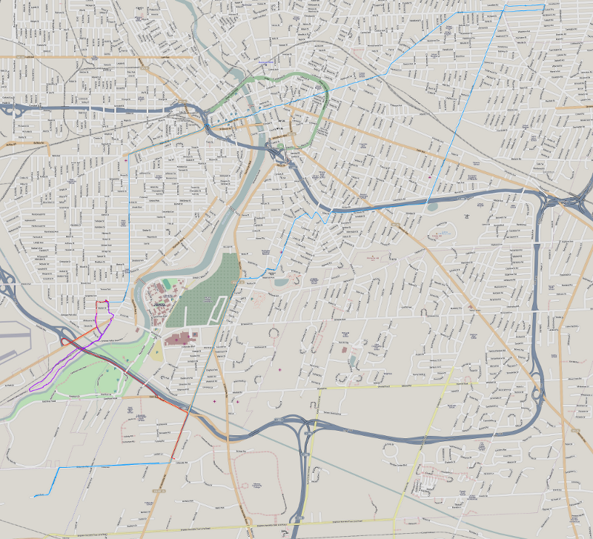



Relationships Matter
Notes:
Relationships matter
People are social and most of our behavior
Our society is built on human relationships and therefore most behavior can be fully understood only in the context of the actions of other---related---people
For example, try to define a meeting event without involving multiple related individuals. Even trivial activities such as waiting in line don’t make much sense without having this notion of multiple participating agents
In order to demonstrate and evaluate our approach in a clear way, we wanted a domain that is rich enough to be interesting and challenging and be based on real data,
but at the same time well defined so that the is no speculation as to what the ground truth is. So that we can objectively evaluate the results of our models.

Slide 7
Joint Activities
Goal:
  Model & recognize multi-agent activities from GPS data
  Focus on joint activities where agents play distinct role
Assumptions
  We can write a qualitative commonsense theory of the domain of activities
    Our theory is partial and inconsistent
  We have access to locations of individuals
    GPS data is noisy and incomplete

Slide 8
Applications
Eldercare: Monitoring Caregiving Activities
  Mary is spending time with Susan
  John is taking Mary to her doctor
  Measures of social and familial engagement are indicators of physical and mental health
Strategic Analysis
  Battlefields or intelligence reports
  Who is doing what with who to whom?

Slide 9
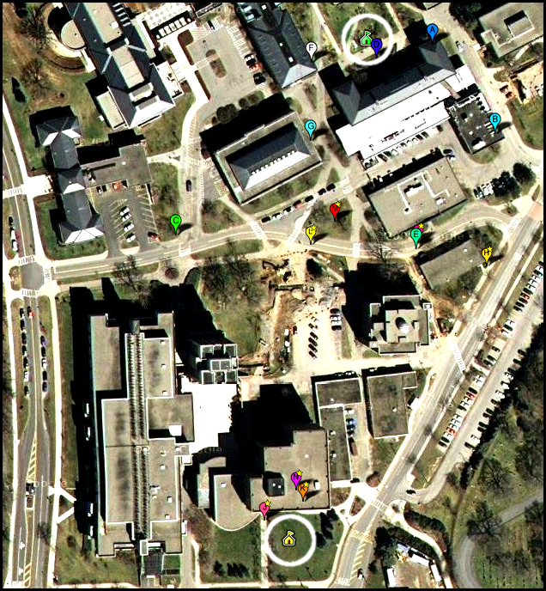

Slide 10
Capture the Flag Domain
Rich but controlled domain of interactive activities
  Very similar to strategic applications
Rules
  Two teams, each has a territory
  A player can be captured when on the opponents' territory
  A captured player cannot move until freed by a teammate
  Game ends when a player captures the opponents' flag

Slide 11
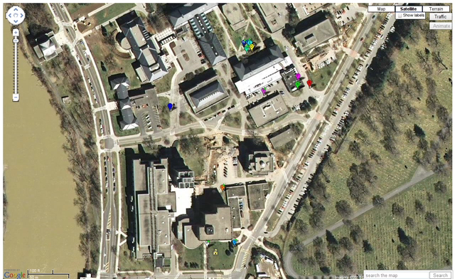
Game Video

Slide 12
Constraints
Player location critical for recognizing events
  Capture requires players to be within an arm's reach
Consumer grade GPS loggers do not appear to have required accuracy
  Error: 1 – 10 meters, typically 3 meters
  Relative error: no better!
    Differences in individual units much larger than systematic component of GPS error

Slide 13
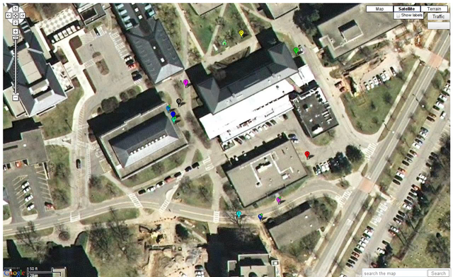
Close Up: Critical Area

Slide 14
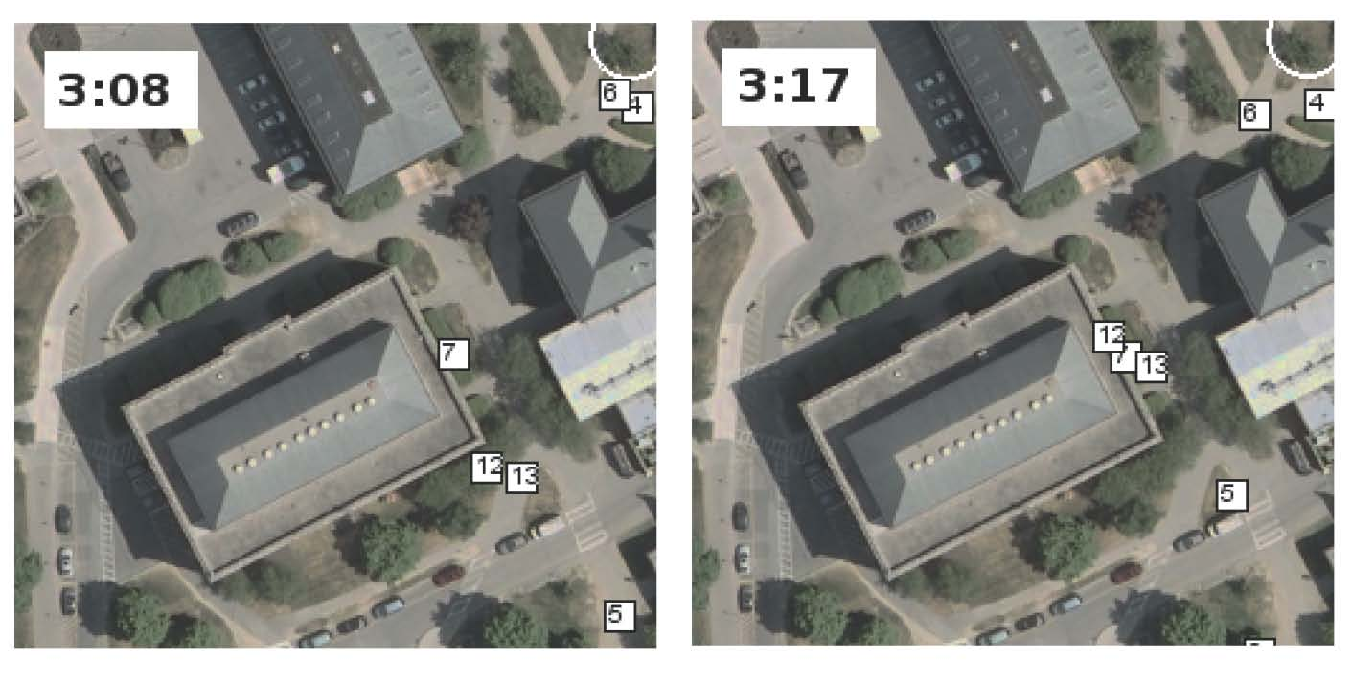
Difficult Example
Did player 7 capture player 12 or player 13?
Can we solve this problem ourselves?

Slide 15
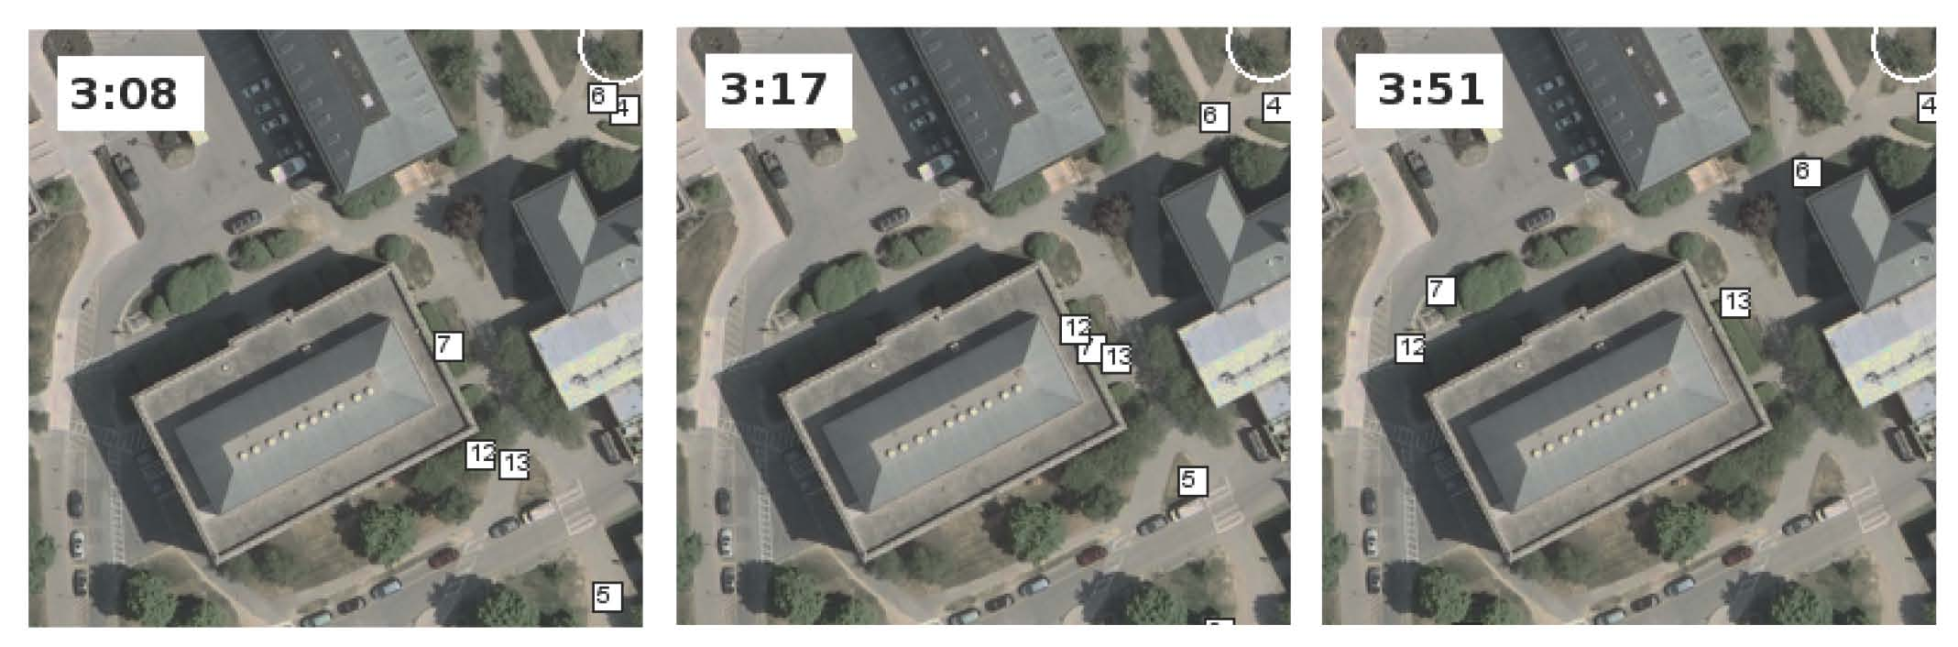
Difficult Example
40 seconds later, we see:
  13 isn't moving
  Another defender, 6 isn't trying to capture 13
  12 is moving
Therefore, 7 must have captured 13!

Slide 16
Approach
Solve localization and joint activity recognition simultaneously for all players
Inputs:
  Raw GPS data from each player
  Spatial constraints
  Rules of Capture the Flag
Output:
  Most likely joint trajectory of all players
  Joint (and individual) activities

Slide 17
Relational Reasoning
This is a problem in relational inference
  Estimate of each player's location & activities affects estimates for other players
Rules of the game are declarative and logical
  A player might cheat, but the rules are the rules!
Tool: Markov Logic (Domingos 2006)
  Statistical-relational KR system
  Syntax: first-order logic + weights
  Defines a conditional random field

Slide 18
Markov Logic
Uses FOL to compactly describe a log normal conditional random field
  ground clause = feature function
  first-order formulas tie the weights of their propositional groundings
  Weights are learned from data

Slide 19
Example
friends(A,B)
friends(B,A)
enemies(A,B)
enemies(B,A)
capturing(A,B,2)
nearby(A,B,2)
capturing(B,A,2)
nearby(B,A,2)

Slide 20
Inference: MaxWalkSAT (Kautz & Selman 1995)
Pick a random unsatisfied clause
p
Flip a random atom
1−p
Flip the atom that maximizes the sum of the weights of the satisfied clauses

Slide 21
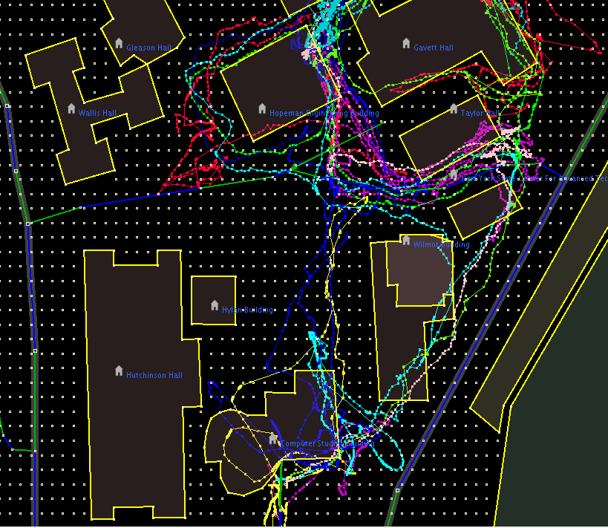
Denoising GPS Data: Snapping

Slide 22
Snapping

Slide 23
Snapping

Slide 24
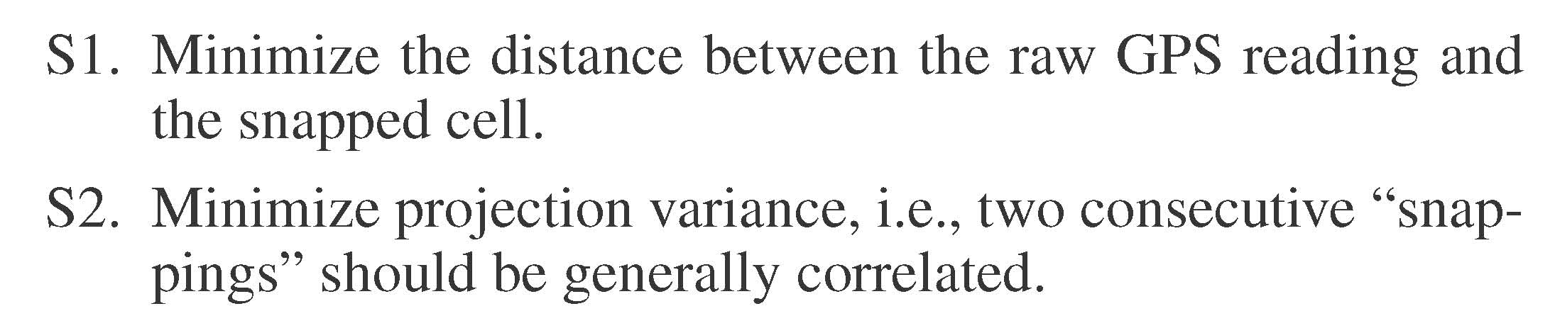
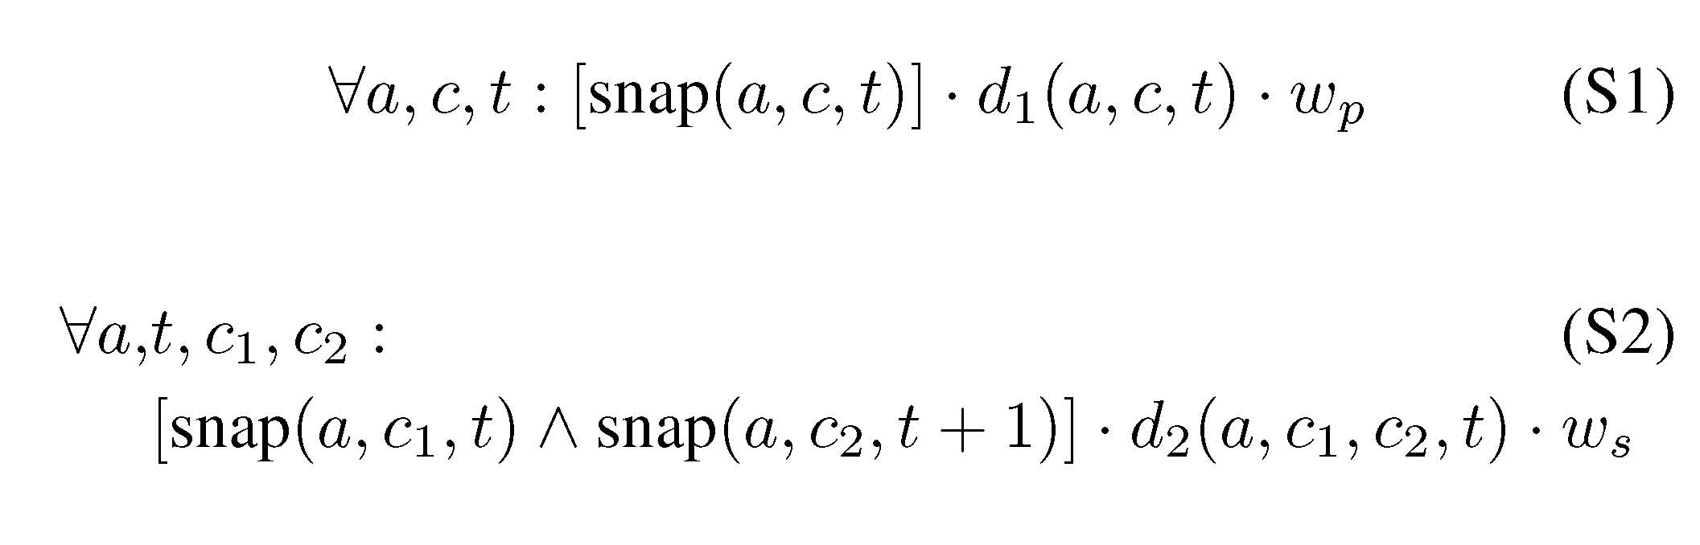
Soft Rules for Snapping (Localization)

Slide 25
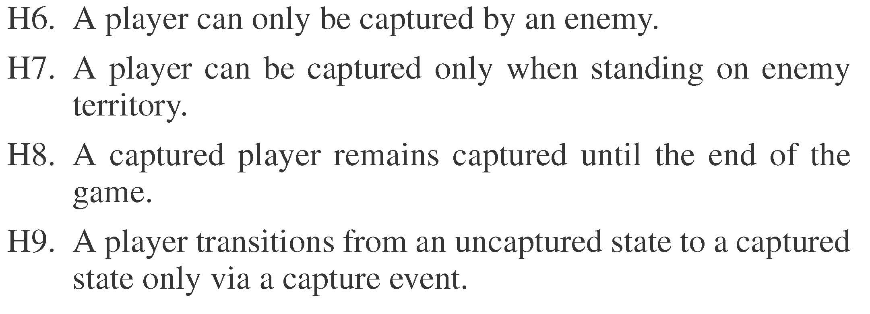
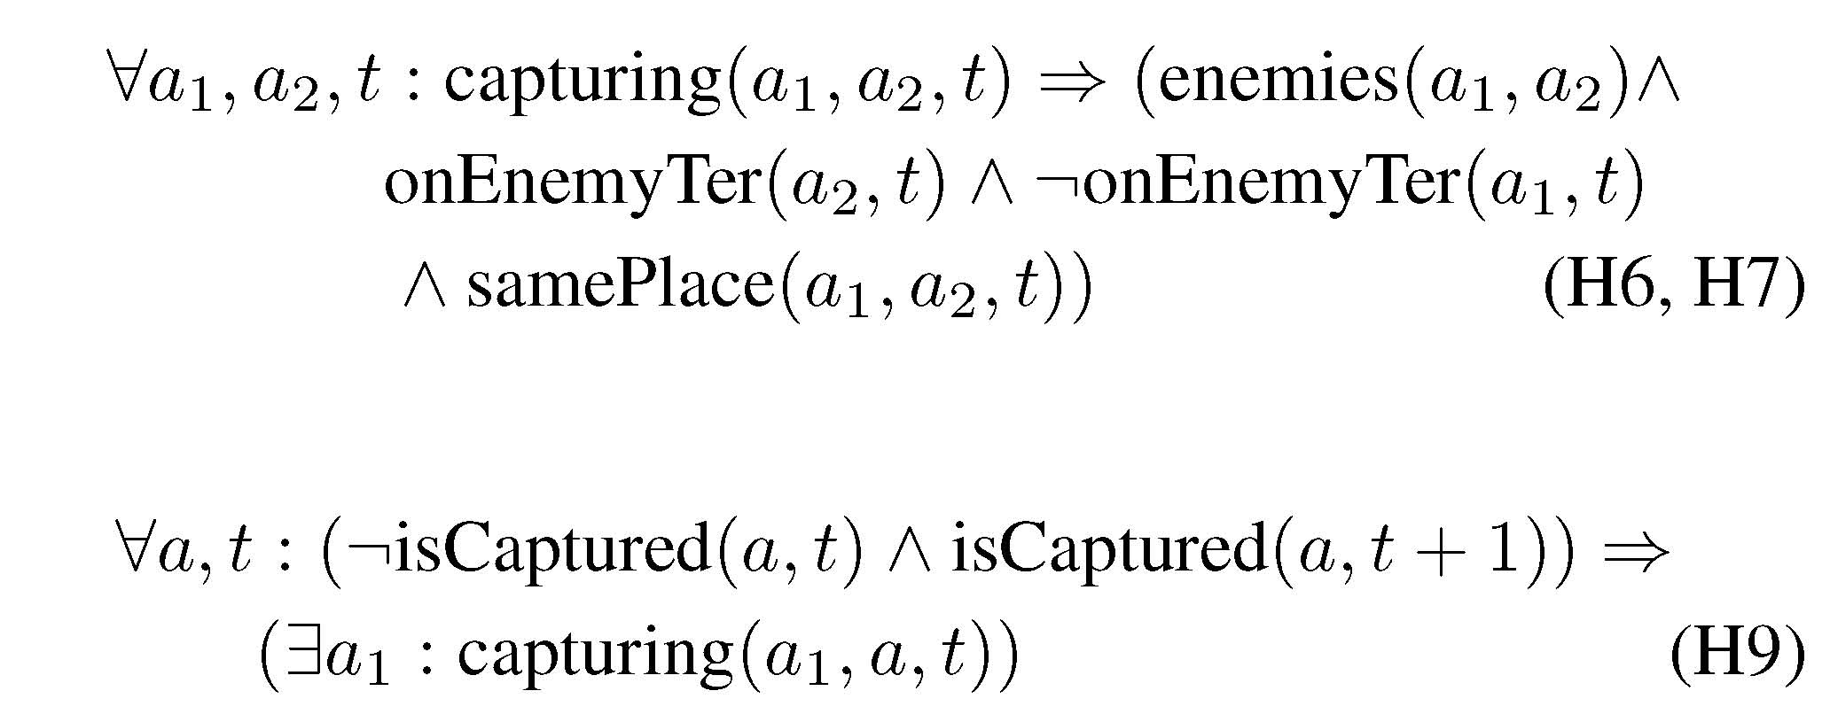
Hard Rules for Capturing

Slide 26
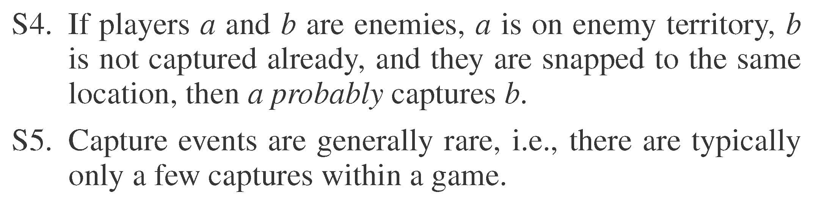
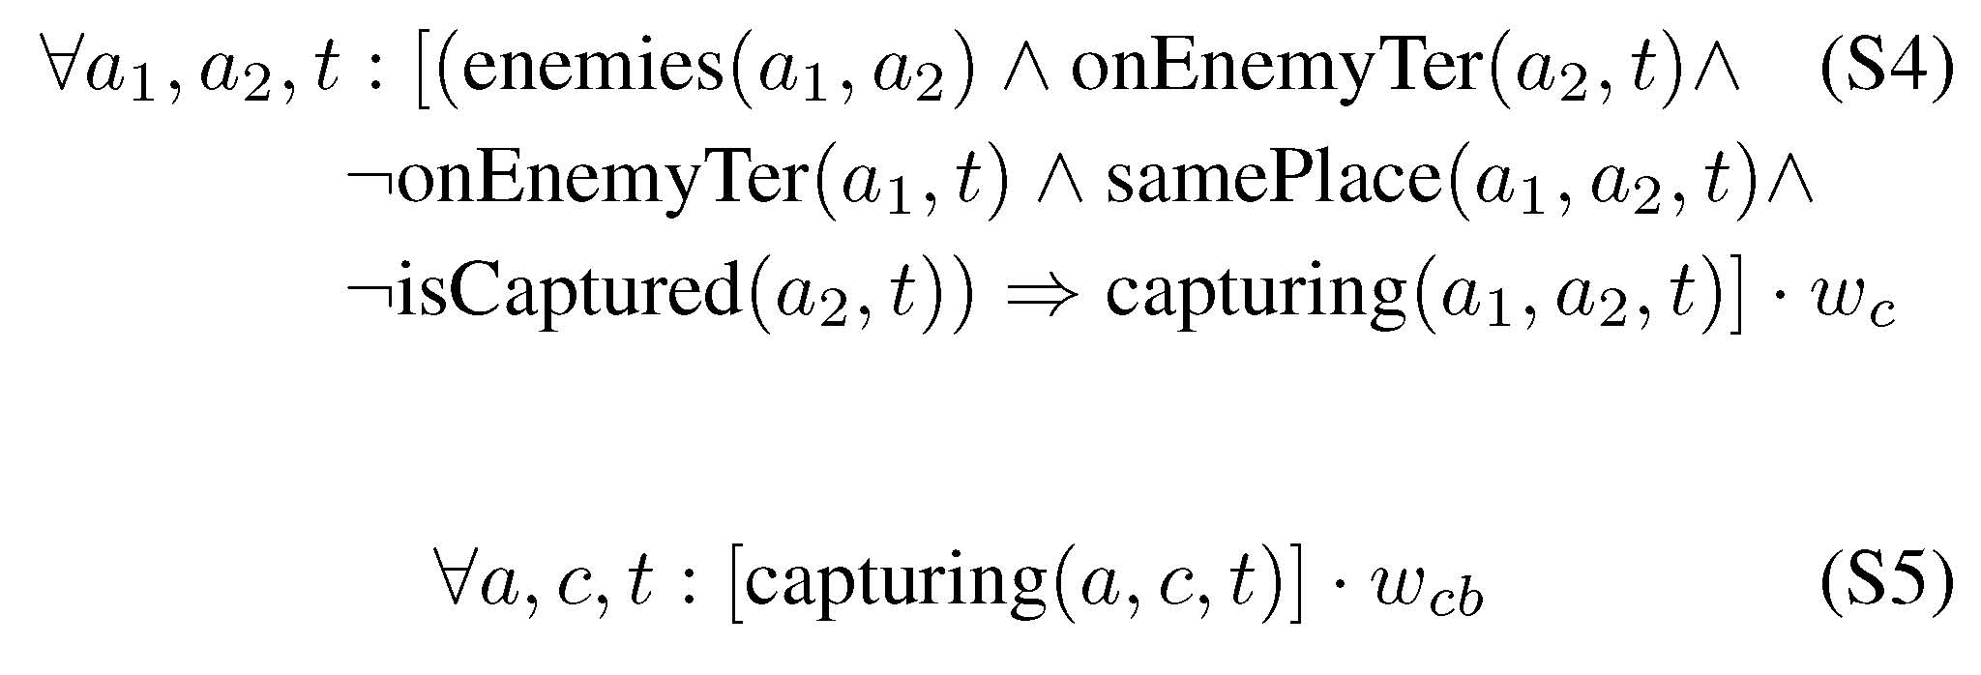
Soft Rules for Capturing

Slide 27
Comparison
Baseline
  Snap to nearest 3 meter cell
  If A next to B on A's territory, A captures B
  Expect high recall, low precision
Baseline+States
  Like baseline, but keep memory of players state {captured, not captured}
  Expect better precision, possibly lower recall
2-Stage Markov Logic Model
  Find most likely explanation using ML theory about location
  Use as input to ML theory about capture
Unified Markov Logic Model
  Find most likely explanation using entire axiom set

Slide 28
Capture The Flag Dataset
3 games
2 teams, 7 players each
GPS data logged each second
Games are 4, 14, and 17 minutes long
 | length of game (minutes) | # GPS readings | # Captures | # Frees
Game 1 | 16 | 13,412 | 2 | 2
Game 2 | 17 | 14,400 | 2 | 2
Game 3 | 4 | 3,472 | 6 | 0
Game 4 | 12 | 10,450 | 3 | 1
Total | 49 | 31,284 | 10 | 5

Slide 29
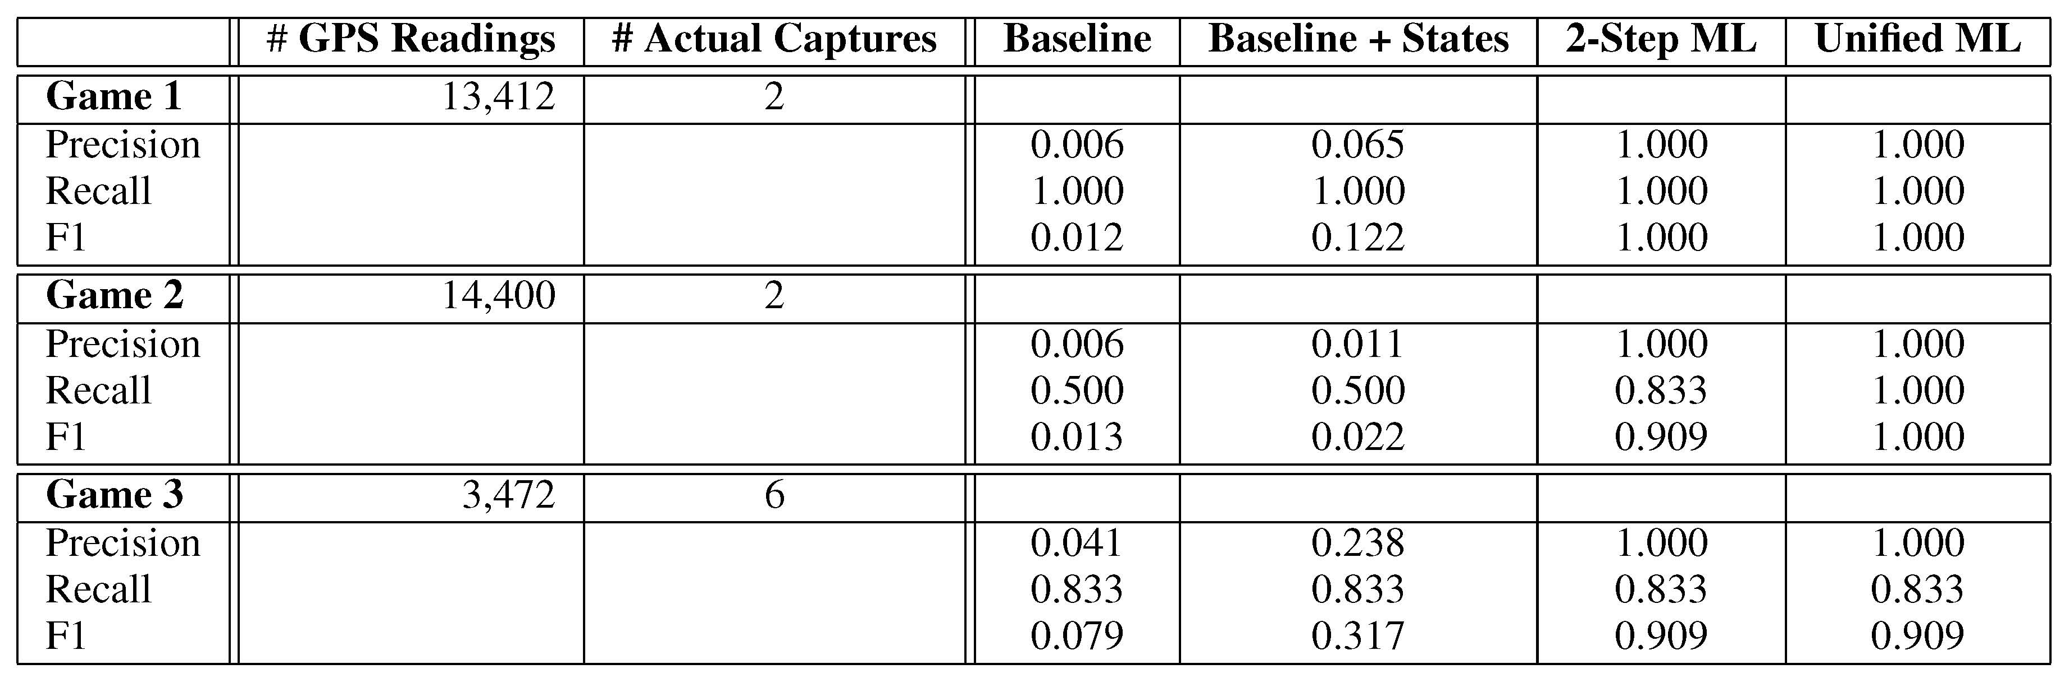
Results for Recognizing Captures
Sadilek & Kautz AAAI 2010

Slide 30
Discovering Failed Activities
In many applications (e.g. strategic analysis) it is as important to recognize failed attempts to perform an activity, as to recognize successful activities
A failed attempt is similar to a successful attempt, but does not achieve the purpose of the activity
Can we automatically extend a theory of activities to discover failed attempts?

Slide 31
Learning Failed Attempts
Given
  A theory of successful activities
  One or more examples of failed activities
Determine how to weaken the definition of the activity so that it also covers the failures
The removed constraints = the intention or purpose of the activity
Add negation of purpose to definition of failed activity

Slide 32
Inducing a Model of Failed Attempts

Slide 33
Inducing a Model of Failed Attempts

Slide 34
Inducing a Model of Failed Attempts

Slide 35
Inducing a Model of Failed Attempts

Slide 36
Inducing a Model of Failed Attempts

Slide 37
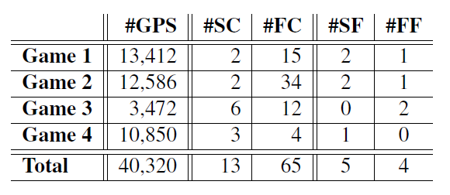
Capture The Flag Dataset
Failed attempts much more common than successful activities
  SC = successful capture
  FC = failed capture
  SF = success freeing
  FF = Failed freeing

Slide 38
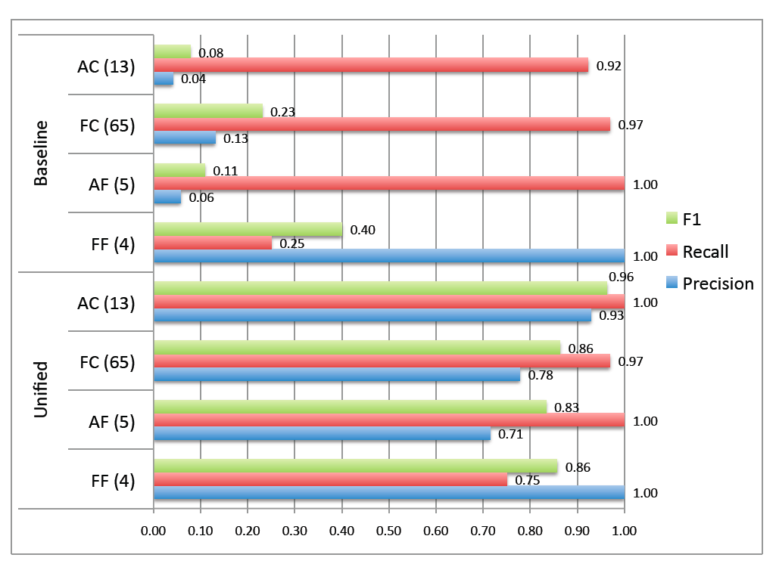
Results

Slide 39
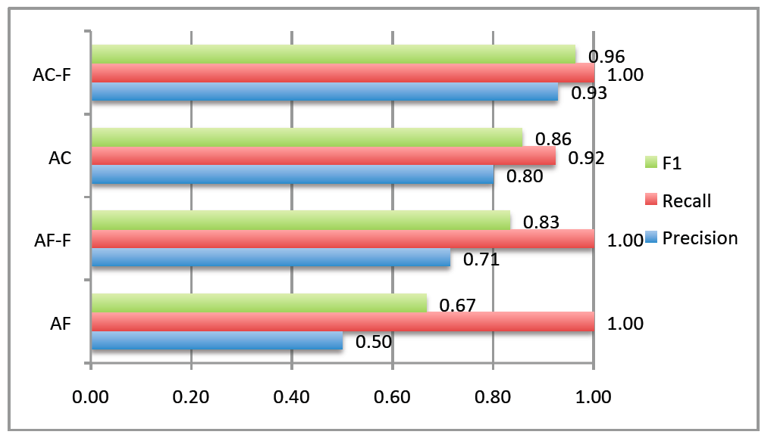
Extended Theory is More Accurate for Successful Activities

Slide 40
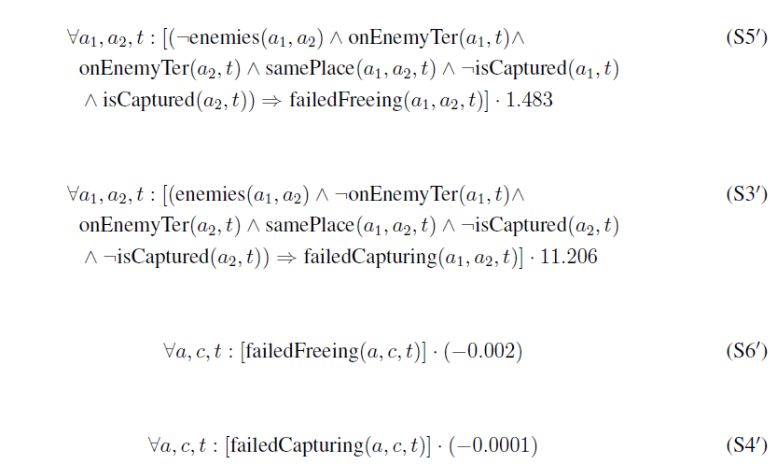
Learned Formulas

Slide 41
Activity Discovery
The approach just described required a domain-specific background theory and a modest amount of labeled training data
Suppose we did not know the rules of Capture the Flag?
  Inductive logic programming techniques can be used to learn clauses as well as weights from labeled data
  But we still would need to know the rules in order to label the data!
How can we discover the interesting interactions and domain-specific rules?

Slide 42
Activity Discovery
Speculation: we can develop a general, domain-independent theory of interesting interactions
Find and cluster interesting interactions in order to discover interaction types (in ML, the predicates)
The "failed activities" (and thus intentions) will be a cluster near the successful cluster

Slide 43
Interesting Interactions
Elements of a general theory of interactions:
  The agents are perceptually available to each other
  Behavior of one agent can be well predicted by the behavior of the other agents during the interaction
  An interaction may change some (hidden) state of an individual
  Changes in the long term behavior of an individual are evidence of such a state change
How to represent this general theory?
  As a higher-order Markov Logic theory?
  As interacting time series (individuals, pairs of individuals, triples, etc)?

Slide 44
Summary
Joint activities can be recognized with high precision from GPS data, even the face of overwhelming noise, by leveraging qualitative domain knowledge encoded in a statistical-relational language
The purpose of an activity can be inferred by comparing successful and failed attempts
Approach is general, extensible, and has practical applications
Interesting challenge: discovering joint activities

