Slide 1
Agenda
9:10 Henry Kautz, State of the Institute
9:25 Ajay Anand, Education
9:40 Walt Johnson, Data Science Consortium
9:50 Coffee Break
10:05 Questions for External Committee
  What are the most important skills you seek when hiring data scientists?
  How can we increase domestic enrollment in our MS programs?
  Should we create a PhD program in data science?
  How can we raise the visibility of Data Science at Rochester?
  Your questions and comments

Slide 2
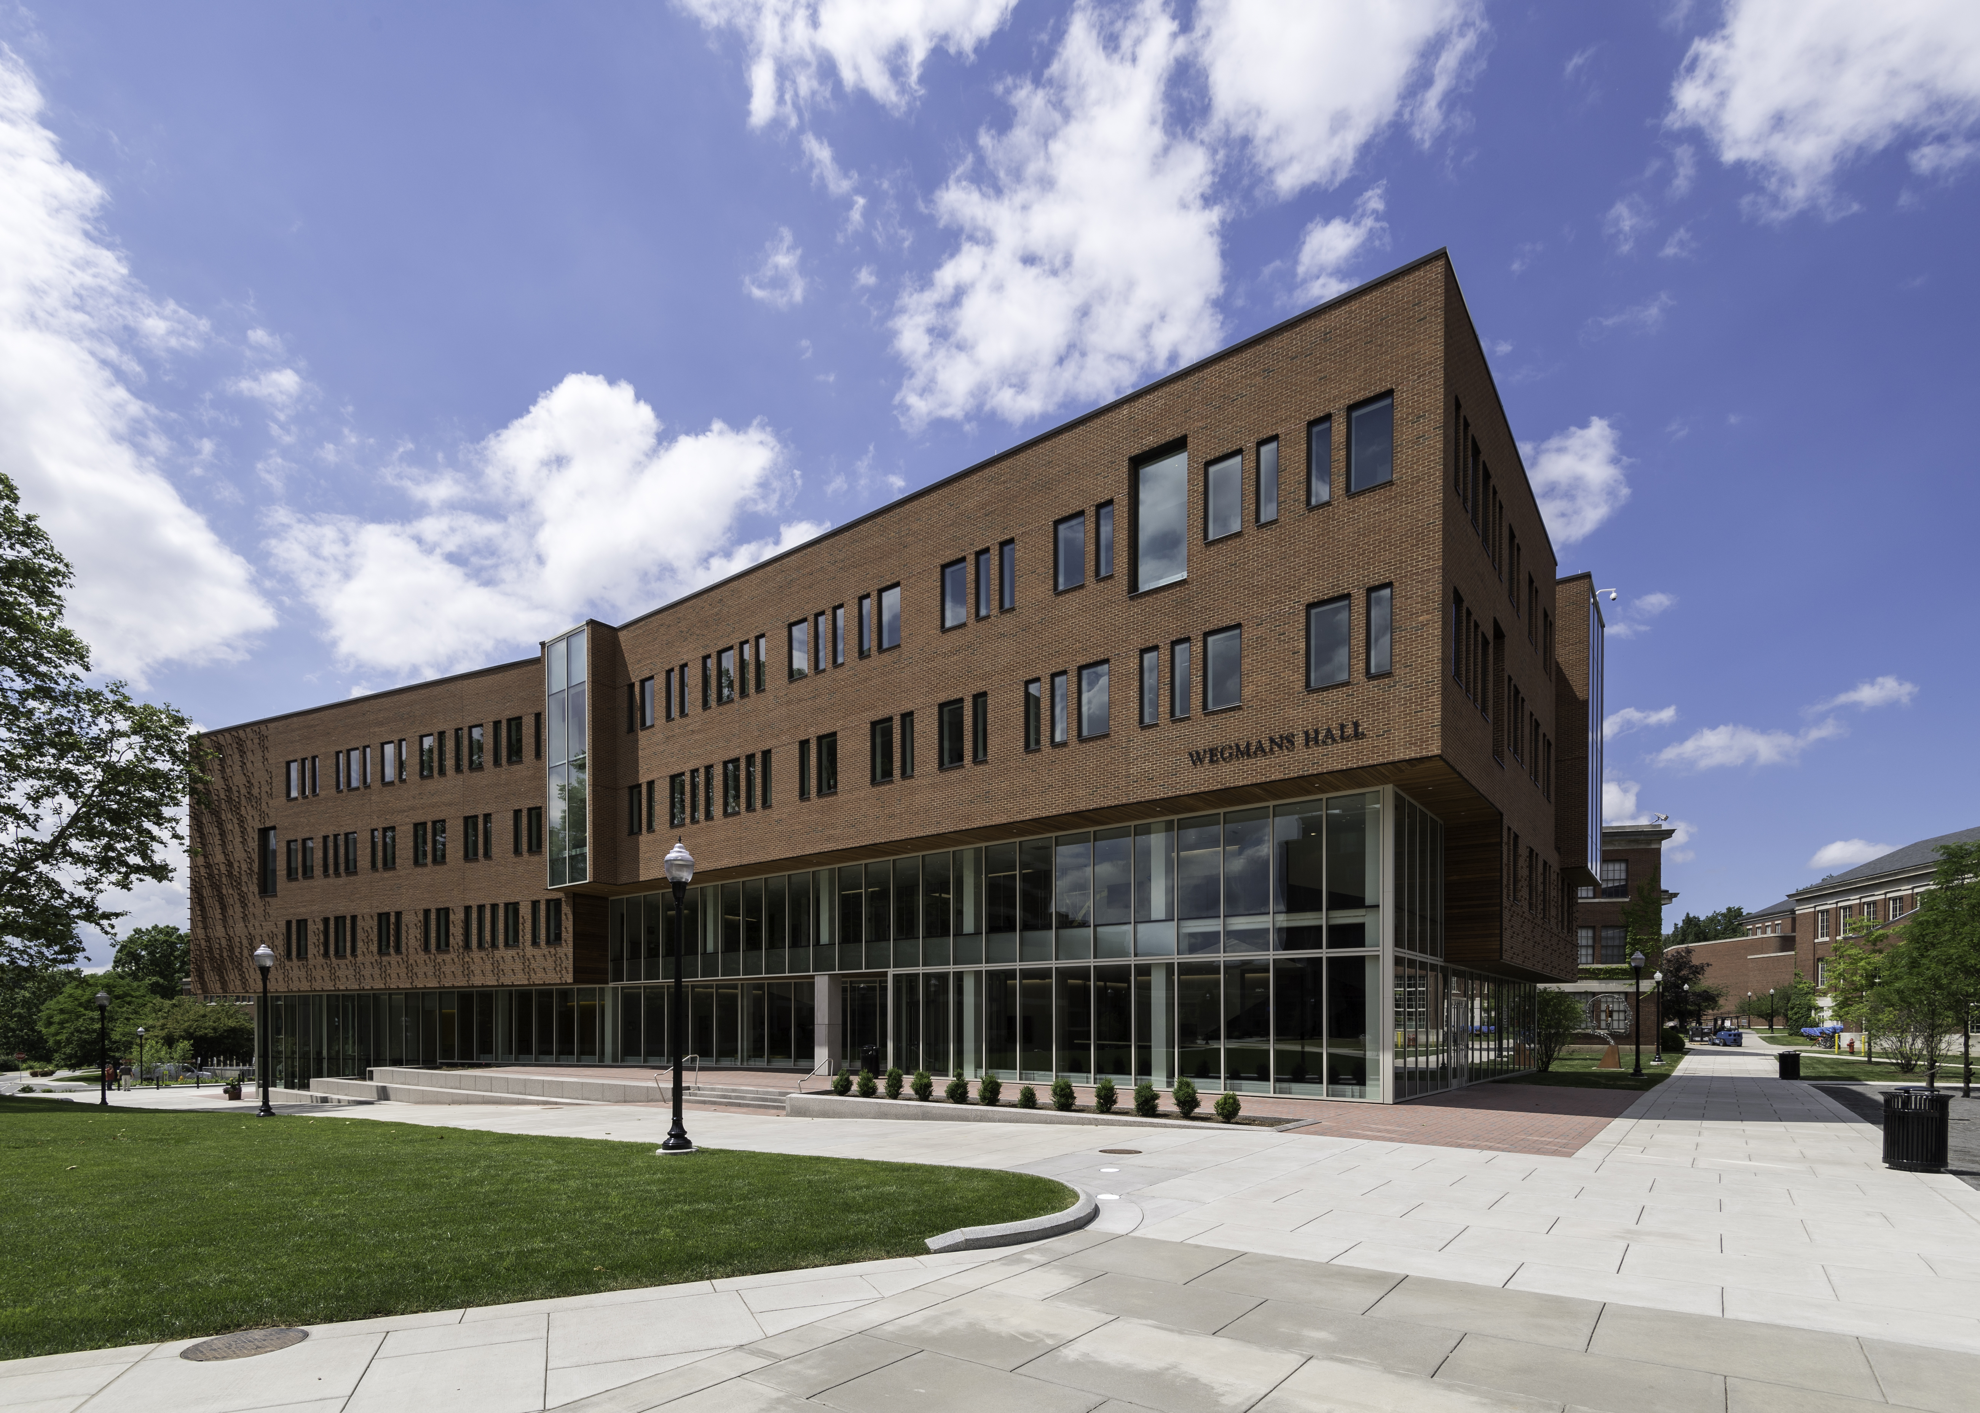

State of the the Institute
Henry Kautz
Robin & Tim Wentworth Director
Goergen Institute for Data Science

Slide 3
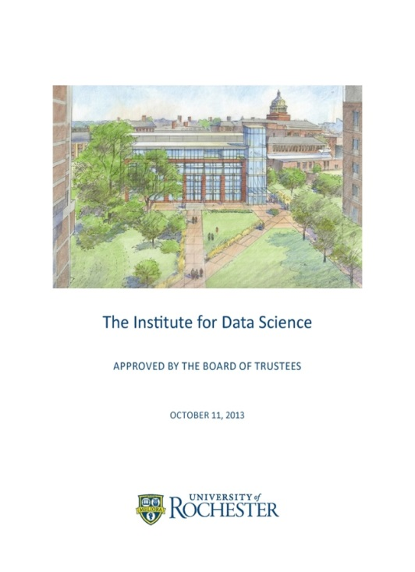
Creating the Goergen Institute for Data Science
October 2013: The signature project of the 2013-2018 University Strategic Plan will be the creation of a University-wide Institute for Data Science
Goals
  Create new education programs
  Spur interdisciplinary research
  Grow industry partnerships and commercialization

Slide 4
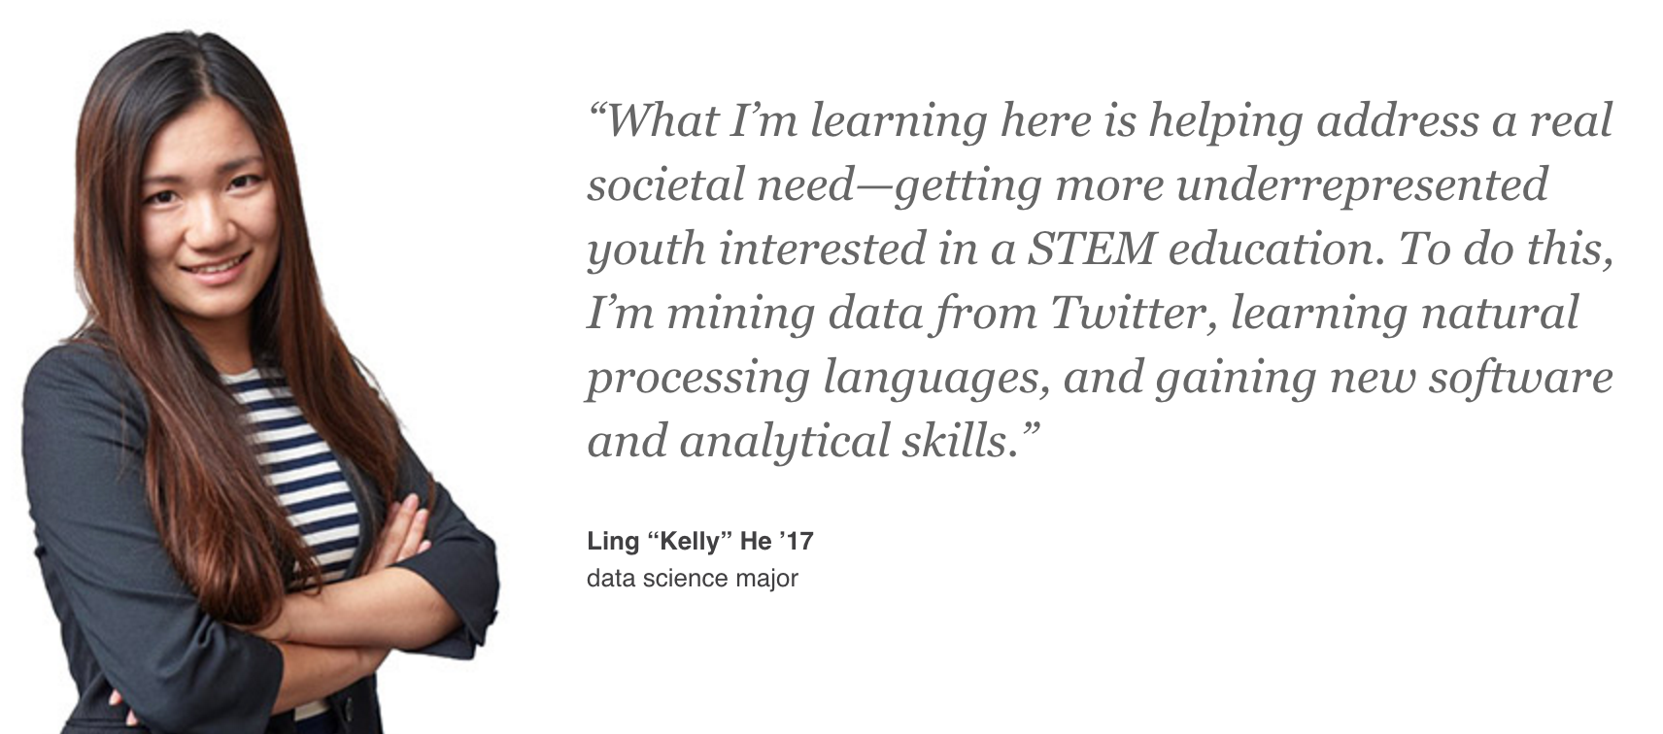
Today
BS / BA in Data Science
Masters in Data Science
Industry Partnerships
  New York State Center of Excellence
  Rochester Consortium for Data Science
  Industry-focused Capstone and Practicum Courses
Seeded 12 research projects to date linking Arts, Sciences, & Engineering with School of Medicine
$3.2M NSF National Research Training Award in Data Science
Wegmans Hall

Slide 5
GIDS Staff
Henry Kautz, Director | Walt Johnson, ED Data Science Consortium | Lisa Altman, Education Manager
Ajay Anand, Deputy Director | Adam Tulgan, Industry Collaborations | Mike Kennerknect, State Relations

Slide 6
Oversight and Outreach
External Advisory Committee
Faculty Steering Committee
Provost and Deans
65 Affiliated Faculty

Slide 7
2017 Highlights

Slide 8
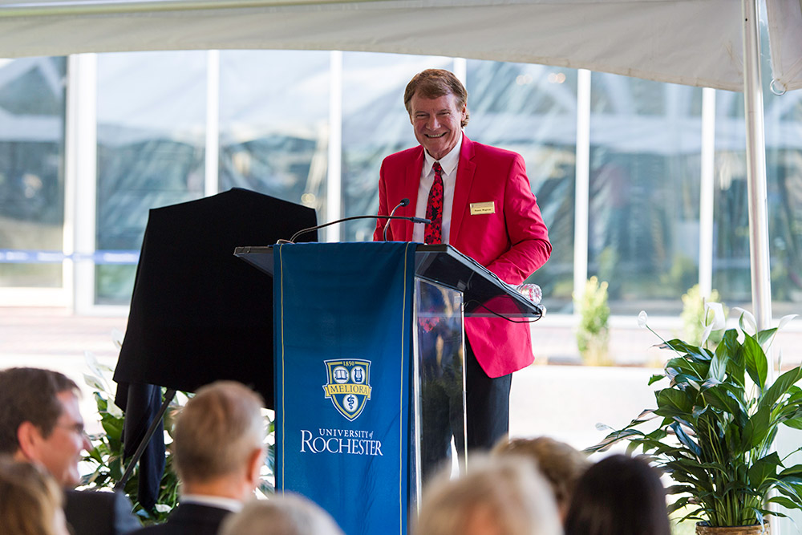
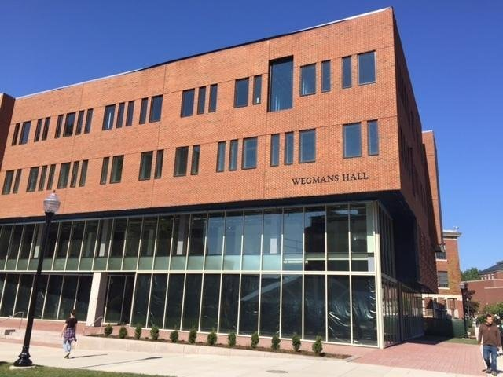
Wegmans Hall
58,000 square foot home to the Goergen Institute, Computer Science, and Center for Integrative Research Computing
$10 million Wegman Family Charitable Foundation
$15 million New York State

Slide 9
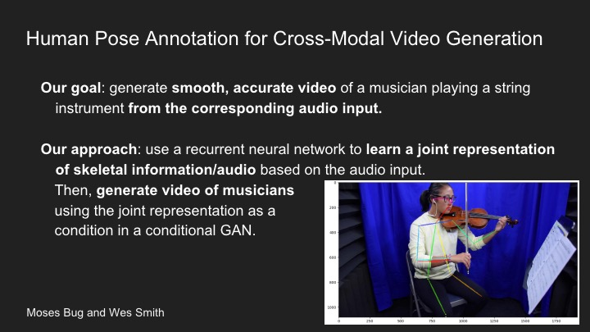
National Science Foundation Research Experience for Undergraduates
Music, Media, and the Mind
  Computer Science
  Audio Engineering
  Eastman School of Music
  Brain & Cognitive Science
  Digital Media Studies

Slide 10
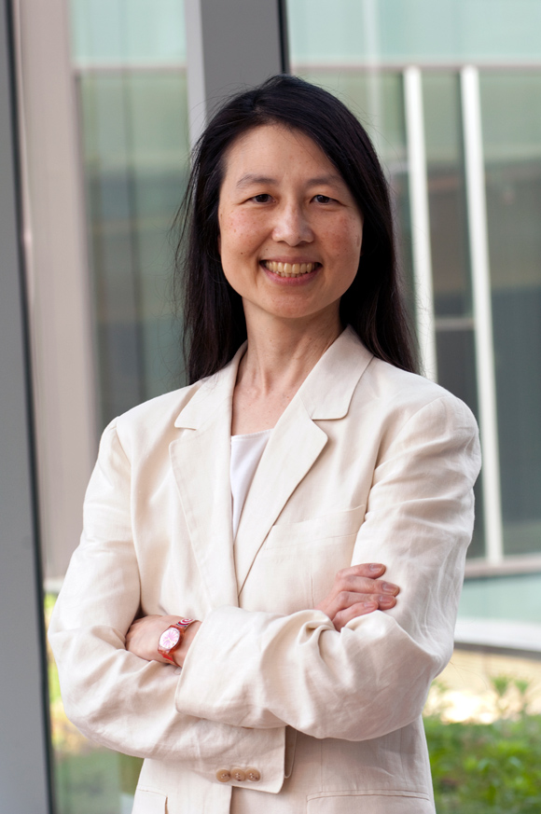
Distinguished Speakers
2017: Jeannette Wing, Director, Columbia Data Sciences Institute: Data for Good
2016: Sandy Pentland, Founder MIT Media Lab: Reinventing the Social Contract in an Age of Big Data
2015: Eric Horvitz, Head of Microsoft Research: Data Science for Social Good

Slide 11
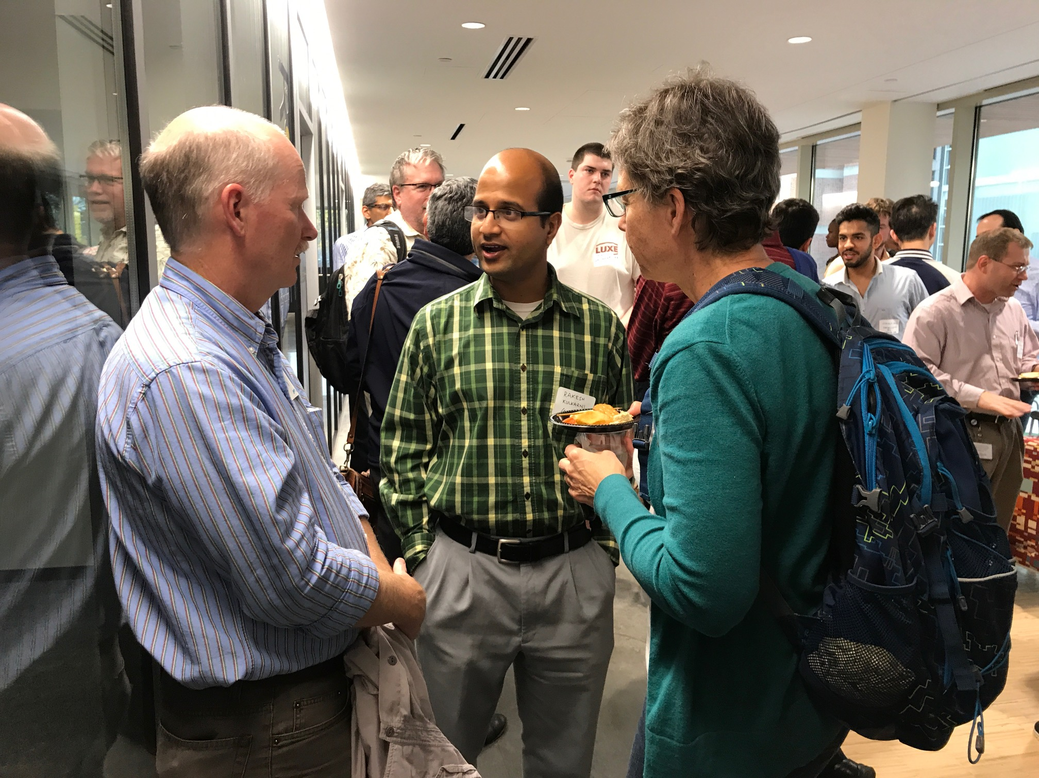
Data Science Meetup

Slide 12
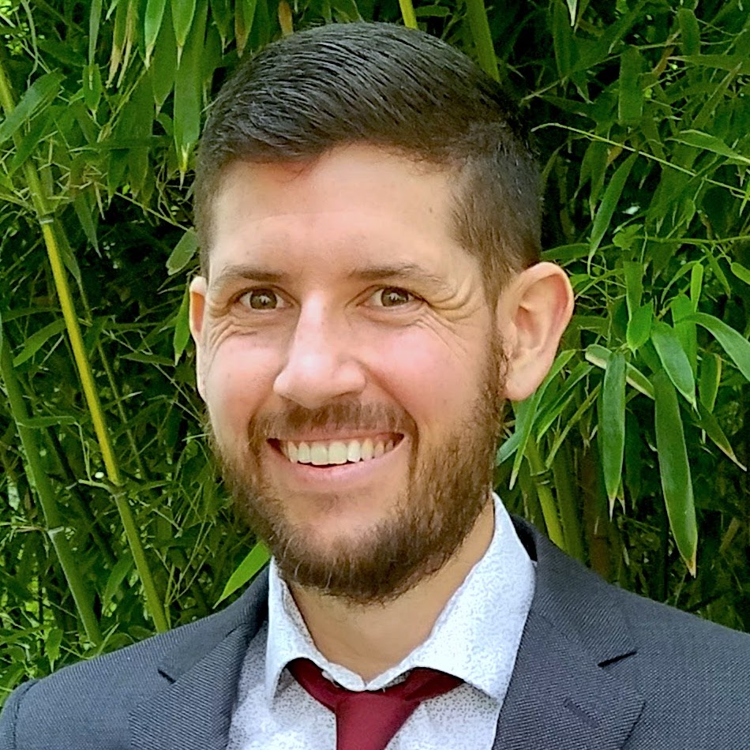
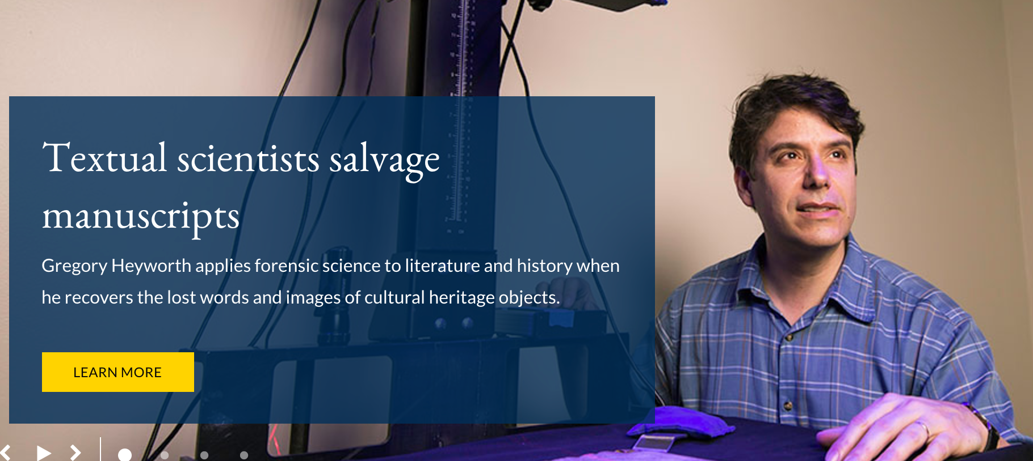
Hiring Transdisciplinary Faculty
2017: Aaron White, Computational Linguistics | 2016: Greg Heyworth, Historic Cultural Imaging
2015: Tom Howard, Human-Robot Interaction | 2015: Gourab Ghoshal, Network Science

Slide 13
Example Research Pilots

Slide 14
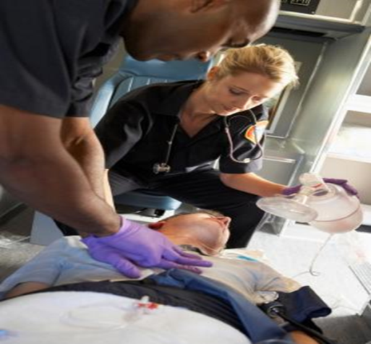
Predicting Adverse Cardiac Events
In-Hospital Cardiac Arrest
  75% mortality rate
  $20 billion heath care costs
Goal: Create a deep neural network to automatically learn patterns from ECG signals to alert clinicians of an upcoming cardiac arrest
Team
  Mina Attin (Nursing)
  Zhiyao Duan (ECE)

Slide 15
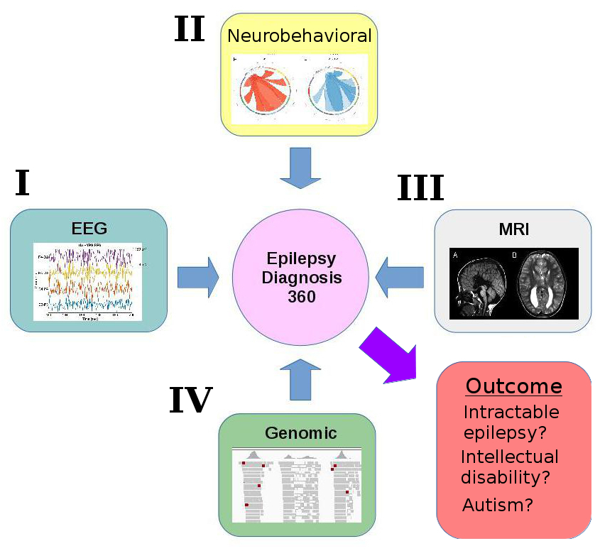
Epilepsy 360
Goal: Predict treatments likely to have best outcomes for epilepsy patients from multimodal data
Team
  Alexander Paciorkowski (Neurology)
  Gonzalo Mateos (ECE)

Slide 16
Wearable Sensor Based Motion Analysis for Parkinson’s and Huntington’s Disease
Goal: Monitor movement disorders using flexible long-term wearable sensors
Team
  Ray Dorsey (Neurology)
  Gaurav Sharma (ECE)

Slide 17
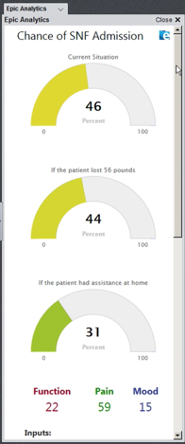
2018 – 2015 Strategic
Planning
Predictive Healthcare
  Provide health providers with patient-specific predictions of treatment outcomes
  Leverage UR Medical Center data and Health Lab information technology group

Slide 18
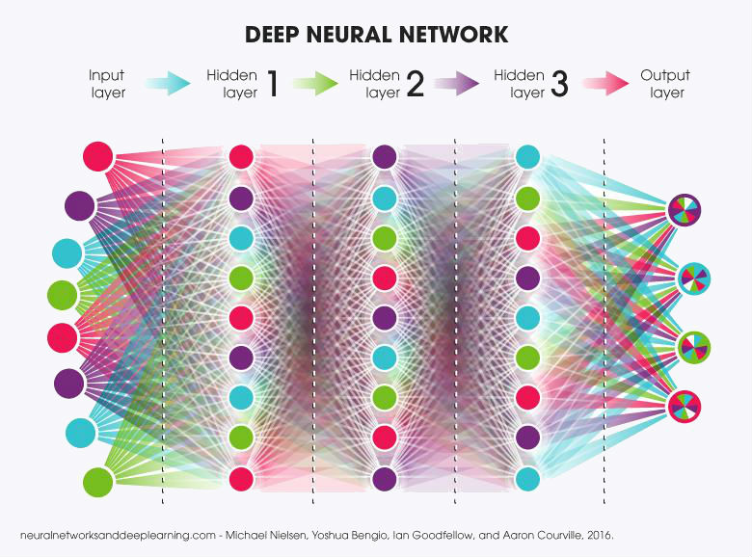
2018 – 2015 Strategic
Planning
Convergent Research in Human and Machine Intelligence
  Build on strength in AI, Neuroscience, and Cognitive Science
  Biologically inspired AI
  Artificial neural networks as fruit fly for studying biololgical intelligence

Slide 19

2018 – 2015 Strategic
Planning
Other Proposals Under Development
  Critical Digital Humanities
  Ethics of Data Science
  Data Science for Sustainability

Slide 20
Agenda
9:10 Henry Kautz, State of the Institute
9:25 Ajay Anand, Education
9:40 Walt Johnson, Data Science Consortium
9:50 Coffee Break
10:05 Questions for External Committee
  What are the most important skills you seek when hiring data scientists?
  How can we increase domestic enrollment in our MS programs?
  Should we create a PhD program in data science?
  How can we raise the visibility of Data Science at Rochester?
  Your questions and comments

