Slide 1
Learning Linguistic and Visual Models of Complex Activities
Henry Kautz
Jiebo Luo, Daniel Gildea
Young Song Chol, Qiguang Liu, Iftekhar Naim

Slide 2
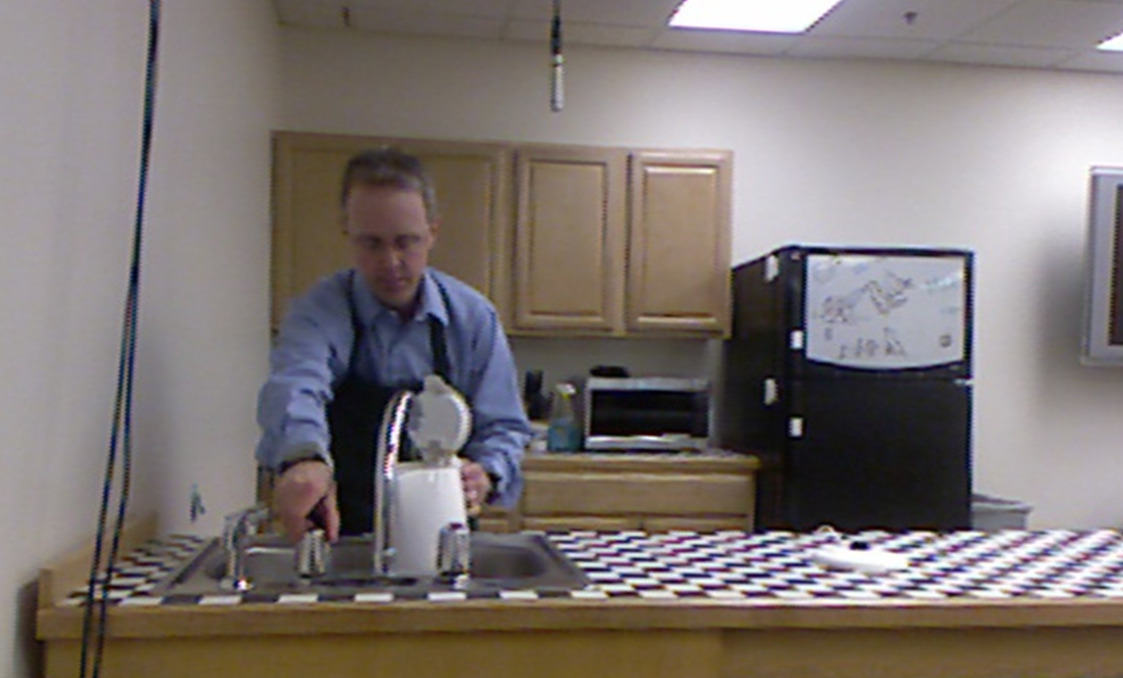
Activity Recognition
What is the person doing?
  Goals
  Action Hierarchy
    Abstraction
    Decomposition
  Fluents
  Sensor Data
Making a grilled cheese sandwich

Slide 3
Scenario
Prepare Tea
I need to get the teabox
Prepare Hot
Water
Get Teabox
Prepare Water
Using Kettle
Fill Kettle
Kettle at Faucet
Sensed: Hand
moving faucet
Sensed: Kettle
at faucet
Turn On
Faucet
Notes:
Good example that captures a lot of aspects of activity recognition

Slide 4

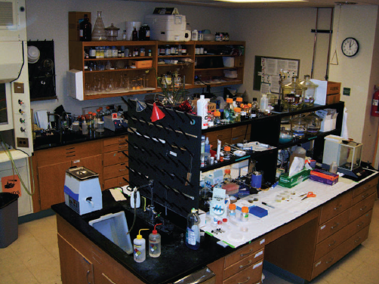
Applications
Assistive technology: smart kitchen
Human-robot interaction
Training and testing
Automated lab notebook
Notes:
Assistive technology:
Education (How to fold a box properly – video, no semantics, etc., how to swim?)
Robotics:
Computers – interaction with screen/keyboard (even with the kinect)
robots – interact with an agent, multiple agents
“natural” interactions (not completely, but somewhat)
Process automation:
computer tasks (list all the files in a directory, draw the UR logo and post it on my website)
Robotics (imitation)
Error detection:
High-risk tasks

Slide 5
Part I: a Markov Logic framework for activity recognition from speech and video
  Framework for hierarchical activities
  Experiments with engineered axioms
Part II: learning complex activities
  Unsupervised alignment of text and video
  Grounded language acquisition

Slide 6
Part I: a Markov Logic framework for activity recognition from speech and video
  Ontology for hierarchical activities
  Experiments with engineered axioms
Part II: learning complex activities
  Unsupervised alignment of text and video
  Grounded language acquisition

Slide 7
Desiderata
Be robust across variations in the appearance of a scene and language used to describe it
  Semantic rather than appearance model
Support knowledge engineering as well as learning
  Hypothesis: we can specify a small set of general actions to bootstrap learning
  when you take an object, it moves with your hand

Slide 8
Desiderata
Represent activity decomposition, abstraction, and reification
  unbounded And/Or hierarchy
  events as entities
Allow non-temporally disjoint events and out-of-order observations
  Speech often refers to actions in the past or future

Slide 9
Recognition Pipeline
Hand/Object detection & tracking
Infer state properties (fluents)
Deduce low-level visual events
Visual- and Linguistic-events
ML MAP Inference; fusing visual and linguistic evidence
Vision
Complex Event Library encoded in ML axioms
Logical Form (LF) extracted from transcribed speech
Low-, Mid-, and High-level linguistic events
User Knowledge
Most Likely Interpretation
Language

Slide 10
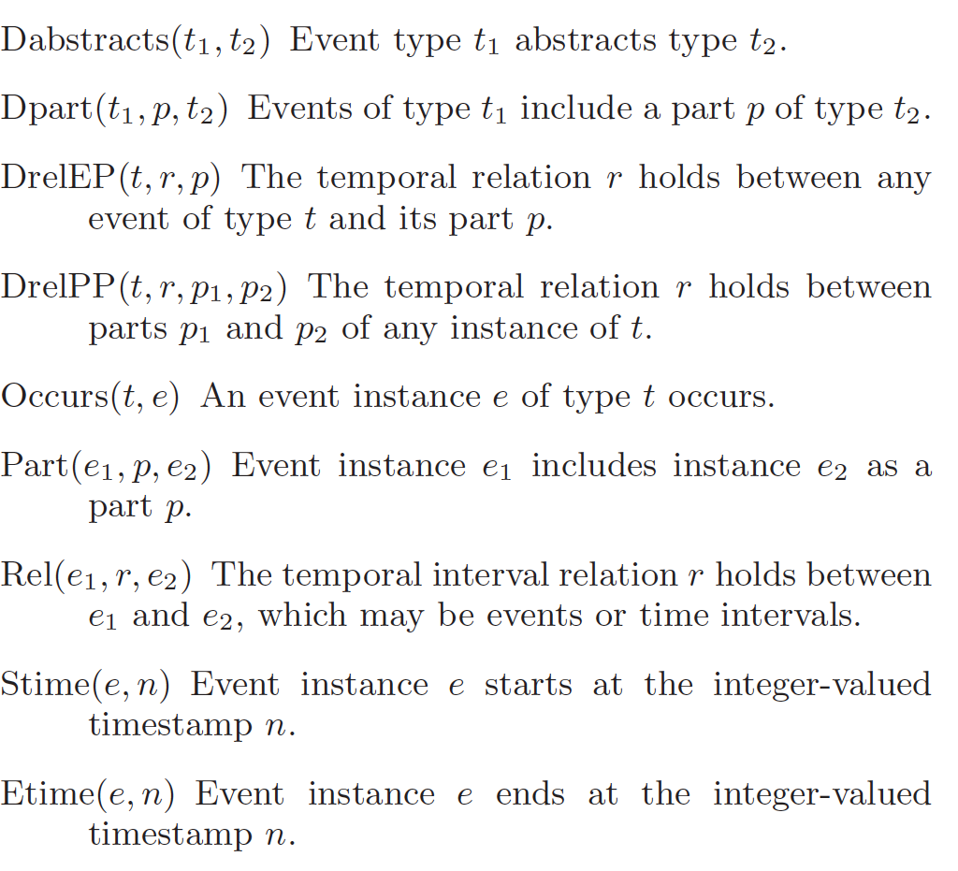
Meta-
Predicates

Slide 11
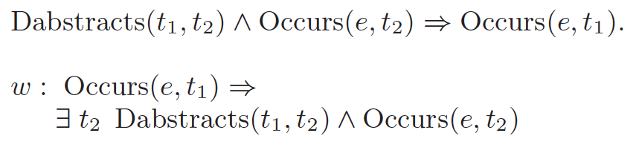
Axioms for Meta-Predicates: Abstraction

Slide 12
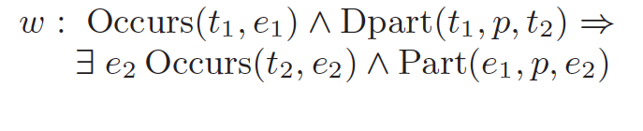
Axioms for Meta-Predicates: Decomposition

Slide 13
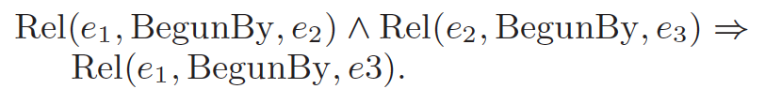
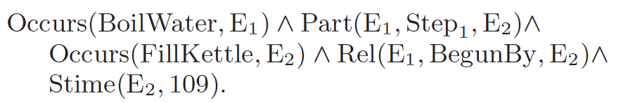
Time
Action and fluents holds over intervals
Endpoints: Stime(interval), Etime(interval)
Allen-temporal relations hold between intervals
An action instance can directly appear where a time interval could appear

Slide 14
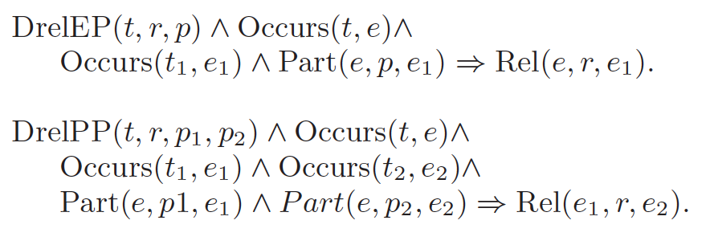
Axioms for Meta-Predicates: Constraints

Slide 15
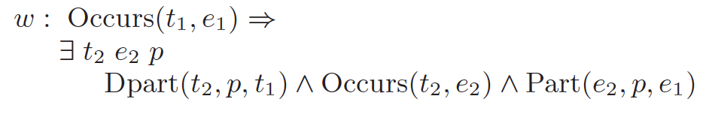
Axioms for Meta-Predicates: Abduction

Slide 16
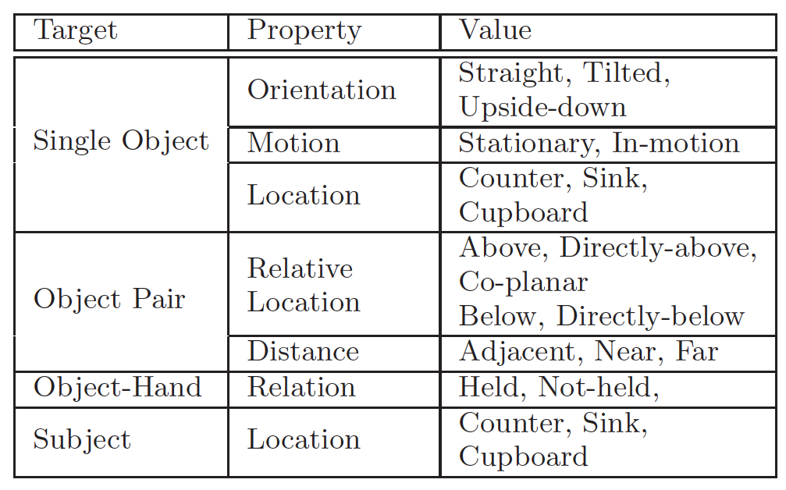
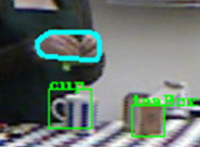
Visual Fluents
  Qualitative relational features
  Robust across variations in scenes
Notes:
Starting from a data collected from HD cameras and Kinect-like Depth sensors, we introduce a system that is able to represent relationships between objects and hands in a qualitative fashion, for example in this image we can say that the cup is adjacent to the teabox, and the hands are directly-above the cup. This differs from many current systems that detect events directly from visual appearance.
This additional qualitative step makes it so that the system captures scene independent object relational features, and removes the need to be re-trained when working in different environments. This qualitative relational information is used to generate a low-level event representation of actions occurring in the scene.

Slide 17
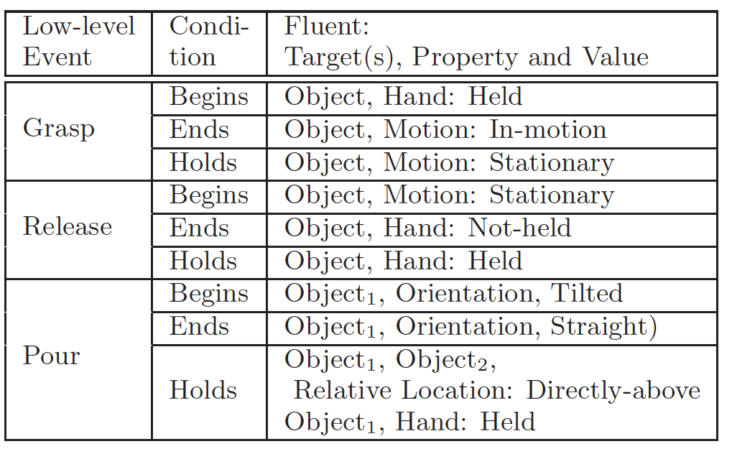
Primitive Actions
  Initial set computed from observed fluents at instantiation time
  Additional primitive actions may be inferred at MAP time

Slide 18
Extracting events from narrative speech
  Speech recognition
    “Next I’ll put the tea bag into the cup.”
  Computer logical form
    TRIPS domain independent parser
  Simplify logical form to head verb, direct and indirect objects
    CREATE TEA, CLOSE LID, POUR WATER CUP
  Extract temporal information
    PUT(BAG,CUP) :TEMPRELN FUTURE
  Assert ML observation
    Occurs(Put, E25) ^ Object(E25, Bag) ^ Destination(E2, Cup) ^ Rel(E25, After, [190, 203])

Slide 19
Experiments
Activity library: making tea, making cocoa, making sandwich, making oatmeal
Weights on soft axioms set manually
4 subjects, 3 trials each
Evaluation:
  Ability of activity library to correct positive and negative errors in visual system
  Ability of speech to compensate for errors in visual system

Slide 20
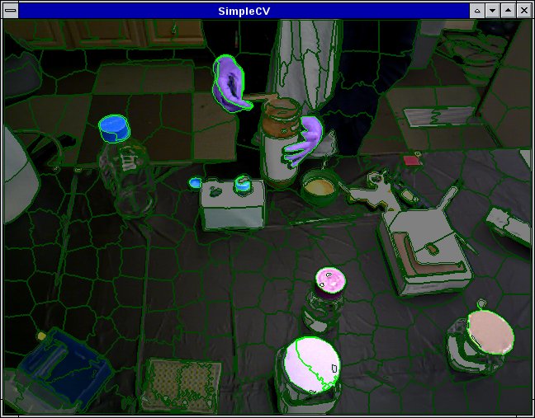
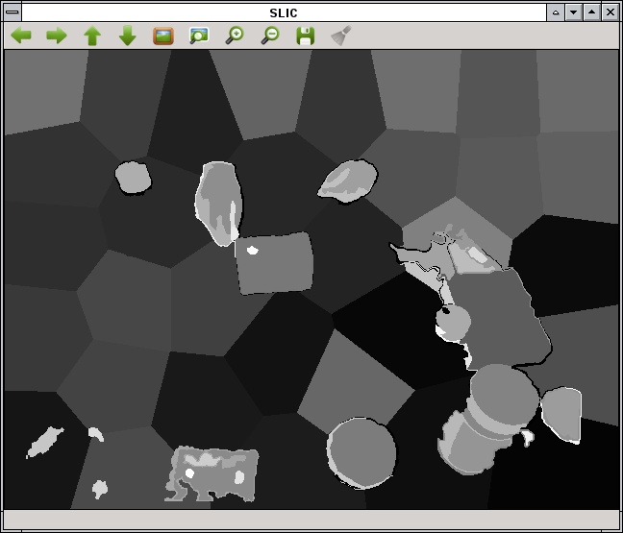
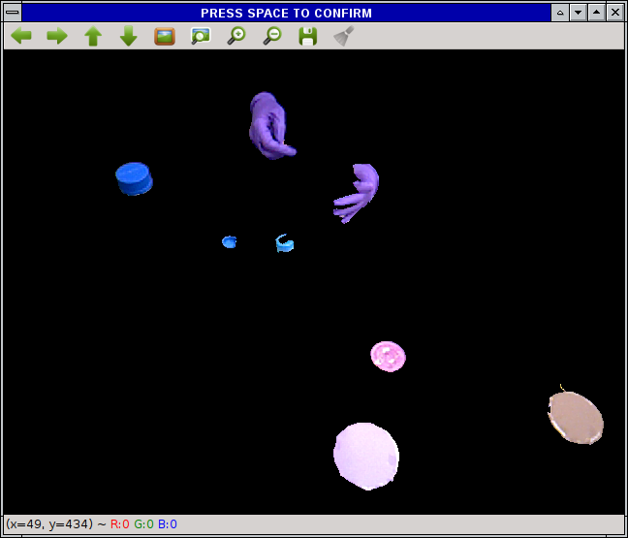
Object and Hand Recognition
Use superpixel segmentation to segment adjacent pointclouds (hands and object)
  Off-the-shelf algorithms for superpixel segmentation (QuickShift, SLIC)

Slide 21
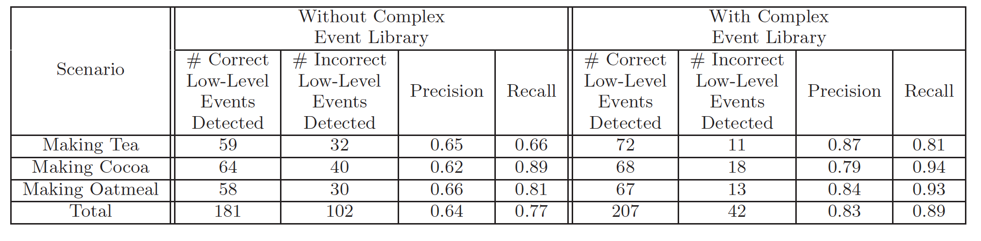
Impact of Activity Library

Slide 22
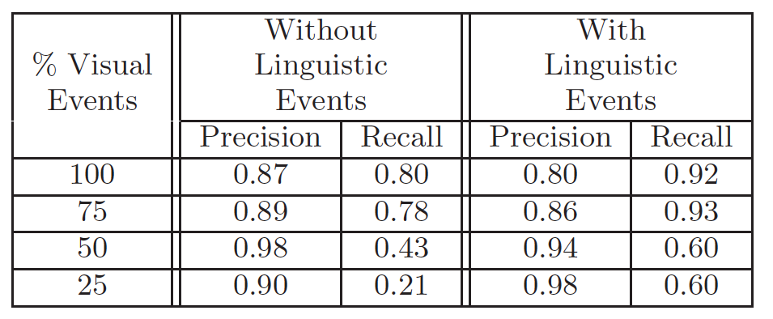
Impact of Speech

Slide 23
Issues
Approach is promising, but how can we learn
  Complex actions (meta-predicate domains)
  Weights
  Physical object models
in a scalable way?
Supervised learning:
  Labeling by experimenters not feasible
  Mechanical Turk? (See W. Laski et al. 2013, 2014)
  Labeling by parallel corpus alignment

Slide 24
Part I: a Markov Logic framework for activity recognition from speech and video
  Framework for hierarchical activities
  Experiments with engineered axioms
Part II: learning complex activities
  Unsupervised alignment of text and video
  Grounded language acquisition

Slide 25
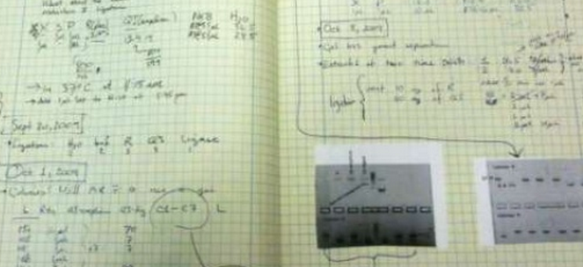
Synthetic Biology
(Intel STC-PC workshop))
What we want to do
  Design and implement new genetic programs
What we spend most of our time doing
  Transferring, heating, cooling, filtering, spinning colorless liquids, refining and optimizing biochemical protocols
Where is the knowledge?
  Post-doc brains, superstitions, lab notebooks
  Results differ drastically depending on personnel

Slide 26
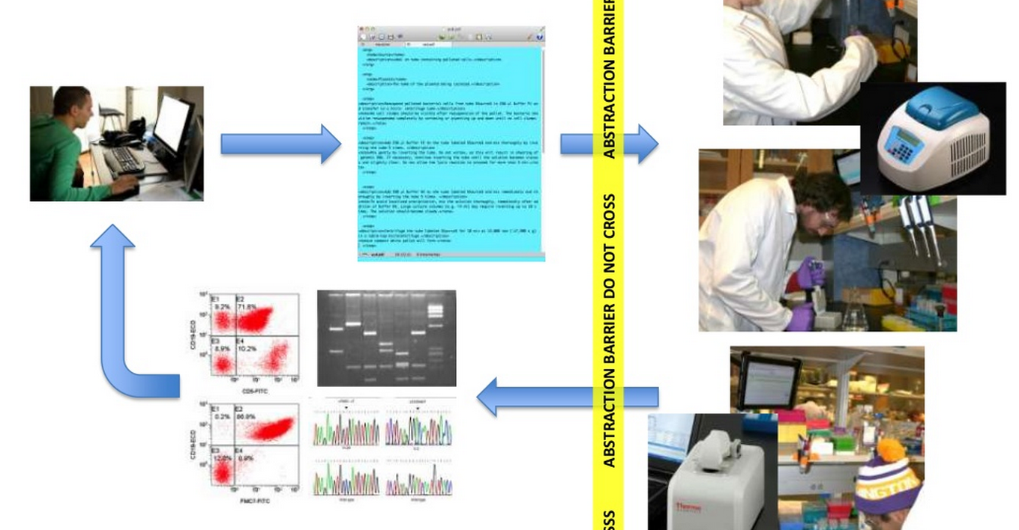
BioTurk (University of Washington)
Make technicians as interchangeable as Mechanical Turk Workers
Formalize lab how-to knowledge

Slide 27
Activity Recognition in BioTurk
Step 1
  Document in video and audio all things occurring during a protocol session
  Kinect-style RGBD
Step 2
  Recognize steps in a session and document errors
Step 3
  Intervene when errors have been detected
Our goal: Automate!
Notes:
One in many groups that are participating
Egocentric cameras, GMTK, grounded speech, WISPs

Slide 28
Media Protocols
Written in stylized English
  Attempts to be precise: XLM tagging of verb/noun/preposition structure, steps, sub-steps
Still exhibits ambiguity, synecdoche, implicit actions, …
Protocol LB Liquid Growth Media
Step Label the bottle
Write LB Growth Media on a label, stick it to the bottle.
Affix a piece of autoclave tape to the bottle as well.
Step Measure 20 g of LB Broth Base
Place the plastic boat on the scale.
Zero the scale.
Using the spatula, measure 20 g of LB Broth Base into the plastic boat.
Step Pour the LB Broth Base into the 1000 mL bottle.
Step Add 800 mL of DI water.
Use the DI water near the sink.
Step Mix.
Put a cap on the bottle and shake to mix the dry ingredients with the water.
Dry off the bottle with a paper towel. Place the bottle in location b1.300.

Slide 29
UW Wetlab Dataset
Asus RGB-D Camera, TOF Camera, Microphone, WISPs (RFID-based object motion tags)
Permanent data collection setup
  10s of media sequences recorded each day
  100s of protocol steps (transfer liquid, measure powder, etc) per day
  1000s of protocol actions (pouring, wiping, putting, etc.) per day

Slide 30
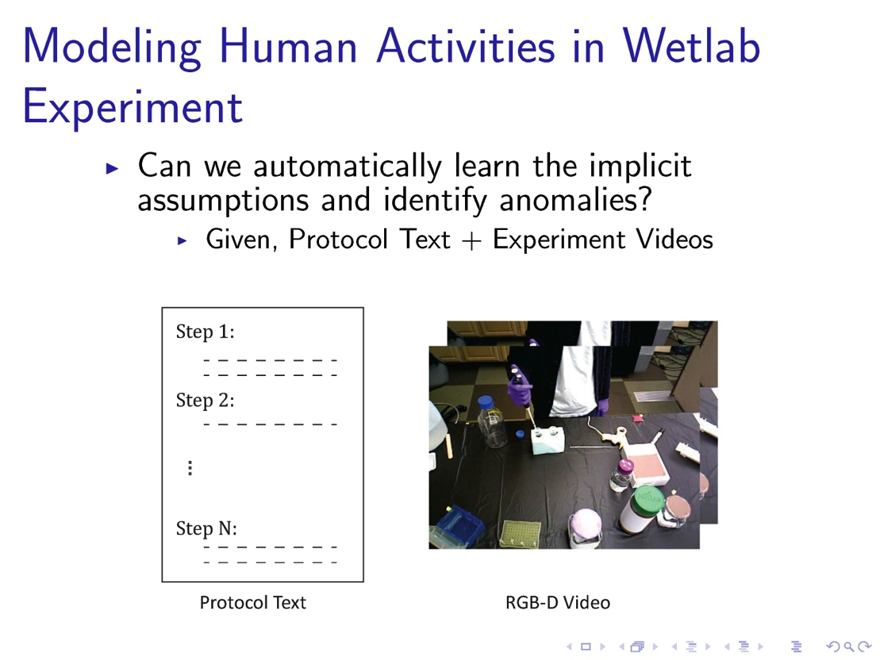

Slide 31
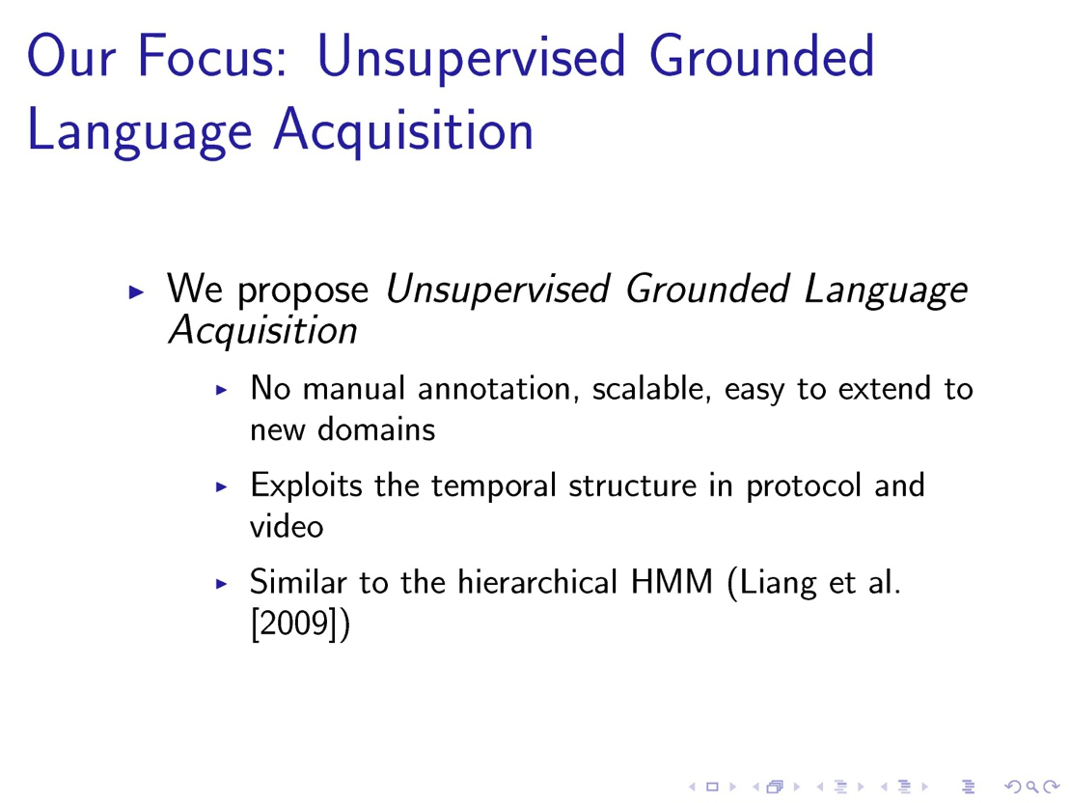

Slide 32
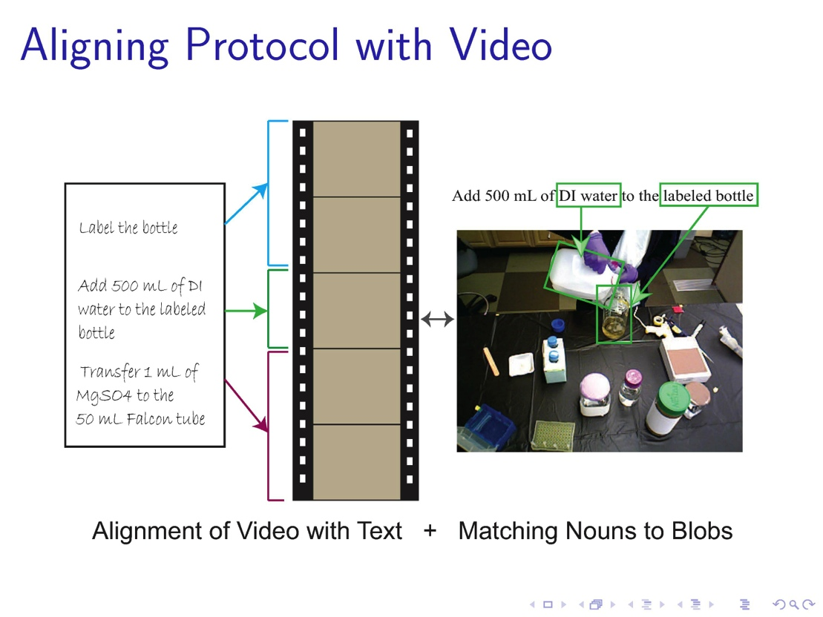

Slide 33
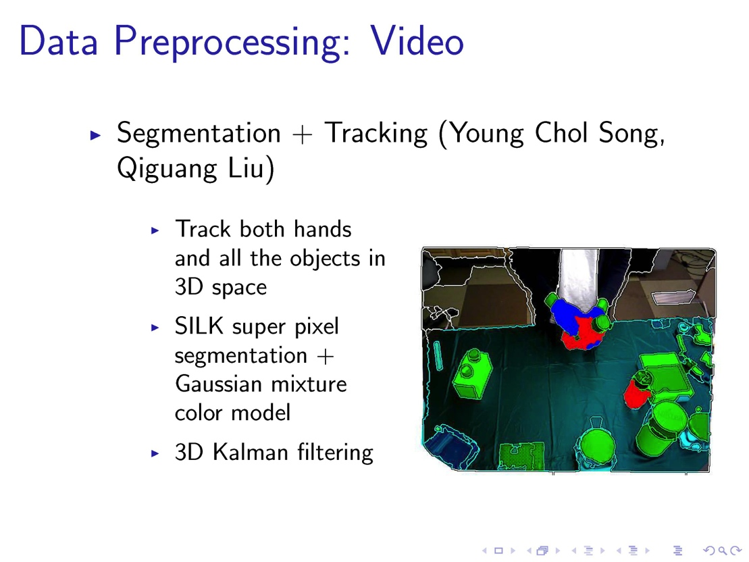

Slide 34
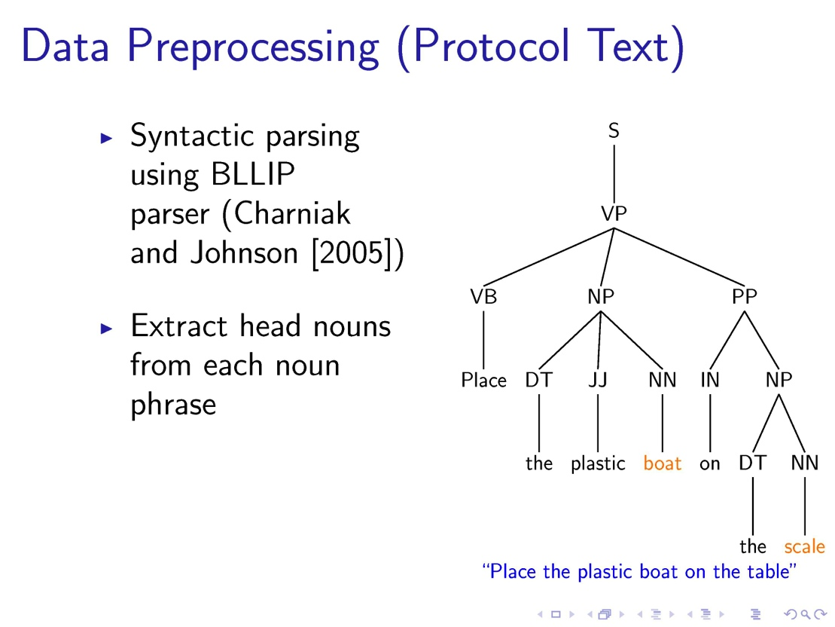

Slide 35
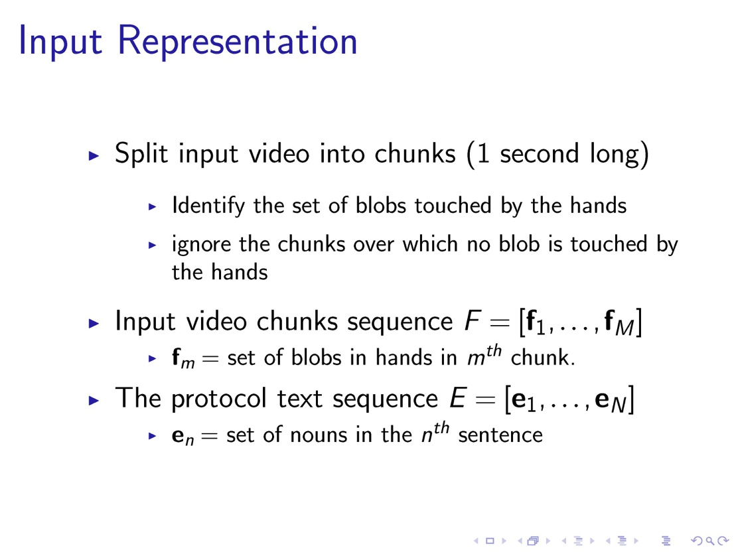

Slide 36



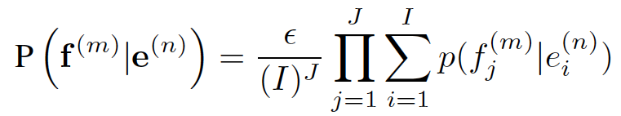
IBM Model 1
Where set of blobs
and set of nouns
Probability of generating a set of blobs f^{(m)} from a set of nouns e^{(n)} is

Slide 37

Blob-Noun Matching
The probability that a blob matches to a noun is given by a matching probability table:
How do we get T? We will learn it, while finding the most likely alignment!

Slide 38
Wrapping Model 1 in an HMM
Following Markov assumption, the hidden alignment state a_{m}=n depends on the alignment state for the previous video segment a_{m-1}=n’
State transition probability is parameterized by the “jump size” between adjacent alignment points, where c(d) = probability of jumps of distance d:

Slide 39
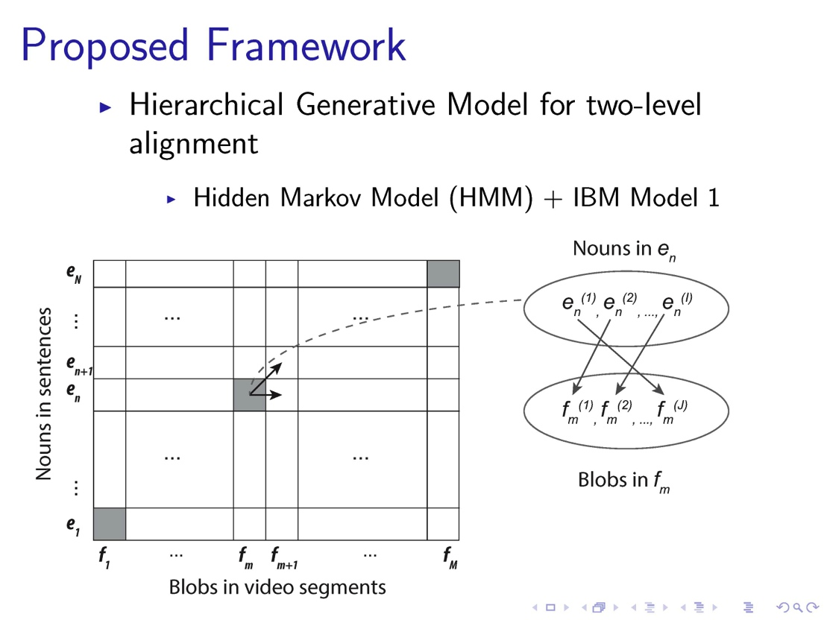

Slide 40
Joint Alignment and Learning
We jointly find the most likely alignment and learn the blob-noun matching table T and the jump probabilities c(dist)
Method: EM
  Initialize T and c(dist) uniformly
  E-step: apply forward-backward recursions to estimate alignment state and state-pair probabilities
  M-step: re-estimate T and c(dist)

Slide 41
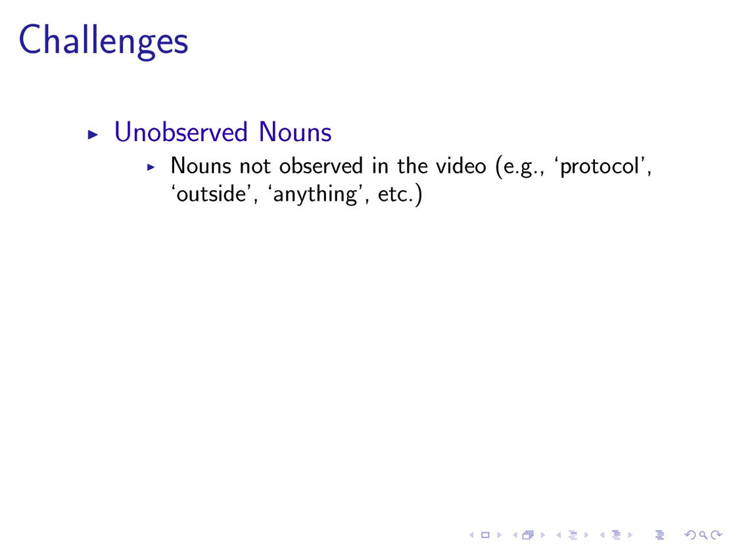

Slide 42
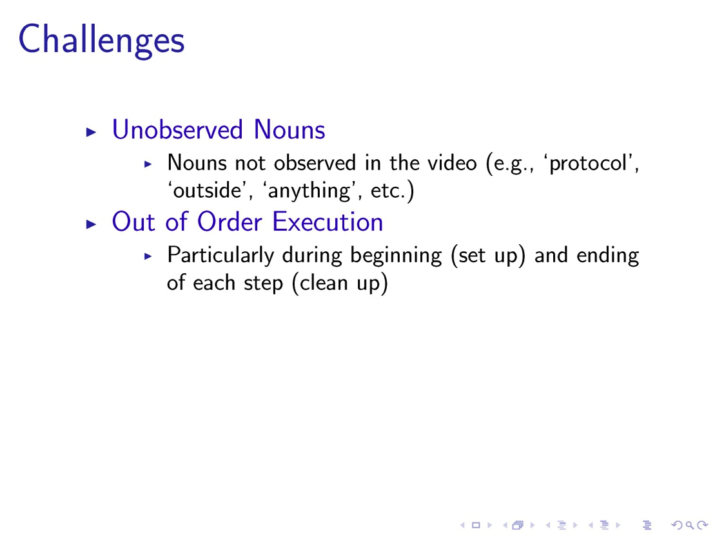

Slide 43
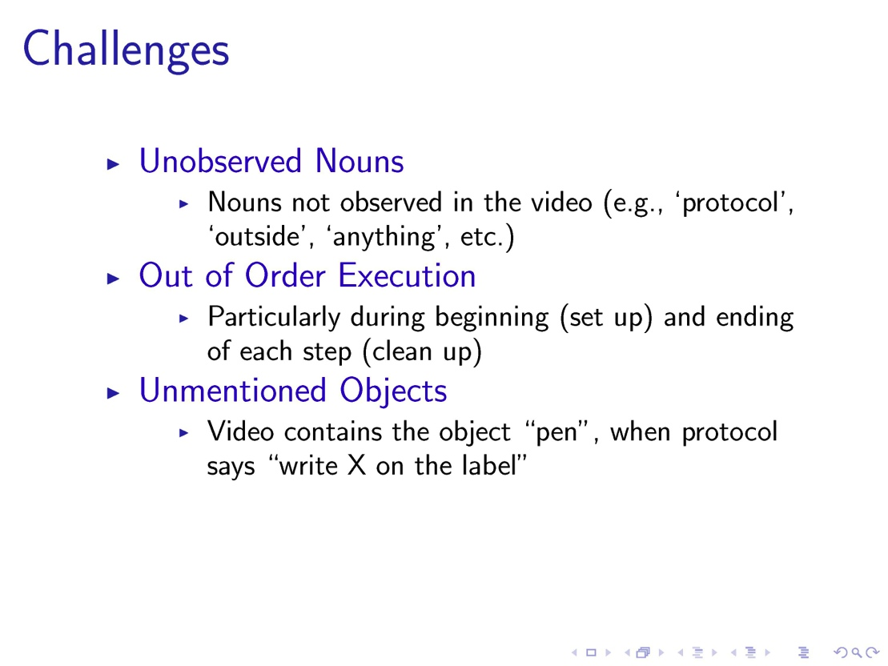

Slide 44
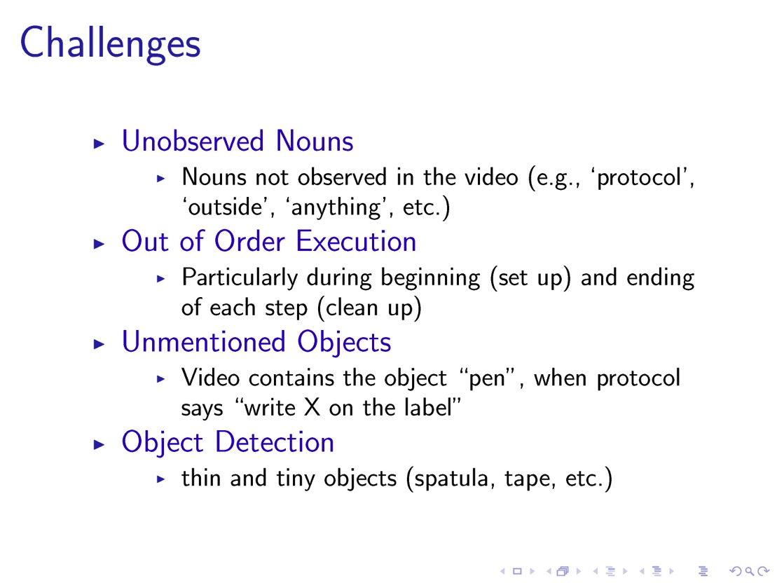

Slide 45
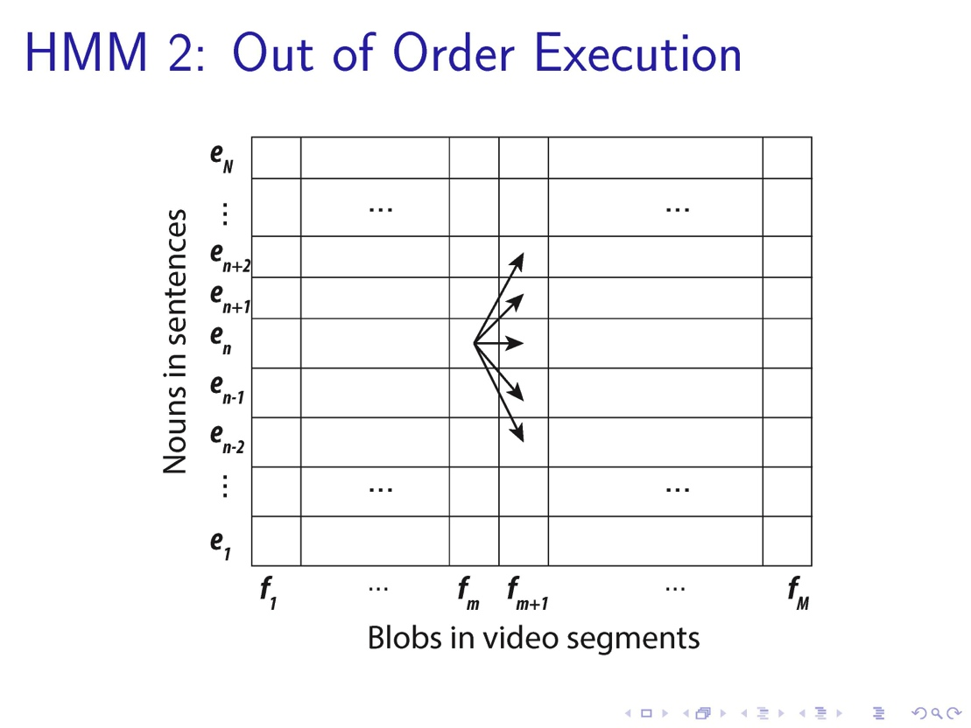

Slide 46
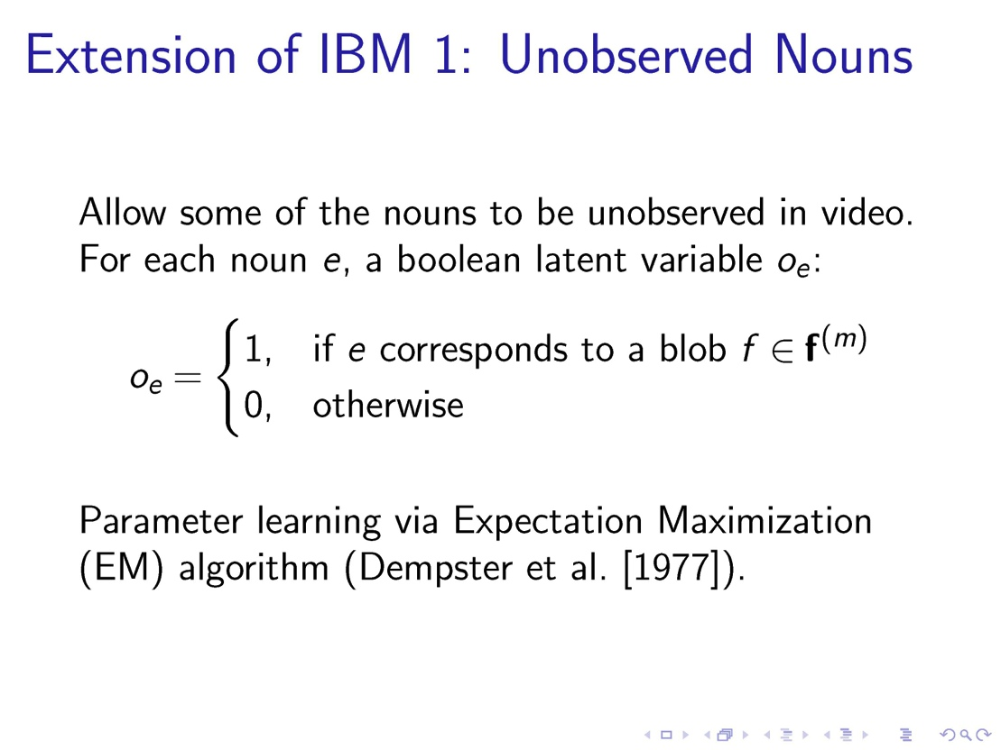

Slide 47
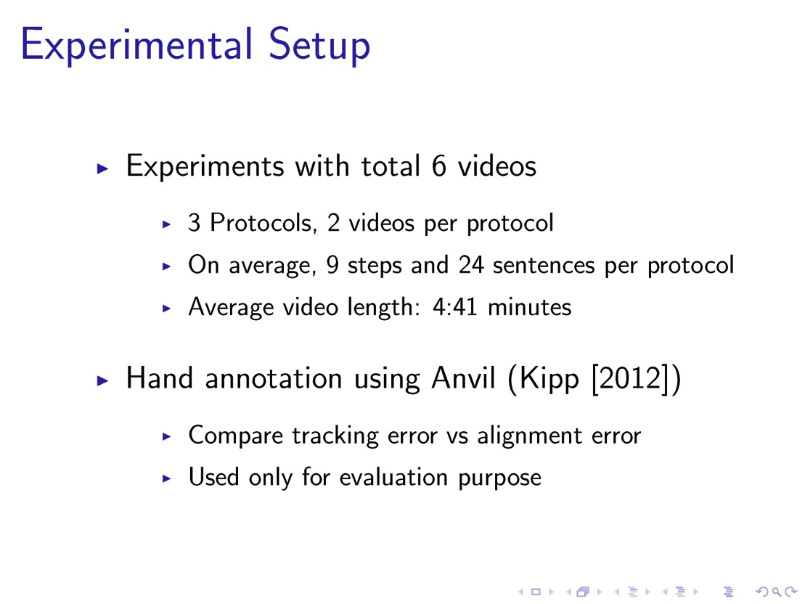

Slide 48
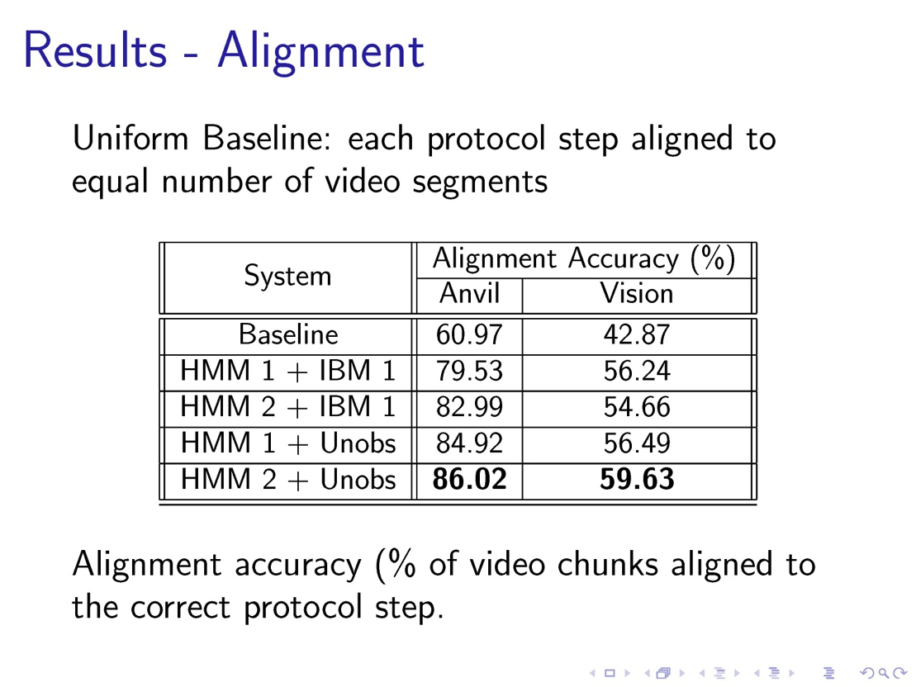

Slide 49
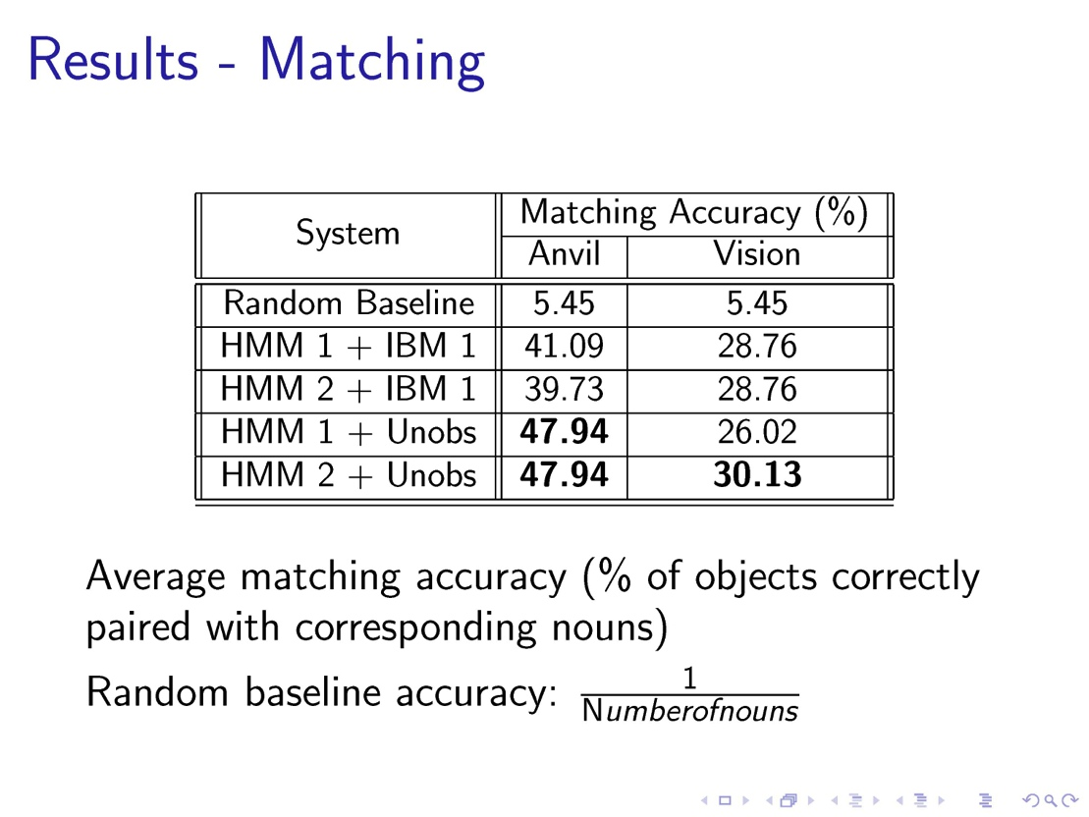

Slide 50
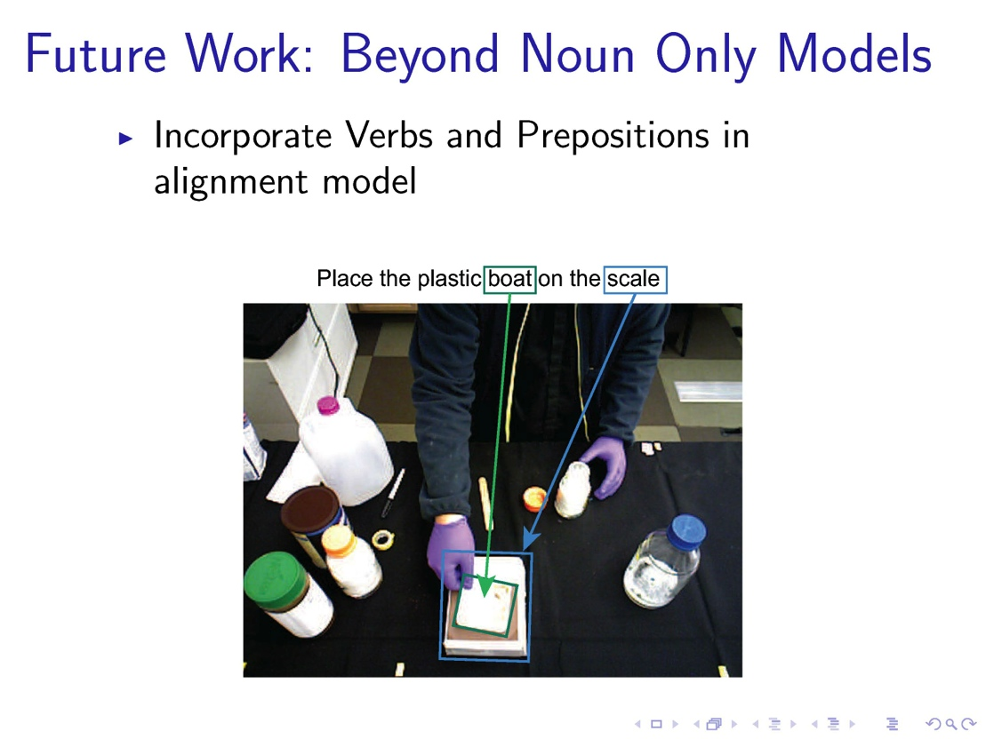
Coming Soon

Slide 51
Part III: Closing the Loop
Use the aligned text as (noisy) labels for learning
  Action definitions (meta-predicate domains)
  Weights
  Object models
Use learned model for anomaly detection in execution of protocols by technicians
Unify the ML and IBM Model 1/HMM models
Solve the grounded language acquisition problem
Win Turing Award, retire!

