Slide 1
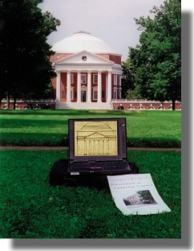
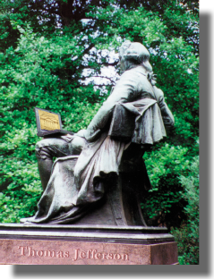
Algorithms
CS4102– Fall 2015
Gabriel Robins
Department of
Computer Science
University of Virginia
www.cs.virginia.edu/robins

Slide 2
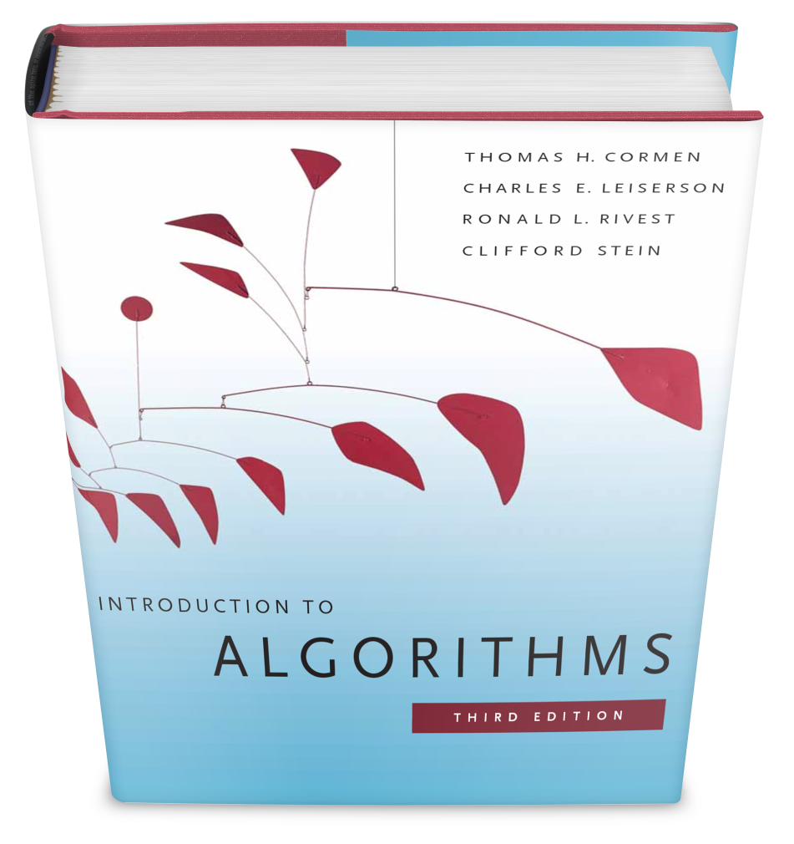
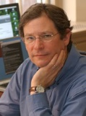
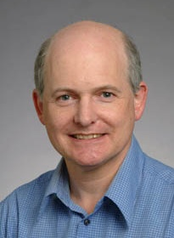
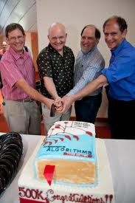
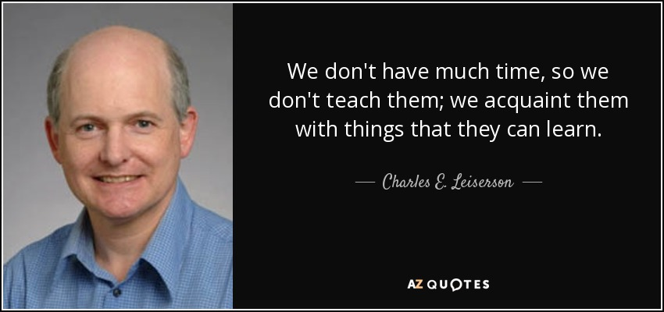
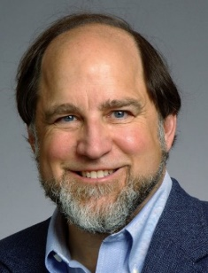
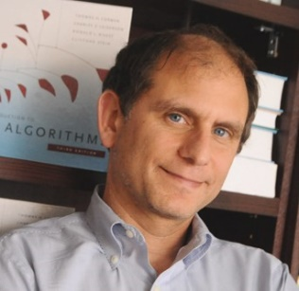
Algorithms (CS4102) Textbook
Textbook:
  Introduction to Algorithms
  by Cormen et al (MIT)
  Third Edition, 2009
Thomas Cormen
Charles Leiserson
Ronald Rivest
Clifford Stein

Slide 3
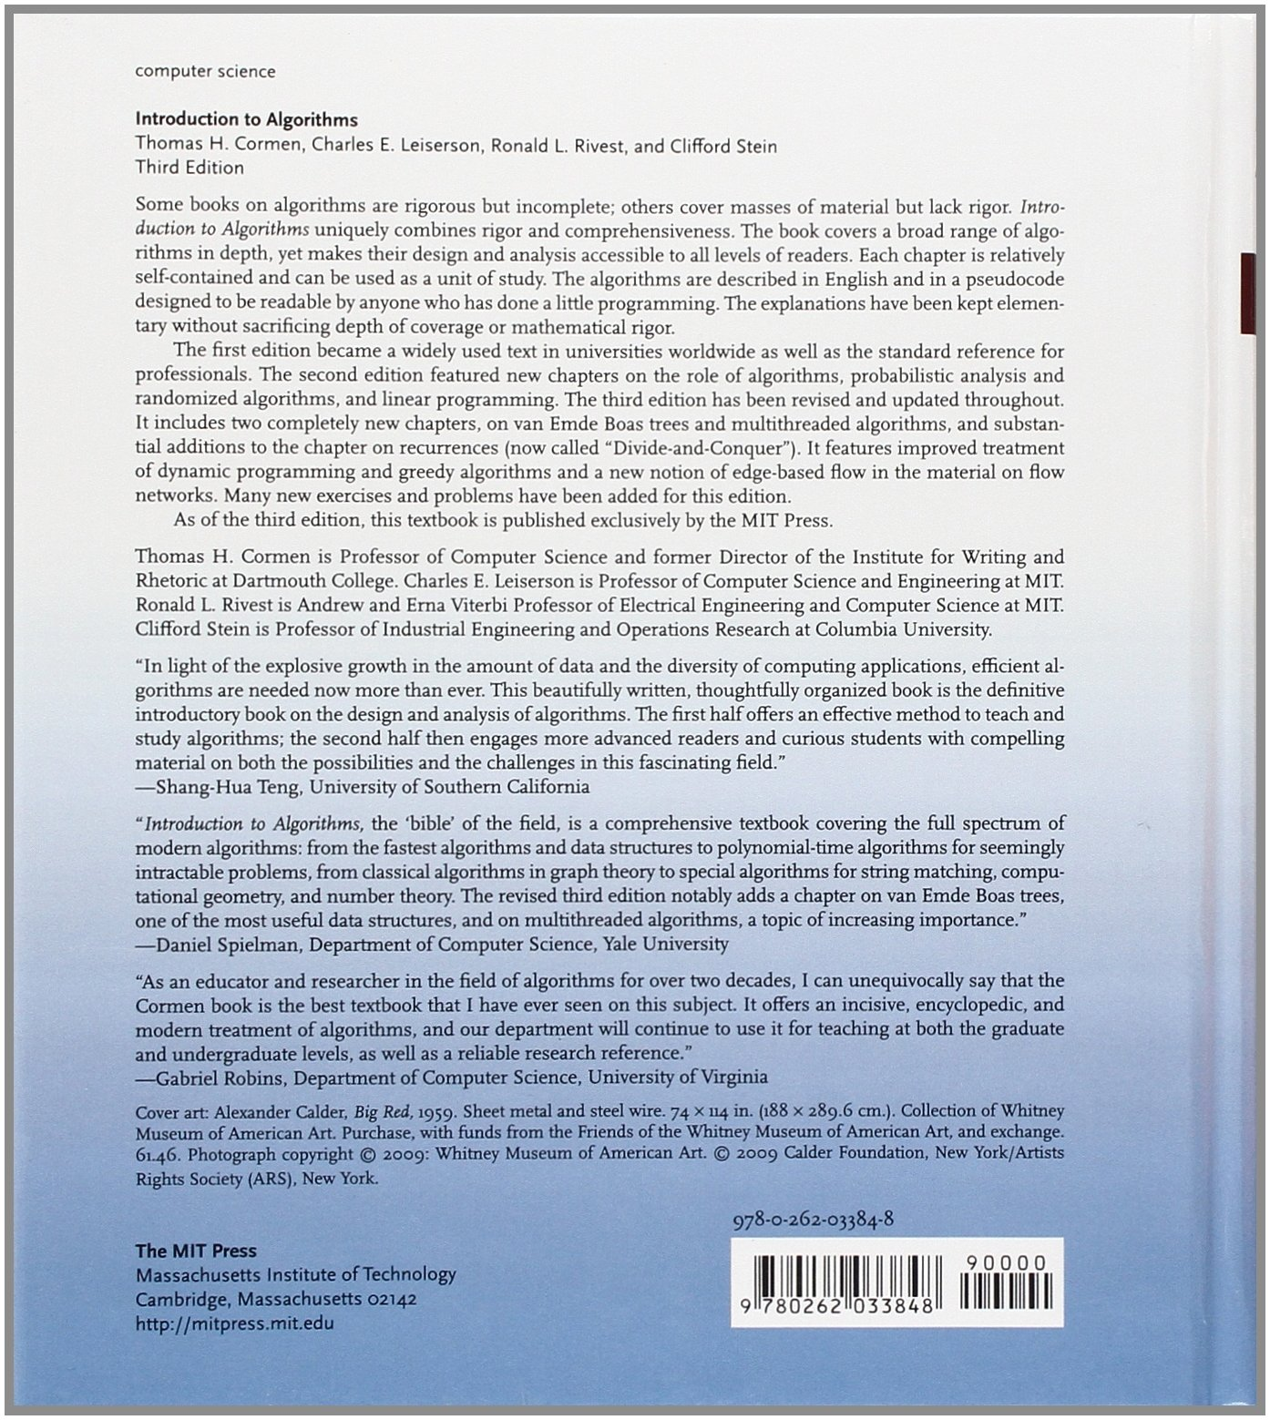

Slide 4
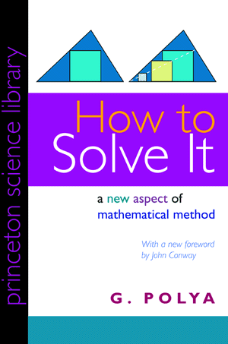
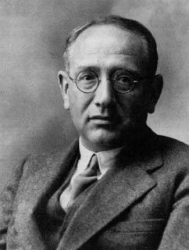
Algorithms (CS4102) Textbook
Supplemental reading:
  How to Solve It, by George Polya (MIT)
  Princeton University Press, 1945
A classic on problem solving
Good Articles / videos:
www.cs.virginia.edu/robins/CS_readings.html
George Polya (1887-1985)

Slide 5
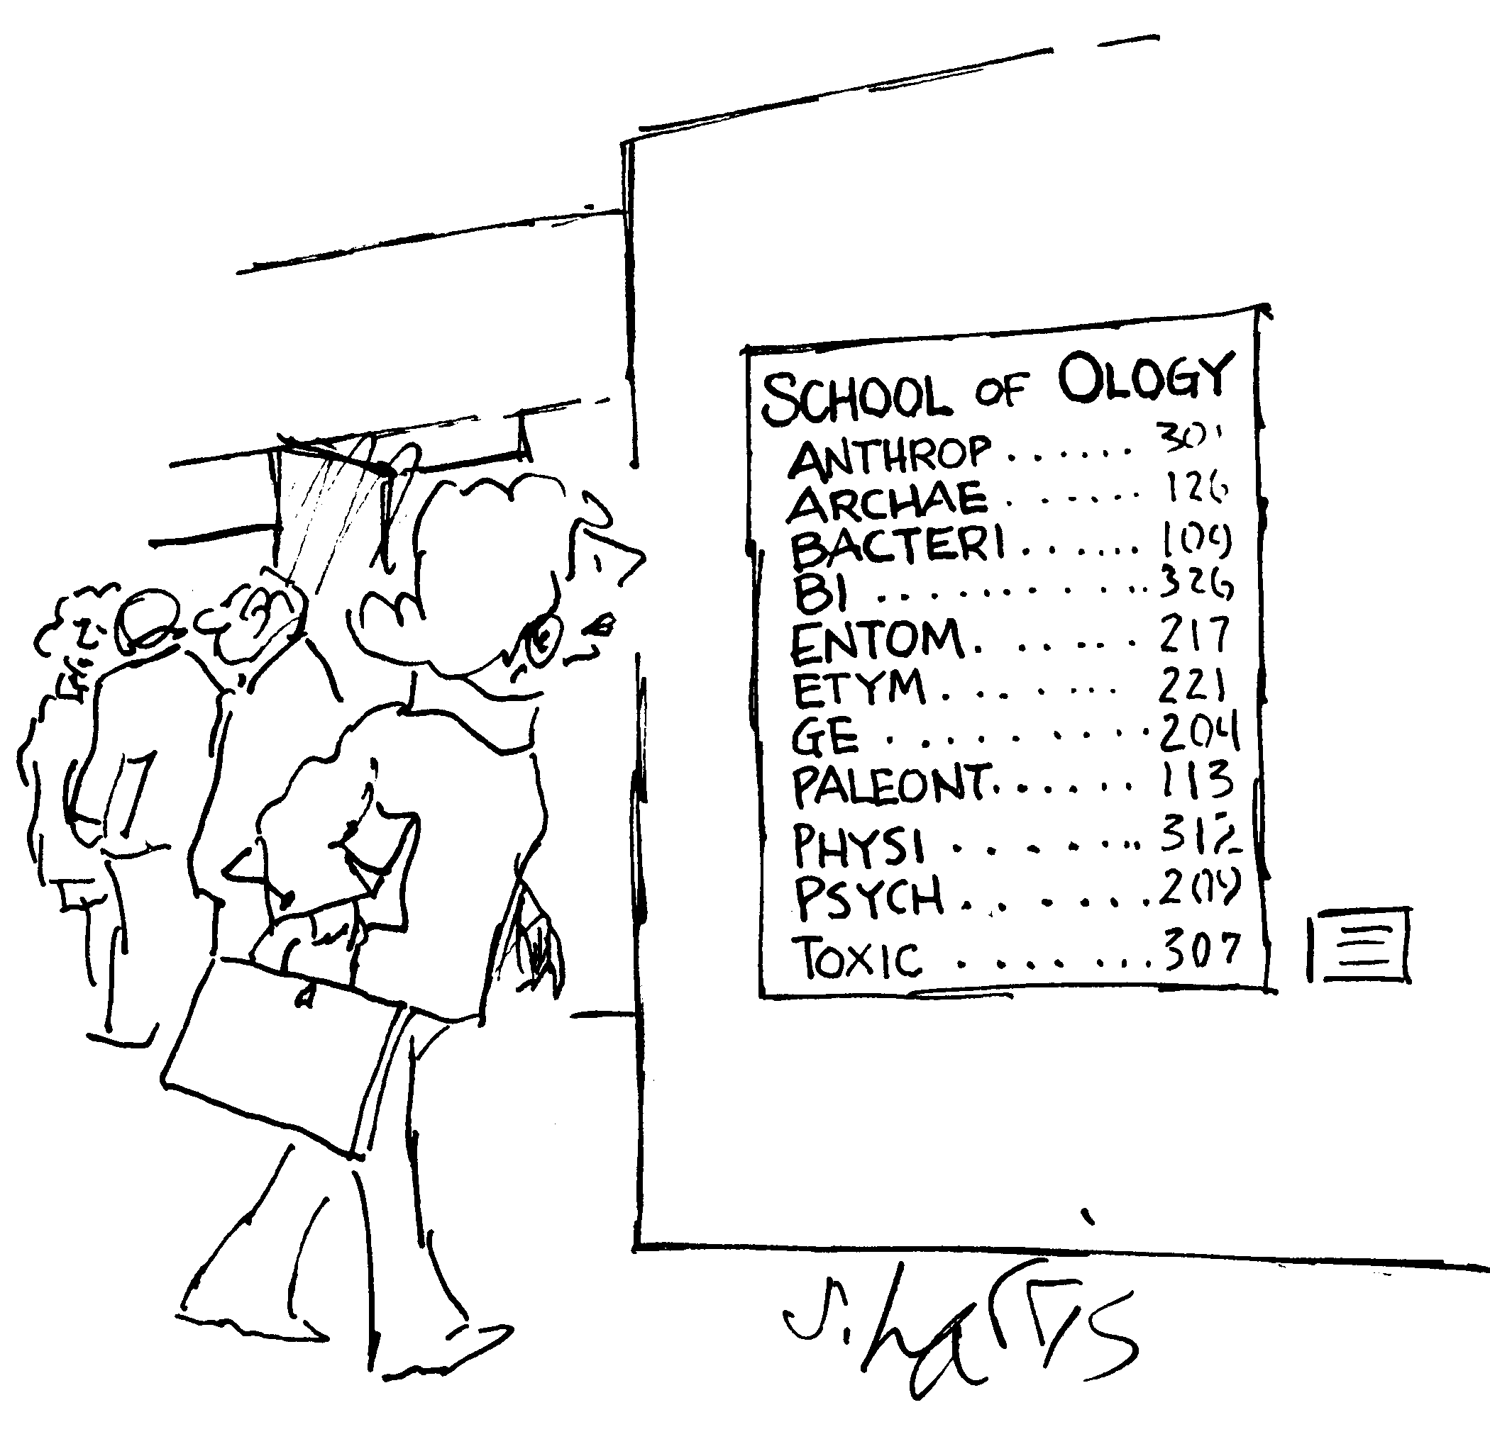

Slide 6
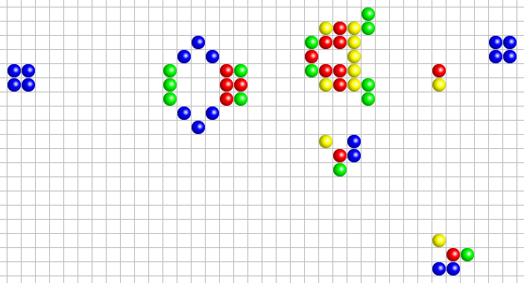
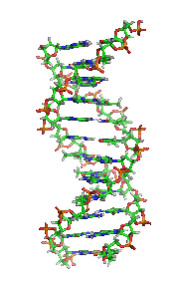
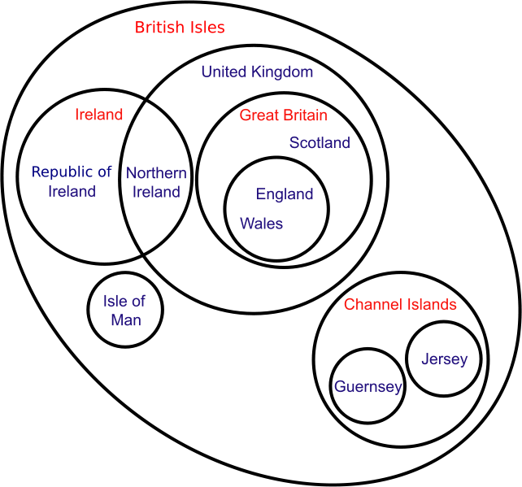
Algorithms Syllabus
Fundamentals:
• History of algorithms
• Problem solving
• Pigeon-hole principle
• Occam's razor
• Uncomputability
• Universality
• Asymptotic complexity
• Set theory and logic

Slide 7
Algorithms Syllabus
Data structures:
• Arrays
• Stacks and queues
• Linked lists
• Binary and general trees
• Height-balanced trees
• Heaps
• Hash tables

Slide 8
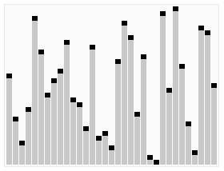
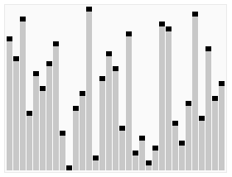
Algorithms Syllabus
Sorting and searching:
• Classical sorting methods
• Specialized sorting techniques
• Finding max & min
• Median finding and K^{th} selection
• Majority detection
• Meta algorithms

Slide 9
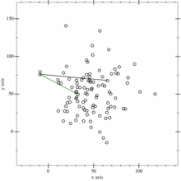

Algorithms Syllabus
Computational geometry:
• Convex hulls
• Lower bounds
• Line segment intersection
• Planar subdivision search
• Voronoi diagrams
• Nearest neighbors
• Geometric minimum spanning trees
• Delaunay triangulations
• Distance between convex polygons
• Triangulation of polygons
• Collinear subsets

Slide 10
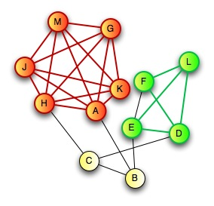
Algorithms Syllabus
Graph algorithms:
• Depth-first search
• Breadth-first search
• Minimum spanning trees
• Shortest paths trees
• Radius-cost tradeoffs
• Steiner trees
• Degree-constrained trees

Slide 11
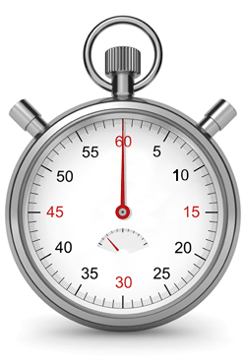

Algorithms Syllabus
NP-completeness:
• Resource-constrained computation
• Complexity classes
• Intractability
• Boolean satisfiability
• Cook-Levin theorem
• Transformations
• Graph clique problem
• Independent sets
• Hamiltonian cycles
• Colorability problems
• Heuristics
NP-complete SAT
NP
P
co-NP
P-complete LP
co-NP-complete TAUT

Slide 12
Algorithms Syllabus
Other topics in algorithms:
• Linear programming
• Matrix multiplication
• String matching
• Minimum matchings
• Network flows
• Distributed algorithms
• Amortized analysis
• Zero knowledge proofs
≈

Slide 13
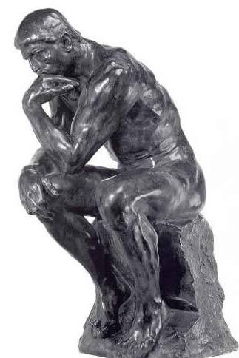
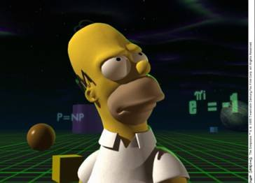
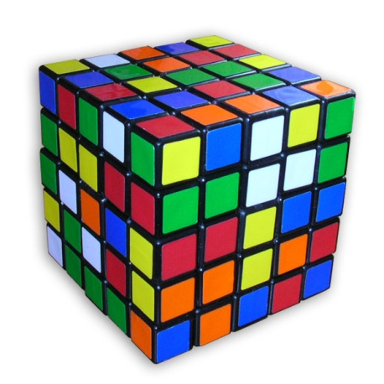
Overarching Philosophy
Focus on the “big picture” & “scientific method”
Emphasis on problem solving & creativity
Discuss applications & practice
A primary objective: have fun!

Slide 14
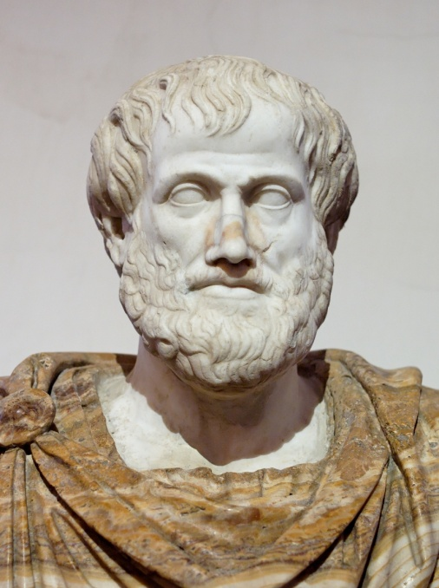
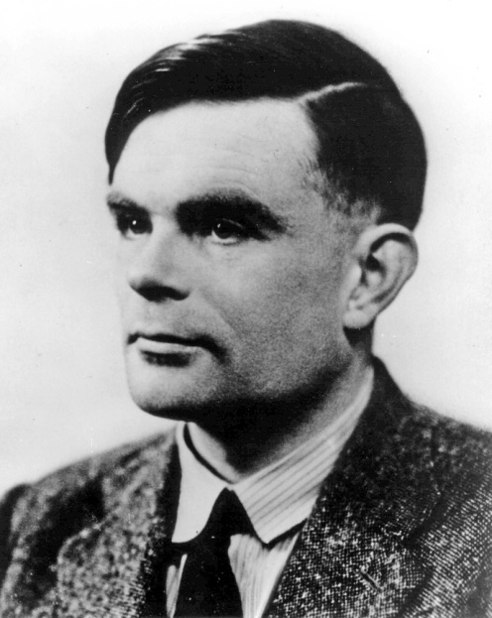
Algorithms Throughout History
A brief history of computing:
• Aristotle, Euclid, Archimedes, Eratosthenes
• Abu Ali al-Hasan ibn al-Haytham
• Fibonacci, Descartes, Fermat, Pascal
• Newton, Euler, Gauss, Hamilton
• Boole, De Morgan, Babbage, Ada Agusta
• Venn, Carroll, Cantor, Hilbert, Russell
• Hardy, Ramanujan, Ramsey
• Godel, Church, Turing, von Neumann
• Shannon, Kleene, Chomsky

Slide 15
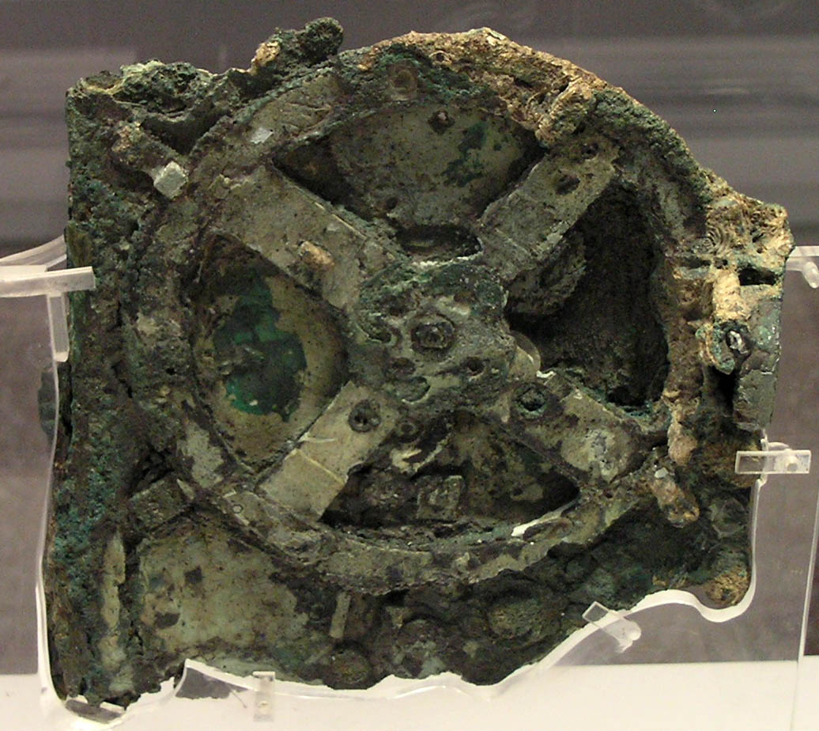
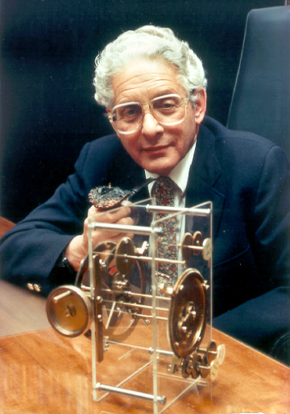
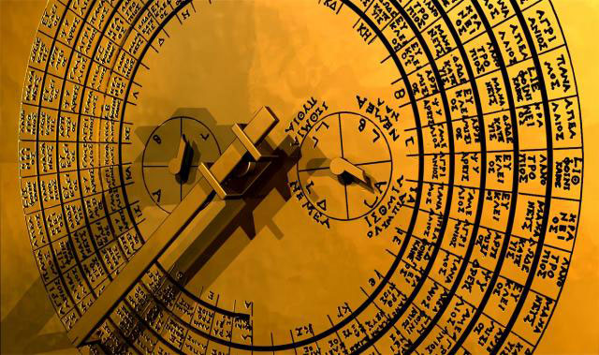
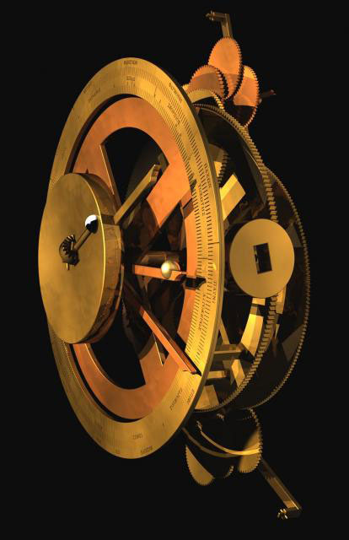
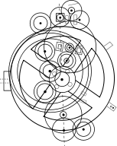
An Ancient Computer: The Antikythera
Oldest known mechanical computer
Built around 150-100 BCE !
Calculates eclipses and astronomical
positions of sun, moon, and planets
Very sophisticated for its era
Contains dozens of intricate gears
Comparable to 1700’s Swiss clocks
Has an attached “instructions manual”
Still the subject of ongoing research

Slide 16
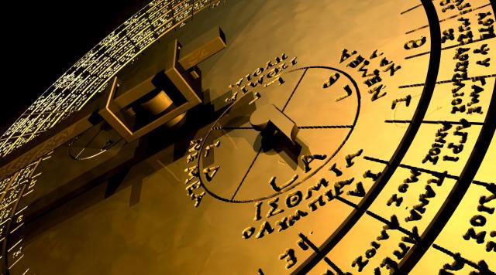
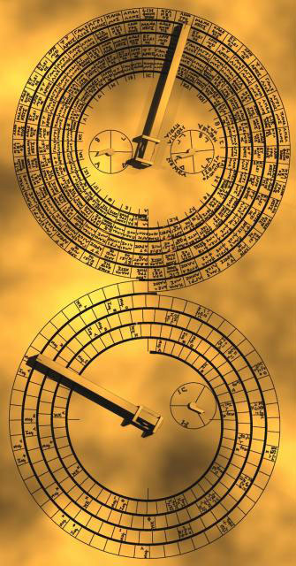
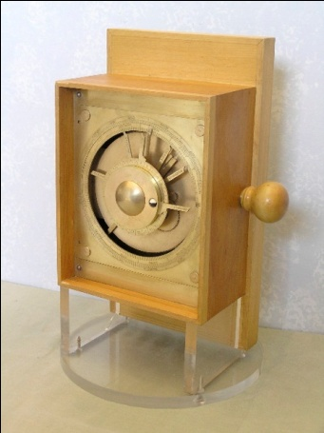
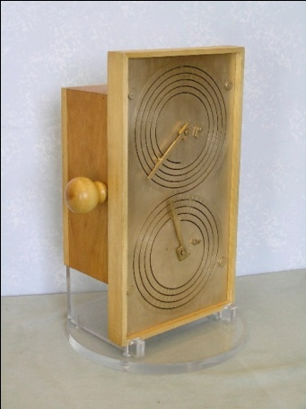
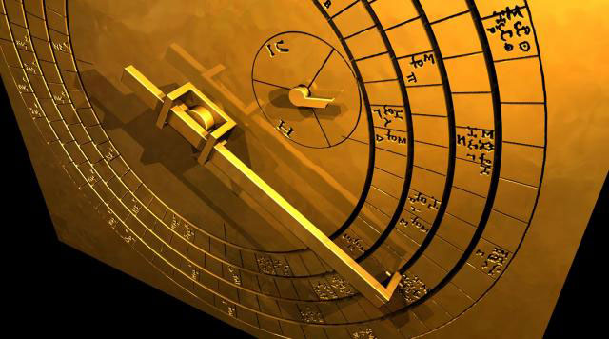
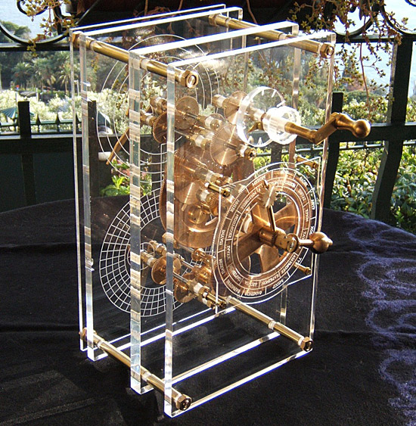
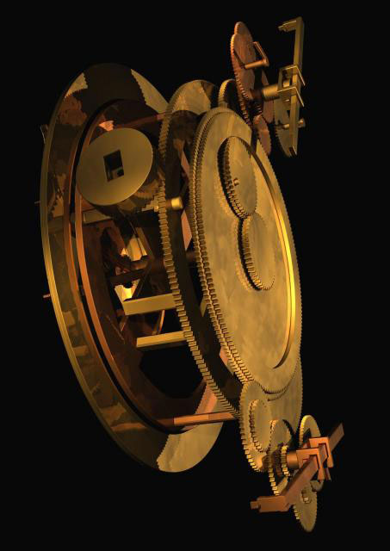
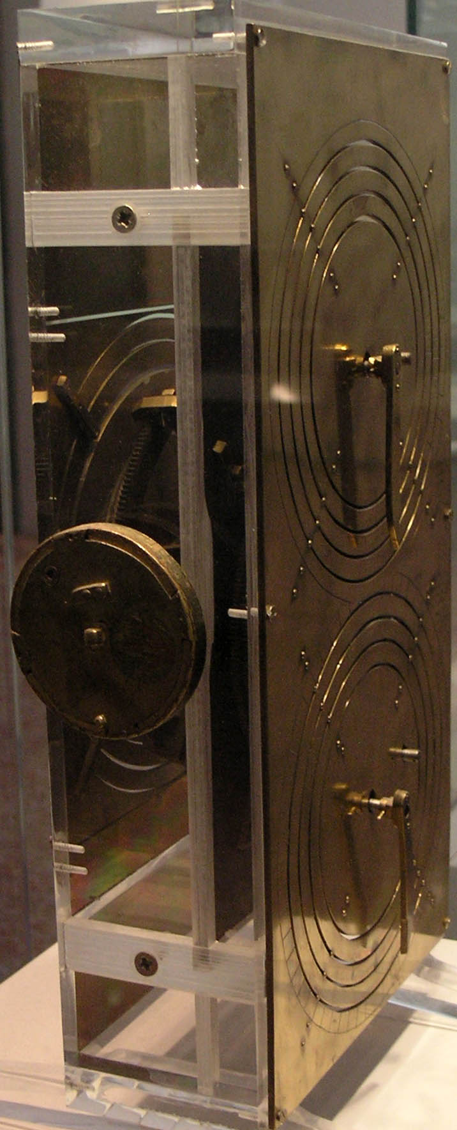
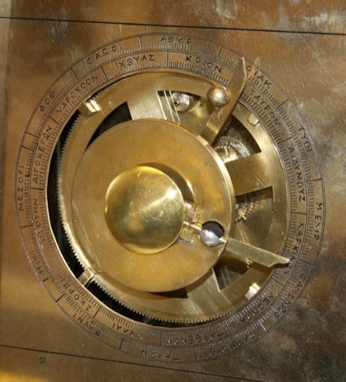
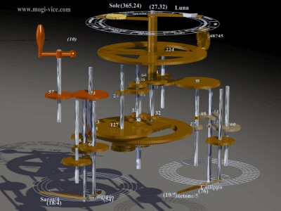
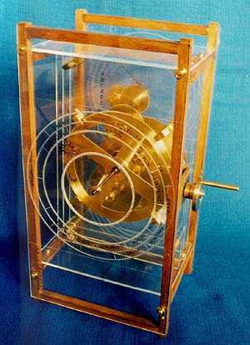
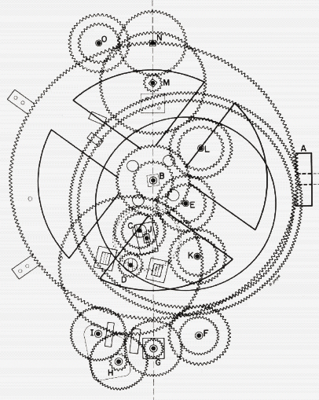

Slide 17
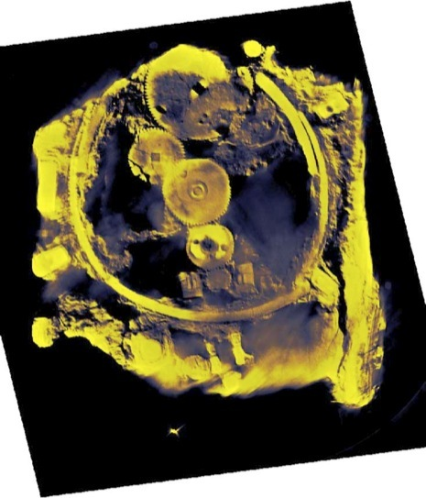
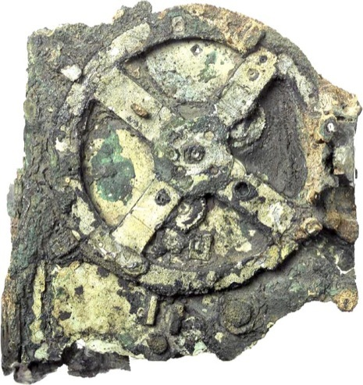
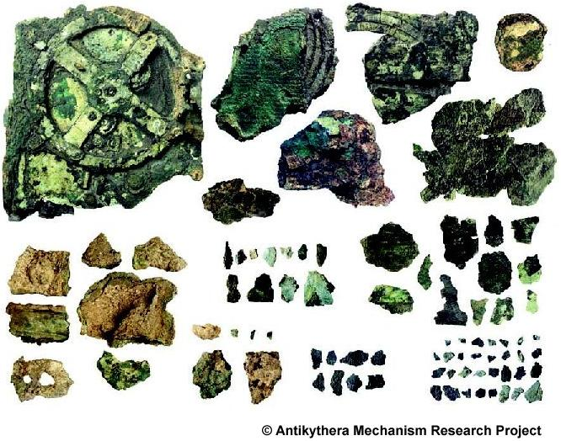
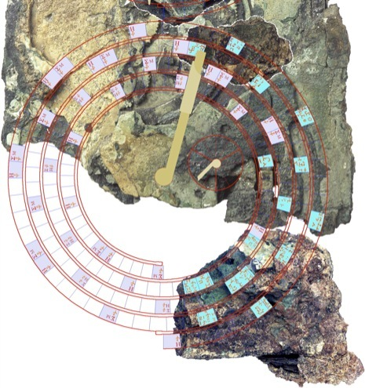
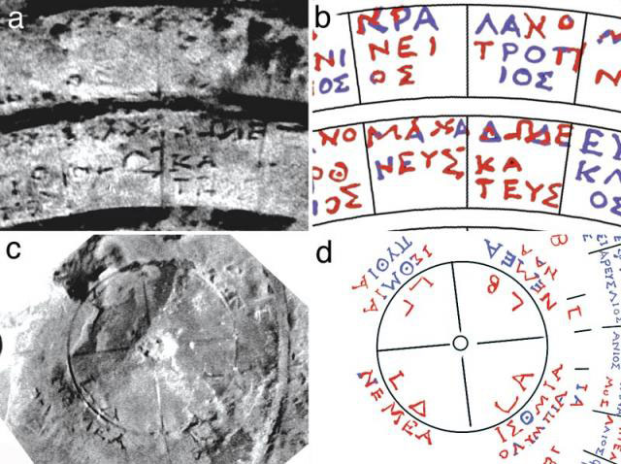
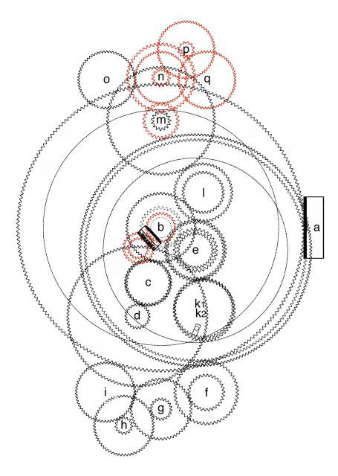
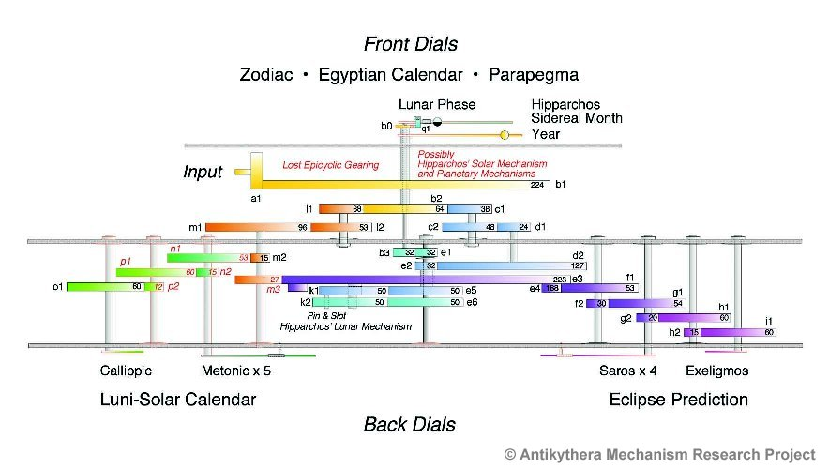






Slide 18

Problem: Can 5 test tubes be spun simultaneously in a 12-hole centrifuge in a balanced way?
What approaches fail?
What techniques work and why?
Lessons and generalizations

Slide 19

Prerequisites
Some discrete math & algorithms knowldege
Ideally, should have taken CS2102
Course will “bootstrap”
(albeit quickly) from first
principles
Critical: Tenacity, patience

Slide 20

Course Organization
Exams: probably take home
  Decide by vote
  Flexible exam schedule
Problem sets:
  Lots of problem solving
  Work in groups!
  Not formally graded
  Many exam questions will
  come from homeworks!
Extra credit problems
  In class & take-home
  Find mistakes in slides, handouts, etc.
Course materials posted on Web site
www.cs.virginia.edu/robins/theory

Slide 21

Grading Scheme
Midterm 35%
Final 35%
Project 30%
Extra credit 10%
Best strategy:
Solve lots of problems!

Slide 22

Contact Information
  Professor Gabriel Robins
  Office: 409 Rice Hall
  Phone: (434) 982-2207
  Email: robins@cs.virginia.edu
  Web: www.cs.virginia.edu/robins
www.cs.virginia.edu/robins
Office hours: after class
  • Any other time
  • By email (preferred)
  • By appointment
  • Q&A blog posted on class Web site

Slide 23

Good Advice
  • Ask questions ASAP
  • Do homeworks ASAP
  • Work in study groups
  • Do not fall behind
  • “Cramming” won’t work
  • Start on project early
  • Attend every lecture
  • Read Email often
  • Solve lots of problems

Slide 24



Supplemental Readings
www.cs.virginia.edu/robins/CS_readings.html
Great videos:
  Randy Pausch's "Last Lecture”, 2007
  Randy Pausch's "Time Management“, 2007
  "Powers of Ten", Charles and Ray Eames, 1977

Slide 25
Supplemental Readings
www.cs.virginia.edu/robins/CS_readings.html
Theory and Algorithms:
  Who Can Name the Bigger Number, Scott Aaronson, 1999
  The Limits of Reason, Gregory Chaitin, Scientific American, March 2006, pp. 74-81.
  Breaking Intractability, Joseph Traub and Henryk Wozniakowski, Scientific American, January 1994, pp. 102-107.
  Confronting Science's Logical Limits, John Casti, Scientific American, October 1996, pp. 102-105.
  Go Forth and Replicate, Moshe Sipper and James Reggia, Scientific American, August 2001, pp. 34-43.
  The Science Behind Sudoku, Jean-Paul Delahaye, Scientific American, June 2006, pp. 80-87.
  The Traveler's Dilemma, Kaushik Basu, Scientific American, June 2007, pp. 90-95.

Slide 26
Supplemental Readings
www.cs.virginia.edu/robins/CS_readings.html
Biological Computing:
  Computing with DNA, Leonard Adleman, Scientific American, August 1998, pp. 54-61.
  Bringing DNA Computing to Life, Ehud Shapiro and Yaakov Benenson, Scientific American, May 2006, pp. 44-51.
  Engineering Life: Building a FAB for Biology, David Baker et al., Scientific American, June 2006, pp. 44-51.
  Big Lab on a Tiny Chip, Charles Choi, Scientific American, October 2007, pp. 100-103.
  DNA Computers for Work and Play, Macdonald et al, Scientific American, November 2007, pp. 84-91.

Slide 27
Supplemental Readings
www.cs.virginia.edu/robins/CS_readings.html
Quantum Computing:
  Quantum Mechanical Computers, Seth Lloyd, Scientific American, 1997, pp. 98-104.
  Quantum Computing with Molecules, Gershenfeld and Chuang, Scientific American, June 1998, pp. 66-71.
  Black Hole Computers, Seth Lloyd and Jack Ng, Scientific American, November 2004, pp. 52-61.
  Computing with Quantum Knots, Graham Collins, Scientific American, April 2006, pp. 56-63.
  The Limits of Quantum Computers, Scott Aaronson, Scientific American, March 2008, pp. 62-69.
  Quantum Computing with Ions, Monroe and Wineland, Scientific American, August 2008, pp. 64-71.

Slide 28
Supplemental Readings
www.cs.virginia.edu/robins/CS_readings.html
History of Computing:
  Alan Turing's Forgotten Ideas, B. Jack Copeland and Diane Proudfoot, Scientific American, May 1999, pp. 98-103.
  Ada and the First Computer, Eugene Kim and Betty Toole, Scientific American, April 1999, pp. 76-81.
Security and Privacy:
  Malware Goes Mobile, Mikko Hypponen, Scientific American, November 2006, pp. 70-77.
  RFID Powder, Tim Hornyak, Scientific American, February 2008, pp. 68-71.
  Can Phishing be Foiled, Lorrie Cranor, Scientific American, December 2008, pp. 104-110.

Slide 29
Supplemental Readings
www.cs.virginia.edu/robins/CS_readings.html
Future of Computing:
  Microprocessors in 2020, David Patterson, Scientific American, September 1995, pp. 62-67.
  Computing Without Clocks, Ivan Sutherland and Jo Ebergen, Scientific American, August 2002, pp. 62-69.
  Making Silicon Lase, Bahram Jalali, Scientific American, February 2007, pp. 58-65.
  A Robot in Every Home, Bill Gates, Scientific Am, January 2007, pp. 58-65.
  Ballbots, Ralph Hollis, Scientific American, October 2006, pp. 72-77.
  Dependable Software by Design, Daniel Jackson, Scientific American, June 2006, pp. 68-75.
  Not Tonight Dear - I Have to Reboot, Charles Choi, Scientific American, March 2008, pp. 94-97.
  Self-Powered Nanotech, Zhong Lin Wang, Scientific American, January 2008, pp. 82-87.

Slide 30

Supplemental Readings
www.cs.virginia.edu/robins/CS_readings.html
The Web:
  The Semantic Web in Action, Lee Feigenbaum et al., Scientific American, December 2007, pp. 90-97.
  Web Science Emerges, Nigel Shadbolt and Tim Berners-Lee, Scientific American, October 2008, pp. 76-81.
The Wikipedia Computer Science Portal:
  Theory of computation and Automata theory
  Formal languages and grammars
  Chomsky hierarchy and the Complexity Zoo
  Regular, context-free &Turing-decidable languages
  Finite & pushdown automata; Turing machines
  Computational complexity
  List of data structures and algorithms

Slide 31


Supplemental Readings
www.cs.virginia.edu/robins/CS_readings.html
The Wikipedia Math Portal:
  Problem solving
  List of Mathematical lists
  Sets and Infinity
  Discrete mathematics
  Proof techniques and list of proofs
  Information theory & randomness
  Game theory
Mathematica's “Math World”

Slide 32




Slide 33
Problem: Can 5 test tubes be spun simultaneously in a 12-hole centrifuge in a balanced way?
No vector calculus / trig!
No equations!
Truth is guaranteed!
Fundamental principles exposed!
Easy to generalize!
High elegance / beauty!
What does “balanced” mean?
Why are 3 test tubes balanced?
Symmetry!
Can you merge solutions?
Superposition!
Linearity! ƒ(x + y) = ƒ(x) + ƒ(y)
Can you spin 7 test tubes?
Complementarity!
Empirical testing…

Slide 34
Problem: 1 + 2 + 3 + 4 + …+ 100 = ?
Proof: Induction…
1 + 2 + 3 + … + 99 + 100
100 + 99 + 98 + … + 2 + 1
101 + 101 + 101 + … + 101 + 101 =
= (100*101)/2
= 5050
100*101
n
n+1

Slide 35


Drawbacks of Induction
You must a priori know the formula / result
Easy to make mistakes in inductive proof
Mostly “mechanical” – ignores intuitions
Tedious to construct
Difficult to check
Hard to understand
Not very convincing
Generalizations not obvious
Does not “shed light on truth”
Obfuscates connections
Conclusion: only use induction as a last resort!
I.e., almost never!
Oh oh!
induction

Slide 36
Problem: (1/4) + (1/4)² + (1/4)³ + (1/4)⁴ + … = ?
Extra Credit:
Find a short, geometric, induction-free proof.

Slide 37
Problem: (1/4) + (1/4)² + (1/4)³ + (1/4)⁴ + … = ?
Find a short, geometric, induction-free proof.
1
1

Slide 38
Problem: (1/8) + (1/8)² + (1/8)³ + (1/8)⁴ + …= ?
Extra Credit:
Find a short, geometric, induction-free proof.

Slide 39



Problem: (1/8) + (1/8)² + (1/8)³ + (1/8)⁴ + …= ?
Find a short, geometric, induction-free proof.

Slide 40

Problem: 1³ + 2³ + 3³ + 4³ + …+ n³ = ?
Extra Credit:
find a short, geometric,
induction-free proof.

Slide 41
Problem: Can an 8x8 board with two opposite corners missing be tiles with 31 dominoes?
= 31 x
?
What approaches fail?
What techniques work and why?
Lessons and generalizations

Slide 42

Problem: Given any five points in/on the unit
square, is there always a pair with distance ≤ ?
1
1
What approaches fail?
What techniques work and why?
Lessons and generalizations

Slide 43

Problem: Given any five points in/on the unit equilateral triangle, is there always a pair with distance ≤ ½ ?
1
1
1
What approaches fail?
What techniques work and why?
Lessons and generalizations

Slide 44

Problem: Prove that there are an infinity of primes.
Extra Credit: Find a short, induction-free proof.
What approaches fail?
What techniques work and why?
Lessons and generalizations

Slide 45

Problem: True or false: there are arbitrary long blocks of consecutive composite integers
(i.e., big “prime deserts”)
Extra Credit: find a short, induction-free proof.
What approaches fail?
What techniques work and why?
Lessons and generalizations

Slide 46

Problem: Prove that is irrational.
Extra Credit: find a short, induction-free proof.
What approaches fail?
What techniques work and why?
Lessons and generalizations

Slide 47

Problem: Does exponentiation preserve irrationality? i.e., are there two irrational numbers x and y such that x^{y} is rational?
Extra Credit: find a short, induction-free proof.
What approaches fail?
What techniques work and why?
Lessons and generalizations

Slide 48
Problem: Solve the following equation for X:
where the stack of exponentiated x’s extends forever.
…
X
X
X
X
X = 2
What approaches fail?
What techniques work and why?
Lessons and generalizations

Slide 49


Problem: Are the complex numbers closed under exponentiation ? E.g., what is the value of i^{i}?

Slide 50


Theorem [Turing]: not all problems are solvable by algorithms.
Theorem: not all functions are computable by algorithms.
Theorem: not all Boolean functions are computable by algorithms.
Theorem: most Boolean functions are not computable!
Q: Can we find a concrete example of an uncomputable function?
A [Turing]: Yes, for example, the Halting Problem.
Definition: The Halting problem: given a program P
and input I, will P ever halt if we ran it on I?
Define H:ℕ×ℕ→{0,1}
H(P,I)=1 if program P halts on input I
H(P,I)=0 otherwise
Both P and I can be encoded as strings
P and I can also be encoded as integers (in some canonical order )
H is an everywhere-defined Boolean function on natural #’s
H
P
Does P(I)
halt?
yes
I
no

Slide 51


Theorem [Turing]: the halting problem (H) is not computable.
Ex: the “3X+1” problem (the Ulam conjecture):
  Start with any integer X>0
  If X is even, then replace it with X/2
  If X is odd then replace it with 3X+1
  Repeat until X=1 (i.e., short cycle 4, 2, 1, ...)
Ex: 26 terminates after 10 steps
27 terminates after 111 steps
Termination verified for X<10¹⁸
Q: Does this terminate for every X>0 ?
A: Open since 1937!
“Mathematics is not yet ready for such confusing,
troubling, and hard problems." - Paul Erdős, who
offered a $500 bounty for a solution to this problem
Observation: termination is
in general difficult to detect!
Number of steps to termination
for the first 10,000 numbers

Slide 52

Theorem [Turing]: the halting problem (H) is not computable.
Corollary: we can not algorithmically detect all infinite loops.
Q: Why not? E.g., do the following programs halt?
main()
{ int k=3; }
main()
{ while(1) {} }
Halts!
Runs forever!
?
main()
{ Find a Fermat
triple a^{n}+b^{n}=c^{n}
with n>2 & stop}
main()
{ Find a Goldbach
integer that is not a sum
of two primes & stop}
Runs forever!
Open from 1637-1995!
?
Still open since 1742!
Theorem: solving the halting problem is at least as
hard as solving arbitrary open mathematical problems!

Slide 53



Theorem [Turing]: the halting problem (H) is not computable.
Proof: Assume ∃ algorithm S that solves the halting problem
H, that always stops with the correct answer for any P & I.
S
S
yes
P
yes
P
Does
P(I) halt?
Does
P(I) halt?
I
I
no
no
Using S, construct algorithm / TM T:
Non-existence proof!
∞
T
S
Diagonalization
yes
P
X
Does
P(I) halt?
I
no
T(T) halts
⇒ T(T) does not halt
Q ⇔ ~Q ⇒ Contradiction!
T(T) does not halt
⇒ T(T) halts
⇒ S cannot exist! (at least as an algorithm / program / TM)

Slide 54

Theorem: all computable numbers are finitely describable.
Proof: A computable number can be outputted by a TM.
A TM is a (unique) finite description.
What the unsolvability of the Halting Problem means:
There is no single algorithm / program / TM that correctly
solves all instances of the halting problem in finite time each.
This result does not necessarily apply if we allow:
Incorrectness on some instances
Infinitely large algorithm / program
Infinite number of finite algorithms / programs
Some instances to not be solved
Infinite “running time” / steps
Powerful enough oracles

Slide 55
Q: When do we want to feed a program to itself in practice?
A: When we build compilers.
Q: Why?
A: To make them more efficient!
To boot-strap the coding in the compiler’s own language!
C
compiler
Program
Executable
code

Slide 56



Theorem: Infinite loop
detection is not computable.
Theorem: virus detection
is not computable.

Slide 57




Self-Replication
Biology / DNA
Nanotechnology
Computer viruses
Space exploration
Memetics / memes
“Gray goo”
Self-replicating
cellular automata
designed by von Neumann
Problem (extra credit): write a program that
prints out its own source code (no inputs of
any kind are allowed).

Slide 58



Slide 59



Slide 60



Slide 61



Slide 62



Slide 63






Non-Existence Proofs
Must cover all possible (usually infinite) scenarios!
Examples / counter-examples are not convincing!
Not “symmetric” to existence proofs!
Ex: proof that you
are a millionaire:
“Proof” that you
are not a millionaire ?
Existence proofs
can be easy!
Non-existence proofs
are often hard!
P≠NP

Slide 64



Slide 65



Slide 66



Slide 67


Slide 68


Slide 69



Pigeon-Hole Principle
J. Dirichlet (1834)
“Drawer principle”
“Shelf Principle”
“Box principle”
Theorem (pigeon-hole): There is no injective (1-to-1) function from a finite set (domain) to a smaller finite set (range).
Generalization:
N objects placed in M containers; then:
at least 1 container must hold
at least 1 container must hold

Slide 70


Generalized Numbers
?
Finitely describable numbers H
Hypernumbers
Complex ℂ 7+3i
Reals ℝ
Rationals ℚ 2/9
Octonions 1+i+j+k+E+I+J+K
Integers ℤ -4
Sedenions S 1+i+j+k+…+e₁₅+e₁₆
Computable numbers
Quaternions ℍ 1+i+j+k
Trancendental π
Naturals ℕ 6
Algebraic 2
Irrationals J
Primes ℙ 5
Surreal {L|R}
Boolean 1
Surcomplex A+Bi
Theorem: some real numbers are not finitely describable!
Theorem: some finitely describable real numbers are not computable!

