Slide 1
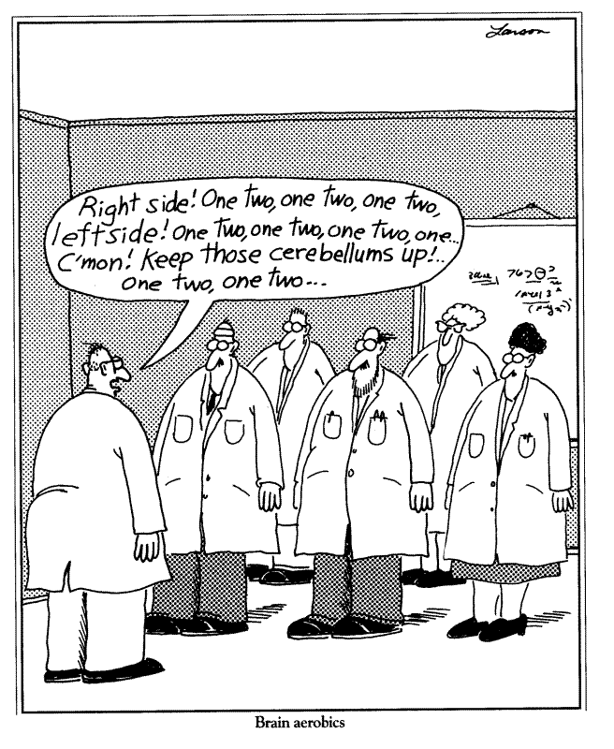
Problem: Given any five points in/on the unit
square, is there always a pair with distance ≤ ?
1
1
What approaches fail?
What techniques work and why?
Lessons and generalizations

Slide 2
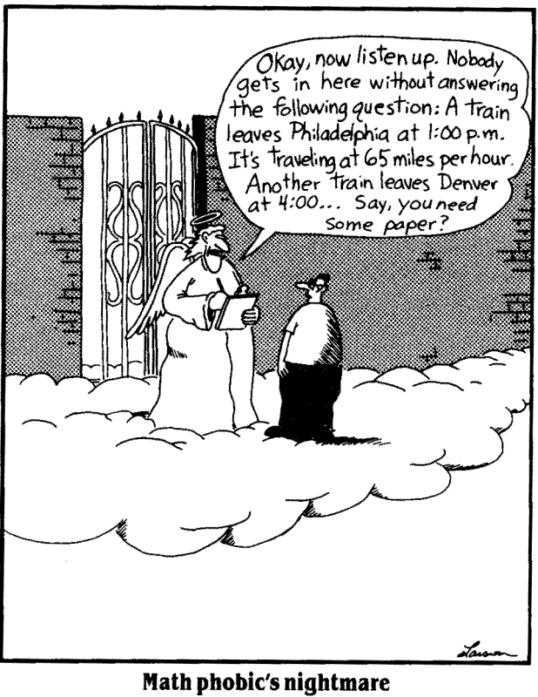
Problem: Given any five points in/on the unit equilateral triangle, is there always a pair with distance ≤ ½ ?
1
1
1
What approaches fail?
What techniques work and why?
Lessons and generalizations

Slide 3
Problem: Given any five points in/on the unit equilateral triangle, is there always a pair with distance ≤ ½ ?
1
1
1
What approaches fail?
What techniques work and why?
Lessons and generalizations

Slide 4
Problem: Given any ten points in/on the unit
square, what is the maximum pairwise distance?
1
1
What approaches fail?
What techniques work and why?
Lessons and generalizations

Slide 5
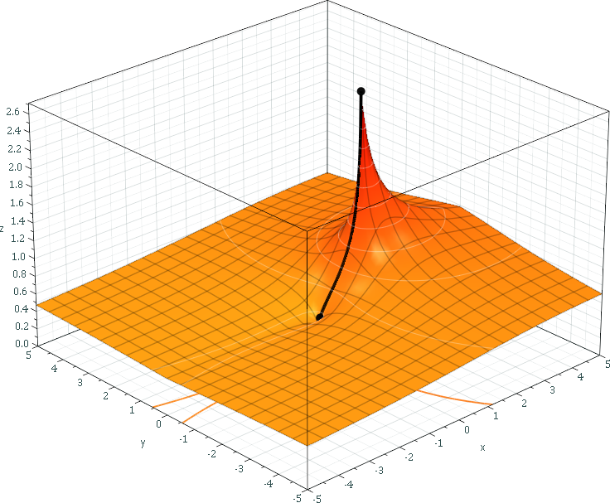
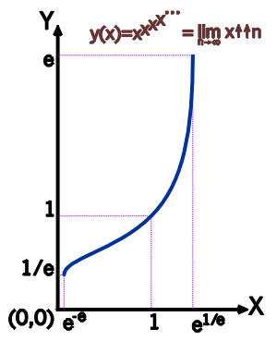
Problem: Solve the following equation for X:
where the stack of exponentiated x’s extends forever.
…
= 2
X
X
X
X
X = 2
⇒ X²=2
⇒X=√2
This “power tower” converges for:
0.065988 ≈ e^{−e} < X < e^{1/e} ≈ 1.444668
Generalization to
complex numbers:

Slide 6
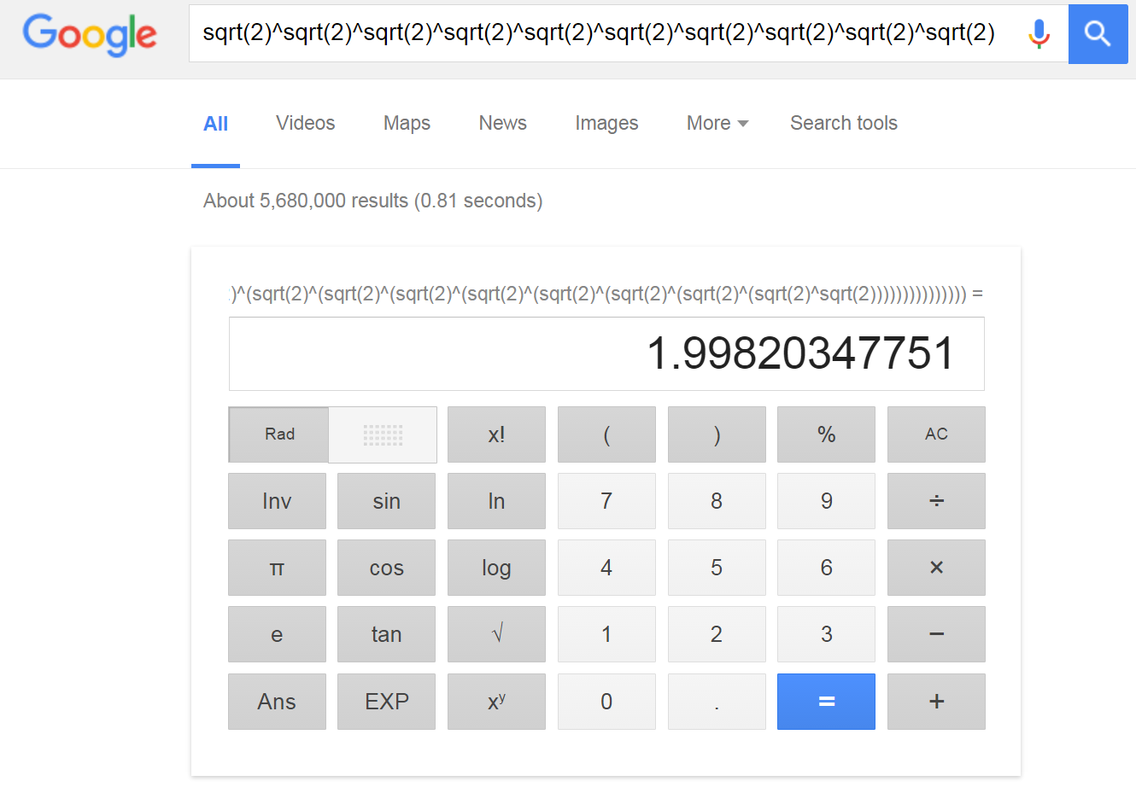

Slide 7
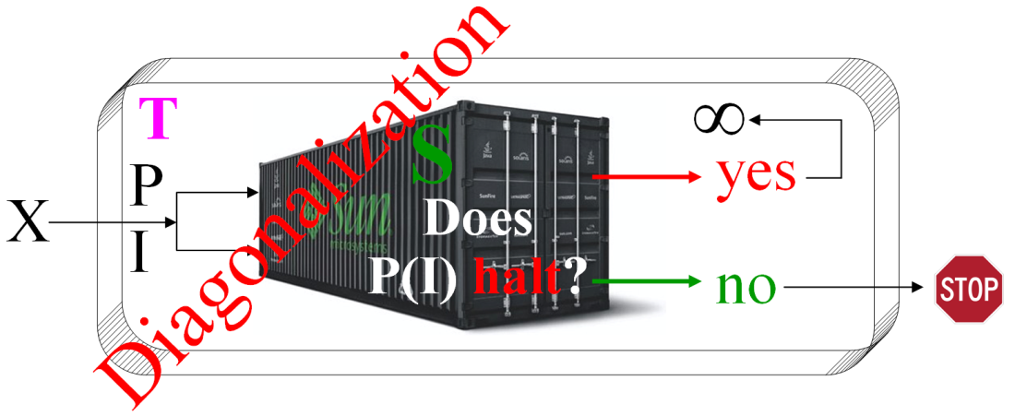



Algorithms
Existence
Efficiency
  Time
  Space
Worst case behavior analysis
as a function of input size
Asymptotic growth: O Ω Θ ο ω
Donald Knuth

Slide 8
Upper Bounds
Definition: f(n) = O(g(n))
⇔ ∃ c,k > 0 ∋ 0 ≤ f(n) ≤ c⋅g(n) ∀ n>k
⇔ Lim f(n) / g(n) exists
n→∞
O(g(n))={f | ∃ c,k>0 ∋ 0 ≤ f(n) ≤ c⋅g(n) ∀ n>k}
“f(n) is big-O of g(n)”
Ex: n = O(n²)
33n+17 = O(n)
n⁸+n⁷ = O(n¹²)
n¹⁰⁰ = O(2^{n})
213 = O(1)
g(n)
f(n)
n
k

Slide 9
Lower Bounds
Definition: f(n) = Ω(g(n))
⇔ g(n)=O(f(n))
⇔ Lim g(n) / f(n) exists
n→∞
Ω(g(n))={f | ∃ c,k>0 ∋ 0 ≤ g(n) ≤ c⋅f(n) ∀ n>k}
“f(n) is Omega of g(n)”
Ex: 100n = Ω(n)
33n+17 = Ω(log n)
n⁸-n⁷ = Ω(n⁸)
213 = Ω(1/n)
10¹⁰⁰ = Ω(1)
f(n)
g(n)
n
k

Slide 10
Tight Bounds
Definition: f(n) = Θ(g(n))
⇔ f(n)=O(g(n)) and g(n)=O(f(n))
⇔ f(n)=O(g(n)) and f(n)=Ω(g(n))
⇔ Lim g(n)/f(n) and Lim f(n)/g(n) exist
n→∞ n→∞
“f(n) is Theta of g(n)”
Ex: 99n = Θ(n)
n + log n = Θ(n)
n⁸-n⁷ = Θ(n⁸)
n² + cos(n) = Θ(n²)
213 = Θ(1)
c₁⋅g(n)
f(n)
c₂⋅g(n)
n
k

Slide 11
Loose Bounds
Definition: f(n) = ο(g₁(n))
⇔ f(n)=O(g₁(n)) and f(n)≠Ω(g₁(n))
“f(n) is little-o of g₁(n)”
Definition: f(n) = ω(g₂(n))
⇔ f(n)=Ω(g₂(n)) and f(n)≠O(g₂(n))
“f(n) is little-omega of g₂ (n)”
Ex: 8n = ο(n log log n)
n log n = ω(n)
n⁶ = ο(n^{6.01})
n² + sin(n) = ω(n)
213 = ο(log n)
g₁(n)
f(n)
g₂(n)
n
k

Slide 12
Growth Laws
Let f₁(n)=O(g₁(n)) and f₂(n)=O(g₂(n))
Thm: f₁(n) + f₂(n) = O(max(g₁(n) , g₂(n))
Sequential code
Thm: f₁(n) • f₂(n) = O(g₁(n) • g₂(n))
Nested loops & subroutine calls
Thm: n^{k} = O(c^{n}) ∀ c,k>0
Ex: n¹⁰⁰⁰ = O(1.001^{n})

Slide 13
Solving Recurrences
T(n) = a • T(n/b) + f(n)
a≥1, b>1, and let c = log_{b}a
Thm: f(n)=Ο(n^{c-ε}) for some ε>0 ⇒ T(n)=Θ(n^{c})
f(n)=Θ(n^{c}) ⇒ T(n)=Θ(n^{c} log n)
f(n)=Ω(n^{c+ε}) some ε>0 and a•f(n/b) ≤ d•f(n)
for some d<1 ∀ n>n₀ ⇒ T(n)=Θ(f(n))
Ex: T(n) = 2T(n/2)+n ⇒ T(n)=Θ(n log n)
  T(n) = 9T(n/3)+n ⇒ T(n)=Θ(n²)
T(n) = T(2n/3)+1 ⇒ T(n)=Θ(log n)

Slide 14
Stirling’s Formula
Factorial:
Theorem:
where e is Euler’s constant = 2.71828…
Theorem:
Corollary:
log(n!) = O(n log n)
Useful in analyses and bounds

Slide 15
Data Structures

Slide 16
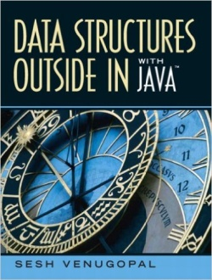


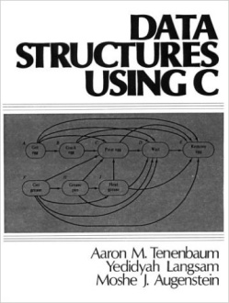
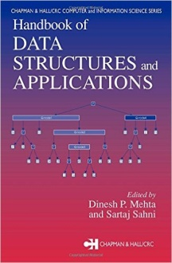
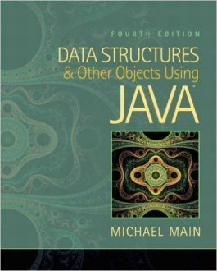

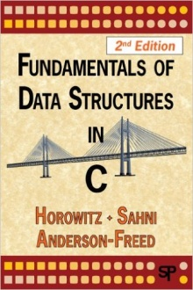
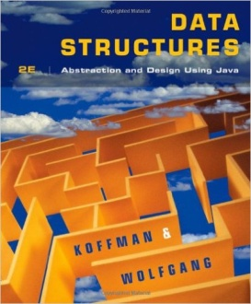
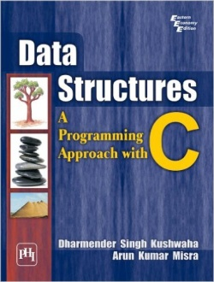
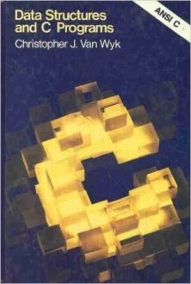
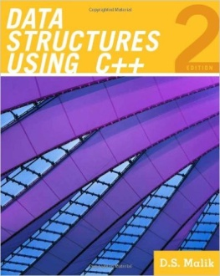
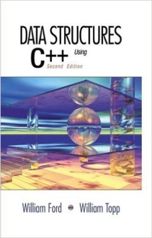

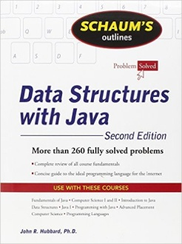
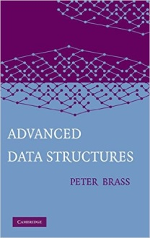
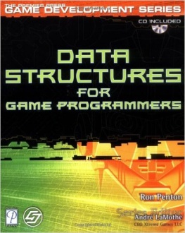
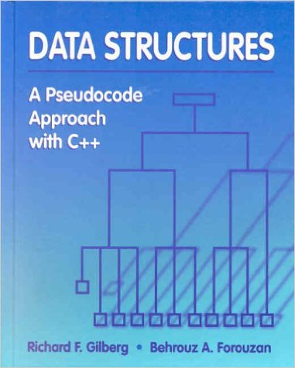
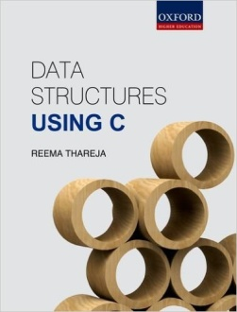
Data Structures
Techniques for organizing information effectively
Allowed operations:
  Initialize
  Insert
  Delete
  Search
  Min/max
  Successor
  Predecessor
  Merge
  Split
  Revert

Slide 17
Data Structures
Primitive types:
Boolean
Character
Floating-point
Double
Integer
Enumerated type
Abstract data types:
Array
Container
Map
Associative array
Dictionary
Multimap
List
Set
Multiset / Bag
Priority queue
Queue
Double-ended queue
Stack
String
Tree
Graph
Composite types:
Array
Record
Union
Tagged union
Arrays:
Bit array
Bit field
Bitboard
Bitmap
Circular buffer
Control table
Image
Dynamic array
Gap buffer
Hashed array tree
Heightmap
Lookup table
Matrix
Parallel array
Sorted array
Sparse array
Sparse matrix
Iliffe vector
Variable-length array
Lists:
Doubly linked list
Array list
Linked list
Self-organizing list
Skip list
Unrolled linked list
VList
Xor linked list
Zipper
Doubly connected edge list
Difference list
Free list
Binary trees:
AA tree
AVL tree
Binary search tree
Binary tree
Cartesian tree
Order statistic tree
Pagoda
Randomized binary search tree
Red-black tree
Rope

Slide 18
Data Structures
Binary trees (continued):
Scapegoat tree
Self-balancing search tree
Splay tree
T-tree
Tango tree
Threaded binary tree
Top tree
Treap
Weight-balanced tree
Binary data structure
Trees:
Trie
Radix tree
Suffix tree
Suffix array
Compressed suffix array
FM-index
Generalised suffix tree
B-trie
Judy array
X-fast trie
Y-fast trie
Ctrie
B-trees:
B-tree
B+ tree
B*-tree
B sharp tree
Dancing tree
2-3 tree
2-3-4 tree
Queap
Fusion tree
Bx-tree
AList
Heaps:
Heap
Binary heap
Weak heap
Binomial heap
Fibonacci heap
AF-heap
Leonardo Heap
2-3 heap
Soft heap
Pairing heap
Leftist heap
Treap
Beap
Skew heap
Ternary heap
D-ary heap
Brodal queue
Multiway trees:
Ternary tree
K-ary tree
And–or tree
(a,b)-tree
Link/cut tree
SPQR-tree
Spaghetti stack
Disjoint-set data structure
Fusion tree
Enfilade
Exponential tree
Fenwick tree
Van Emde Boas tree
Rose tree
Space-partitioning trees:
Segment tree
Interval tree
Range tree

Slide 19
Data Structures
Space-partitioning trees (cont):
Bin
Kd-tree
Implicit kd-tree
Min/max kd-tree
Adaptive k-d tree
Quadtree
Octree
Linear octree
Z-order
UB-tree
R-tree
R+ tree
R* tree
Hilbert R-tree
X-tree
Metric tree
Cover tree
M-tree
VP-tree
BK-tree
Bounding interval hierarchy
BSP tree
Rapidly exploring random tree
Application-specific trees:
Abstract syntax tree
Parse tree
Decision tree
Alternating decision tree
Minimax tree
Expectiminimax tree
Finger tree
Expression tree
Log-structured merge-tree
Hashes:
Bloom filter
Count-Min sketch
Distributed hash table
Double Hashing
Dynamic perfect hash table
Hash array mapped trie
Hash list
Hash table
Hash tree
Hash trie
Koorde
Prefix hash tree
Rolling hash
MinHash
Quotient filter
Ctrie
Graphs:
Graph
Adjacency list
Adjacency matrix
Graph-structured stack
Scene graph
Binary decision diagram
0-suppressed decision diagram
And-inverter graph
Directed graph
Directed acyclic graph
Propositional dir. acyclic graph
Multigraph
Hypergraph
Other:
Lightmap
Winged edge
Doubly connected edge list
Quad-edge
Routing table
Symbol table

Slide 20
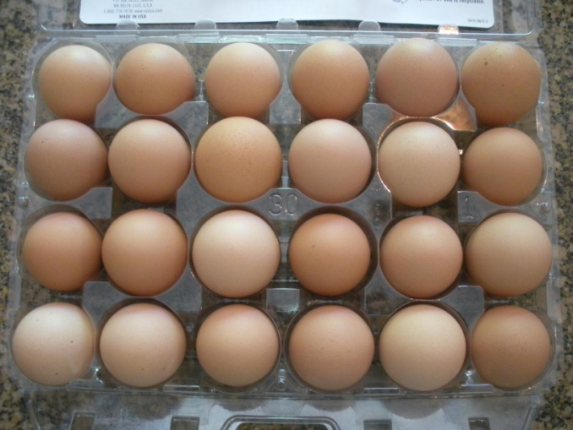
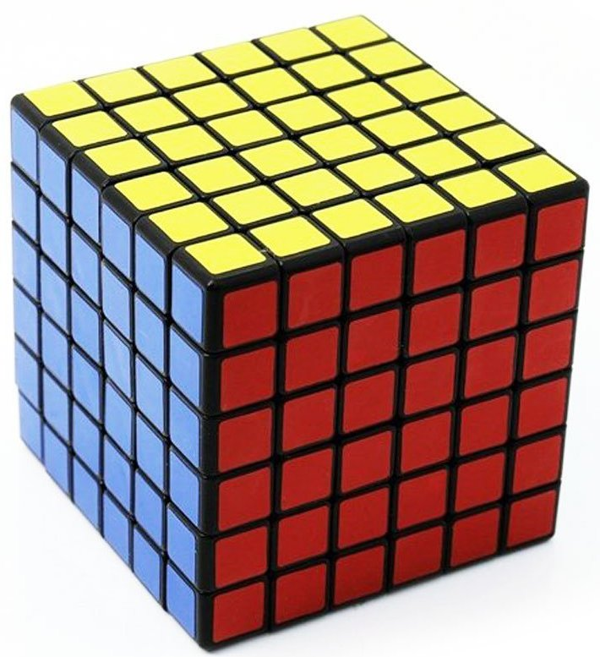
Arrays
• Sequence of "indexible" locations
• Unordered:
• O(1) to add
• O(n) to search / delete
• O(n) for min / max
• Ordered:
• O(n) to add / delete
• O(log n) to (binary) search
• O(1) for min / max
.
.
.
1
2
3
4
5
6
7

Slide 21
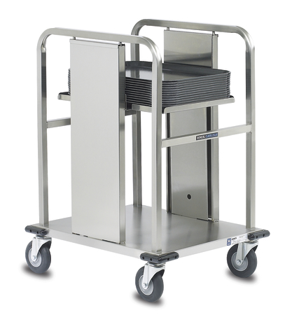
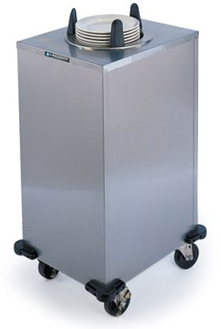
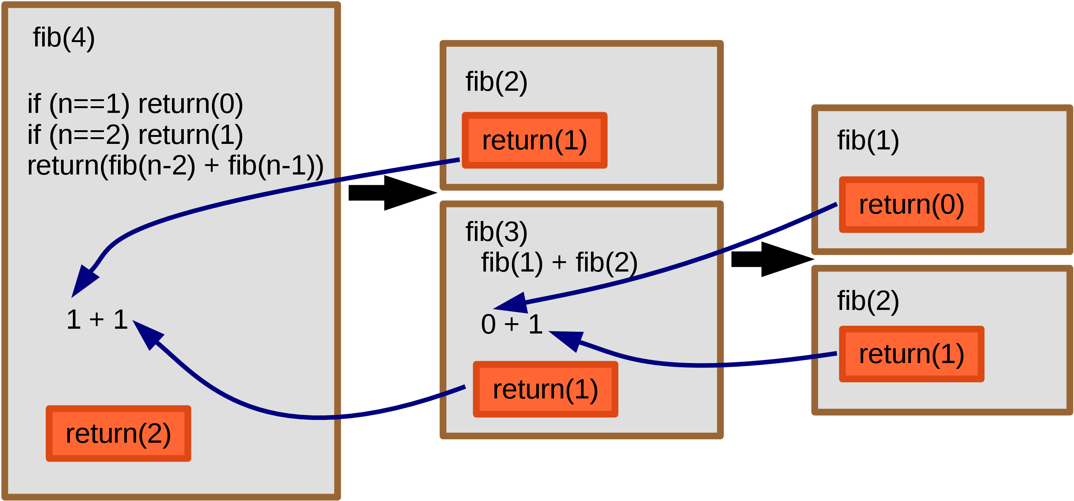
Stacks
• LIFO (Last-In First-Out)
• Operations: push / pop O(1) each
• Can not access “middle”
• Analogy: trays/plates at cafeteria
• Applications:
• Recursion
• Compiling / parsing
• Dynamic binding
• Web surfing
i
n
o
u
t

Slide 22
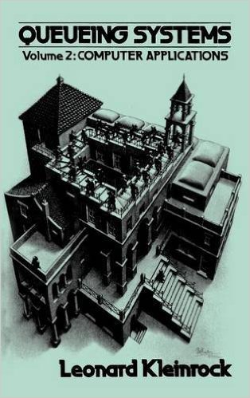

Queues
• FIFO (First-In First-Out)
• Operations: push / pop O(1) each
• Can not access “middle”
• Analogy: line at the store
• Applications:
  • Simulations
  • Scheduling
  • Networks
  • Operating systems

Slide 23
Linked Lists
• Successor / predecessor pointers
• Types:
  • Single linked
  • Double linked
  • Circular
• Operations:
  • Add: O(1) time
  • Search: O(n) time
  • Delete: O(1) time (given pointer)

Slide 24

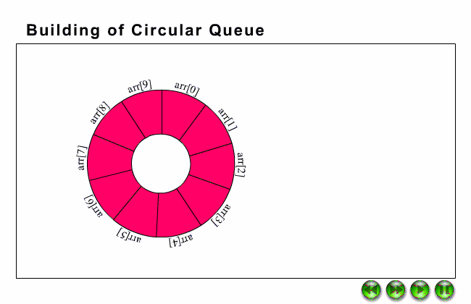
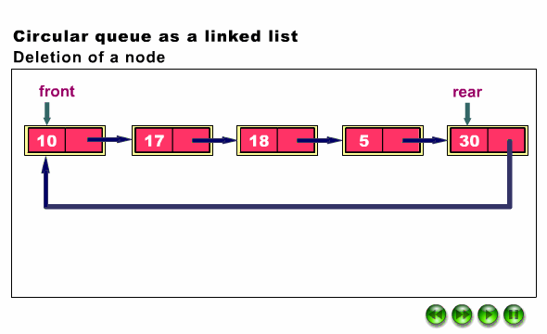
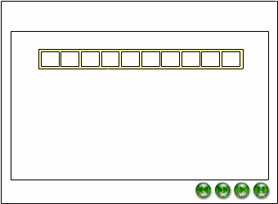

Slide 25
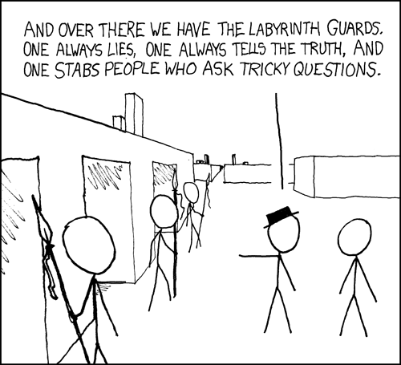
Extra Credit Problem: Given a pointer to a read-only (unmodefiable) linked list containing an unknown number of nodes n, devise an O(n)-time and O(1) space algorithm that determines whether that list contains a cycle.
or
What approaches fail?
What techniques work and why?
Lessons and generalizations

Slide 26
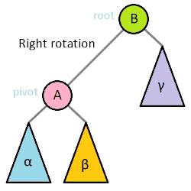
Trees
• Parent/children pointers
• Binary / N-ary
• Ordered / unordered
• Height-balanced:
  • B-trees
  • AVL trees
  • Red-black trees
  • 2-3 trees
  • add / delete / search in O(log n) time

Slide 27
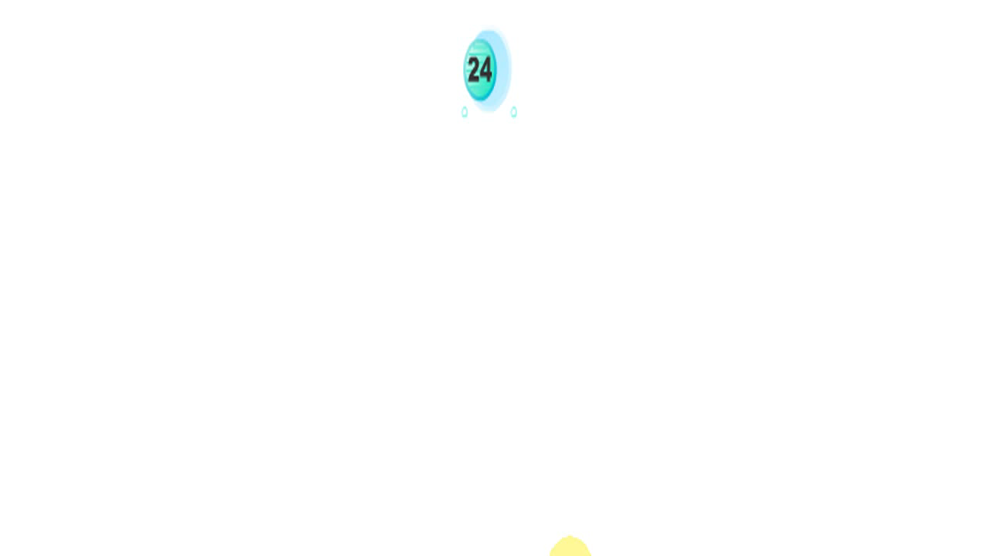
B-Trees
• Multi-rotations occur infrequently
• Rotations don’t propagate far
• Larger tree ⇒ fewer rotations
• Same for other height-balanced trees
• Non-balanced search trees average O(log n) height

Slide 28
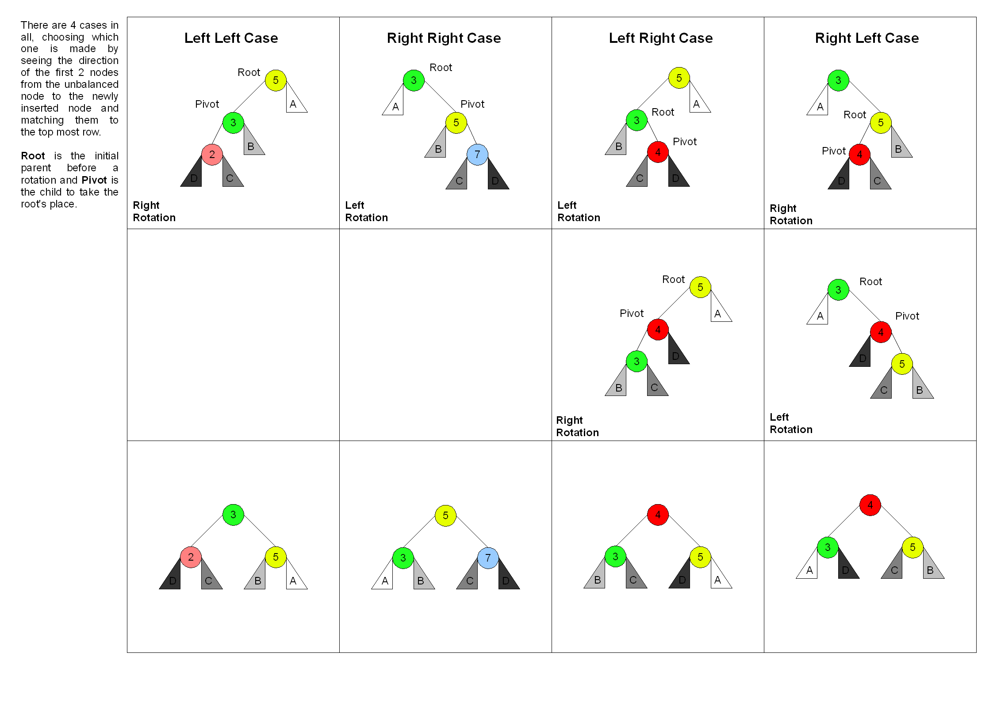
Height-Balanced AVL Trees

Slide 29

AVL Trees
• Multi-rotations occur infrequently
• Rotations don’t propagate far
• Larger tree ⇒ fewer rotations
• Same for other height-balanced trees
• Non-balanced trees average O(log n) height

Slide 30
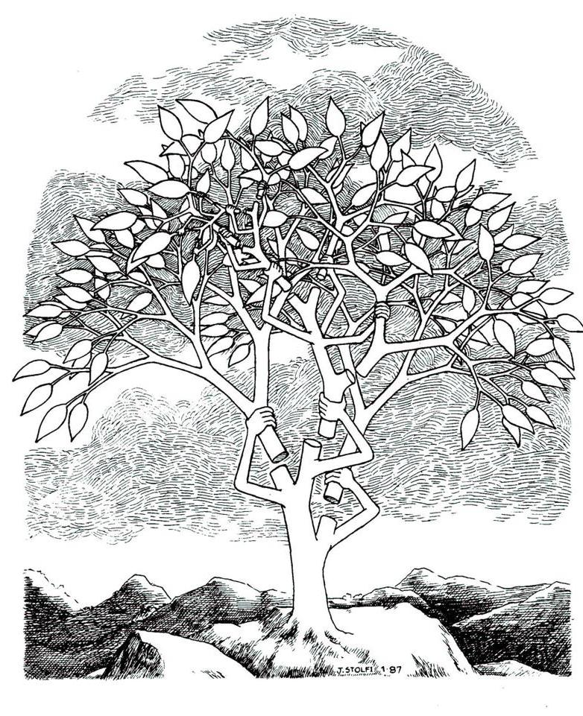
Self-Adjusting Trees

Slide 31
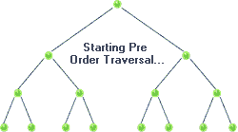
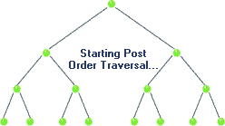
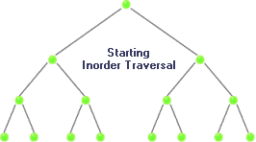
Tree Traversal
Pre-order:
  process node
  visit children
⇒ c b a e d f
Post-order:
  visit children
  process node
⇒ a b d f e c
In-order:
  visit left-child
  process node
  visit right-child
⇒ a b c d e f

Slide 32
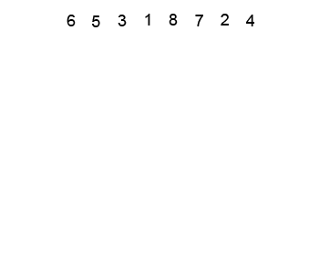
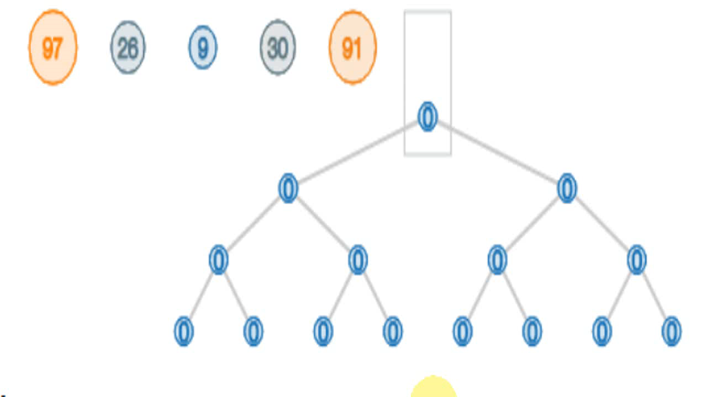
Heaps
• A tree where all of each node’s children
have larger / smaller “keys”
• Can be implemented
using binary tree or array
• Operations:
  • Find min/max: O(1) time
  • Add: O(log n) time
  • Delete: O(log n) time
  • Search: O(n) time

Slide 33
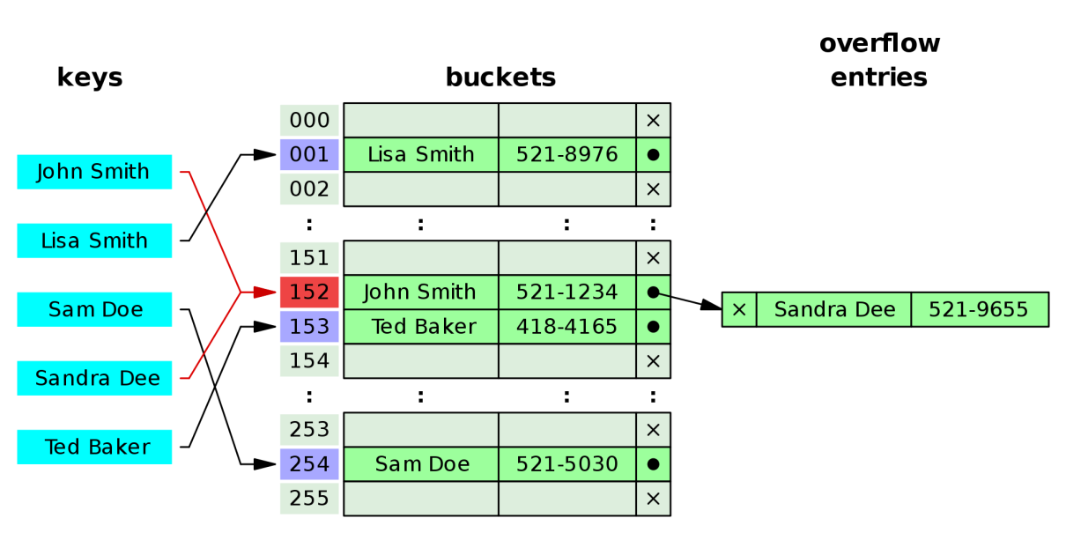
Hash Tables
• Direct access
• Hash function
• Collision resolution:
  • Chaining
  • Linear probing
  • Double hashing
• Universal hashing
• O(1) average access
• O(n) worst-case access
Q: Improve worst-case access to O(log n)?

Slide 34
