Slide 1
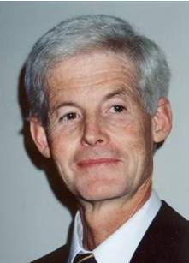
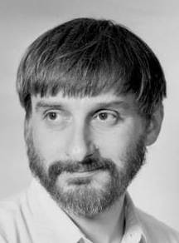
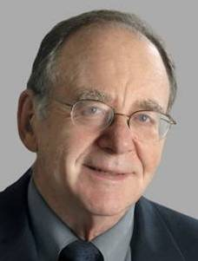


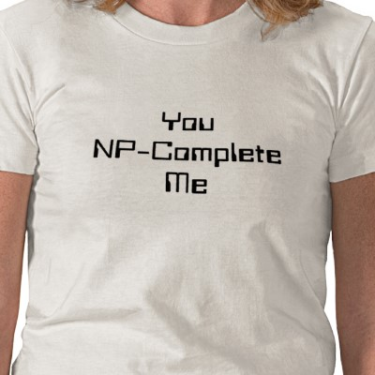
NP Completeness
• Tractability
• Polynomial time
• Computation vs. verification
• Power of non-determinism
• Encodings
• Transformations & reducibilities
• P vs. NP
• “Completeness”
Stephen Cook
Leonid Levin
Richard Karp

Slide 2
NP Completeness Benefits
Saves time & effort of trying to solve intractable problems efficiently;
Saves money by not separately working to efficiently solve different problems;
Helps systematically build on & leverage the work (or lack of progress) of others;
Transformations can be used to solve new problems by reducing them to known ones;
Illuminates the structure & complexity of seemingly unrelated problems;

Slide 3
NP Completeness Benefits
Informs as to when we should use approximate solutions vs. exact ones;
Helps understand the ubiquitous concept of parallelism (via non-determinism);
Enabled vast, deep, and general studies of other “completeness” theories;
Helps explain why verifying proofs seems to be easier than constructing them;
Illuminates the fundamental nature of algorithms and computation;

Slide 4
NP Completeness Benefits
Gave rise to new and novel mathematical approaches, proofs, and analyses;
Helps us to more easily reason about and manipulate large classes of problems;
Robustly decouples / abstracts complexity from underlying computational models;
Gives disciplined techniques for identifying “hardest” problems / languages;
Forged new unifications between computer science, mathematics, and logic;
NP-Completeness is interesting and fun!

Slide 5
Reducibilities Reloaded
Def: A language A is polynomial-time reducible to a language B if ∃ polynomial-time computable function ƒ:∑*→∑* where w∈A ⇔ ƒ(w)∈B ∀w
Def: A language A is polynomial-time reducible to a language B if ∃ polynomial-time computable function ƒ:∑*→∑* where w∈A ⇔ ƒ(w)∈B ∀w
∈P
Note: ƒ is a polynomial-time “reduction” of A to B
Note: ƒ is a polynomial-time “reduction” of A to B
Denotation: A ≤_{P} B
Denotation: A ≤_{P} B
Intuitively, A is “no harder” than B (modulo P)
Intuitively, A is “no harder” than B (modulo P)

Slide 6
Reducibilities Reloaded
Def: A language A is polynomial-time reducible to a language B if ∃ polynomial-time computable function ƒ:∑*→∑* where w∈A ⇔ ƒ(w)∈B ∀w
Def: A language A is polynomial-time reducible to a language B if ∃ polynomial-time computable function ƒ:∑*→∑* where w∈A ⇔ ƒ(w)∈B ∀w
Note: be very
careful about
the reduction
direction!
∈P
Theorem: If A ≤_{P} B and B is decidable within polynomial time then A is decidable within polynomial time.
Theorem: If A ≤_{P} B and A is not decidable within polynomial time then B is not decidable within polynomial time.

Slide 7
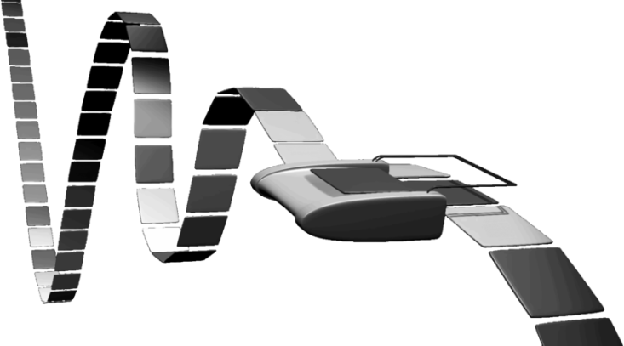
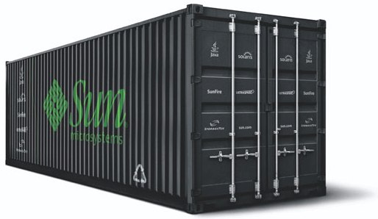
Problem Transformations
Idea: To solve a problem, efficiently transform to another problem, and then use a solver for the other problem:
Satisfiability
SAT solution
x=1, y=0
(x+y)(x'+y')
Colorability
solver
Colorability

Slide 8
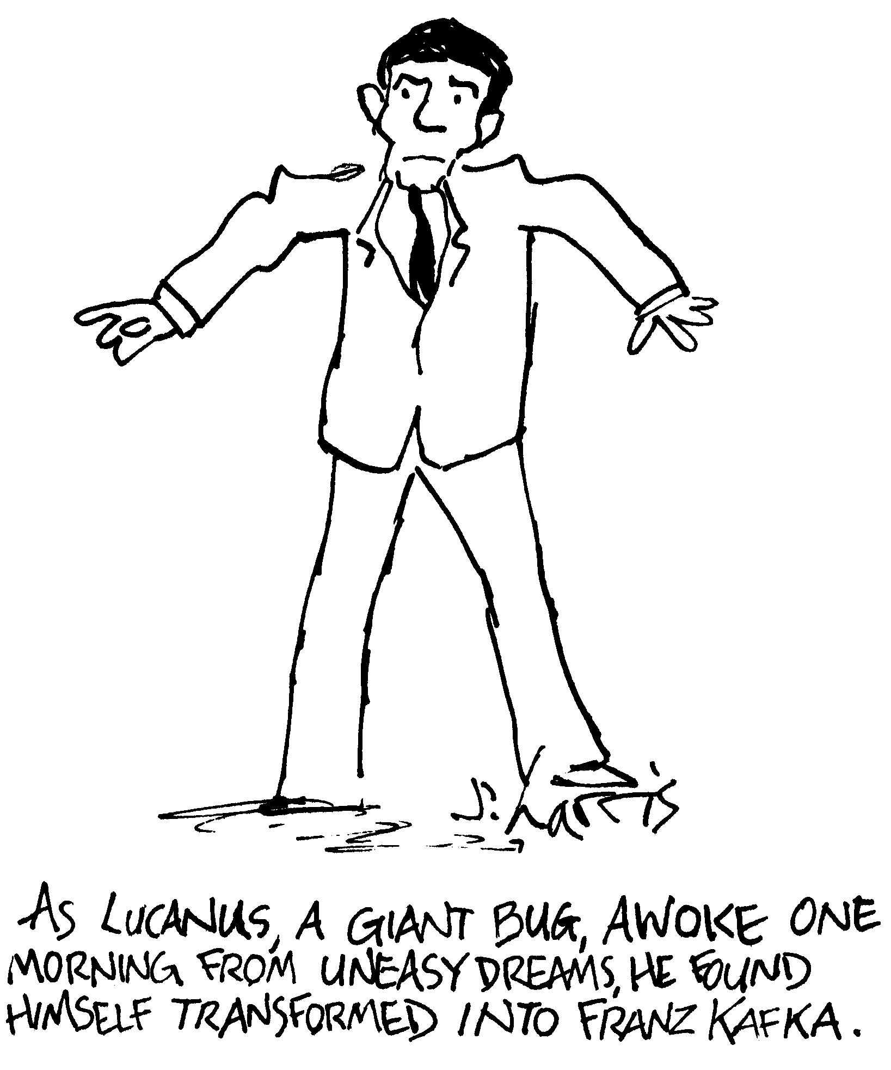

Slide 9
NP Hardness & Completeness
Def: A problem L’ is NP-hard if:
(1) Every L in NP reduces to L’ in polynomial time.
Def: A problem L’ is NP-complete if:
(1) L is NP-hard; and (2) L is in NP.
One NPC problem is in P ⇒ P=NP
Open: is P=NP ?
Open: is NP=co-NP ?
Theorem: P = co-P
NP-complete SAT
NP
P
co-NP
P-complete LP
co-NP-complete TAUT

Slide 10
Boolean Satisfiability Problem (SAT)
Def: CNF (Conjunctive Normal Form) formula
is in a product-of-sums format.
Ex: (x₁+x₄+x₅+x₇+x'₈)(x'₁+x₃+x'₄+x'₅)
Def: A formula is satisfiable if it can be made true
by some assignment of all of its variables.
Problem (SAT): given an n-variable Boolean
formula (in CNF), is it satisfiable?
Ex: (x+y)(x'+z') is satisfiable (e.g., let x=1 & Z=0)
(x+z)(x')(z') is not satisfiable (why?)

Slide 11

The Cook/Levin Theorem
Theorem [Cook/Levin, 1971]: SAT is NP-complete.
Proof idea: given a non-deterministic polynomial
time TM M and input w, construct a CNF
formula that is satisfiable iff M accepts w.
Create boolean variables:
q[i,k] ⇒ at step i, M is in state k
h[i,k] ⇒ at step i, M’s RW head scans tape cell k
s[i,j,k] ⇒ at step i, M’s tape cell j contains symbol S_{k}
M halts in polynomial time p(n)
⇒ total # of variables is polynomial in p(n)
Stephen Cook
Leonid Levin
Q_{k}

Slide 12
The Cook/Levin Theorem
Add clauses to the formula to enforce necessary
restrictions on how M operates / runs:
At each time i:
M is in exactly 1 state
r/w head scans exactly 1 cell
All cells contain exactly 1 symbol
At time 0 ⇒ M is in its initial state
At time P(n) ⇒ M is in a final state
Transitions from step i to i+1
all obey M's transition function
Resulting formula is satisfiable iff M accepts w!
Stephen Cook
Leonid Levin
Q_{k}

Slide 13
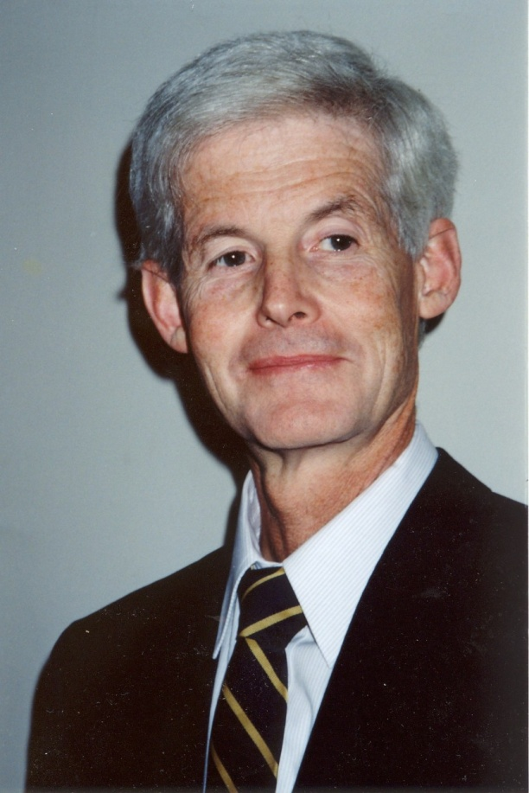
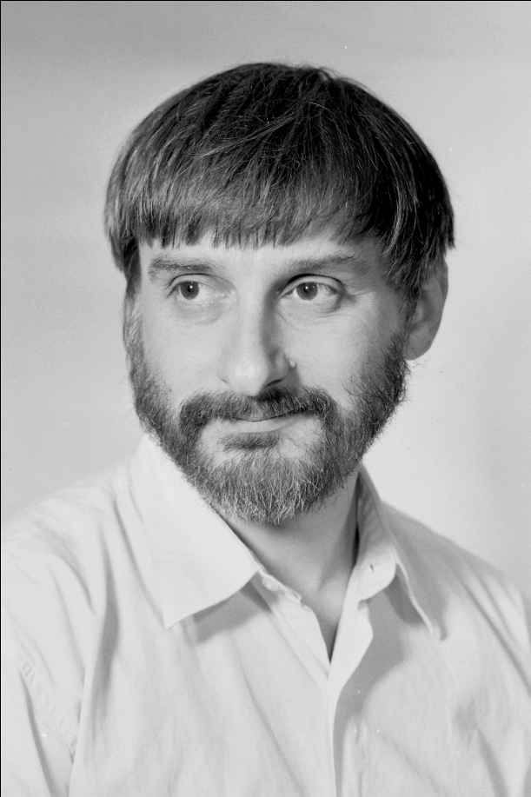
Historical Note
The Cook/Levin theorem was independently proved by Stephen Cook and Leonid Levin
Denied tenure at Berkeley (1970)
Invented NP completeness (1971)
Won Turing Award (1982)
Student of Andrei Kolmogorov
Seminal paper obscured by
Russian, style, and Cold War

Slide 14
“Guess and Verify” Approach
Note: SAT ∈ NP.
Idea: Nondeterministically “guess” each Boolean
variable value, and then verify the guessed solution.
⇒ polynomial-time nondeterministic algorithm ∈ NP
This “guess & verify” approach is general.
Idea: “Guessing” is usually trivially fast (∈ NP)
⇒ NP can be characterized by the “verify” property:
NP ≡ set of problems for which proposed
solutions can be quickly verified
≡ set of languages for which string
membership can be quickly tested.

Slide 15
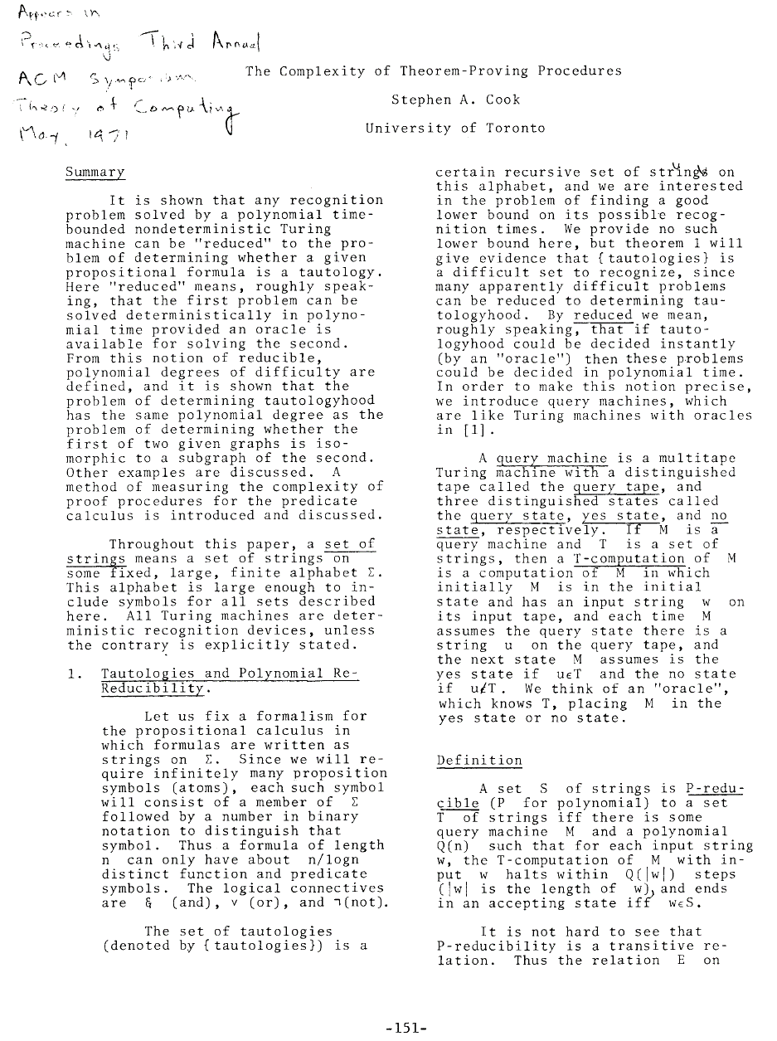
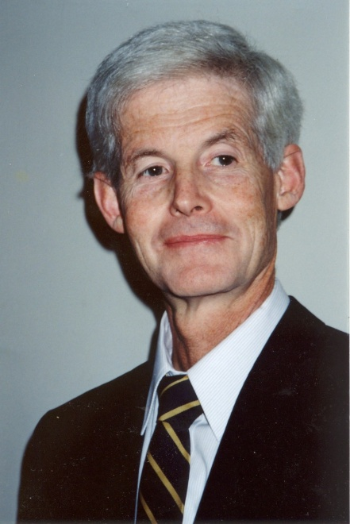

Slide 16
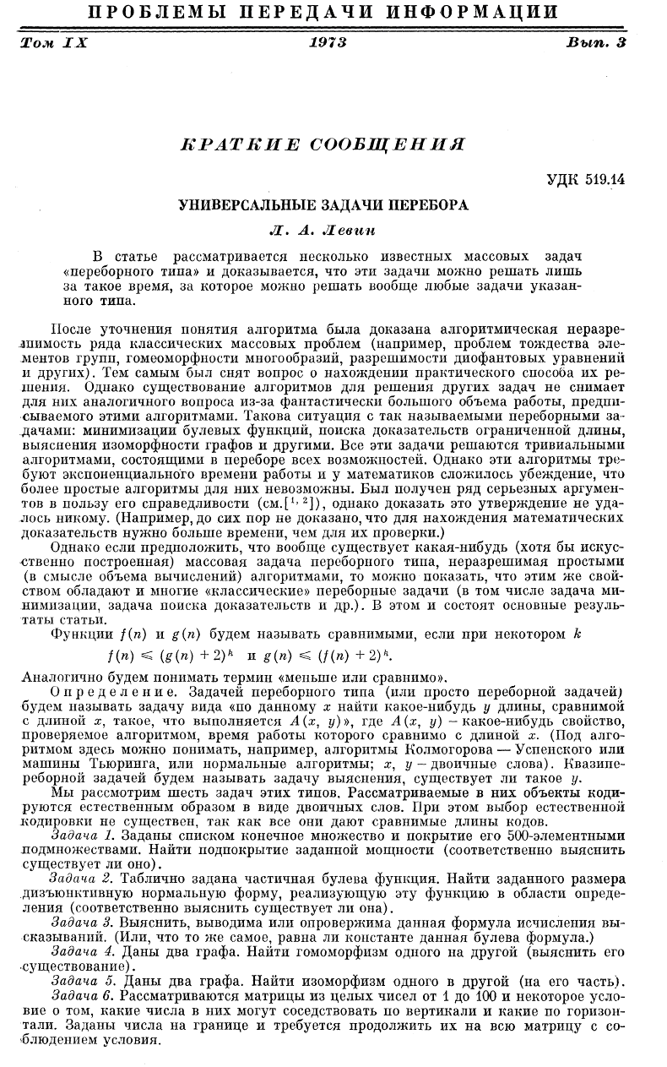
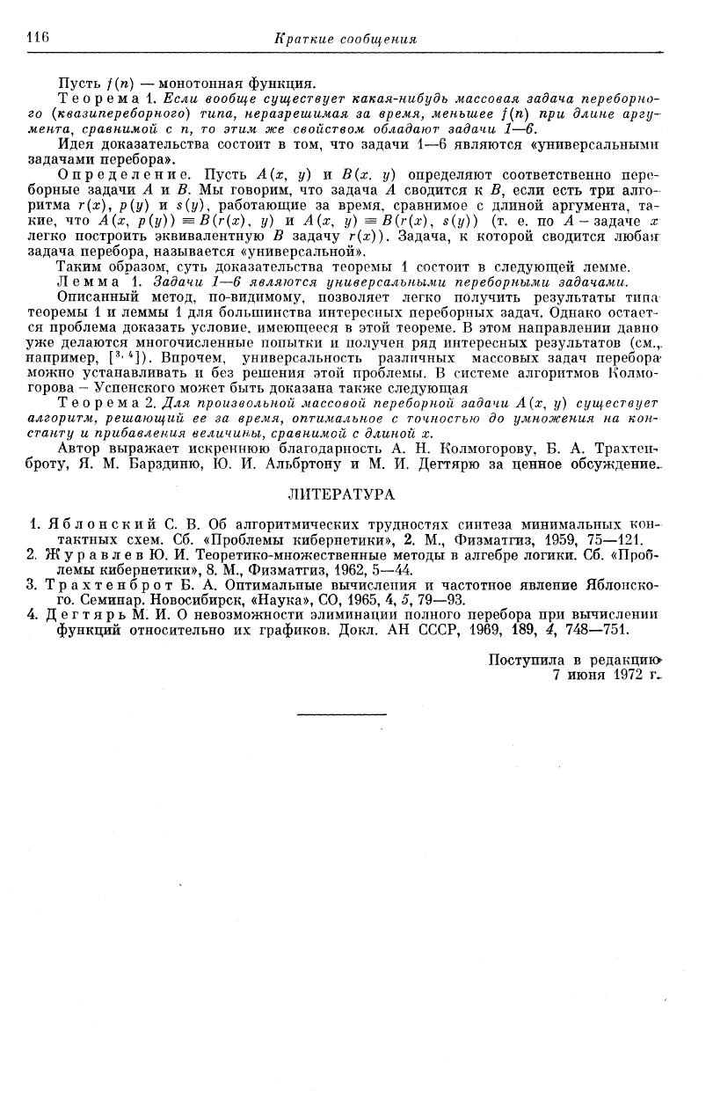
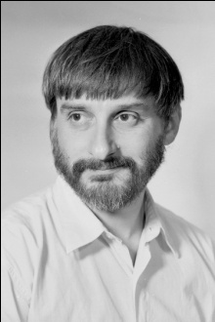
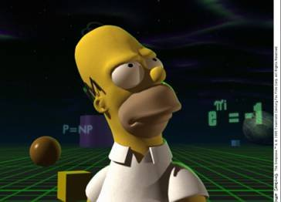
Entire paper!

Slide 17

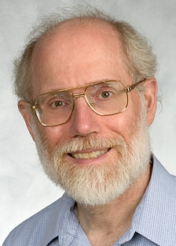
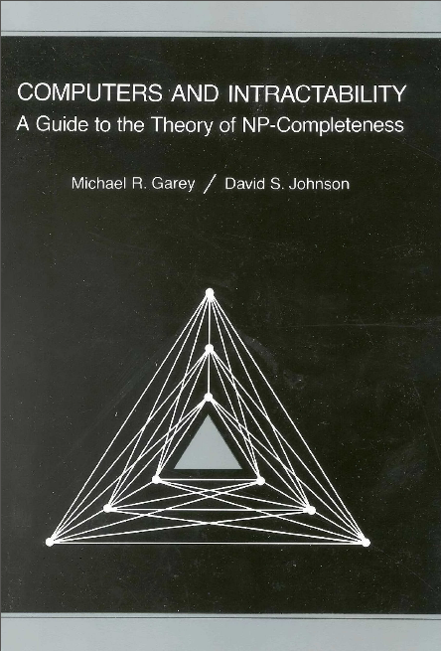
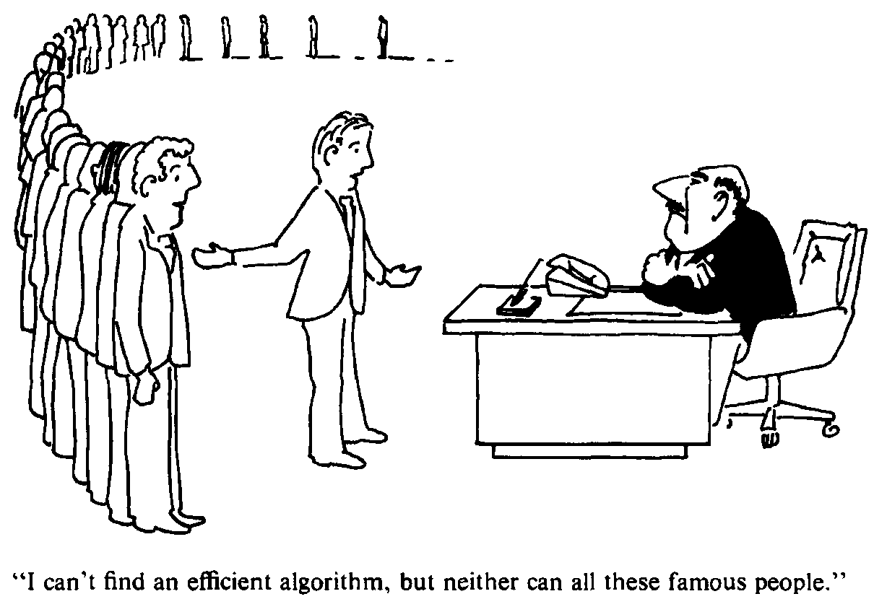
An NP-Complete Encyclopedia
Classic book: Garey & Johnson, 1979
Definitive guide to NP-completeness
Lists hundreds of NP-complete problems
Gives reduction types and refs
Michael Garey
David Johnson

Slide 18
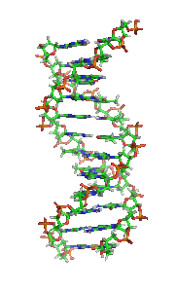
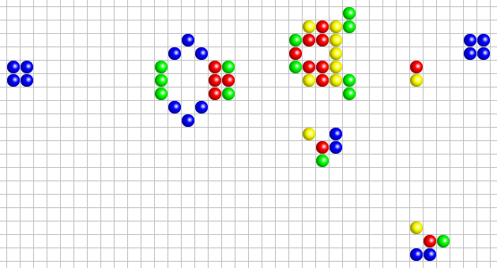
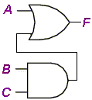
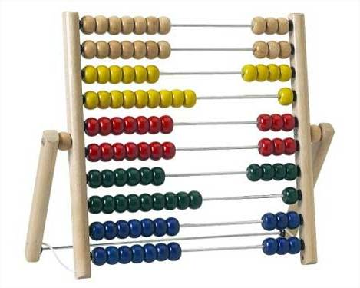
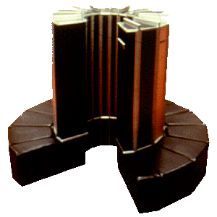
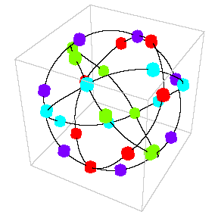

Robustness of P and NP
Compositions of polynomials yields polynomials
Computation models’ efficiencies are all polynomially
related (i.e., can efficiently simulate one another).
Defs of P and NP is computation model-independent!
μ
x³ + y³ + z³ = 33
λ

Slide 19
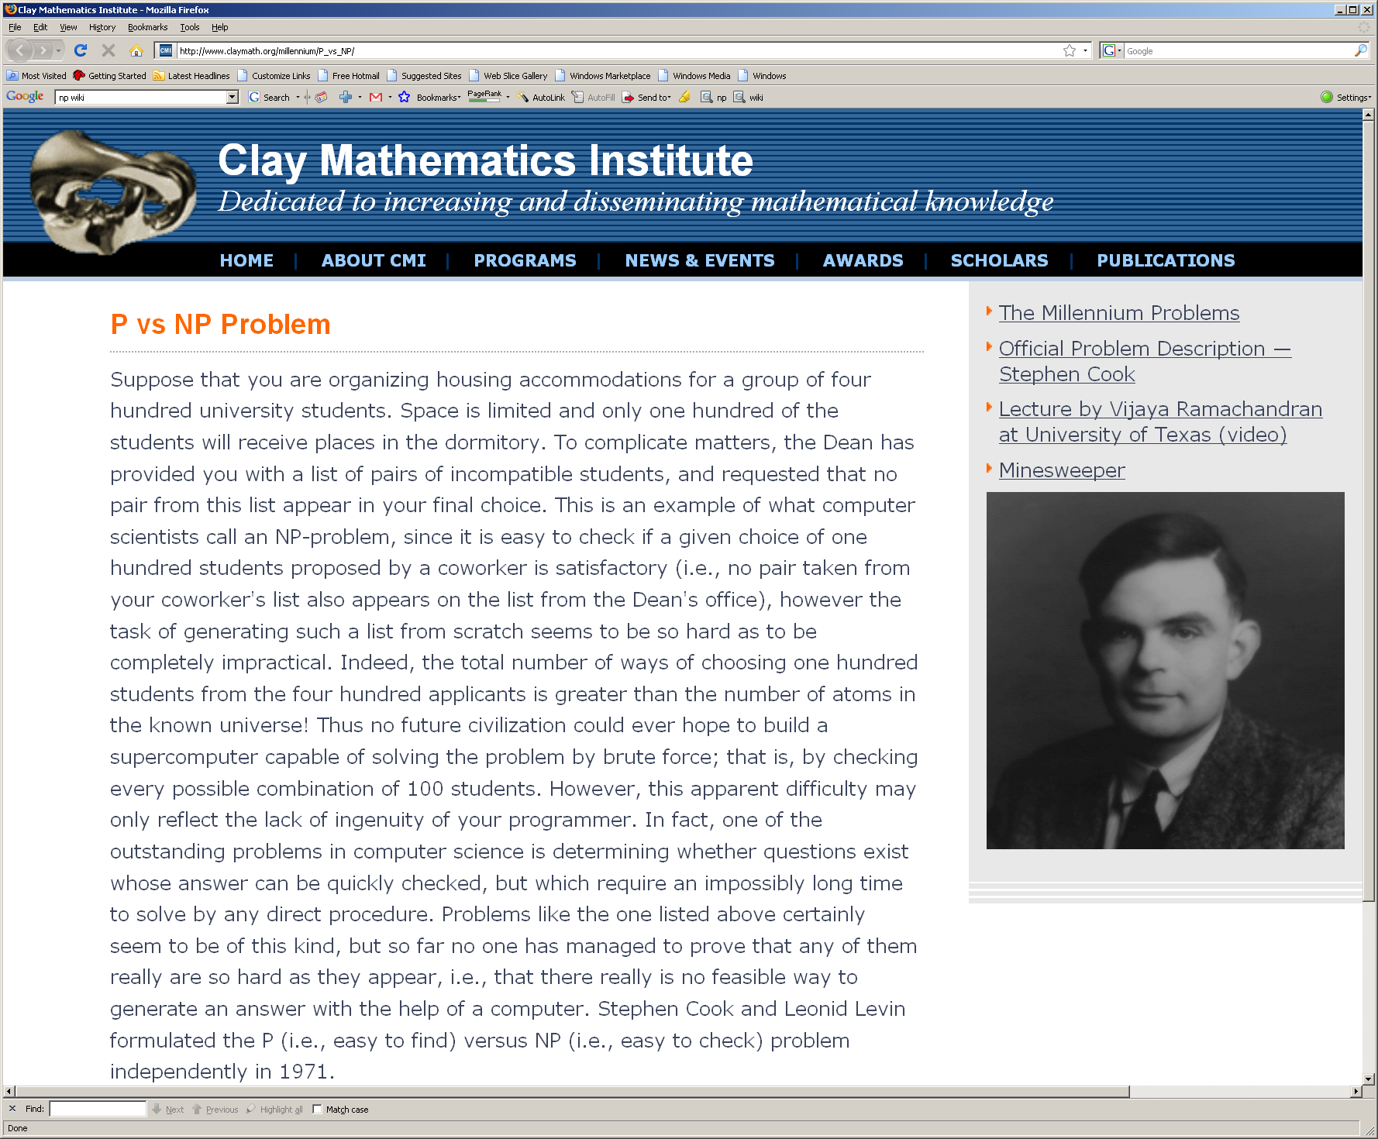

Slide 20
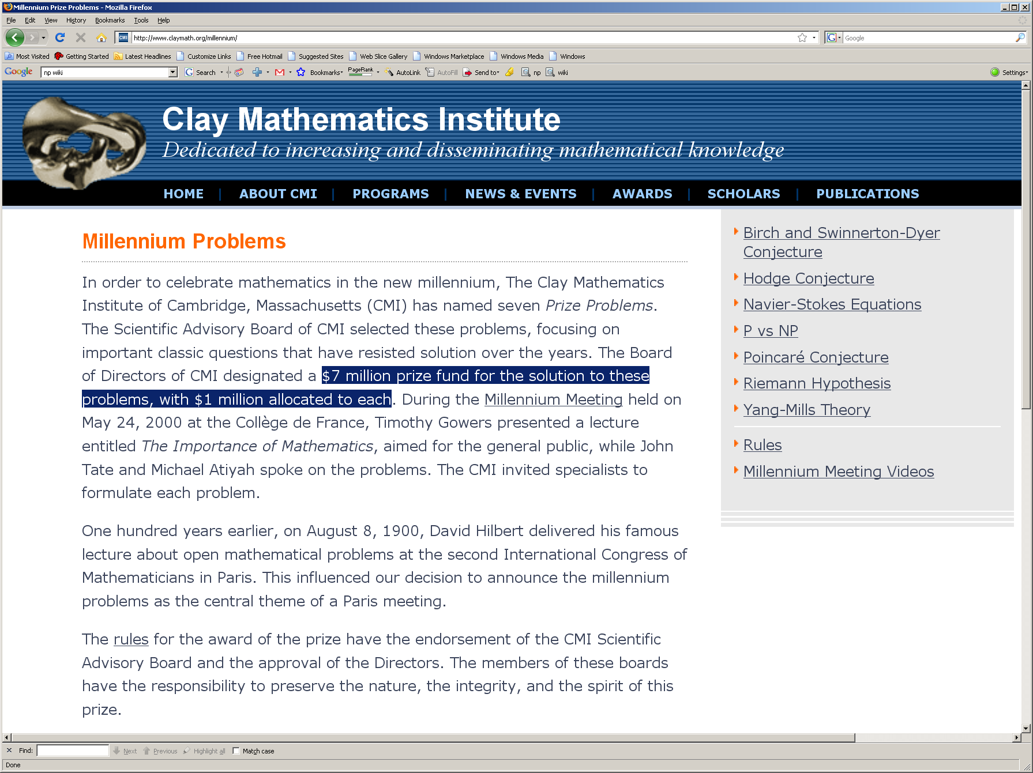
??
Perelman
2006

Slide 21

Reduction Types
Many-one reduction: converts an instance of one problem to a single instance of another problem.
A ≤_{M} B
Turing reduction: solves a problem A by multiple calls to an “oracle” for problem B.
A
B
A ≤_{T} B

Slide 22
Polynomial-Time Reduction Types
Polynomial-time many-one reduction: transforms in
polynomial time an instance of problem A to an
instance of problem B.
⇒ “Karp” reduction (transformation)
Polynomial-time Turing reduction: solves problem
A by polynomially-many calls to “oracle” for B.
⇒ “Cook” reduction
Richard Karp
A
B
Stephen Cook
Open: do polynomial-time-bounded many-one and
Turing reductions yield the same complexity classes?
(NP, co-NP, NP-complete, co-NP-complete, etc.)

Slide 23
Boolean 3-Satisfiability (3-SAT)
Def: 3-CNF: each sum term has exactly 3 literals.
Ex: (x₁+x₅+x₇)(x₃+x'₄+x'₅)
Def: 3-SAT: given an n-variable boolean formula
(in CNF), is it satisfiable?
Theorem: 3-SAT is NP-complete.
Proof: convert each long clause of the given formula
into an equivalent set of 3-CNF clauses:
Ex: (x+y+z+u+v+w)
⇒ (x+y+a)(a'+z+b)(b'+u+c)(c'+v+w)
Resulting formula is satisfiable iff original formula is.

Slide 24
1-SAT and 2-SAT
Idea: Determine the “boundary of intractability” by
varying / trivializing some of the parameters.
Q: Is 1-SAT NP-complete?
A: No (look for a variable & its negation)
Q: Is 2-SAT NP-complete?
A: No (cycles in the implication graph)

Slide 25
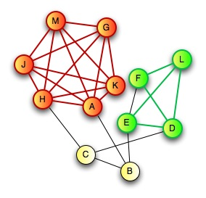
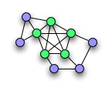

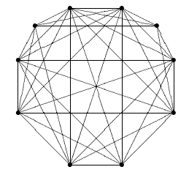
Classic NP Complete Problems
Clique: given a graph and integer k, is there a
subgraph that is a complete graph of size k?
Richard Karp

Slide 26

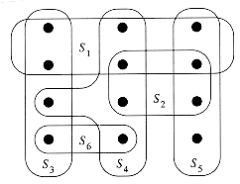
Classic NP Complete Problems
Set Cover: given a universe U, a collection of subsets S_{i}
and an integer k, can k of these subsets cover U?
S₁
U
S₂
S₅
S₃
S₄

Slide 27
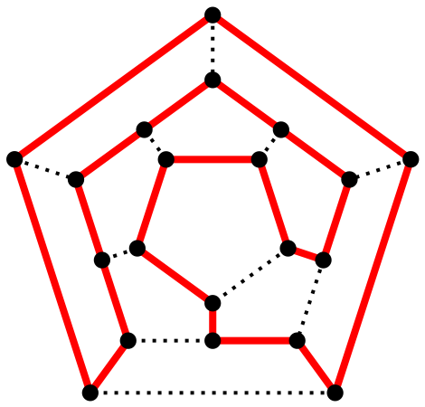
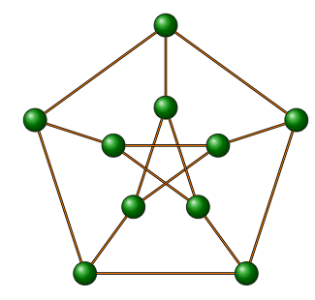
Classic NP Complete Problems
Hamiltonian cycle: Given an undirected graph, is there
a closed path that visits every vertex exactly once?

Slide 28
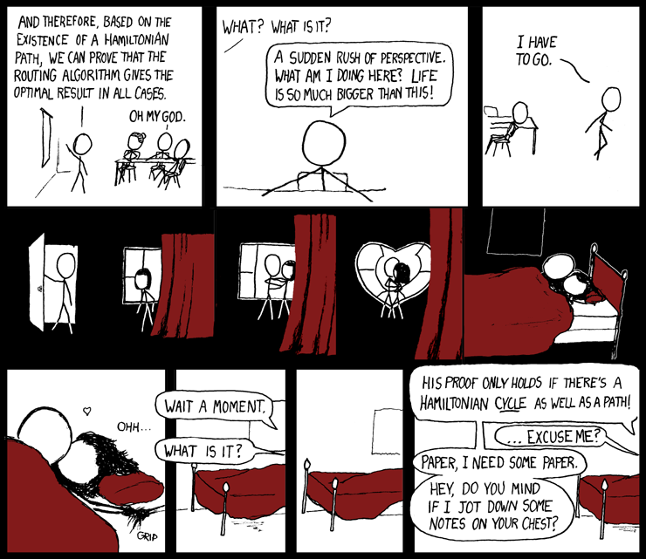

Slide 29
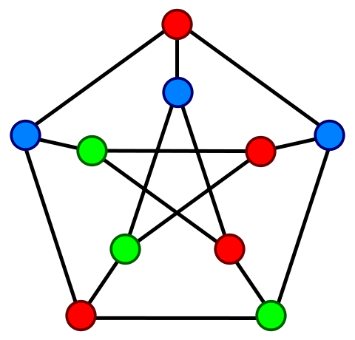
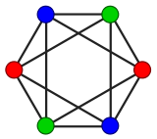
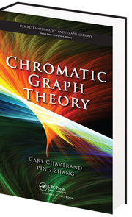
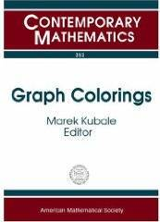
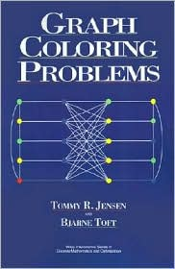
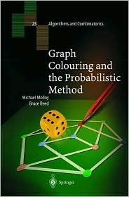
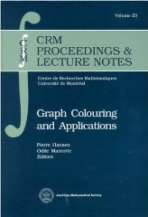
Classic NP Complete Problems
Graph coloring: given an integer k and a graph, is it
k-colorable? (adjacent nodes get different colors)

Slide 30
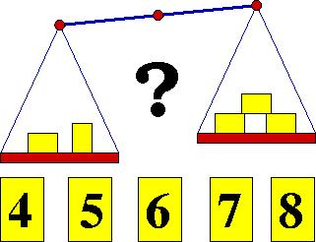
Classic NP Complete Problems
Partition: Given a set of integers, is there a way to
partition is into two subsets each with the same sum?

Slide 31
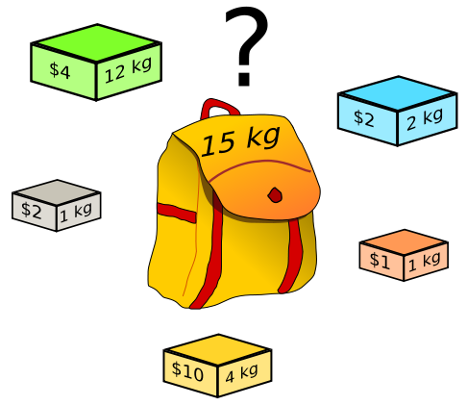
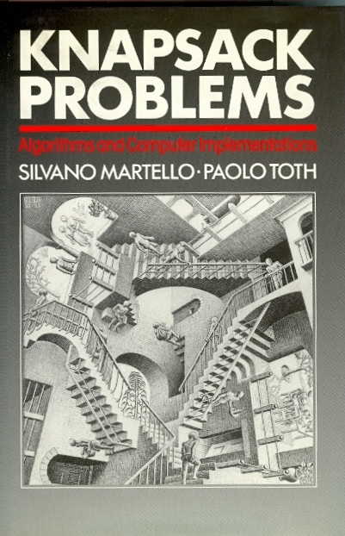
Classic NP Complete Problems
Knapsack: maximize the total value of a set of items
without exceeding an overall weight constraint.

Slide 32
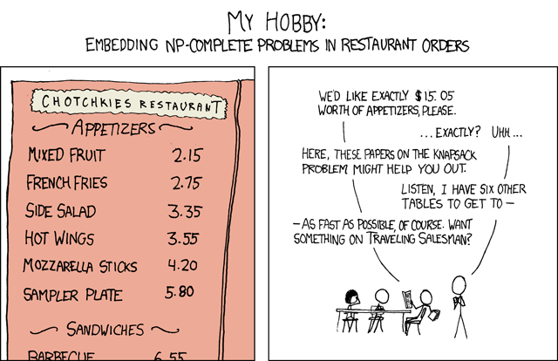

Slide 33
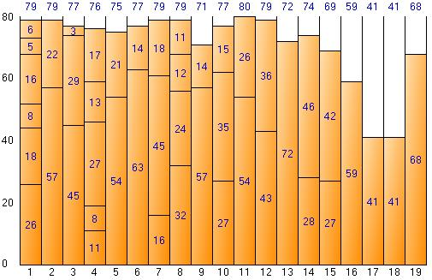
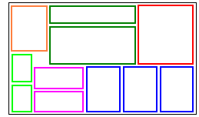
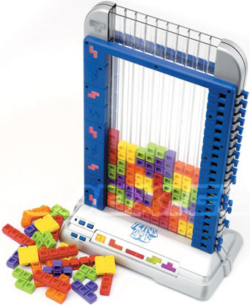
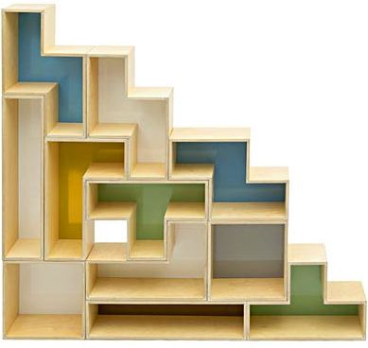
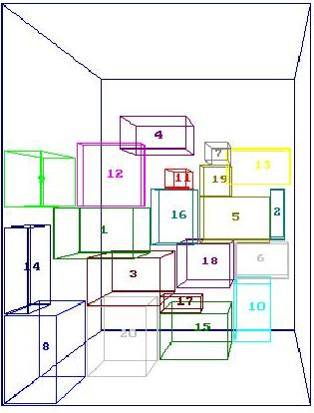
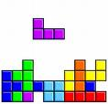
NP Complete Problems
Bin packing: minimize the number of same-size bins
necessary to hold a set of items of various sizes.

Slide 34





Other Classic NP Complete Problems
Steiner Tree: span a given node subset in a weighted
graph using a minimum-cost tree.
2

Slide 35






Other Classic NP Complete Problems
Traveling salesperson: given a set of points, find the
shortest tour that visits every point exactly once.

Slide 36


Slide 37



Slide 38

Graph Colorability
Problem: given a graph G and an integer k,
is G k-colorable?
Note: adjacent nodes must have different colors
⇒

Slide 39



from “Complexity of Computer Computations”, pp. 85–103, 1972.

Slide 40



Slide 41



Slide 42



Slide 43


Origin of NP-Completeness!

Slide 44



Slide 45


Slide 46



Slide 47


PSPACE-complete
Membership in NP
is still open!

Slide 48


Still open!
∈P [2004]

Slide 49
Problem Transformations
Idea: To solve a problem, efficiently transform to another
problem, and then use a solver for the other problem:
Satisfiability
SAT solution
x=1, y=0
(x+y)(x'+y')
Colorability
solver
Colorability

Slide 50


Decision vs. Optimization Problems
Decision problem: “yes” or “no” membership answer.
Ex: Given a Boolean formula, is it satisfiable?
Ex: Given a graph, is it 3-colorable?
Ex: Given a graph & k, does it contain a k-clique?
Optimization problem: find a (minimal) solution.
Ex: Given a formula, find a satisfying assignment.
Ex: Given a graph, find a 3-coloring.
Ex: Given a graph & k, find a k-qlique.
Theorem: Solving a decision problem is not harder
than solving its optimization version.
Theorem: Solving an optimization problem is not (more than
polynomially) harder than solving its decision version.
(x+y+z)
^(x'+y'+z)
^(x'+y+z')

Slide 51

Decision vs. Optimization Problems
Corollary: A decision problem is in P if and only if its
optimization version is in P.
Corollary: A decision problem is in NP if and only if its
optimization version is in NP.
Building an optimizer from a decider:
Satisfiability
Decider
yes
Ex: what is a satisfying assignemnt
of P=(x+y+z)(x'+y'+z)(x'+y+z') ?
Idea: Ask the decider 2 related yes/no questions:
no
Satisfiability
Optimizer
Satisfiability
Decider
yes
x is true
P
P^x
no
x is false
Iterate!
Satisfiability
Decider
yes
x is “don’t care”
P^x'
no
P is not satisfiable

Slide 52

Graph Cliques
Graph clique problem: given a graph and an integer k, is
there a subgraph in G that is a complete graph of size k?
Theorem: The clique problem is NP-complete.
Proof: Reduction from 3-SAT:
Literals become nodes; k clauses induce node groups;
Connect all inter-group compatible nodes / literals.
Example: (x+y+z)(x'+y'+z)(x'+y+z')
X'
Y'
Z
Graph clique
solver
X
X'
k-clique corresponds
to 3-SAT solution:
x = true, y = false, z = false
Y
Y
Z
Z'
Clique is in NP ⇒ clique is NP-complete.

Slide 53

Independent Sets
Independent set problem: given a graph and an integer k,
is there a pairwise non-adjacent node subset of size k?
Theorem: The independent set problem is NP-complete.
Proof: Reduction from graph clique:
Idea: independent set is an “anti-clique” (i.e., negated clique)
finding a clique reduces to finding an independent set
in the complement graph:
Graph clique
solver
Independent
set solver
Independent set ∈NP
⇒ NP-complete.

Slide 54


Slide 55
Graph Colorability
Problem: is a given graph G 3-colorable?
Theorem: Graph 3-colorability is NP-complete.
Proof: Reduction from 3-SAT.
Idea: construct a colorability “OR gate” “gadget”:
⇒
x
x
∀x
(x+y+z)
y
x'
T
z
T
Property: gadget is 3-colorable iff
(x+y+z) is true
F

Slide 56
x+y+z
x'+y'+z
Example: (x+y+z)(x'+y'+z)(x'+y+z')
x'+y+z'
x
x
y
T
z
y
z
T
x'
F
F
y'
T
F
x
∀x
x'
z'

Slide 57
Example: (x+y+z)(x'+y'+z)(x'+y+z')
3-colorability
Solution:
x
y
3-satisfiability
Solution:
x = true
y = false
z = false
z
x'
y'
T
F
z'

Slide 58
What Makes Colorability Difficult?
Q: Are high node degrees the reason that graph
colorability is computationally difficult?
A: No!
Graph colorability is easy for max-degree-0 graphs
Graph colorability is easy for max-degree-1 graphs
Graph colorability is easy for max-degree-2 graphs
Theorem: Graph colorability is NP-complete for
max-degree-4 graphs.
Why?

Slide 59
Restricted Graph Colorability
Theorem: Graph 3-colorability is NP-complete for
max-degree-4 graphs.
Proof: Use “degree reduction” gadgets:
3-colorability
constraint propagation:
Gadget properties:
Gadget has max-degree of 4
Gadget is 3-colorable but not 2-colorable
In any 3-coloring all corners get the same color

Slide 60
Restricted Graph Colorability
Idea: combine gadgets into “super nodes”!
Local node
replacement:
High
degree
Max
degree 4
Properties (inherited from simple gadget):
Super-node has max-degree of 4
Super-node is 3-colorable but not 2-colorable
In any 3-coloring all “corners” get the same color
Idea: Use “super nodes” as “fan out” components
to reduce all node degrees to 4 or less

Slide 61

Restricted Graph Colorability
Example: convert high-degree to max-degree-4 graph
Max-degree-4
colorability
solver
Max degree 6
Max degree 4
Conclusion: Solving max-degree-4 graph colorability
is as difficult as solving general graph colorability!

Slide 62
Restricted Graph Colorability
Theorem: Planar graph 3-colorability is NP-complete.
Proof: Use “planarity preserving” gadgets:
3-colorability
constraint propagation
Gadget properties:
Gadget is planar and 3-colorable
In any 3-coloring opposite corners get same color
Pairs of opposite corners are “independent”

Slide 63

Restricted Graph Colorability
Idea: use gadgets to eliminate edge intersections!
Local replacement:
Planar graph
colorability
solver
Planar graph is 3-colorable
IFF original graph was
Conclusion: Solving planar graph colorability
is as difficult as solving general graph colorability!

Slide 64
Restricted Graph Colorability
Theorem: Graph colorability is NP-complete for
planar graphs with max degree 4.
Proof: Compose max-degree-4 transformation with
planarity preserving transformation:
More degree reduction
replacements needed here
Local
intersection
replacement
Degree
reduction
replacement
Resulting planar max-deg-4 graph is 3-colorable IFF original graph is!

Slide 65





Planar Graph Colorability
Theorem: Planar graph 1-colorability is trivial. DTIME(n)
Theorem: Planar graph 2-colorability is easy. DTIME(n)
Theorem: Planar graph 3-colorability is NP-complete.
Theorem: Planar graph 4-colorability is trivial. DTIME(1)
Theorem: All planar graphs have 4-colorings.
Open since 1852; solved by Appel & Haken in 1976 using
long computer-assisted proof based on 1936 special cases!
Why?

Slide 66




Planar Graph Colorability
Theorem: Finding planar graph 4-coloring is in DTIME(n²).
Theorem: Finding planar graph 5-coloring is in DTIME(n).
Theorem: Graph planarity testing is in DTIME(n).
Theorem: 4-coloring a 3-colorable graph is NP-hard.
Theorem: 7 colors are necessary and sufficient on a torus.
Theorem: For a surface of genus G, the number of colors
that are both necessary and sufficient is
Genus: | 0 | 1 | 2 | 3 | 4 | 5 | 6 | 7 | 8
# colors: | 4 | 7 | 8 | 9 | 10 | 11 | 12 | 12 | 13

Slide 67
Applications of Graph Coloring
Job scheduling:
Need to assign jobs to time slots;
Some jobs conflict (e.g., use shared resource);
Model jobs as nodes and conflicts as edges;
Chromatic number is “minimum makespan”
(optimal time to finish all jobs without conflict)
4
Time 1
1
2
1
2
5
2
Time 2
5
4
5
4
3
3
1
3
Time 3
Jobs & conflicts
Coloring
Schedule

Slide 68
Applications of Graph Coloring
CPU Register allocation:
Compiler optimizes assignment of variables to registers;
Interference graph: model registers as nodes, and edges
represent variables needed simultaneously;
Chromatic number corresponds to minimum # of CPU
registers needed to accommodate all the variables.
Register 1
Register 2
1
2
1
2
1
2
5
4
5
4
5
4
Register 3
3
3
3
Variables
& simultaneity
Graph
coloring
Register
allocation

Slide 69



Slide 70
The Extended Chomsky Hierarchy Reloaded
2^{Σ*}
Decidable Presburger arithmetic
…
…
…
…
…
EXPSPACE
?
H
H
…
…
…
…
EXPTIME
…
…
…
Turing
…
…
PSPACE
…
PH
BPP
degrees
…
…
…
…
…
…
…
…
…
…
…
Context sensitive LBA
…
…
…
…
NP
…
…
…
…
…
…
…
…
…
…
…
…
P a^{n}b^{n}c^{n}
…
…
…
…
…
…
Not finitely describable
…
…
EXPSPACE-complete =RE
Context-free ww^{R}
PSPACE-complete QBF
EXPTIME-complete Go
Det. CF a^{n}b^{n}
Not Recognizable
NP-complete SAT
…
…
…
…
…
Regular a*
Recognizable
…
…
…
…
…
…
…
…
…
…
Finite {a,b}
…
…
…
…
…
Dense infinite time & space complexity hierarchies
…
…
…
…
Other infinite complexity & descriptive hierarchies
…
…
…
…
…
…

Slide 71
Algorithms
Tradeoff: Execution speed vs. solution quality
Solution
exact
approximate
fast
“Short & sweet”
“Quick & dirty”
Speed
slow
“Slowly but surely”
“Too little, too late”

Slide 72
Computational Complexity
Problem: Avoid getting trapped in local minima
Global optimum

Slide 73

Approximation Algorithms
Idea: Some intractable problems can be efficiently
approximated within close to optimal!
Fast:
Simple heuristics (e.g., greed)
Provably-good approximations
Slower:
Branch-and-bound approaches
Integer Linear Programming relaxation

Slide 74




Approximation Algorithms
Wishful:
Simulated annealing
Genetic algorithms

Slide 75
Minimum Vertex Cover
Minimum vertex cover problem: Given a graph, find
a minimum set of vertices such that each edge is
incident to at least one of these vertices.
Example:
Input graph
Heuristic solution
Optimal solution
Applications: bioinformtics, communications,
civil engineering, electrical engineering, etc.
One of Karp’s original NP-complete problems
Richard Karp

Slide 76












Minimum Vertex Cover Examples

Slide 77
Approximate Vertex Cover
Theorem: The minimum vertex cover problem is NP-
complete (even in planar graphs of max degree 3).
Theorem: The minimum vertex cover problem can be
solved exactly within exponential time n^{O(1)}2^{O(n)}.
Theorem: The minimum vertex cover problem can not
be approximated within ≤ 1.36*OPT unless P=NP.
Theorem: The minimum vertex cover problem can be
approximated (in linear time) within 2*OPT.
Idea: pick an edge, add its endpoints, and repeat.

Slide 78
Approximate Vertex Cover
Algorithm [Gavril, 1974]: Linear time 2*OPT
approximation for minimum vertex cover:
  Pick random edge (x,y)
  Add {x,y} to the heuristic solution
  Eliminate x and y from graph
  Repeat until graph is empty
Best approximation
bound known for VC!
x
y
Idea: one of {x,y} must be in any optimal solution.
⇒ Heuristic solution is no worse than 2*OPT.

Slide 79
Maximum Cut
Maximum cut problem: Given a graph, find a partition
of the vertices maximizing the # of crossing edges.
Example:
cut size = 2
cut size = 4
cut size = 5
A
B
A
B
A
B
E
C
E
E
D
D
C
D
C
Input graph
Heuristic solution
Optimal solution
Applications: VLSI circuit design, statistical
physics, communication networks.
One of Karp’s original NP-complete problems.
Richard Karp

Slide 80
Maximum Cut
Theorem [Karp, 1972]: The minimum vertex cover
problem is NP-complete.
Theorem: The maximum cut problem can be solved
in polynomial time for planar graphs.
Theorem: The maximum cut problem can not
be approximated within ≤ 17/16*OPT unless P=NP.
Theorem: The maximum cut problem can be
approximated in polynomial time within 2*OPT.
Theorem: The maximum cut problem can be
approximated in polynomial time within 1.14*OPT.
=1.0625*OPT

Slide 81
Maximum Cut
Algorithm: 2*OPT approximation for maximum cut:
  Start with an arbitrary node partition
  If moving an arbitrary node across the partition
  will improve the cut, then do so
  Repeat until no further improvement is possible
cut size = 2
cut size = 3
cut size = 5
A
B
A
B
A
B
E
E
C
E
C
D
D
D
C
Input graph
Heuristic solution
Optimal solution
Idea: final cut must contain at least half of all edges.
⇒ Heuristic solution is no worse than 2*OPT.
Why?

Slide 82
Approximate Traveling Salesperson
Traveling salesperson problem: given a pointset, find
shortest tour that visits every point exactly once.
2*OPT metric TSP heuristic:
  Compute MST
  T = Traverse MST
  S = shortcut tour
  Output S
Analysis:
S < T
=
2*
MST < OPT TSP
2*
triangle inequality!
T covers minimum spanning tree twice
TSP minus an edge is a spanning tree

Slide 83



Slide 84
Non-Approximability
NP transformations typically do not preserve the
approximability of the problem!
Some NP-complete problems can be approximated
arbitrarily close to optimal in polynomial time.
Theorem [Arora, 1996] Geometric TSP approximation
in polynomial time within (1+ε)*OPT for any ε>0.
Other NP-complete problems can not be approximated
within any constant in polynomial time (unless P=NP).
Theorem: General graph TSP can not be approximated
efficiently within K*OPT for any K>0 (unless P=NP).

Slide 85


Graph Isomorphism
Definition: two graphs G₁=(V₁,E₁) and G₂=(V₂,E₂) are
isomorphic iff ∃ bijection ƒ:V₁→V₂ such that
∀v_{i},v_{j}∈V₁ (v_{i},v_{j})∈E₁ ⇔ (ƒ(v_{i}),ƒ(v_{j}))∈E₂
Isomorphism ≡ edge-preserving vertex permutation
Problem: are two given graphs isomorphic?
≈
≈
Note: Graph isomorphism ∈NP, but not known to be in P

Slide 86






Graph Isomorphism
≈
≈
≈
≈
≈
≈

Slide 87
Zero-Knowledge Proofs
Idea: proving graph isomorphism without disclosing it!
Premise: Everyone knows G₁ and G₂ but not ≈
≈ must remain secret!
≈
G₁
G₂
Create random G ≈ G₁
Note: ≈ is ≈(≈)
Broadcast G
Verifier asks for ≈ or ≈
Broadcast ≈ or ≈
Verifier checks G≈G₁ or G≈G₂
Repeat k times
⇒ Probability of cheating: 2^{-k}
≈
≈
≈
G
Approximating a “proof”!

Slide 88
Zero-Knowledge Proofs
Idea: prove graph 3-colorable without disclosing how!
Premise: Everyone knows G₁ but not its 3-coloring χ
which must remain secret!
χ'
G₂
Create random G₂ ≈ G₁
Note: 3-coloring χ'(G₂) is ≈(χ(G₁))
Broadcast G₂
Verifier asks for ≈ or χ'
Broadcast ≈ or χ'
Verifier checks G₁≈G₂ or χ'(G₂)
Repeat k times
⇒ Probability of cheating: 2^{-k}
χ
≈
χ
G₁
Interactive proof!

Slide 89

Zero-Knowledge Caveats
Requires a good random number generator
Should not use the same graph twice
Graphs must be large and complex enough
χ
Applications:
Identification friend-or-foe (IFF)
Cryptography
Business transactions

Slide 90


Zero-Knowledge Proofs
Idea: prove that a Boolean formula P is satisfiable
without disclosing a satisfying assignment!
Premise: Everyone knows P but not its secret
satisfying assignment V !
P = (x+y+z)(x'+y'+z)(x'+y+z')
ƒ
Convert P into a graph 3-colorability
instance G =ƒ(P)
Publically broadcast ƒ and G
Use zero-knowledge protocol
to show that G is 3-colorable
⇒ P is satisfiable iff G is 3-colorable
⇒ P is satisfiable with probability 1-2^{-k}
G =
Interactive proof!

Slide 91
Interactive Proof Systems
Prover has unbounded power and may be malicious
Verifier is honest and has limited power
Completeness: If a statement is true, an honest verifier will
be convinced (with high probability) by an honest prover.
Soundness: If a statement is false, even an omnipotent
malicious prover can not convince an honest verifier that
the statement is true (except with a very low probability).
The induced complexity class depends on the verifier’s
abilities and computational resources:
Theorem: For a deterministic P-time verifier, class is NP.
Def: For a probabilistic P-time verifier, induced class is IP.
Theorem [Shamir, 1992]: IP = PSPACE

