Slide 1
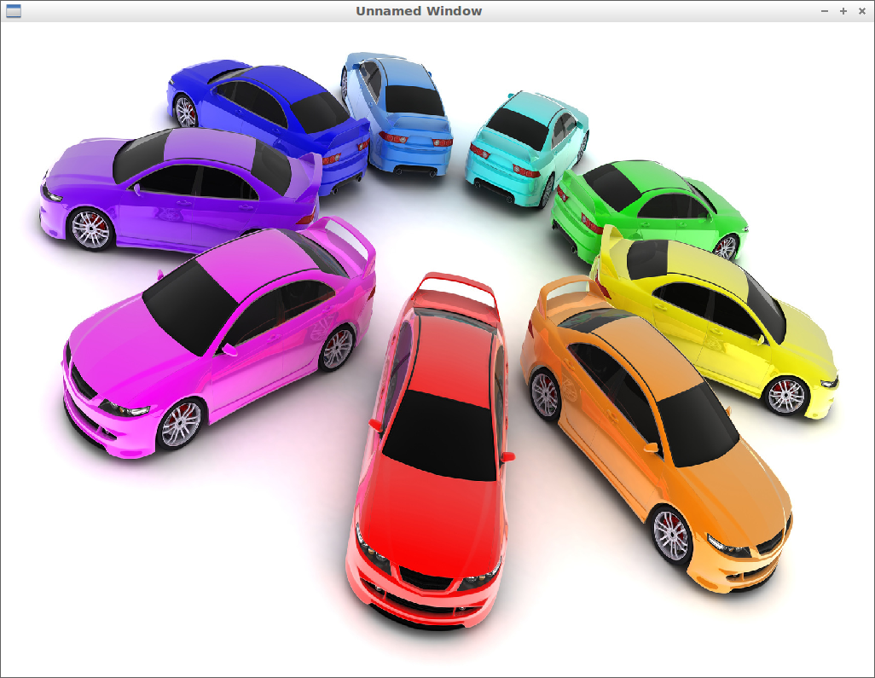
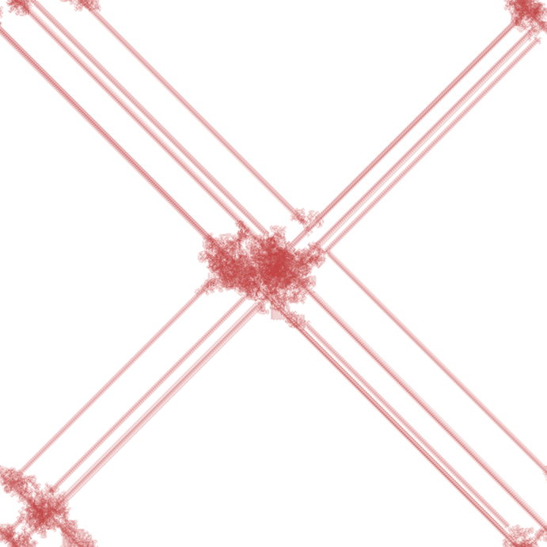
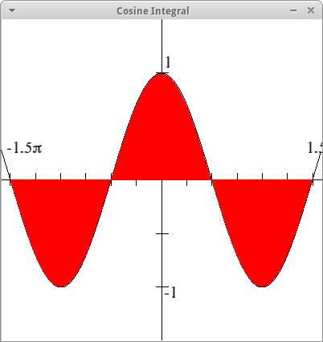
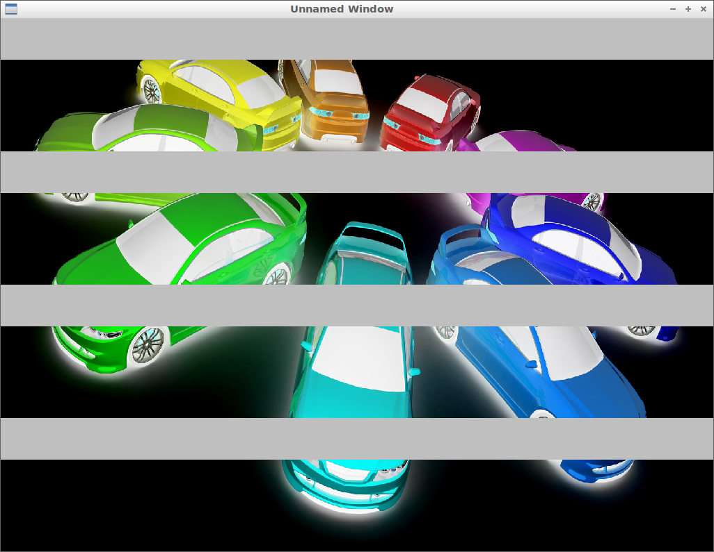
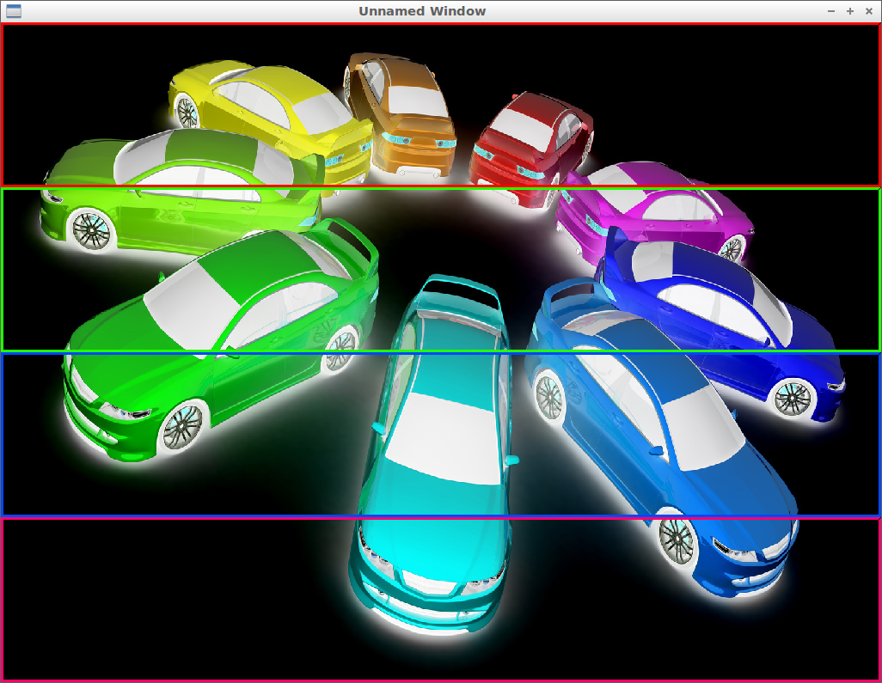
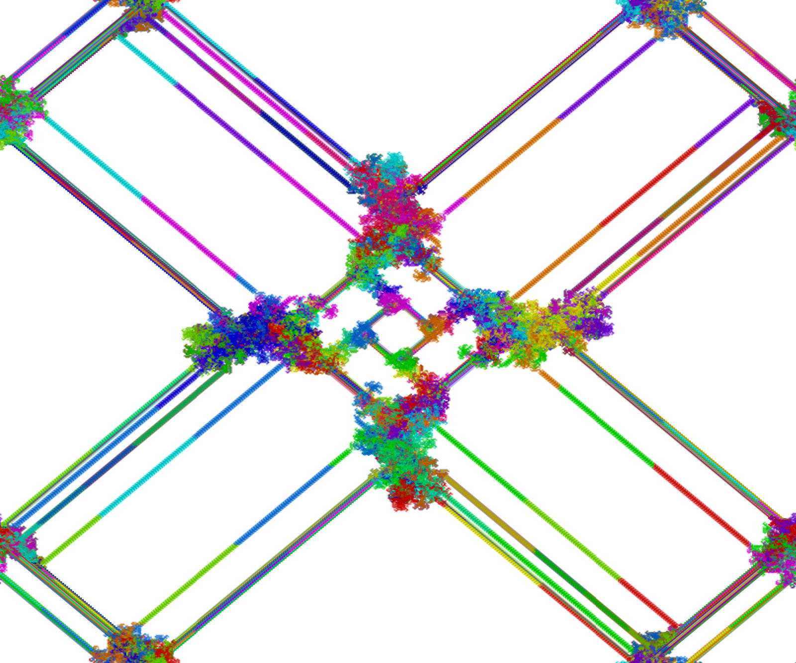
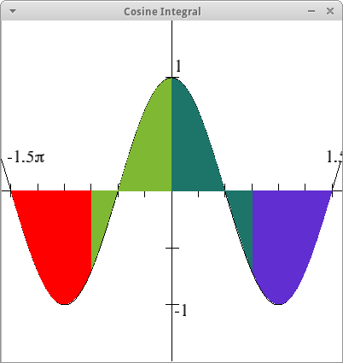
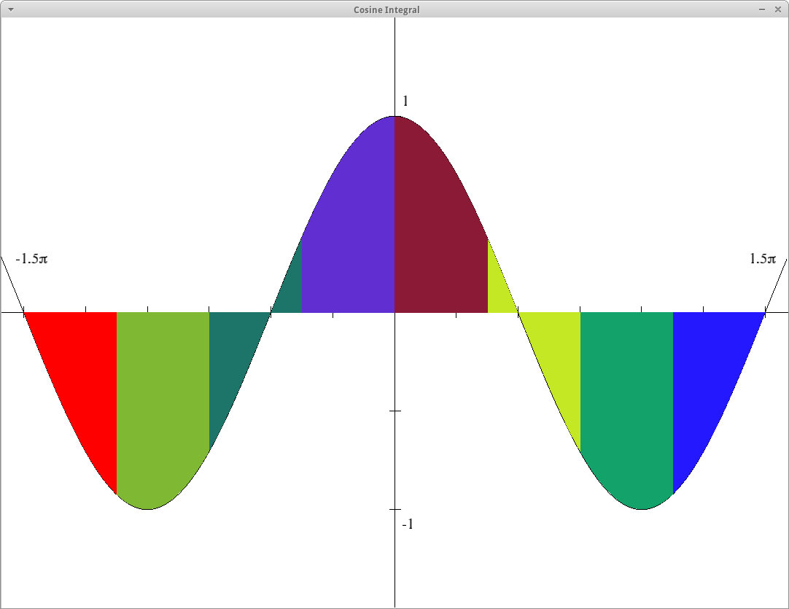

Patternlets and TSGL: CSinParallel Tools for
Visualizing Parallel Behavior
Joel Adams (Calvin College), with Richard Brown (St Olaf College) and Elizabeth Shoop (Macalester College)
http://csinparallel.org
Abstract
TSGL Examples
Image Processing (e.g., Inversion):
Langton’s Ants:
Langton’s Ants illustrates emergent behavior from a few simple rules. In this visualization, each “ant” is a thread that draws the ant’s path using a unique color as it follows the rules.
Parallel and distributed computing (PDC) is now in the core CS curriculum, and every CS student needs to learn about PDC. CSinParallel is a project to provide modular pedagogical materials, tools, and faculty development workshops for PDC.
One of our tools is patternlets, a collection of self-paced, minimalist, text-based, scalable parallel programming exercises.
Another of our tools is TSGL, a thread-safe graphics library that can be used with OpenMP, C++11, and/or POSIX threads. Using TSGL, an educator (or student) can annotate a multithreaded computation with graphics calls to show precisely what each thread is contributing to the computation as the program is running, in near real-time.
This presentation includes an overview of the CSinParallel project, plus "live" demonstrations of patternlets and TSGL visualizations that illustrate different ways of visualizing parallel behavior.
Integration (Area Under the Curve):
Intermediate
This visualization uses the Cosine function to show how integration can be parallelized. Each different-colored region shows the area computed by one thread.
Original
Image:
1 Thread
Integration Using 1 Thread
Partially Completed Inverse
Image
(4 Threads):
Final
Inverse
Image
(4 Threads):
4 Threads
4 Threads
Integration Using 4 Threads
8 Threads
The Dining Philosophers Problem:
TSGL Objectives
N philosophers (5 here) sit around a table,
each thinking for a random length of time until becoming hungry. To eat, a philosopher (the medium circles) needs two chopsticks (the small circles), of which there are N, one between each philosopher. The problem is to devise an algorithm each philosopher can follow that ensures that no one will starve.
Create a graphics library that:
Allows different threads to safely draw on the same graphical Canvas in real-time, each using its own unique color.
Is object-oriented; compatible with C++11, OpenMP and POSIX multithreading
Supports image-processing (JPG, PNG,…)
Permits rendering speed to be controlled
Supports mouse-keyboard interactivity
Is platform-neutral (Linux, Mac, Windows)
Is open source, so that users can extend the library with new features and functionality
Integration Using 8 Threads
Conclusions
Patternlets and TSGL are CSinParallel tools by which CS educators can help their students visualize abstract concepts related to parallel and/or concurrent computing.
Both have been shown to improve student understanding of such concepts.
CSinParallel.org
This work made possible by NSF DUE #1225739.

