Slide 1
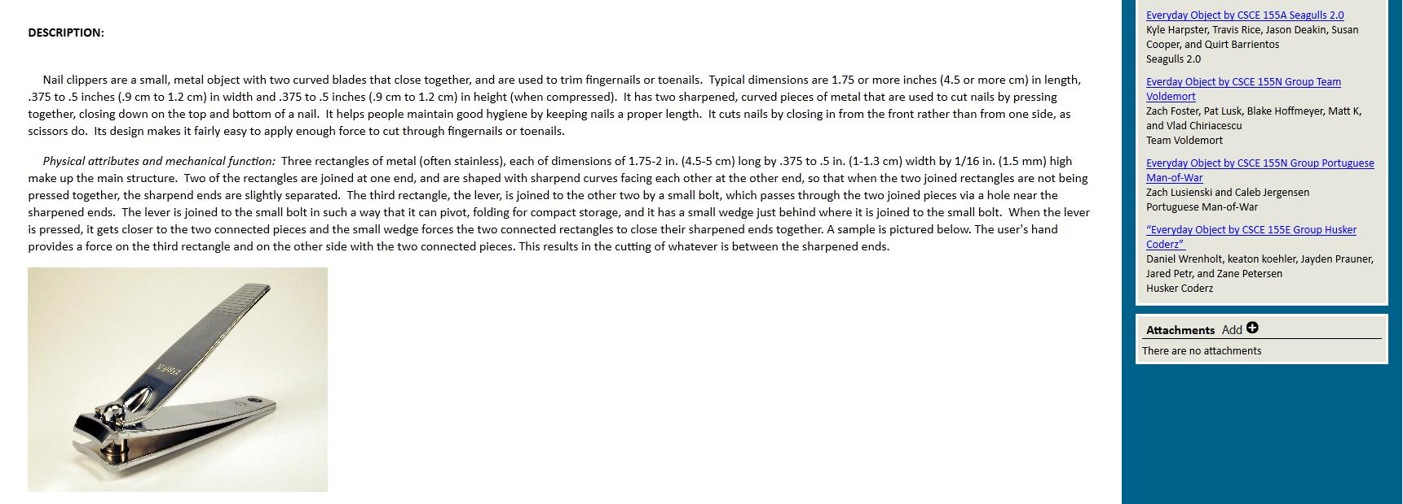
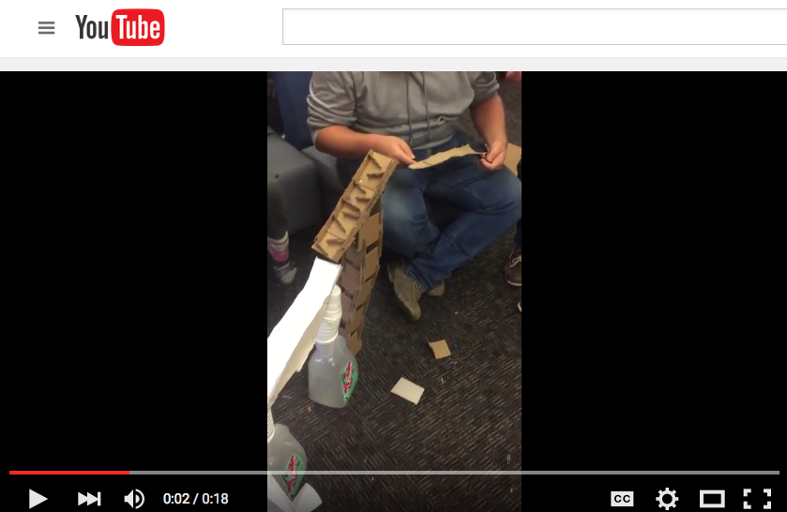
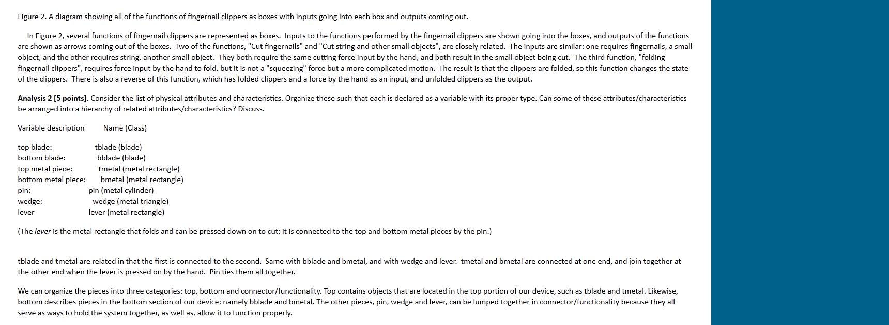
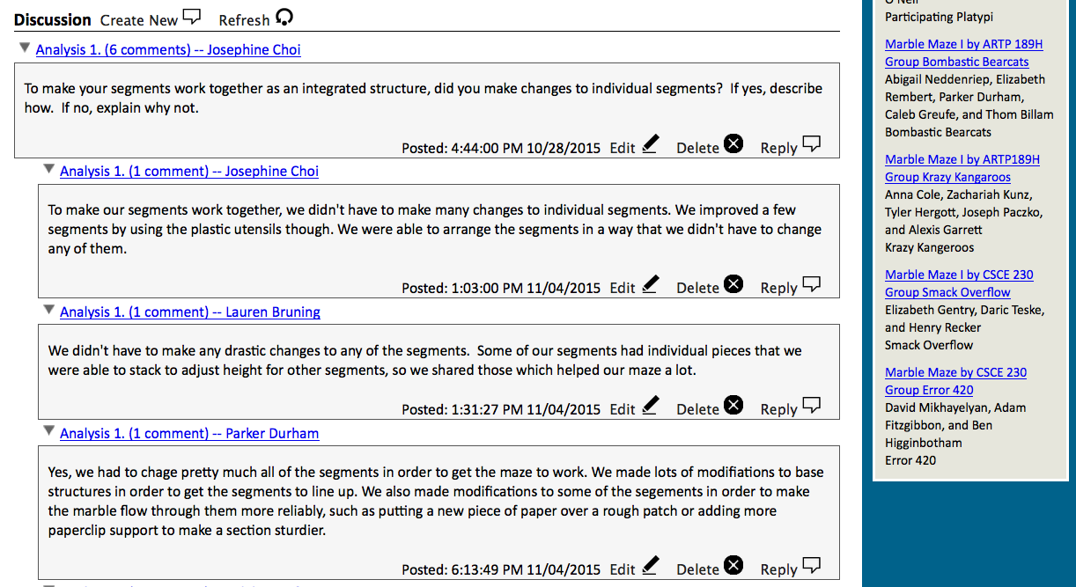
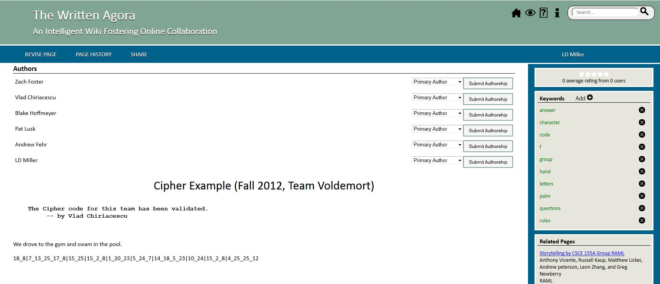
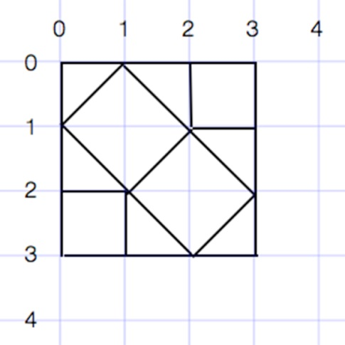
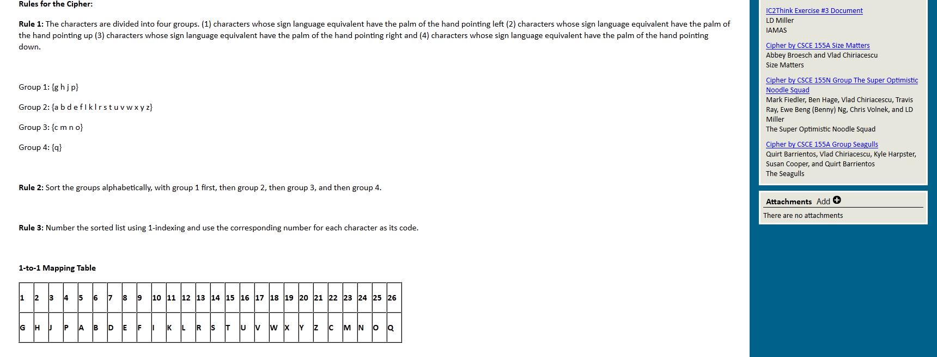
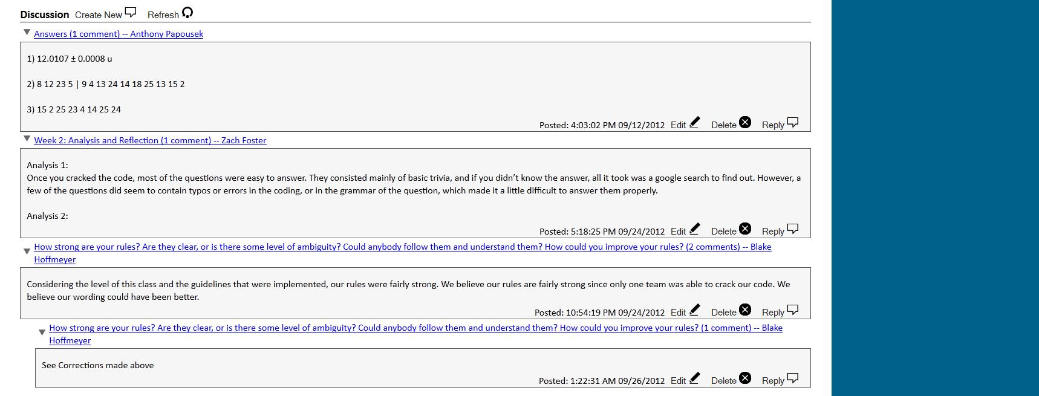
Computational thinking and creativity are critical to addressing important societal problems and central to 21st century skills. Computational thinking is a collection of analytic skills that everyone, not just computer scientists, can use to help solve problems, design systems, and understand human behavior; comparable in importance and significance to mathematical, linguistic, and logical reasoning and vital to today’s increasingly data-intensive and digital industries. Likewise, creative thinking is not just the province of a few individuals within the arts or of those possessing special talent, but is instead an integral component of human intelligence that can be exercised within any context and which can be practiced, encouraged and developed. Computational thinking and creative thinking are complementary skills that when blended together become computational creativity, enhancing learning and application of both.
Our long-term vision is to address the growing need for computationally savvy, creative thinkers and problem solvers by incorporating computational creativity into the undergraduate CS curriculum to reach both CS majors and other students in STEM and non-STEM fields. A suite of Computational Creativity Exercises (CCEs) was created through a TUES grant (DUE-1122956). Evaluations found that students who completed the exercises had higher course grades and better learning of CS content and students in a CCE intervention class had better learning of CS content than those in the same class without CCEs.
The goal of this project IUSE: Design, Development, and Implementation Projects: Computational Creativity to Improve CS Education for CS and non-CS Undergraduates is to build on the innovation and results from the previous TUES grant.
Specific Aims
Computational Creativity
Aim 1. Produce a final suite of validated, high quality Computational Creativity Exercises and a Computational Creativity undergraduate course for broad dissemination to other post-secondary educational institutions and organize a workshop to share and document instructional experiences, lessons learned, and student pedagogy teaching with these exercises as part of the suite.
Aim 2. Investigate and understand for whom, and under what conditions, Computational Creativity Exercises are most efficacious by conducting systematic studies to test how variations in delivery and utilization of the Computational Creativity Exercises (timing, supplement or entire course, introductory vs advanced courses, CS and non-CS courses, and STEM and non-STEM courses) affect exercise efficacy and examine how different student characteristics (prior knowledge, motivation, ability, strategic self-regulation, demographics) impact exercise effectiveness.
Aim 3. Investigate and understand why the Computational Creativity Exercises are effective by conducting systematic studies to test how students’ collaborative interactions during exercises impact exercise effectiveness, how the Unified Learning Model learning processes of attention, repetition, and connection occur during the exercises and lead to learning and achievement, and how students’ reactions to the exercises impact their motivation and engagement.
Aim 4. Investigate and understand how the Computational Creativity Exercises impact students’ enrollment and retention in CS and STEM courses by examining exercise impacts on subsequent enrollment in more CS and STEM courses, subsequent enrollment of women and underrepresented minorities in CS and STEM courses and majors, and retention of current CS and STEM majors.
Result Highlights
Dosage Effect in a Suite of CS1 Courses
Found a “dosage” effect that higher grades and learning of core computational thinking principles were associated with increasing CCE completion from 0-1 to 4 exercises
Found associations between creative competency and course grades and associations between creative competency and higher strategic self-regulation
The “dosage” effect was present for CS majors and non-CS majors, freshmen and upper class students, and men and women students
Exercise Completion
CCE completion did not impact overall creative competency scores or scores for any of the four Epstein creative competencies
Completion of more CCEs was motivated by higher task-approach goals and perceived instrumentality and lower negative affect
Some students thought the CCEs were unrelated to the course and did not help their learning of course content
Suggests a need to make the role of the exercises in helping learn the material and the connection of the exercises and course to students’ futures more apparent
Effects on Engineering Students in a CS1 Course With CCEs
Found that engineering students in the CCE intervention class learned and retained more of the core computational thinking and CS course content with a large effect size (Cohen’s d = .48) and had significantly higher self-efficacy for applying computational thinking and CS knowledge and skill in their field also with a large effect size (Cohen’s d = .56)
The findings supported our contention that computational creativity can enhance students’ strategic self-regulation and engagement in courses as Engineering students in the CCE implementation semester reported significantly higher study time indicating more engagement with the class and significantly lower lack of regulation—an indicator of difficulties with self-regulation and inability to effectively learn without help
As active learning and student-centered approaches to the classroom are being increasingly applied, our findings suggest that computational creativity and the CCEs may help improve student self-directed learning and engagement in these learner centered classrooms
Website: http://cse.unl.edu/agents/ic2think
Email: lksoh@cse.unl.edu, dshell2@unl.edu
Principal Investigator Leen-Kiat Soh (Computer Science & Engineering) | Co-Principal Investigators
Duane Shell (Education Psychology), Elizabeth Ingraham (Art & Art History), Brian Moore (Music), Stephen Ramsay (English) | Research Assistants Bin Chen, Markeya Dubbs, Adam Eck, Abraham Flanigan, Melissa Hazley, LD Miller, Shiyuan Wang
This work is supported in part by the National Science Foundation under Grants 1122956 (NSF TUES Project), DUE-1431874 (NSF IUSE Project), and a University of Nebraska Pathways to Interdisciplinary Research Center (PIRC) grant
Publications
FIE’2013 | Miller et al. (2013) Improving Learning of Computational Thinking using Creative Thinking Exercises in CS-1 Computer Science Courses. FIE’2014 | Shell et al. (2014). Improving Learning of Computational Thinking Using Computational Creativity Exercises in a College CS1 Computer Science Course for Engineers. SIGCSE’2014 | Miller et al. (2014). Integrating Computational and Creative Thinking to Improve Learning and Performance in CS1. AERA’2014 | Shell et al. (2014) Impact of Creative Competency Exercises in College Computer Science Courses on Students’ Creativity and Learning. CACM’2015 | Soh et al. (2015). Viewpoint: Improving Learning and Achievement in Introductory Computer Science through Computational Creativity. ICER’2015 | Flanigan et al. (2015). Exploring Changes in Computer Science Students’ Implicit Theories of Intelligence across the Semester. JEE’2015 | Nelson et al. (2015). Motivational and Self-Regulated Learning Profiles of Students Taking a Foundational Engineering Course. Journal of Engineering Education, 104(1):74-100. SIGCSE’2016 | Eck et al. (2016). Investigating Differences in Wiki-Based Collaborative Activities between Student Engagement Profiles in CS1. SIGCSE’2016 | Shell et al. (2016). Students’ Initial Course Motivation and Their Achievement and Retention in College CS1 Courses.

